Slide 1
DevOps on Windows
How to Deploy Complex Windows Workloads
Akhtar Hossain, Solution Architect, HCLS, Amazon Web Services
June 14, 2017

Slide 2
What to expect from the session
How we can leverage DevOps in making the Magic of Software come true
We walk through the DevOps tools in AWS and how it works in Windows
We describe and demonstrate Windows-specific CI/CD pipeline for .NET in AWS

Slide 3
Why invest in DevOps
Startups can now take on giants with little to no funding ahead of time
Getting your software into the hands of millions is a click/download away
Your ability to move fast is paramount to your ability to fight off disruption
Know before your customer that your service is unavailable — trust/goodwill
Notes:
Know before your customer

Slide 4
The software delivery model has drastically changed
Old software delivery model
New software delivery model

Slide 5
Starting point:
Is the release process automated
Is the testing automated
Unit test
Integration test
Continuous production testing
Synthetic traffic
Notes:
So where do we start …
Is the release process automated … commit code, build, test, deploy
Is the testing automated – do you automated scripts as part for Unit Testing, for Integrated Testing, Do you do Continuous Production Testing, Are you introducing synthetic traffic

Slide 6
Be aware that a service is unavailable
Problem:
A service can stop working at any time for reasons inside or outside of its control
Consequence:
Your service may be unavailable without your team knowing about it
Notes:
Importantly be aware that a service is unsalable … So automating - Monitoring, production testing and synthetic traffic are equally important

Slide 7
Use synthetic traffic to simulate real users
Test all business critical functionality (UI and APIs)
Tests must run quickly
Measure client latencies
Check for reachability
Notes:
A little more on synthetic traffic

Slide 8


Techniques
Continuous production testing
Manage deployment health
Segment production deployment
Halt promotions
Gates

Slide 9
Prerequisites for success
Source
Build
Deploy to Integration Stack
Integration Tests
Deploy to Production
Versioned source
Automated build
Automated deployments
Deploy to > 1 instance
Unit tests
Integration tests
Continuous delivery
Operations dashboard

Slide 10
What tools do you need to move fast?
Releasing software in this new software-driven world requires a number of tools:
Tools to manage the flow of your software development release process
Tools to properly test and inspect your code for defects and potential issues
Tools to deploy your applications
This talk uses AWS tools

Slide 11
A story from Amazon
In 2014:
Thousands of service teams across Amazon
+ Building microservices
+ Practicing continuous delivery
+ Many environments (staging, beta, production, multiple regions)
=50 million deploys

Slide 12

Automated actions and transitions—from check-in to production
Development benefits:
Faster
Safer
Consistent & standardized
Visualization of the process
Pipelines

Slide 13
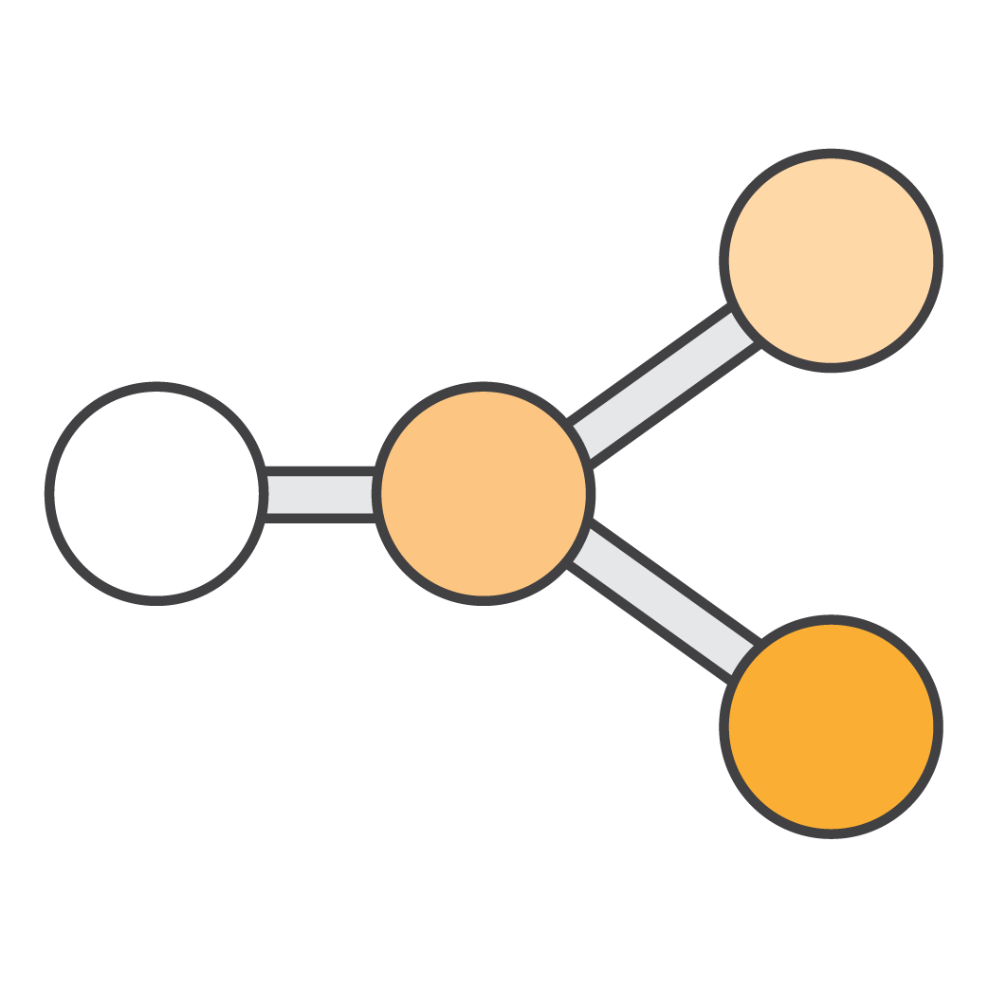

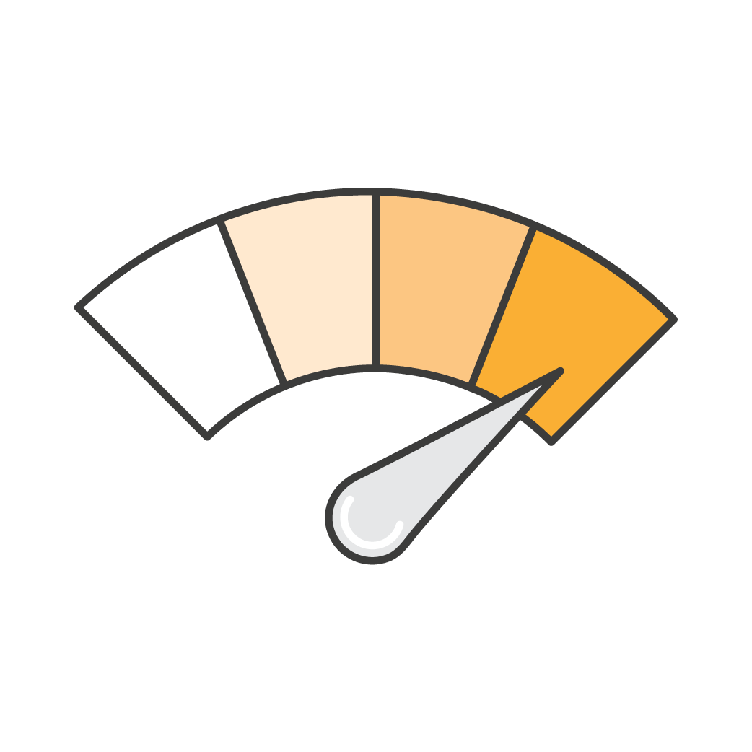
Release processes have four major phases
Source
Build
Production
Test
Check-in source code such as .java files
Peer review new code
Compile code
Unit tests
Style checkers
Code metrics
Create container images
Integration tests with other systems
Load testing
UI tests
Penetration testing
Deployment to production environments

Slide 14
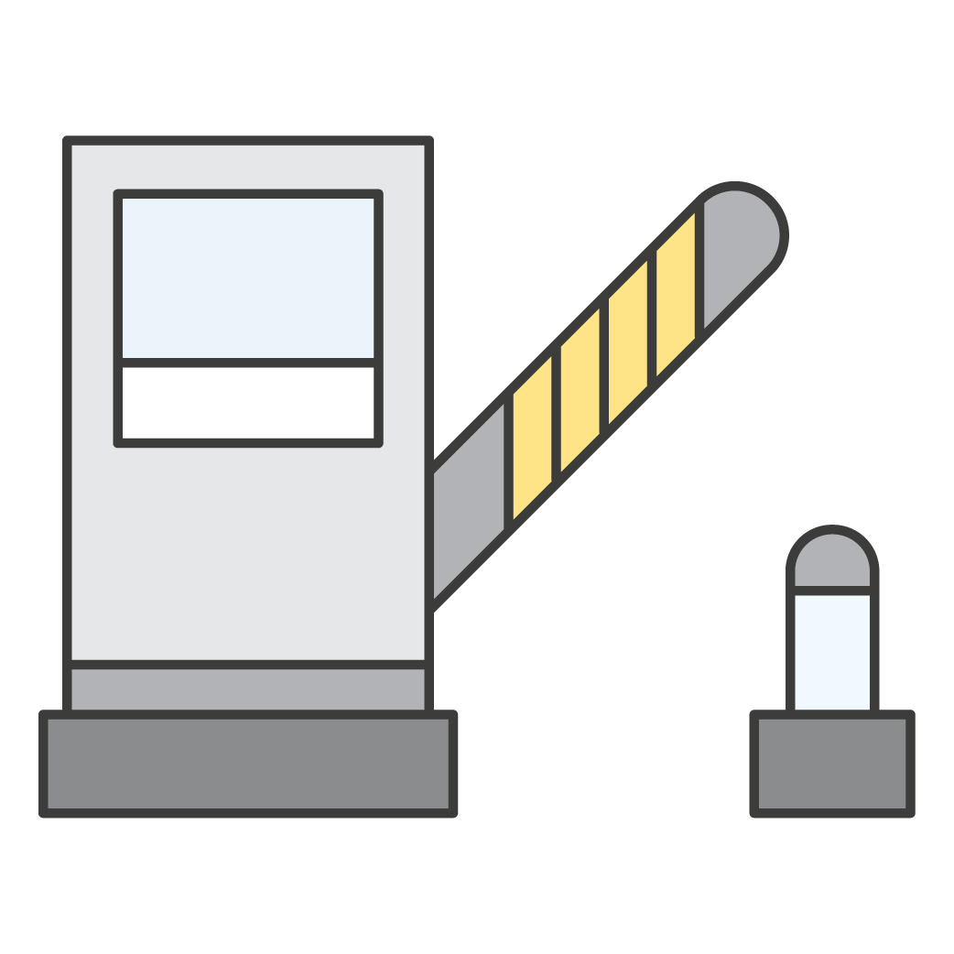
Release processes levels
Source
Build
Production
Test
Continuous integration
Continuous delivery
Continuous deployment

Slide 15
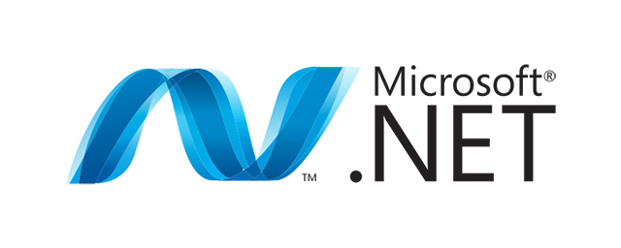
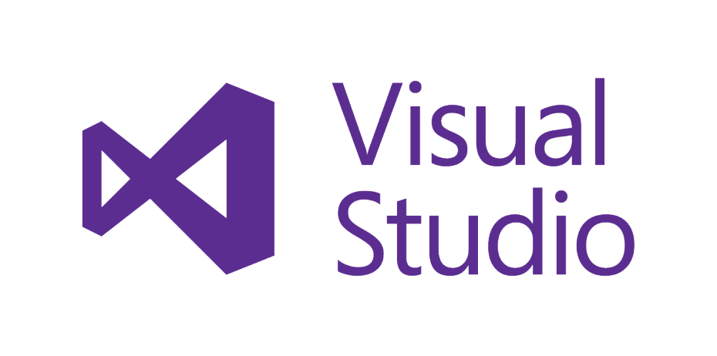
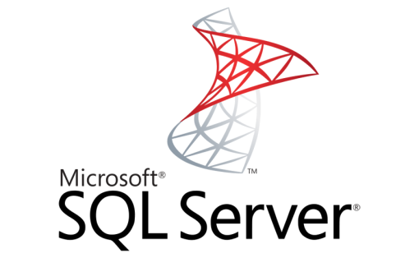
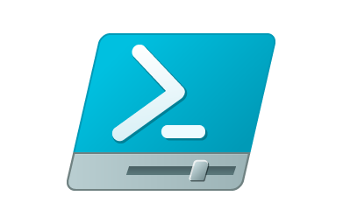
State of Windows development on AWS
AWS SDK for .NET
AWS Toolkit for Visual Studio
AWS Tools for Windows PowerShell
AWS higher-level services
AWS Code*, OpsWorks
AWS Elastic Beanstalk
RDS for SQL Server
Amazon EC2 Systems Manager
Notes:
Notes
SDK for .NET – Many recent improvements related to .NET Core, Extensions went live in Sept. to deal with the removal of the ConfiguraitonManager.
Toolkit – This continues to be a tool AWS invests in to make it easier to do development targeting AWS. There is an explorer and a simple mechanism for pushing directly to beanstalk. It’s one of the best tools available for editing CF templates
Tools for Powershell – continue to evolve these and as services release the CLI will rev and so does the powershell cmdlets
CodeDeploy – Service that provides an agent solution that runs on Windows in AWS or on-premise and communicates to a central command/control service you can configure to run a bunch of setup hooks and code laydown. Customers are using this to deploy to 100’s of instances.
ElasticBeanstalk – often characterized as the AWS platform as a service but that really isn’t what this service is all about. This service is about simplifying and putting consistency into your deployment and operations of a constrained solution. Think .NET multi-tier web API or a backend worker fleet that needs to crunch through events coming into a queue or …
RDS for SQL Server – We deploy and provide SQL Server in a managed way and recently allow you to implement a domain join and integrated security model
SSM – This gives you remote powershell command automation.
More Info
> http://blogs.aws.amazon.com/net/

Slide 16

Introducing Windows-based AWS Quick Starts
Active Directory Domain Services
Web Application Proxy + AD FS
SQL Server
SharePoint Server
Exchange Server
Lync/Skype for Business Server
Remote Desktop Gateway
CI/CD for Windows
Notes:
The AWS Cloud makes it easy for developers to code, build, and deploy .NET solutions. AWS has a.NET SDK that simplifies the work for .NET developers who want to use AWS services. AWS also has a continuous integration (CI) orchestration service called AWS CodePipeline, and multiple deployment options to help developers quickly deploy and manage their .NET solutions. AWS Elastic Beanstalk and AWS CodeDeploy provide an easy model for deploying and versioning .NET applications.
Quick Starts are automated reference deployments for key workloads on the AWS Cloud.
Each Quick Start launches, configures, and runs the AWS compute, network, storage, and
other services required to deploy a specific workload on AWS, using AWS best practices for
security and availability.

Slide 17
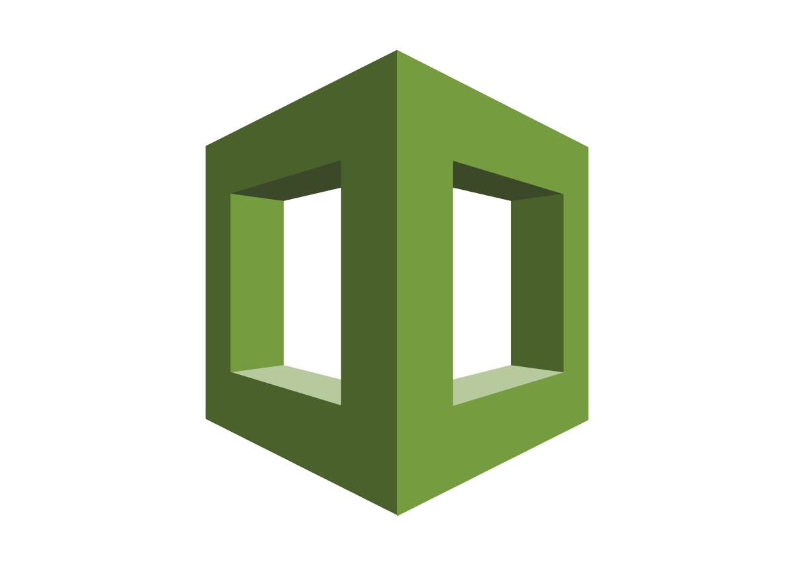



AWS DevOps Tools
AWS CloudFormation
AWS Elastic Beanstalk
AWS OpsWorks
AWS X-Ray
AWS CodePipeline
AWS CodeCommit
AWS CodeBuild
AWS CodeDeploy

Slide 18
DEMO1
OpsWorks

Slide 19

AWS Code* services
Software release steps:
AWS CodePipeline
Commit
Build
Production
Test

Slide 20

AWS Code* services
Software release steps:
AWS CodePipeline
Commit
Build
Production
Test
AWS CodeCommit
AWS CodeBuild
Third-party tooling
AWS CodeDeploy

Slide 21
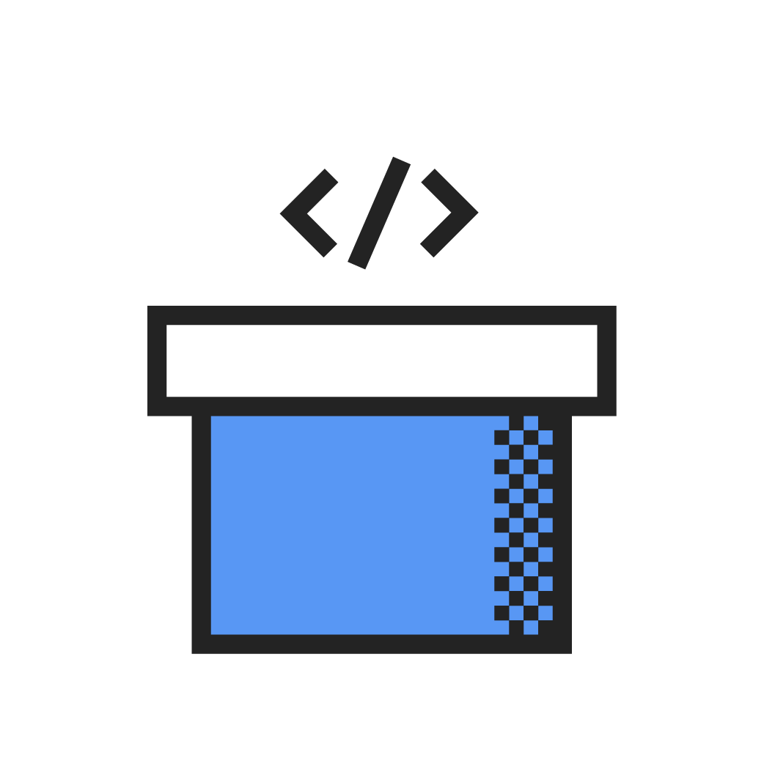
AWS CodePipeline
Continuous delivery service for fast and reliable application updates
Model and visualize your software release process
Builds, tests, and deploys your code every time there is a code change
Integrates with third-party tools and AWS

Slide 22

Release process modeled in AWS CodePipeline
Source
Build
Deploy to Integration Stack
Integration Tests
Deploy to Production
Source
Source change
Starts a run; and
Creates an artifact to be used by other actions.
Change 1
MyApp
CodeCommit
Build
Build
CodeCommit
Pipeline
Pipeline Run
Integration
DeployToInteg
CodeDeploy
Action
Stage
IntegTest
End2EndTester
Production
DeployToProd
CodeDeploy

Slide 23


Release and deploy process – starting point
Source
MyApp
CodeCommit
Build
Build
Build
Integration
DeployToInteg
CodeDeploy
IntegTest
End2EndTester
Production
DeployToProd
CodeDeploy
CodeDeploy

Slide 24





CodePipeline
MyApplication
Source
1. Get changes
Source
GitHub
2. Store source artifact
EC2 instance
Build
3. Poll for job
S3
5. Get source artifact
4. Acknowledge job
JenkinsOnEC2
Jenkins
7. Put success
Source Artifact
6. Store build artifact
S3
Build Artifact
Deploy
8. Retrieve build artifact
Elastic Beanstalk
Web container
.Net App
Elastic Beanstalk
9. Deploy build artifact
.Net App

Slide 25




Extend AWS CodePipeline using custom actions
Mobile testing
Update tickets
Provision resources
Update dashboards
Send notifications
Security scan

Slide 26
AWS service integrations
Source
Invoke Logic
Deploy
Amazon S3
AWS Lambda
AWS CodeDeploy
AWS CodeCommit
AWS CloudFormation
AWS Elastic Beanstalk
AWS OpsWorks

Slide 27




We have a strong partner list, and it’s growing
Source
Build
Deploy
Test

Slide 28
DEMO 2
CI/CD Pipeline

Slide 29
AWS CloudFormation
Gives developers and systems administrators an easy way to create and manage a collection of related AWS resources
Understands dependencies and supports rollbacks and versioning
Allows for reusable component design strategies
Supports a portable JSON or YAML format
Authoring tools continue to improve
Notes:
Done in a declarative fashion

Slide 30
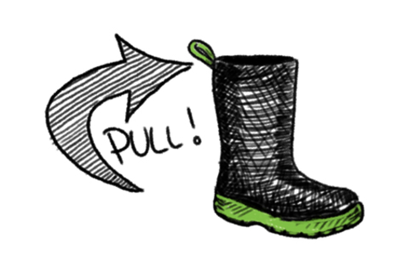
Bootstrapping
The last mile of your automation comes down to this
In the Windows world, this is almost always PowerShell
Some Windows challenges are always there (reboots, service restarts, security models)
The techniques you standardize on here can make or break your approach

Slide 31
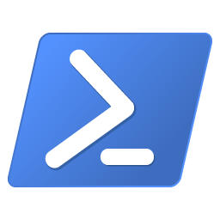



Configuration management
Making your scripts idempotent ensures that they can be rerun in place as needed
PowerShell DSC or AWS Partner solutions can help you
PowerShell DSC
Ansible
Chef
Puppet
Notes:
Making scripts reusable is great, but making scripts re-run in place is ideal
PowerShell DSC -> Configurations
Ansible -> Playbooks
Chef -> Recipes
Puppet -> Manifests

Slide 32
Reusable PowerShell module and scripts
PowerShell module
PowerShell scripts
Initialize
New-AWSQuickStartWaitHandle
New-AWSQuickStartResourceSignal
Finalize
Write-AWSQuickStartException
Write-AWSQuickStartStatus
Create-ADServiceAccount
Create-Share
Disable-AutoLogon
DisableCredSsp
Download-File
Enable-AutoLogon
EnableCredSsp
Install-Module
Install-WMF5
Invoke-ADReplication
Join-Domain
Mount-DiskImage
New-LocalAdministrator
Rename-Computer
Set-Dns
Unzip-Archive
https://github.com/aws-quickstart/quickstart-microsoft-utilities
Notes:
Found recurring pieces of code across Microsoft-based Quick Starts. For example: Many Windows environment need to join an AD domain.
Converted these to reusable scripts and modules.
Show how we use the AWSQuickStart PS Module to handle signaling.
Reused across Quick Starts

Slide 33
Sourcing files and relative paths
"C:\\cfn\\scripts\\Install-ADFS.ps1": {
"source": {"Fn::Join": [
"/",[
{"Fn::FindInMap": [
"AWSInfoRegionMap",
{"Ref": "AWS::Region"},
"QuickStartS3URL"]},
{"Ref": "QSS3BucketName"},
{"Ref": "QSS3KeyPrefix"},
"scripts/Install-ADFS.ps1"
]]}}
Notes:
This is inside the "files" section of a specific cfn-init config set
Sourcing files:
We should do our best to not include the complex or potentially unreliable scripts inside “content” for a file and instead use “source” to get the file from a known location and place it in a secure location locally.
This also makes it easier to develop and debug the scripts separately.
Relative paths:
Show how we take in a bucket and key prefix and figure out everything from there

Slide 34
Nested CloudFormation stacks
"Resources": {
"VPCStack": {
"Type": "AWS::CloudFormation::Stack",
"Properties": { "TemplateURL": {...},
"Parameters": {...}}},
"ADStack": {
"Type": "AWS::CloudFormation::Stack",
"Properties": { "TemplateURL": {...},
"Parameters": {...}}},
...
}
Notes:
Relative paths are also used for the TemplateURL and Parameters (as needed)
Realized that AD Stack and RDGateway were usually common building blocks across stacks.

Slide 35
PowerShell scripts
param(
[Parameter(Mandatory=$true)]
[string]$Parameter1
)
try {
$ErrorActionPreference = "Stop"
#DO STUFF
}
catch {
$_ | Write-AWSQuickStartException
}
Notes:
Show a PS Script with try/catch and catch using a Cmdlet from AWSQuickStart to signal the exception.
Don’t forget the $ErrorActionPreference=Stop to ensure that non-terminating errors are also caught.

Slide 36
Invoking PowerShell scripts
"commands": {
...
"e-install-windows-failover-clustering": {
"command": "powershell.exe -Command \"C:\\cfn\\scripts\\Install-WindowsFailoverClustering.ps1\"",
"waitAfterCompletion": "0"
},
...
}
Notes:
This is inside the “commands" section of a specific cfn-init config set

Slide 37
Handling Windows reboots
"b-rename-computer": {
"command": {"Fn::Join": ["",[
"powershell.exe ",
"–Command
"\"C:\\cfn\\scripts\\Rename-Computer.ps1 ",
"-Restart -NewName '",
{"Ref": "WSFCNode1NetBIOSName"},
"'\""
]]},
"waitAfterCompletion": "forever"
}

Slide 38
CloudFormation signaling
"commands": {
"a-reboot": {
"command": "powershell.exe -Command \"Restart-Computer -Force\"",
"waitAfterCompletion": "forever"
},
"b-signal-success": {
"command": "powershell.exe -Command \"Write-AWSQuickStartStatus\""
}
}
Notes:
Why not put it in UserData? because of Windows reboots since UserData is only executed once (on the first instance launch) and not on subsequent reboots. Signaling must be handled via CFN init if there are reboots in the bootstrapping process.
If you aren’t doing any reboots, it is OK to put this in user data. However, many Windows operations require reboots like host rename and domain join.

Slide 39
DEMO 3
CI/CD Pipeline

Slide 40
Thank you!

