Slide 1

Final Project Case Study in Clinical Trials
Mathur, Sachin
CSCI E-89 Deep Learning, Spring 2019
Harvard University Extension School
Prof. Zoran B. Djordjević

Slide 2
Introduction
Drug Companies run clinical trials to find if a drug works in humans
Clinical trials are very expensive and often face challenges in recruiting patients
Eligibility Criteria (EC): Rules for including patients
Inclusion Criteria – Desired patient characteristics
Exclusion Criteria – Undesired characteristics
EC have to be carefully selected
Problem: To find if the eligibility criteria is specific for a disease
Candidate Solution in the Project:
Usecase: Breast Cancer and Alzheimer’s
Developed a model to distinguish EC language patterns of Breast Cancer and Alzheimer’s
Model can be used to classify text when making EC for clinical trials

Slide 3

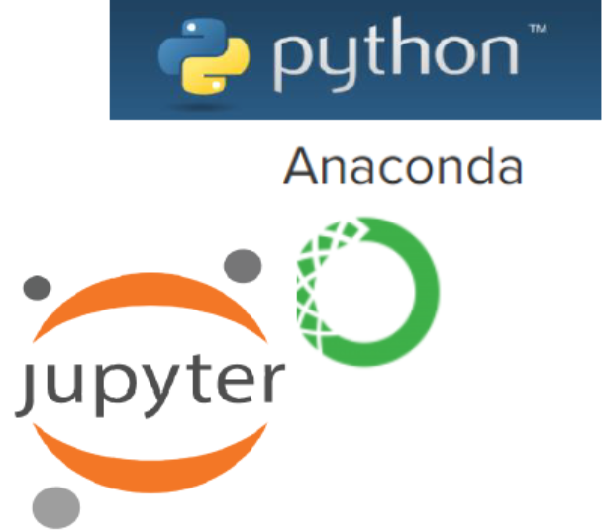

Software & Technology
Rstudio
R-3.4.1
Packages
PostgreSQL
stringR
tidyR
dplyr
Account at AACT (Free to register)
Jupyter Notebook
Python 3.6
Packages
NLTK
Keras
Pandas
GitHub for the final project report

Slide 4
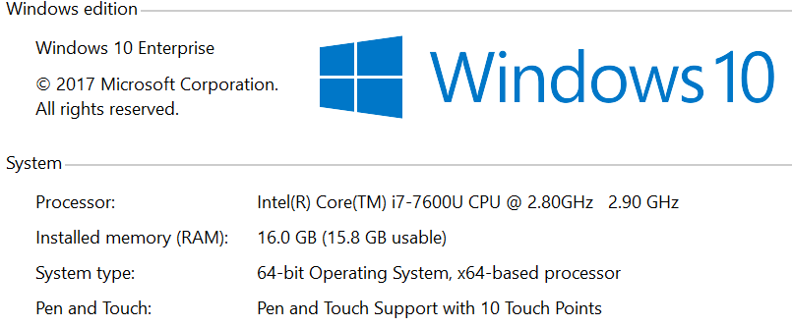
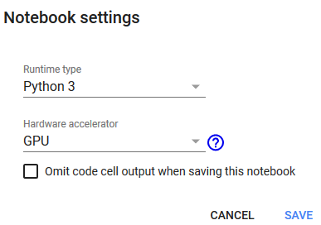
Hardware Environment
Rstudio was run on PC with Windows-10
Google Colaboratory was used for code in python with a GPU

Slide 5
Dataset
Data consists of 3 parts
Data for Word Embedding: Eligibility criteria for 12000 randomly selected clinical trials were extracted through an API from AACT
Training Set: ~500 clinical trials belonging to Breast Cancer and Alzhiemer’s were extracted. These were also part of the 12000 clinical trials used for word embedding
Test Set: ~200 clinical trials belonging to Breast Cancer and Alzhiemer’s were extracted. These were not part of the word embedding
Location of Data: https://github.com/smathurdc/ClinicalTrials , https://aact.ctti-clinicaltrials.org/
160789 sentences were used for word embedding (21 MB)
~2500 training samples
608 test samples

Slide 6
Overview of Steps
Install R-Studio on PC
Sign up for an account at AACT
Use R to extract data using the AACT API
Clean the inclusion and exclusion criteria
Use Google Colab – Google account will suffice
Install NLTK, Gensim in Google Colab
Upload data files to Google Drive
Perform NLP on the word embedding text
Make word embedding
Create models, train using training data and report results on test data

Slide 7
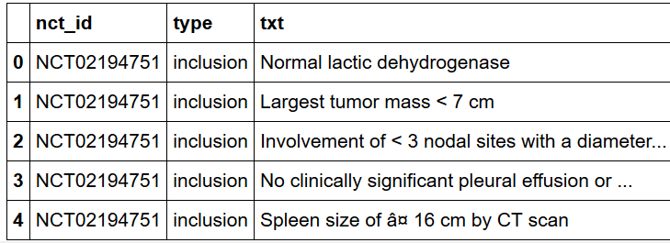
Data Set Overview and Prep
After extraction, dataset was cleaned by removing newlines and the number of criteria were extracted
Further NLP included
Converting to lower case
Removing numeric and alphanumeric characters/words
Raw text

Slide 8
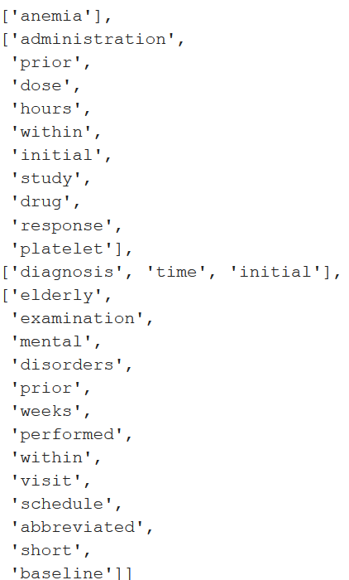
Data Prep Cont..
Removing extra spaces
Keeping only words of length >3 characters
Tokenizing
Keeping only tokens that occurred with a frequency of >= 5 in the corpus

Slide 9
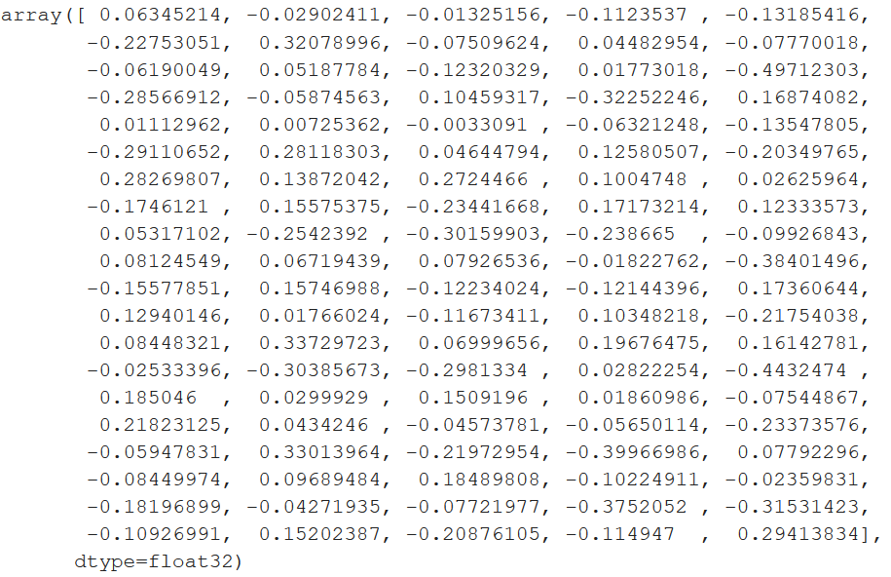
Word Embedding
Used Skipgram word2vec model
Created the wordembedding using genism
Vocabulary size = 6438 tokens
Dimension size = 100
Words most similar to ‘Diagnoses’
Example Word Vector

Slide 10
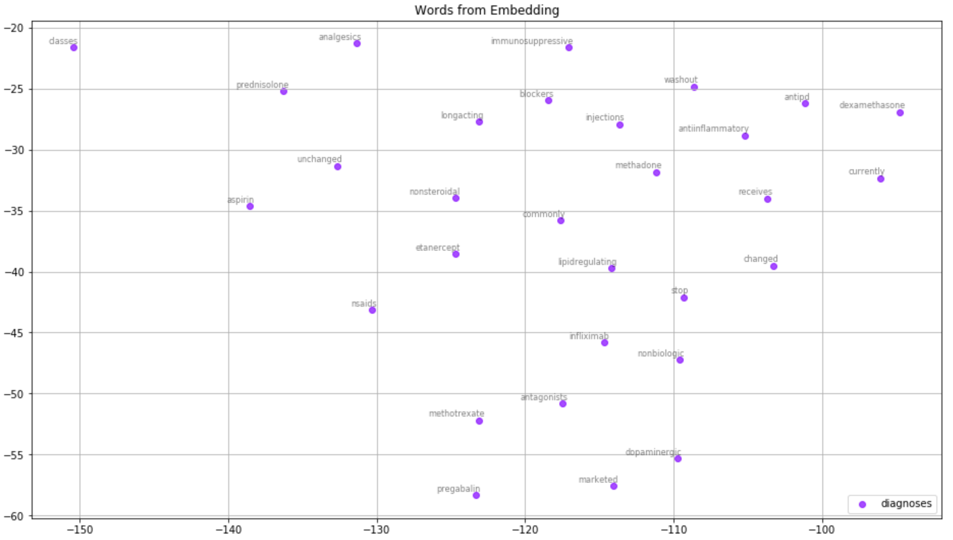
Word Embedding Visualization
Similar diagnoses are grouped together

Slide 11
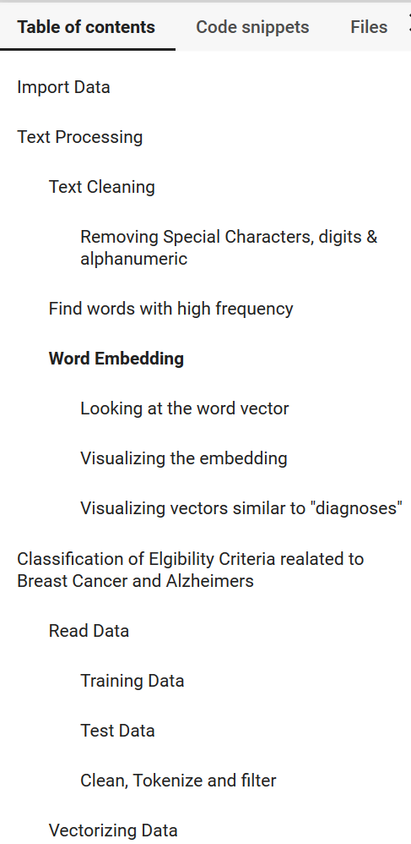
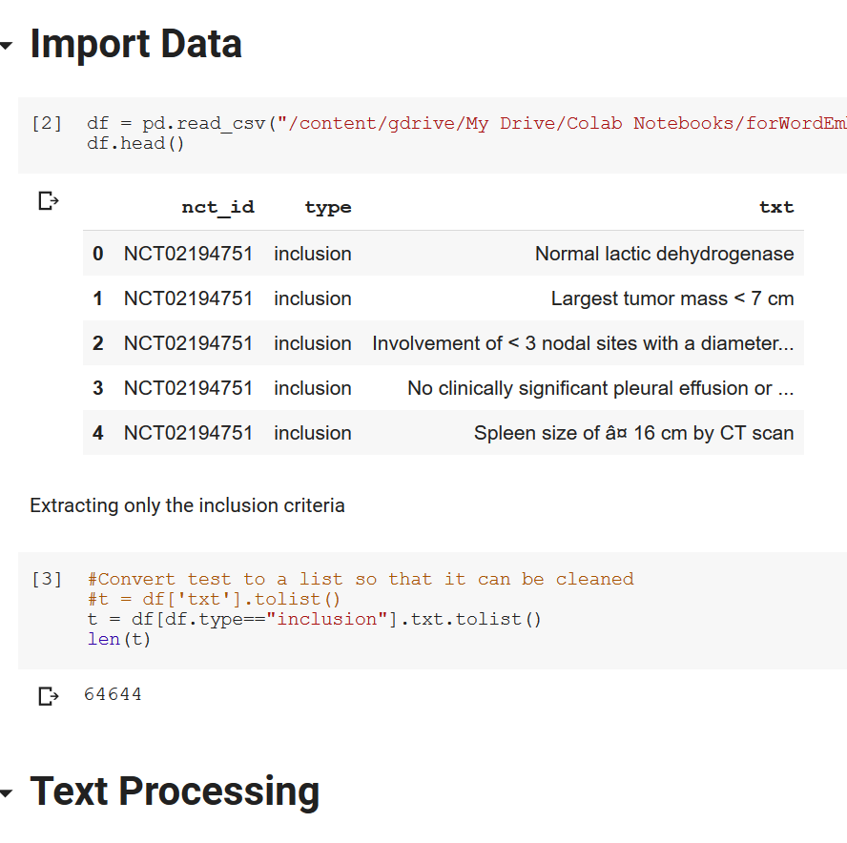
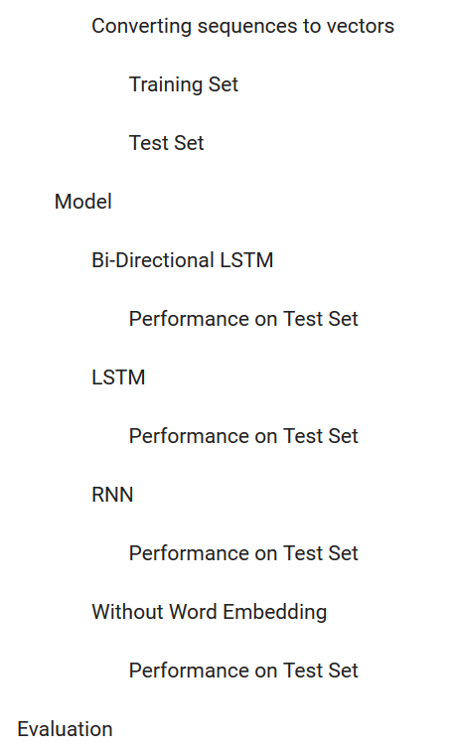
Code Overview

Slide 12
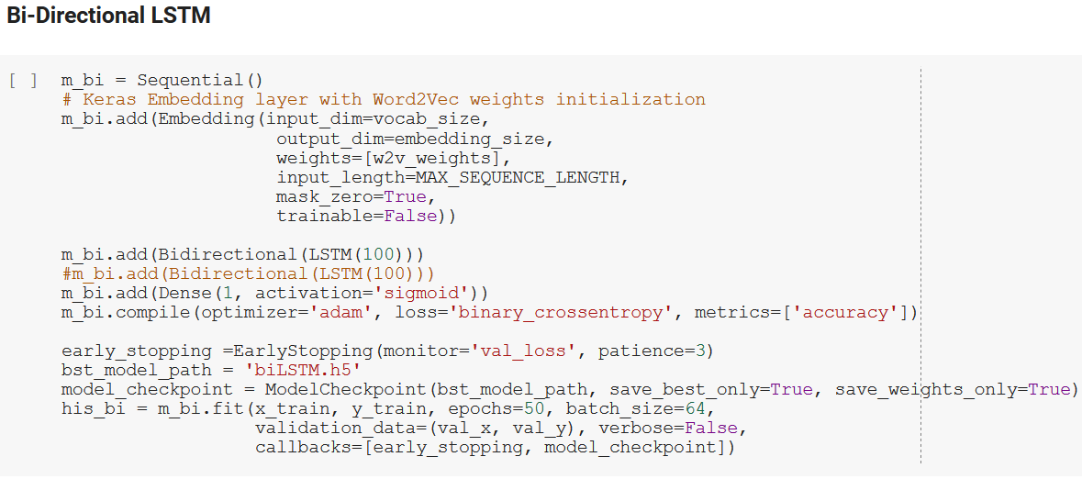
Model
Created Model using RNN, LSTM, Bi-Directional LSTM
Created a one-hot model to compare performance against a word embedding model
Used callback functions such as early stopping
Ran the model for 50 epochs
Created a validation set from the training set

Slide 13
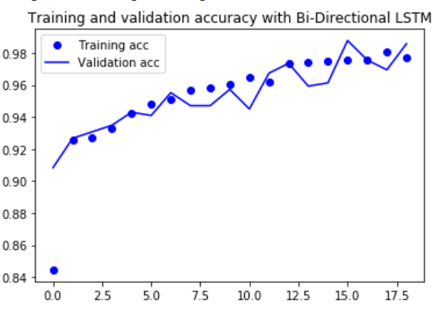
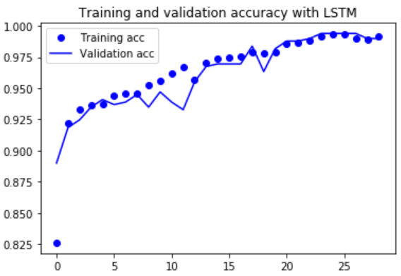
Results
Bi-Directional LSTM gave an accuracy of ~98% on the validation set
The LSTM also gave > 97% accuracy on validation set

Slide 14
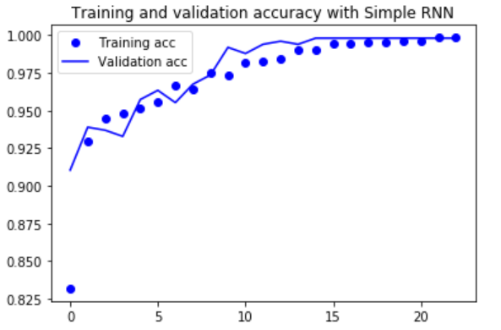
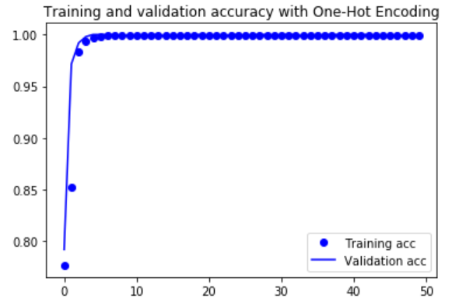
Results
The RNN also gave > 97% accuracy on validation set
The one-hot encoding neural net model overfits the data

Slide 15
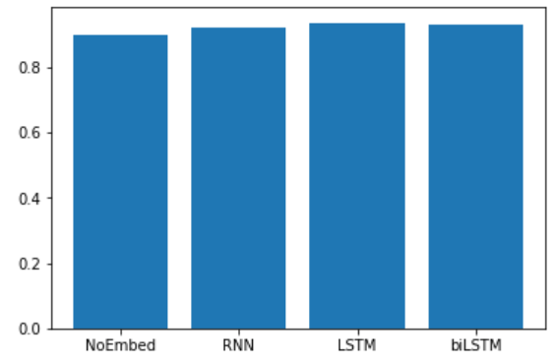
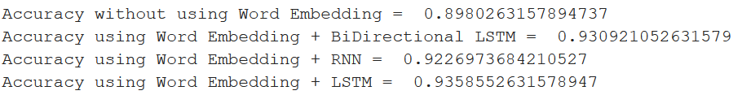
Final Result
Increase in ~4% accuracy by using LSTM or Bi-Directional LSTM

Slide 16
Lessons Learned
It is important to clean up text before creating a word embedding
Stemming or lemmatization may make it worse
One way to check if word embedding makes sense is to use a word and examine its similar words. If the similar words in context are chosen then the word embedding is good
Do not run word embedding on PC, always use a GPU
The LSTM and BiDirectional LSTM are able to classify inclusion criteria with a very high accuracy of ~93%
Using one-hot encoding the accuracy is ~88%, so word embedding was useful in increasing the accuracy

Slide 17
Future Work
Extent the work to include other indications such as ‘Fatty Liver’
Create separate models for inclusion and exclusion criteria
Find reasons for misclassifications
Experiment with other word embeddings such as Glove, FastText
Try NLP techniques like stemming so that word inflexions are avoided

Slide 18
YouTube URLs, Last Page
Two minute (short): https://youtu.be/cJRaqV5CsYM
15 minutes (long): https://youtu.be/wHrhfr3NSz4

