Slide 1
Was
outside
Get
Sunburn
Get
Insect bite
Have
Acne
Skin
Red
Bump
On Skin

Slide 2
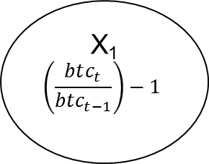
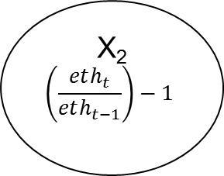
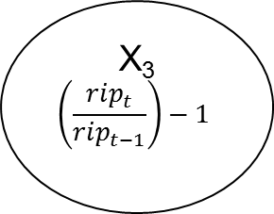
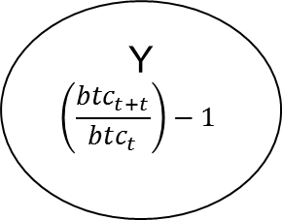
Model

