Slide 1


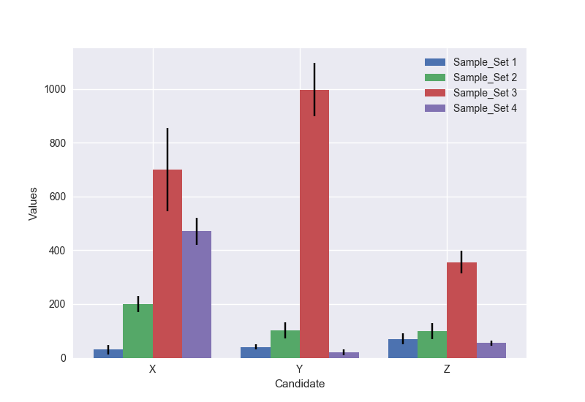
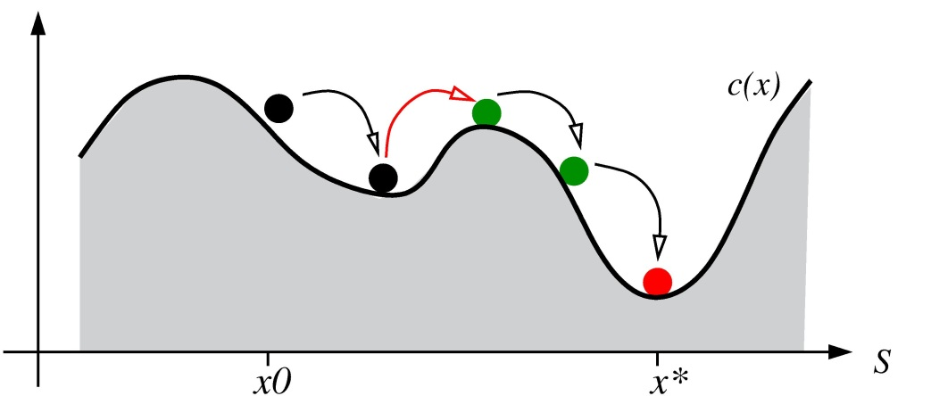
House Price Prediction Methods using Airbnb Listing Data
Authors
Affilication
CS109b/STAT121b/AC209b
Spring 2018
Introduction
I am an abstract. I am succinct and carefully written.
Founded in 2006, Airbnb is a peer-to-peer marketplace dedicated to finding you a nice place for your vacation. Pavlos uses it all the time.
blah blah blah
Methodology
Method description goes here
Figure 1. Finding good lodging is a matter of luck
Conclusions
Data Exploration
blah blah blah
We got data from here and there and we found this interesting result
Results
blah blah blah
blah blah blah
Citations and Links
Figure 2. And all about Figure 2.
Protopapas, P. P., and friends. 2013. How we taught AM207 and lived to tell the tale. IACS Journal 1:1–3.
The students of AM207. 2013. Everything we know, we learned in AM207. IACS Journal 1:3–5.
School of Engineering and Applied Sciences

