Slide 1
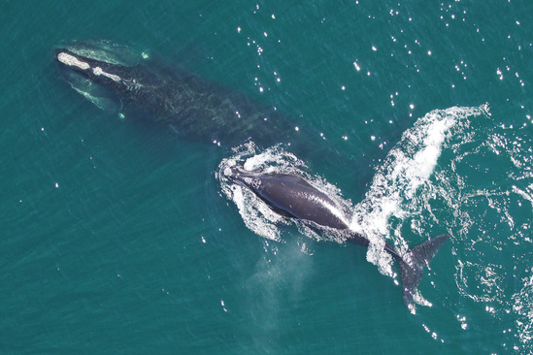

NARW North Atlantic Right Whale
Notes:
Introduce yourself
Audience

Slide 2
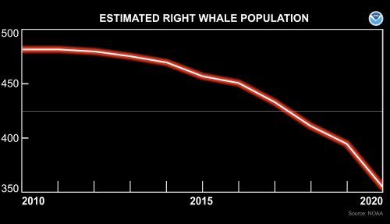
Fishing Technology and NARW
Last of the Right Whales
whale entanglement NARW #4615
another film - Entangled
Notes:
Motivation
Summary
Portland showing of LOTRW
Belfast showing of Entanglement

Slide 3
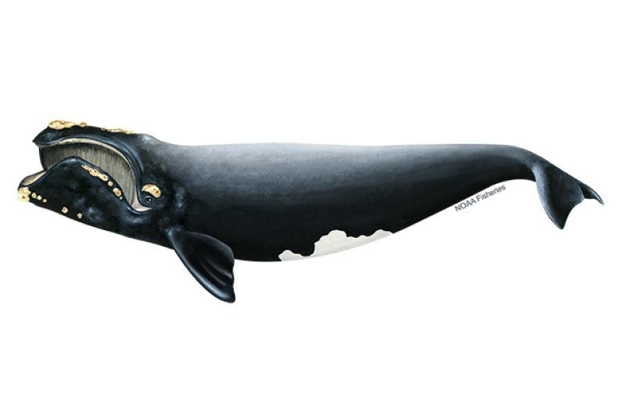
what
North Atlantic Right Whale Eubalaena glacialis
North Pacific Right Whale - Eubalaena japonica
Southern Right Whale - E. australis
Weight: Up to 140,000 pounds
Lifespan: up to 70 years
Length: up to 52 feet
Threats: changes in distribution of prey, climate change, entanglement in fishing gear, habitat degradation, ocean noise, pop. size, vessel strikes
Notes:
Southern population larger, more healthy

Slide 4
whoi
whales http://rwcatalog.neaq.org/#/whales
Snow Cone NARW #3560
scientists (including citizens)
management- multi-level
Atlantic Large Whale Take Reduction - 1997 (25 years)
yearly "stock assessment"
Endangered Species Act - "jeopardy"
fishing
whalers
lobster and crab fishers
others (lines, nets)
tracking vessels for research and enforcement
shipping

Slide 5
where / when
https://whalemap.ocean.dal.ca/#map
2019 Canada - Critical Habitat (Fisheries and Oceans Canada, 2014
Notes:
Where are the whales
When did they start moving from Bay of Fundy to Gulf of St, Lawrence? 2010
Map of current locations
Canadian Report on Gulf of St. Lawrence issues

Slide 6
why
"The principal factor believed to be retarding growth and recovery of the [NARW] population is entanglement with fishing gear" - NOAA Technical Memorandum NMFS-NE-258
"There are two endangered populations at stake here: the North Atlantic right whale and the Maine lobster fishermen.” - The Lobster Trap
The lobster industry in Maine has doubled since 2000
Since 2010, the average number of new NARW calves per year has halved, from 23 to 12
Due to warming waters in Gulf of Maine, lobster fishing has moved farther North and off-shore, ropes got stronger
Knowlton, A.R., J. Robbins, S. Landry, H.A. McKenna, S.D. Kraus and T.B. Werner. 2016. Effects of fishing rope strength on the severity of large whale entanglements. Conserv. Biol. 30:318–328. DOI: 10.1111/cobi.12590
A Risk Analysis of Entanglement
"Unusual Mortality Event": "a stranding that is unexpected, involves a significant die-off of any marine mammal population, and demands immediate response"
Notes:
Boston Globe / Portland Herald series Lobster Trap
Graph of lobster take

Slide 7
how
NOAA - science, regulation, and technology
regulations for right whales (2019)
AI for whale id from photos https://conbio.onlinelibrary.wiley.com/doi/10.1111/cobi.13226
Closures around Cape Code since 2015
Closures in Maine since 2021
Notes:
NOAA search – new regs
NOAA – federal regs
More traps per lines (depending on distance)
Allow ropeless gear – testing during winter
1700 pound rope breaks
Gear marking
comments, which represent up to 201,269 people, were in favor of stronger regulations to protect North Atlantic right whales.
Of the 336 unique commenters who identified themselves as fishermen, either directly or through context, 312 voiced opposition to all or part of the rule, 19 commented on particular provisions, but did not expressly support or oppose, and 5 supported the general idea of the rule,
economic analysis in Chapter 6 indicates the first-year cost of this rulemaking is $9.8 to $19.2 million, which is 3 percent of the landings value of the lobster fishery in 2019.

Slide 8
and how gory details
ROVs - acoustic detection of whales
season limits - time and area closures
speed limits - slow down when right whales are seen
"voluntary cooperation with DMAs has not proven to have a meaningful impact on vessel speed reduction"
traps/trawl - less vertical lines
weak rope and ropeless aka on-call fishing gear

Slide 9
weak rope - breaks
early ropeless technology
ongoing technology testing
SMELTS
EdgeTech
challenges
Pioneers for a Thoughtful Co-Existence
ropeless gear should also include locator tech, so anyone (trawlers) can know where there are traps without buoys
gill nets - acoustic signals to warn whales
2021 proposed regulation changes related to ALWTR
around 2/3 of entanglements are occurring in Gulf 0f Main and Canada
Notes:
SMELTS animation

Slide 10
thanks
Stephen@Mattin.net
SMattin.github.io - HTML slides

