Slide 1
INSIDER

Slide 2
Meet The Team
Kiara Perez – handlebars|css|routes| Database
Cam Hallmen – javascript|api
Steve Mattis – javascript|Models| authentication

Slide 3
the vision
We have created a user-friendly platform for communication and discovery. Insider comes stock with an easy-on-the-eyes dark theme and a straightforward approach to information sharing

Slide 4
Motivation
With the world growing more connected and sensitive everyday, people demand a new way to express themselves and share ideas. Our team took this into consideration when developing our new social media platform, Insider.

Slide 5
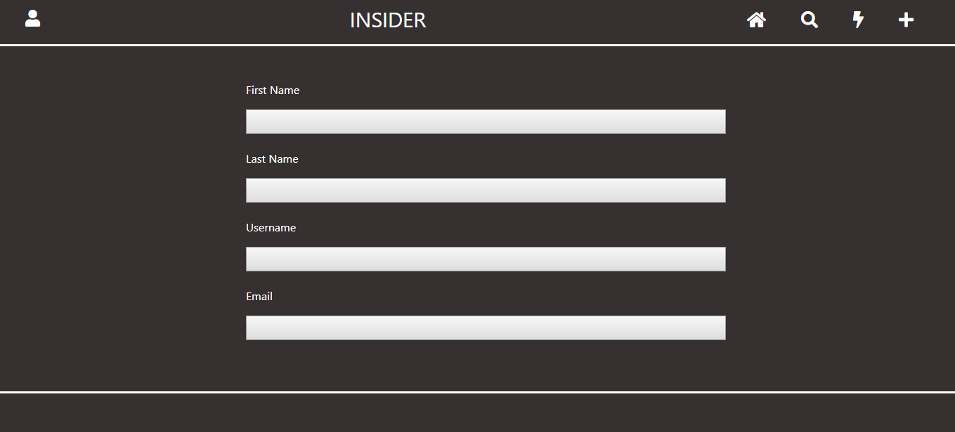

Slide 6
The Design process
Handlebars, CSS, Routes, and Database

Slide 7
The Design process
JavaScript and APIs

Slide 8
The Design process
JavaScript, Models , and Authentication

Slide 9
Future Development
Post Photos
Login Authentication
Find Friends
Comment On Posts
Edit and Delete Posts
Receive Notifications
Merge this project with our first project, Local Orlando. With a few coding and cosmetic tweaks, we could change Local Orlando into a day/trip planning site for the entire world. Upon integration with Insider, users could not only plan their day out based on their own preferences, but also take into consideration what their friends and family have planned.

Slide 10

