Slide 1
THE LANDLORDS
Nirmala, Sam, Sean
Do you think more evictions take place in areas with high crime?
Do you think access to public transportation, like subways might decrease evictions?
Do you think fewer evictions would happen where greater access to parks is available—either due to affluence or the mental and physical benefits of green space?
Do you think time of year has any relationship to evictions?
Using data from NYC and elsewhere, our project answered questions like these.
Notes:
Our project idea:
Evictions in New York City have a measurable relationship to crime, public transportation, and access to green space. Based on those ideas, we expected:
Evictions will be higher in zip codes with more reported crime, and lower in zip codes with less reported crime
Evictions will be higher in zip codes with fewer entry points to the subway, lower where subway access is greater
Evictions will be higher in zip codes with less accessible green space (parks), and lower where more green space is accessible
The questions we asked, and why we asked them
Where are the subway entrances, what were all the reported crimes last year, where are the parks and how much acreage do they cover, how many evictions were there last year and where did they take place? Why doesn’t a real New Yorker think Staten Island counts?

Slide 2
Summary
There does appear to be a relationship between crime and eviction,
And Evictions do follow a pattern through the year,
but we could not determine whether evictions had a similar relationship to Subway Access and/or Parks
Notes:
Data Exploration and Clean Up
Crime, Demographic, Subway, Eviction and Park Data all came from the City of New York’s API and other NYC official sites.
Our data seemed most interesting and understandable when we grouped it by borough.
Parks data was especially dirty without a common delimiter. Integrating the data required a great deal of time.
There are almost as many arrests “for possession of heroin with a needle” as traffic violations in our NYC crime data.

Slide 3
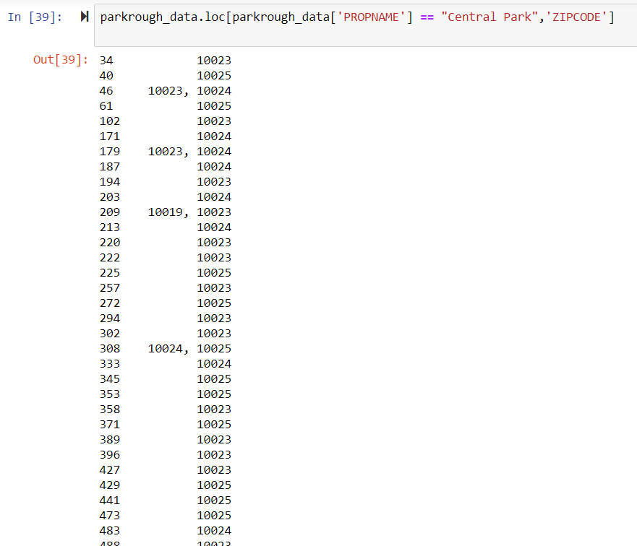
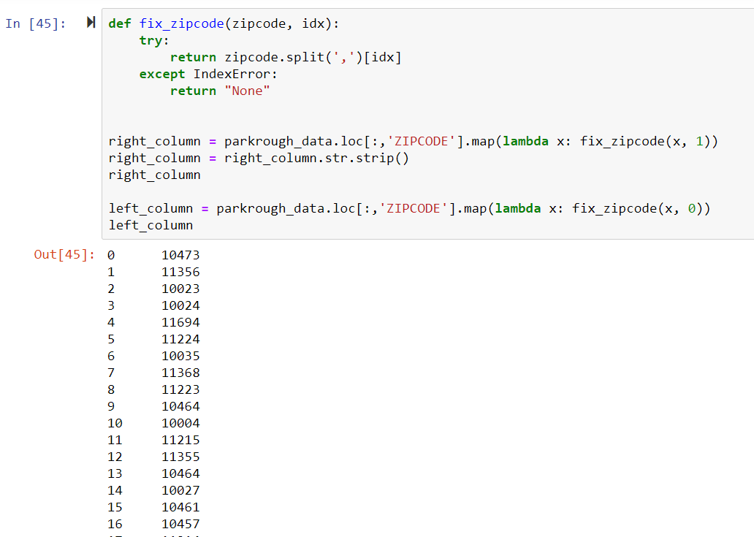
Sample Jupyter Notebook: The Parks Were Filthy
Notes:
Data Exploration and Clean Up
This slide shows (left) how parks data was oddly formatted when we first got it. The second snip (right) shows how we corrected the issue.
Parks data was especially dirty without a common delimiter. Integrating the data required a great deal of time.
Other data cleanup notes:
Crime, Demographic, Subway, Eviction and Park Data all came from the City of New York’s API and other NYC official sites.
Our data seemed most interesting and understandable when we grouped it by borough.
There are almost as many arrests “for possession of heroin with a needle” as traffic violations in our NYC crime data.

Slide 4
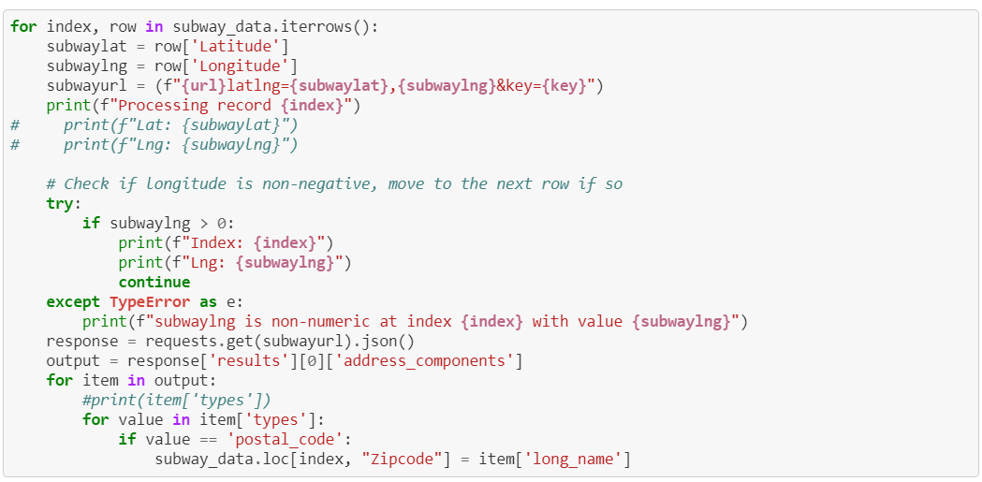
Sample Jupyter Notebook: Itter This
Notes:
Data Exploration and Clean Up
This slide shows (left) how parks data was oddly formatted when we first got it. The second snip (right) shows how we corrected the issue.
Parks data was especially dirty without a common delimiter. Integrating the data required a great deal of time.
Other data cleanup notes:
Crime, Demographic, Subway, Eviction and Park Data all came from the City of New York’s API and other NYC official sites.
Our data seemed most interesting and understandable when we grouped it by borough.
There are almost as many arrests “for possession of heroin with a needle” as traffic violations in our NYC crime data.

Slide 5
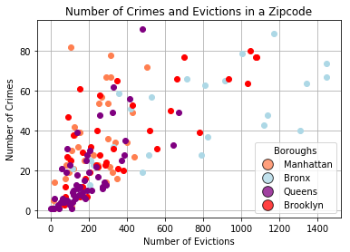
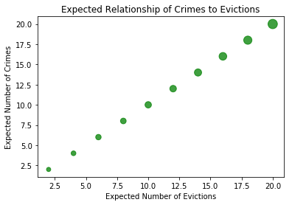
Analysis: Do more evictions take place in areas with high crime?
Based on the data, there does seem to be a relationship between evictions and crime.
Notes:
This slide shows “number of crimes” on the Y axis and “number of evictions on the X axis.
We expected areas of high crime to also have a high number of evictions—like the nset graph, upper right.
Our research suggests that, across all boroughs, as the number of crimes increases, so too does the number of evictions

Slide 6
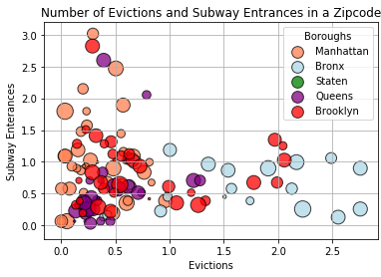
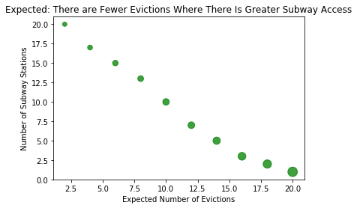
Analysis: Does access to public transportation, like subways decrease evictions?
Based on the data, there does not seem to be a relationship between evictions and subway access.
Notes:
This slide shows the “number of subway entrances in a zip code” on the Y axis and the “number of evictions” on the X axis.
We expected that zip codes with greater access to subways would show fewer evictions, like the inset graph upper right.
The logic was that people with ready access to public transportation like the subway would be more likely to hold jobs and keep up on rent payments
The data we collected and analyzed does not support that idea.
Instead, what we see is a cluster of zip codes with a similar number of subway entrances (15 or fewer) with varying levels of crime associated with the same zip code.
Elsewhere, places like Grand Central Station in NYC (with upwards of 30 subway entrances), stand out as having a very low number of evictions, but we’d expect that – compared to the other zip codes in the city, there are likely fewer rental properties in Grand Central Station’s zip code.

Slide 7
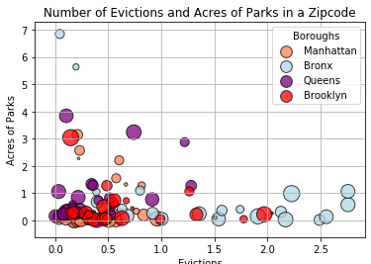
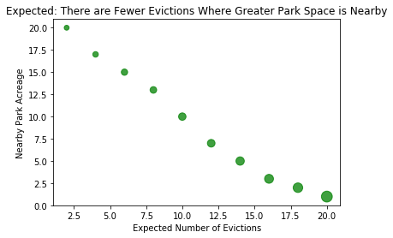
Analysis: Does access to parks decrease evictions?
Based on the data, there does not seem to be a relationship between evictions and access to parks.
Evictions
Circle size is based on the number of crimes in each zip code
Notes:
This slide shows “acres of parks” on the Y axis and the “number of evictions” on the X axis.
We expected that green space—either because of the affluence required to live near it, or the mental health benefits of having access to a park—would be related to a lower number of evictions. See inset graph, upper right.
The data we collected and analyzed does not seem to support that idea, although further research may.
We took a closer look at the Parks data around the X Y intercept to see if the clustered points could tell us anything on closer examination. (next slide)

Slide 8
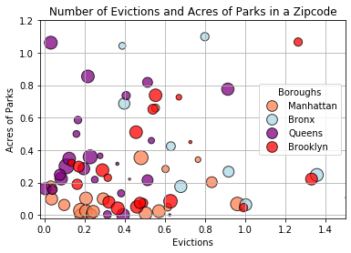
Analysis: Does access to parks decrease evictions?
A closer look at the evictions and parks data, close to the X Y intercept:
Circle size in all graphs is based on the number of crimes in each zip code
Notes:
In this graphic, we’ve limited the X and Y axis so the cluster at the X Y intercept of our original Parks graph (inset, lower right) can be viewed in more detail.
The Y axis remains “acres of parks” the x axis is still “number of evictions.”
The story it tells us is that many zip codes in the city have little access to green space, and that if access to green space is related to lower eviction rates, our data does not prove it, even on slightly closer examination.
One of the more subtle but tough challenges we uncovered is that Park Acreage (and subway entrances too) are different in nature from Evictions and Crimes. Parks are places; evictions and crimes are events. If we carried the research further, we’d want to supplement our data with something we felt compensated for the difference.

Slide 9
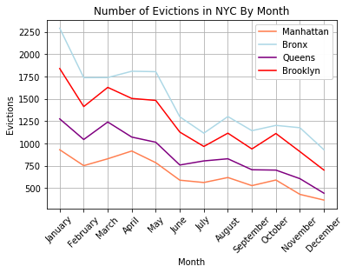
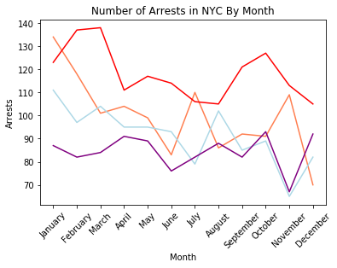
Analysis: Does time of year have any relationship to evictions?
Evictions are highest at the outset of a year; they decrease as the year closes
Notes:
On the right, this slide shows the number of evictions by month in NYC by borough. The number of evictions is on the Y axis this time, and the X axis holds each month of the year.
We thought that time of year would have a relationship to the number of evictions because NYC is cold in the winter. The logic was that landlords would evict fewer tenants in cold months and more when it was warmer.
The timing of evictions doesn’t seem to be related to cold weather, but there is a clear pattern of decreasing evictions from Jan through Dec. This may be a reflection of either the annual nature of rental agreements or proof that landlords have completely lost their Christmas Spirit once the New Year starts.
At left, a graph showing the number of arrests by month in NYC. The number of arrests are on the Y axis, and the X axis holds each month of the year.

Slide 10
Discussion
Discussion
Evictions and crime seem to be related—in boroughs as crime increases, so too do evictions.
Data for Subway Entrances & Parks are different from data for Crimes & Evictions. To determine if a relationship exists between parks and subway access, we’d want to look at different data
Additional questions that came up included new ideas and a few intended to prove out relationships we couldn’t establish in this project. For example:
Type of crime by borough; demographics of those who are evicted; breaking down which crimes happen where; more carefully defining “crime” so that crimes unrelated to evictions may be excluded

Slide 11
Questions?

