Slide 1
THE LANDLORDS
Nirmala, Sam, Sean
Do you think more evictions take place in areas with high crime?
Do you think access to public transportation, like subways might decrease evictions?
Do you think fewer evictions would happen where greater access to parks is available—either due to affluence or the mental and physical benefits of green space?
Using data from NYC and elsewhere, our project answered questions like these.

Slide 2
Motivation
Our project idea:
Evictions in New York City have a measurable relationship to crime, public transportation, and access to green space. Based on those ideas, we expected:
Evictions will be higher in zip codes with more reported crime, and lower in zip codes with less reported crime
Evictions will be higher in zip codes with fewer entry points to the subway, lower where subway access is greater
Evictions will be higher in zip codes with less accessible green space (parks), and lower where more green space is accessible
Describe the questions you asked, and why you asked them
Where are the subway entrances, what were all the reported crimes last year, where are the parks and how much acreage do they cover, how many evictions were there last year and where did they take place? Why doesn’t a real New Yorker think Staten Island counts?

Slide 3
Summary
There does appear to be a relationship between crime and eviction,
but we could not determine whether evictions had a similar relationship to Subway Access and/or Parks

Slide 4
Data, Clean Up & Exploration
Crime, Demographic, Subway, Eviction and Park Data all came from the City of New York’s API and other NYC official sites.
Our data seemed most interesting and understandable when we grouped it by borough.
Parks data was especially dirty without a common delimiter. Integrating the data required a great deal of time.
There are almost as many arrests “for possession of heroin with a needle” as traffic violations in our NYC crime data.

Slide 5
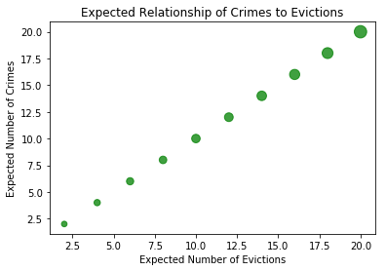
Analysis: Do more evictions take place in areas with high crime?
Based on the data, there does seem to be a relationship between evictions and crime.

Slide 6
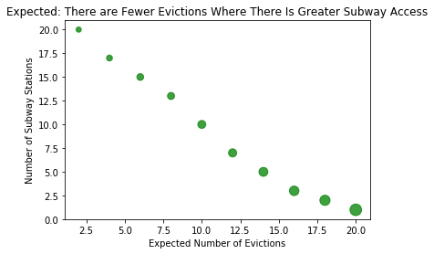
Analysis: Does access to public transportation, like subways decrease evictions?
Based on the data, there does not seem to be a relationship between evictions and subway access.

Slide 7
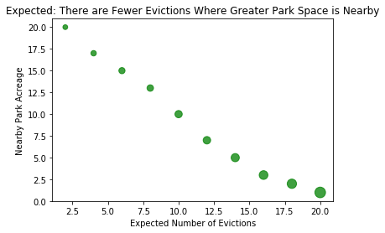
Analysis: Does access to parks decrease evictions?
Based on the data, there does not seem to be a relationship between evictions and access to parks.

Slide 8
Discussion
Discussion
Discuss your findings. Did you find what you expected to find? If not, why not? What inferences or general conclusions can you draw from your analysis?
Post MortemDiscuss any difficulties that arose, and how you dealt with them
Discuss any additional questions that came up, but which you didn't have time to answer: What would you research next, if you had two more weeks?
Discuss the implications of your findings. This is where you get to have an open-ended discussion about what your findings "mean". Tell a good story! Storytelling through data analysis is no different than in literature. Find your narrative and use your analysis and visualization skills to highlight conflict and resolution in your data.

Slide 9
Questions?

