Slide 1
THE LANDLORDS
Nirmala, Sam, Sean
Do you think more evictions take place in areas with high crime?
Do you think access to public transportation, like subways might decrease evictions?
Do you think fewer evictions would happen where greater access to parks is available—either due to affluence or the mental and physical benefits of green space?
Do you think time of year has any relationship to evictions?
Using data from NYC and elsewhere, our project answered questions like these.

Slide 2
Motivation
Our project idea:
Evictions in New York City have a measurable relationship to crime, public transportation, and access to green space. Based on those ideas, we expected:
Evictions will be higher in zip codes with more reported crime, and lower in zip codes with less reported crime
Evictions will be higher in zip codes with fewer entry points to the subway, lower where subway access is greater
Evictions will be higher in zip codes with less accessible green space (parks), and lower where more green space is accessible
Describe the questions you asked, and why you asked them
Where are the subway entrances, what were all the reported crimes last year, where are the parks and how much acreage do they cover, how many evictions were there last year and where did they take place? Why doesn’t a real New Yorker think Staten Island counts?

Slide 3
Summary
There does appear to be a relationship between crime and eviction,
but we could not determine whether evictions had a similar relationship to Subway Access and/or Parks

Slide 4
Data, Clean Up & Exploration
Crime, Demographic, Subway, Eviction and Park Data all came from the City of New York’s API and other NYC official sites.
Our data seemed most interesting and understandable when we grouped it by borough.
Parks data was especially dirty without a common delimiter. Integrating the data required a great deal of time.
There are almost as many arrests “for possession of heroin with a needle” as traffic violations in our NYC crime data.

Slide 5
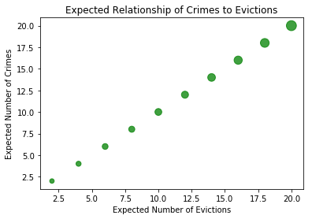
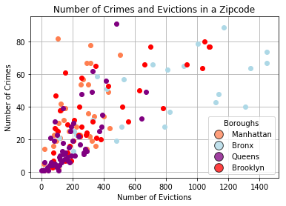
Analysis: Do more evictions take place in areas with high crime?
Based on the data, there does seem to be a relationship between evictions and crime.

Slide 6
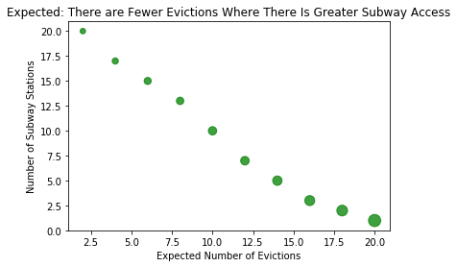
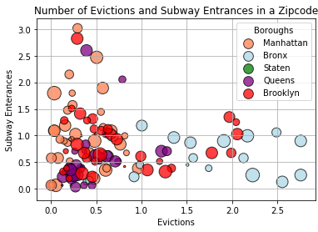
Analysis: Does access to public transportation, like subways decrease evictions?
Based on the data, there does not seem to be a relationship between evictions and subway access.

Slide 7
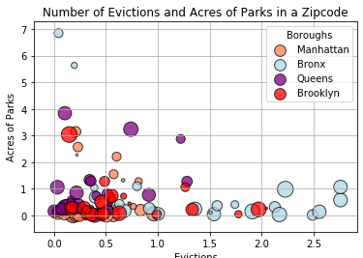
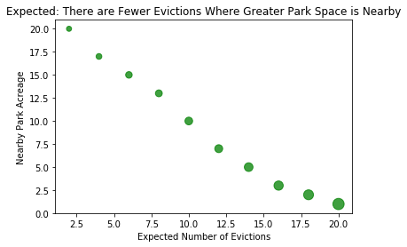
Analysis: Does access to parks decrease evictions?
Based on the data, there does not seem to be a relationship between evictions and access to parks.
Circle size is based on the number of crimes in each zip code

Slide 8
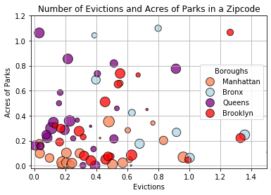
Analysis: Does access to parks decrease evictions?
A closer look at the evictions and parks data, close to the X Y intercept:
Circle size in all graphs is based on the number of crimes in each zip code

Slide 9
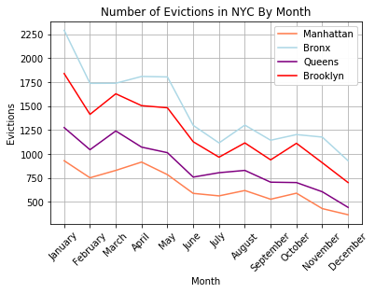
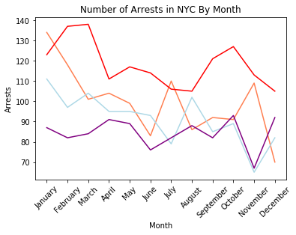
Analysis: Does time of year have any relationship to evictions?
Evictions are highest at the outset of a year; they decrease as the year closes

Slide 10
Discussion
Discussion
Evictions and crime seem to be related—in boroughs as crime increases, so too do evictions.
Data for Subway Entrances & Parks are different from data for Crimes & Evictions. To determine if a relationship exists between parks and subway access, we’d want to look at different data
Additional questions that came up included new ideas and a few intended to prove out relationships we couldn’t establish in this project. For example:
Type of crime by borough; demographics of those who are evicted; breaking down which crimes happen where; more carefully defining “crime” so that crimes unrelated to evictions may be excluded

Slide 11
Questions?

