Slide 1
Guided Capstone - Big Mountain Resort
Presentation by: Sara

Slide 2
Big Mountain Resort - Introduction
Big Mountain Resort is a ski resort in Montana that offers views of Glacier National Park and Flathead National Forest. An additional chair lift was installed and increased operating costs by $1.54 million. The resort’s strategy has been to charge a premium above the average price of similar resorts. They are also looking at other ways to offset the increase by cutting costs or raising ticket prices further.

Slide 3
Big Mountain Resort - Introduction
Their goal is to find a way to maximize revenue above the $1.54 million in increased operating costs from the new chair lift while maintaining quality services in the resort. The focus on identifying ways to maximize revenue will be applied to the facilities in the resort that are more valuable.

Slide 4
Recommendation and Key Findings
Analyzing the data showed a high correlation between summit and base elevation, a positive correlation between the ratio of night skiing area with the number of resorts per capita, and a positive correlation between total chairs and ticket price. The scatterplot shows a strong positive correlation of ticket prices with the vertical drop and with snowmaking.
My recommendation would be to sell the resort’s guaranteed snow, night skiing, and vertical drop.

Slide 5
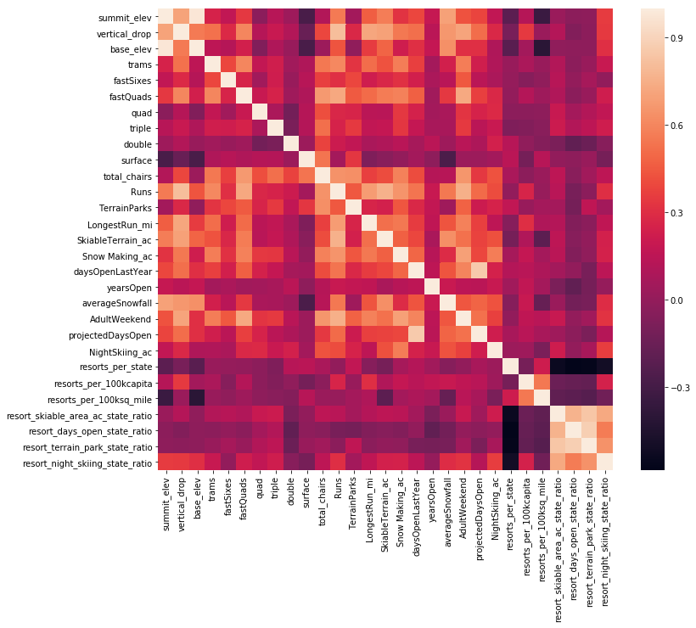
Modeling results and analysis (1)
When doing exploratory data analysis, the heat map analysis showed a high correlation between summit and base elevation, a positive correlation between the ratio of night skiing area with the number of resorts per capita, a positive correlation between total chairs and ticket price.

Slide 6
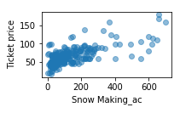
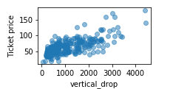
Modeling results and analysis (2)
The scatterplot shows a strong positive correlation of ticket prices with the vertical drop and with snowmaking.

Slide 7
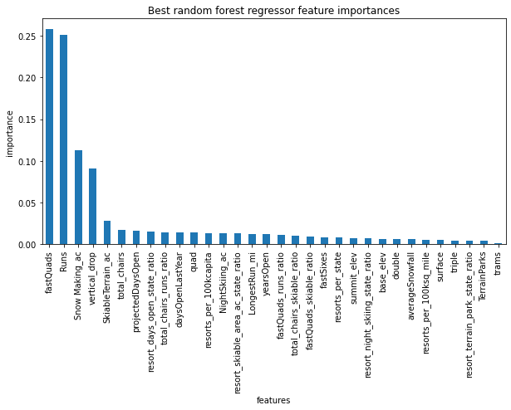
Modeling results and analysis (3)
Applying the Random Forest Model showed fast quads, runs, snow making, and vertical drop as the features in common with the linear model.

Slide 8
Modeling results and analysis (4)
Random Forest was found to be the best model for this dataset because it has a lower cross-validation mean absolute error and less variability.

Slide 9
Summary and conclusion
Modeling the data showed that Big Mountain is actually underpriced, though it isn’t known how the current ticket price of $81 was decided on. The suggested ticket price is almost $15 higher, at $95.87, though even increasing the price by half that amount results in more than enough revenue to cover the extra $1.54 million in operating costs for the new chair lift. The resort can be sold as having more amenities to offer with few other competing resorts.

