Slide 1
Modality 0
Modality 1
Settings
RESET
START
STOP
Settings
Settings
Figure
Figure
Figure
Figure
SAVE

Slide 2
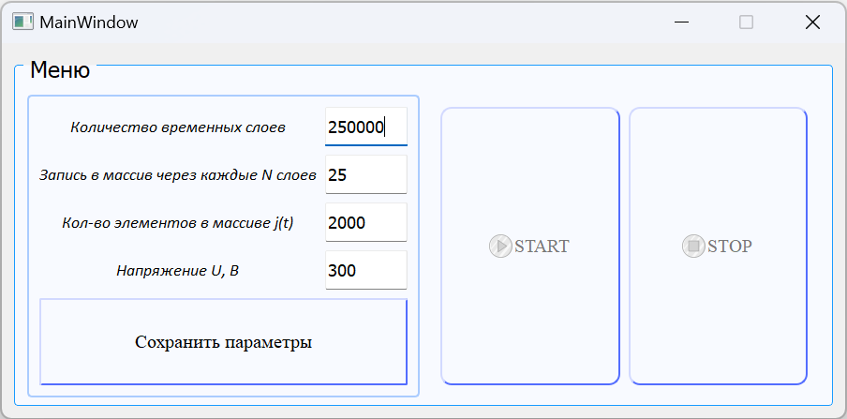

Slide 3
