Slide 1

Customer Registration Analysis
Sandeep Bansal
Fall 2022

Slide 2
Background
Given a set of dimensions can a model predict whether a a will register?
Utilizing customer data allows professionals to:
Determine likelihood a customer will register.
Predict behavior and understand potential lifelong customer value.
Establish baseline metrics for what an ideal returning customer looks like.
Optimize marketing strategy to maximize customer acquisition and profitability.

Slide 3
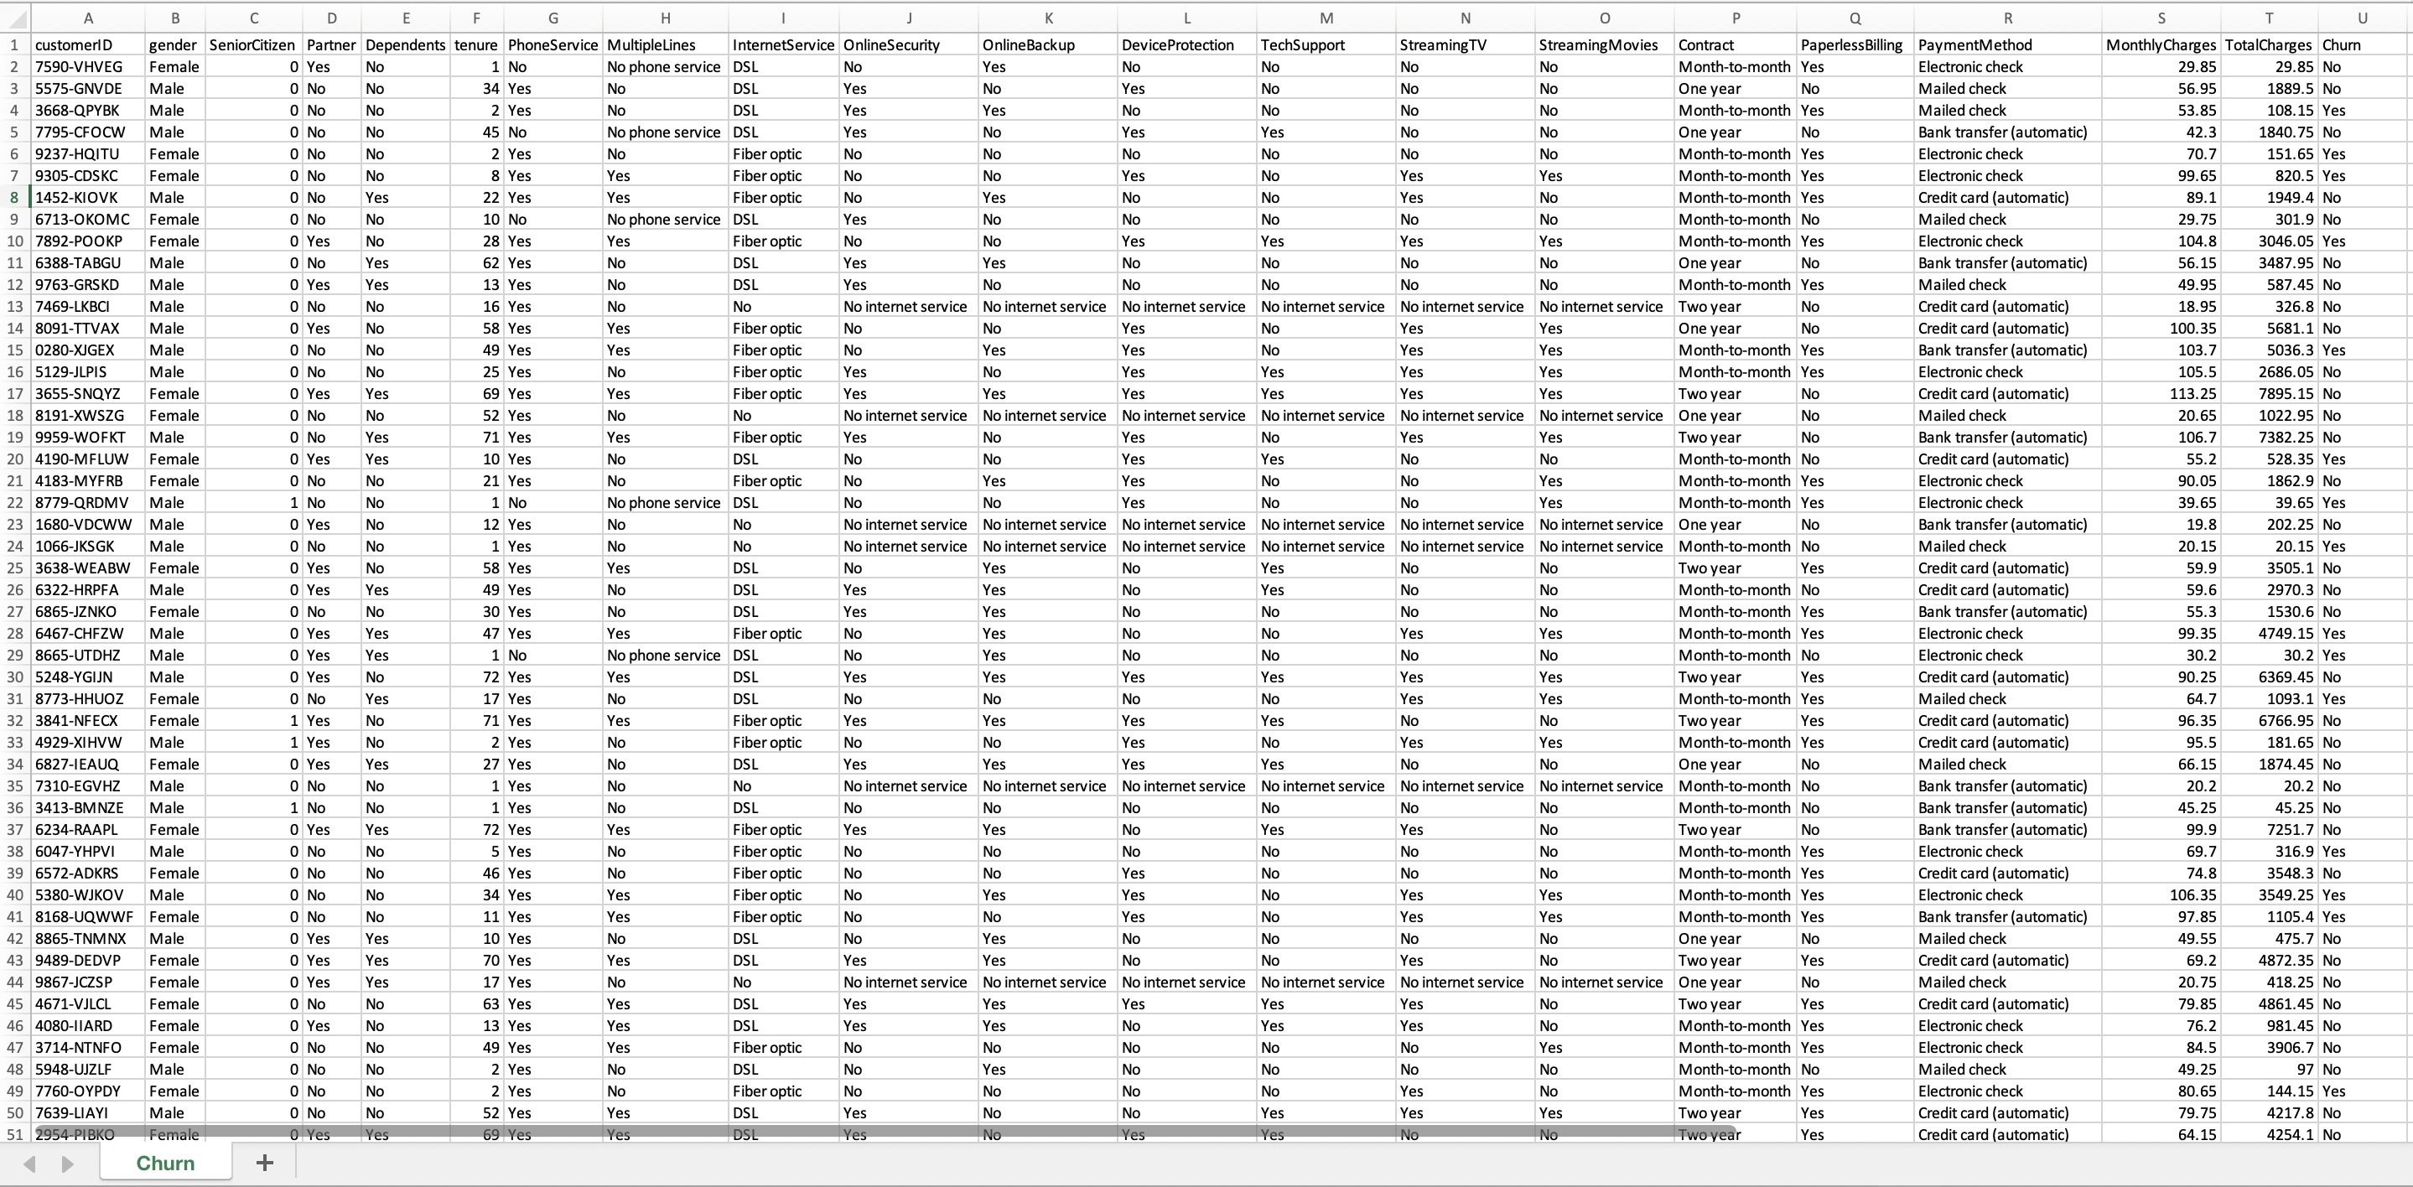
Data Overview

Slide 4
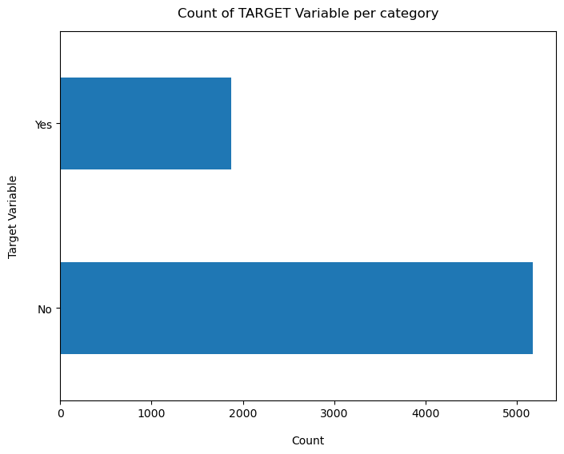
Target Variable Analysis

Slide 5
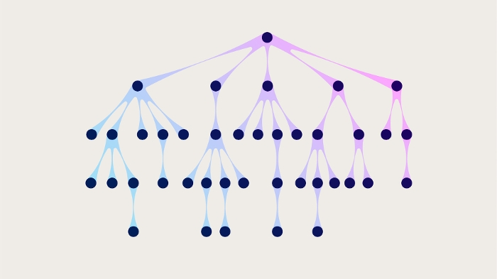
Tree based Method Approach
Classification Regression
Random Forrest
Decision Tree
Random Forest- Multiple trees to make a prediction.
Decision Tree- Single tree utilizing training dataset.
Notes:
The random forest algorithm is a type of ensemble learning algorithm.
This means that it uses multiple decision trees to make predictions.
The advantage of using an ensemble algorithm is that it can reduce the variance in the predictions, making them more accurate.
The random forest algorithm achieves this by averaging the predictions of the individual decision trees.
The decision tree algorithm is a type of supervised learning algorithm.
This means that it requires a training dataset in order to learn how to make predictions.
The advantage of using a supervised learning algorithm is that it can learn complex patterns in the data.
The disadvantage of using a supervised learning algorithm is that it takes longer to train than an unsupervised learning algorithm.
True Positive:

Slide 6
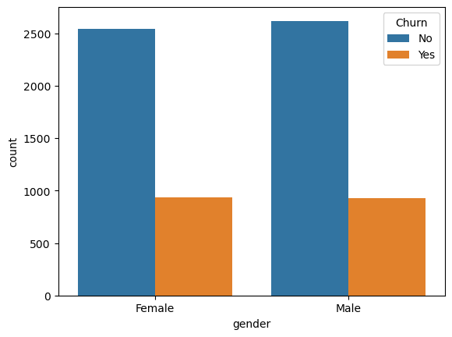
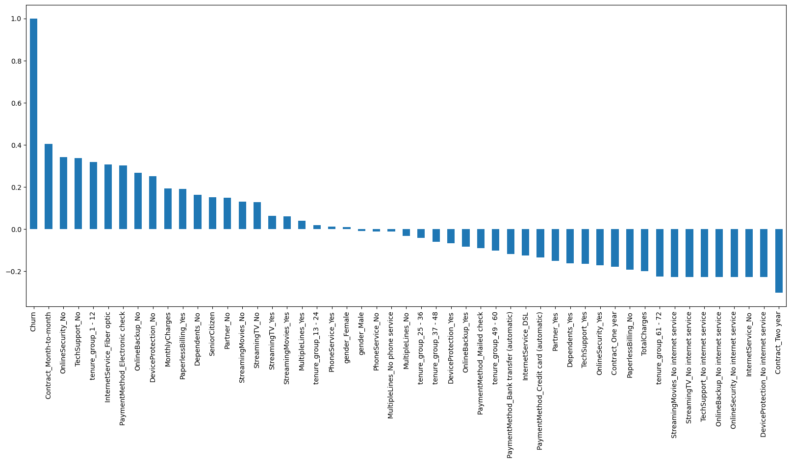
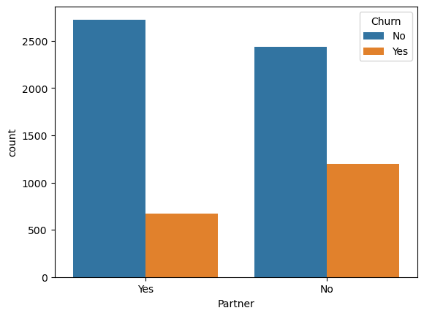
Exploratory Data Analysis Univariate
source https://www.youtube.com/watch?v=GVECbcKUio4

Slide 7
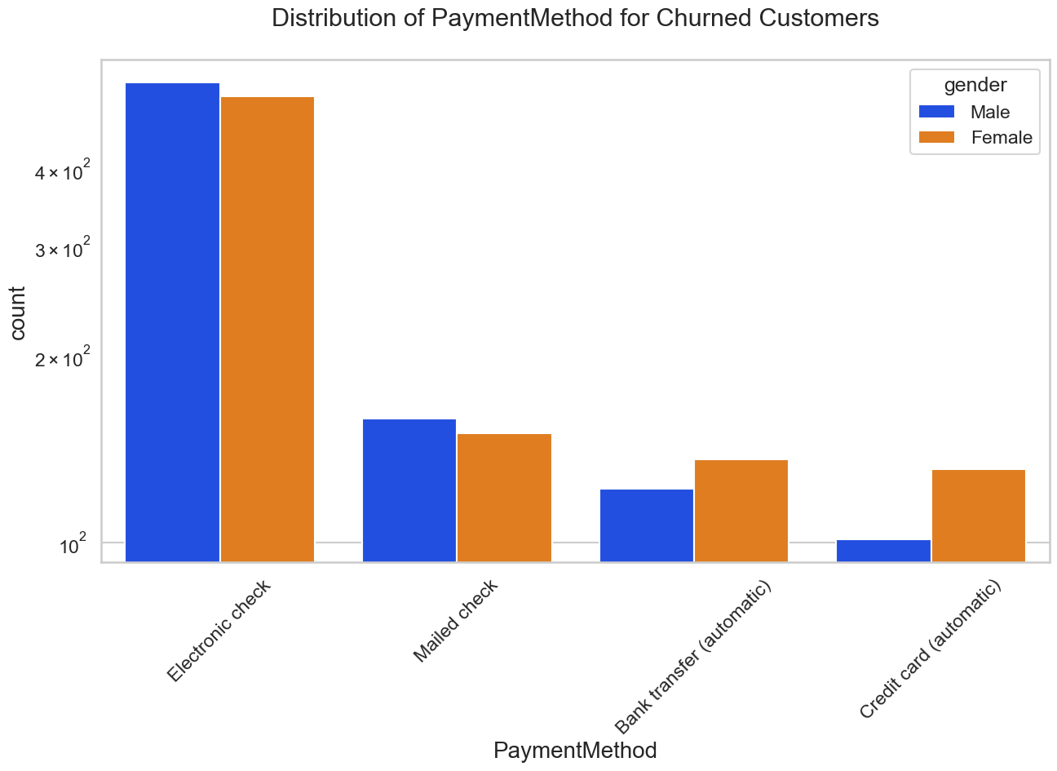
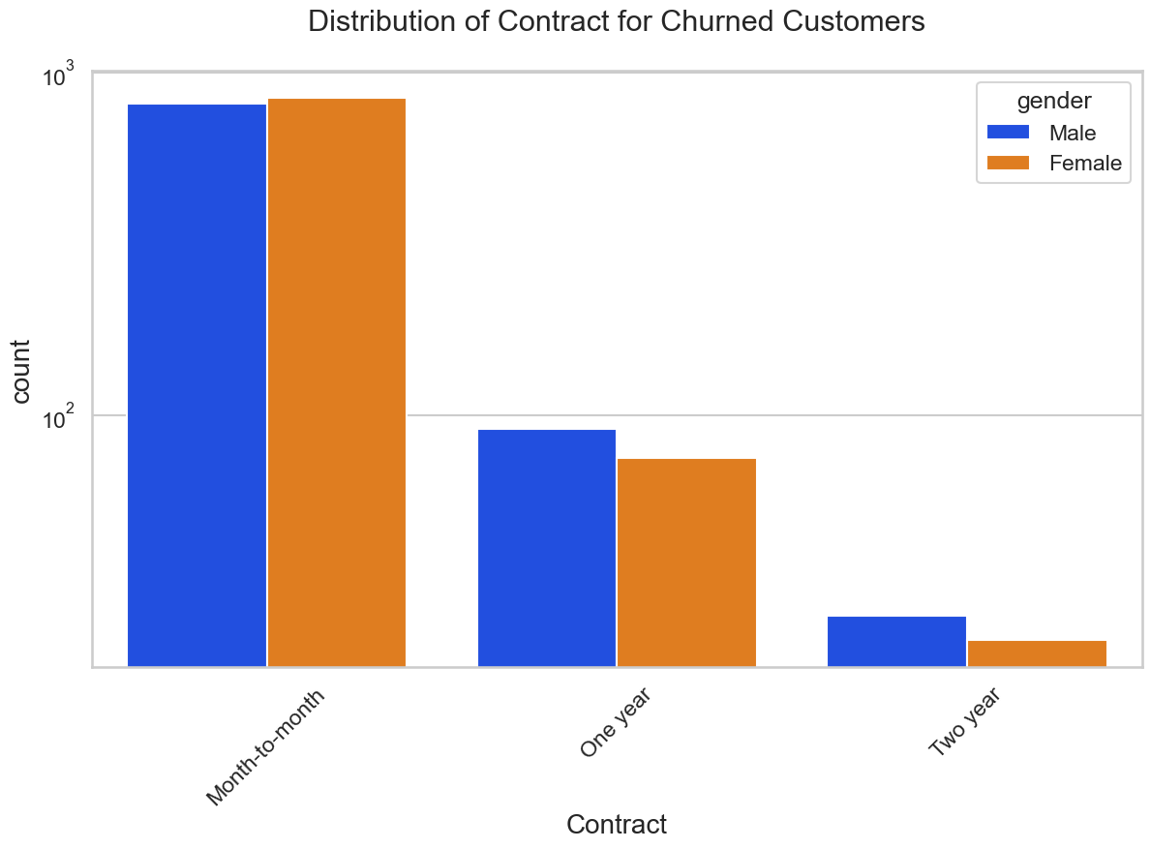
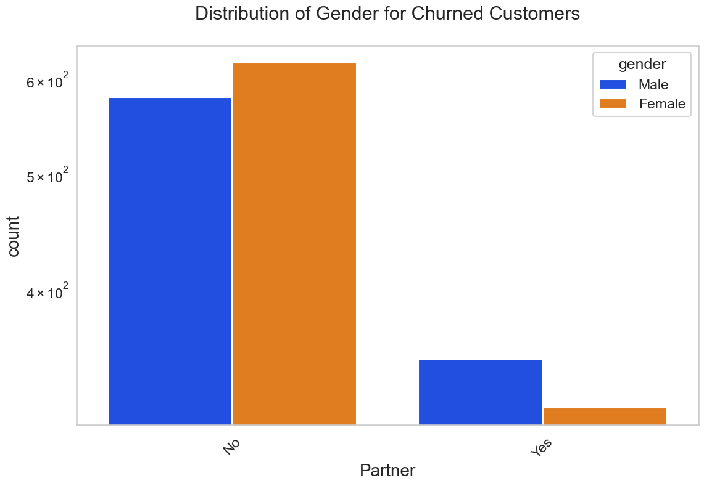
Exploratory Data Analysis Bivariate

Slide 8
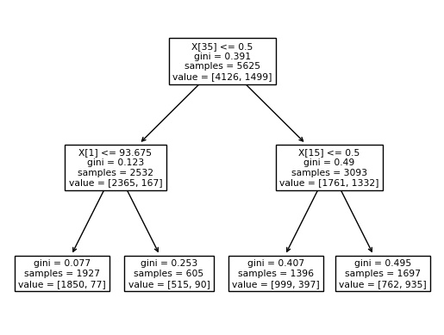
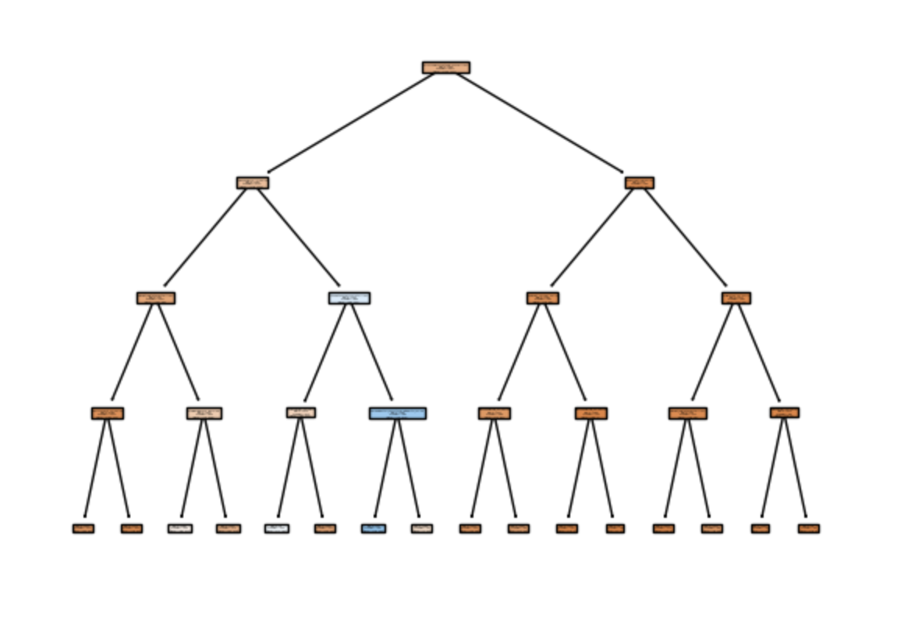
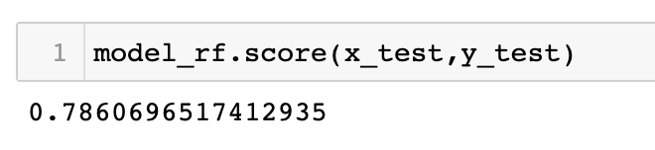
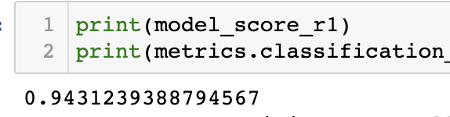
Results: Decision Tree vs Random Forrest

Slide 9
Resources
https://www.kaggle.com/code/anriueno/telco-customer-data-analysis-prediction/data
Tommy Blanchard, Debasish Behera and Pranshu Bhatnagar. “Data Science for Marketing Analytics.”
https://scikit-learn.org/stable/modules/tree.html

