Slide 1

Tau Beta Pi
The National Engineering Honor Society
University of Colorado at Boulder
Colorado Beta Chapter

Slide 2
Who We Are/History
All-Encompassing Engineering Honor Society
National Organization
Founded 1885
Largest Engineering Honor Society
Local Chapter
Founded in 1905, second chapter in Colorado
Over 4,500 Total Members
Notes:
Becoming a member of Tau Beta Pi is a great honor. It means that you are in the top 1/8th of the Junior class or the top 1/4th of the Senior class. You will join many successful engineers in becoming a member of this society.
Former President of McDonnell Douglass, Livingston Farrand, Milo Ketchum, President of Lockheed Martin
Many of the CEO’s of major corporations have affiliations with TBP.

Slide 3

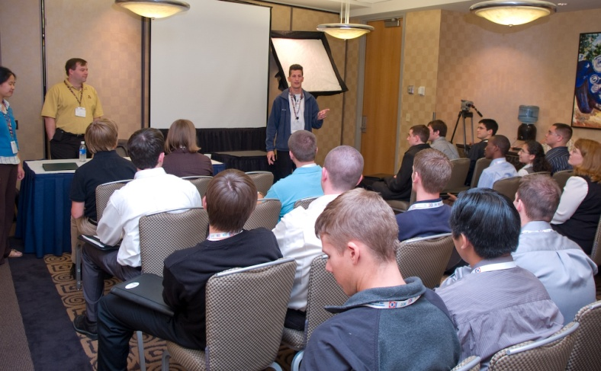


Local Activities
Professional Development
Engineering Futures
Opportunities/Networking
Company Presentations
& Exclusive Recruitment
Notes:
Engineering Futures are professional development courses that deal with interpersonal relationships and working with others, either as teams or in other group settings. Fortune 500 companies pay thousands, but we get them for free. Make you more marketable to employers. Curriculum: People skills, Team chartering, Group Process, Analytical Problem Solving, Effective Presentation Skills

Slide 4
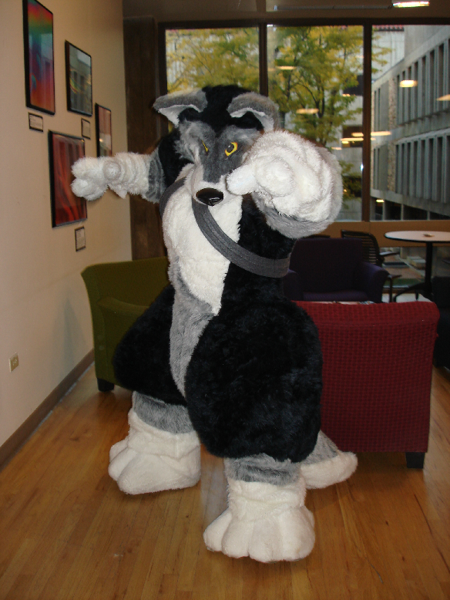
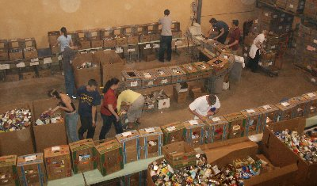
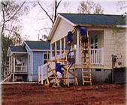

Local Activities
Community Service
Trick Or Can [Fall]
Habitat for Humanity
Relay for Life
Colorado Food Share
Notes:
Character is also very important to Tau Beta Pi. We try and host a group volunteer event once a semester.

Slide 5
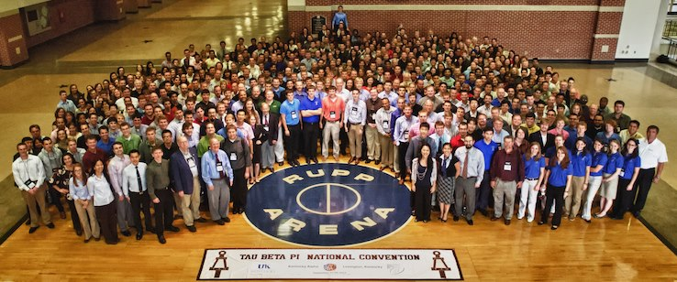
National / District Activities
National Convention
District Conference
Meet engineers from all over the country
Exchange ideas
Network!

Slide 6


National Organization- Benefits
Scholarships
$2000/year
Often ~ 50% chance of receiving one!
Fellowships
$10,000/year
30 Awarded last year
Student Loans
Up to $2500
Career Assistance
Networking and Mentoring
Publications
The Bulletin and The Bent
Other Discounts and Benefits!
Geico discount, FE exam review discounts

Slide 7


How to Become a Member
Top 1/8 of Juniors or 1/5 of Seniors are eligible to become members!
Additional Requirement for Membership:

Slide 8
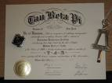
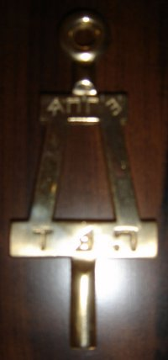
How To Become a Member
You already meet the academic req.
Next Steps:
Interview with an Officer
Sign Up Now!
Creativity Projects: Feb. 23rd & 24th
Community Service Project
Complete before initiation or write up recent past experience
Polish Bent
You will receive one during creativity project presentation

Slide 9
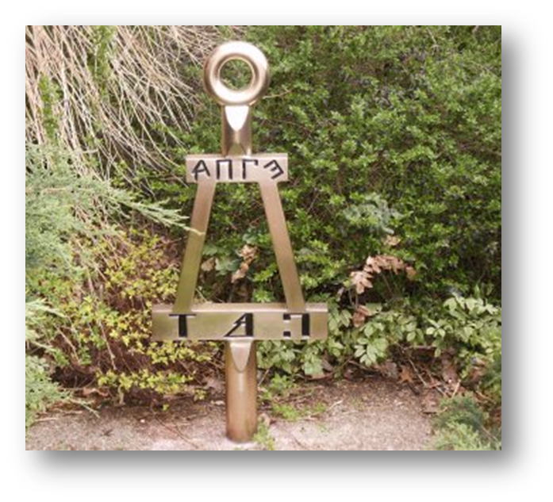
Initiation
Ceremony Sunday, Mar. 15th
Banquet provided
$90 Lifetime Fee

Slide 10
Contact Information
Feel free to email us if you have any questions!
President:
Amber Lane
Amber.Lane@colorado.edu
Vice-President:
Andy Kim
Jihoon.Kim@colorado.edu

