Slide 1

Midterm Presentation Real Time Object Tracking from Non-stationary Camera
Students: Mathias Bensimhon
Supervisor: Johanan Erez
Context: Project B
Semester: Winter 2021
Date: 09/05/2022
Notes:
1

Slide 2
Presentation Outline
- Motivation
- Problems
- Optional Solutions
- Chosen Solution
- Implementation
- Improvements for the future
- Implementation for NVIDIA Jetson
2
Notes:
2

Slide 3
Project goal
Tracking moving objects with non-stationary camera
The project is divided in 2 major parts:
Background subtraction to detect moving objects
Tracking moving objects throughout a movie

Slide 4
Motivation
Whether for video surveillance, robotics, police chasing and many more examples the ability to track moving objects through time is fundamental.
Yet, the limitation of fixed cameras is a huge disadvantage because most of moving objects will disappear from the frame quickly
That's why the ability to track objects using non-stationary cameras is of primary importance
4

Slide 5
Problems
Tracking moving objects with non-stationary camera includes some challenges:
Unlike the fixed camera case, with non-stationary one the computational load is more important.
The background is not fixed so we must find a solution to distinguish between moving background and moving objects/foreground
To be useful, the algorithm needs run in real time so the computational load must be as small as possible
The object tracking is a low-level task, after the detection and tracking most of the time we'll apply other operations (object recognition for video surveillance, robot's navigation, …) so the optimization of the algorithm is of primary importance

Slide 6
Optional Solutions
From my researches, there are 4 main approaches to solve this problem:
- mosaic based approach using panorama but lot of stitching errors cause false detections - segmentation method separate object motion from camera motion but there are too much slow
- compensation-based methods which we choose to work with
- deep-learning based methods that give convincing results but the goal of the project is to run the algorithm on embedded objects that have low computational resources
6
Notes:
mosaic-based approach includes a procedure to make a panorama image using image registration

Slide 7
Chosen solution's details
Perform background subtraction to distinguish between background and foreground pixels there are 3 main steps:
Represent the background using statistical model describe in [1]
Improve the sampling process using [2]
Improvement of foreground detection described in [1] based on [3]
The second step after the foreground obtained will be to track the moving objects across the frames
7

Slide 8
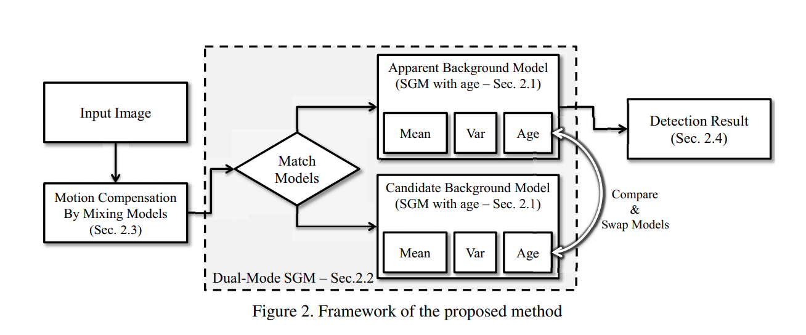
Block Diagram: background subtraction
We'll explain 3 steps to the algorithm:
- bg statistical model using dual-mode Single gaussian model
- motion compensation
- foreground detection
8

Slide 9
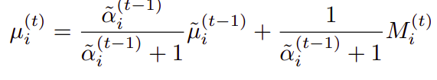
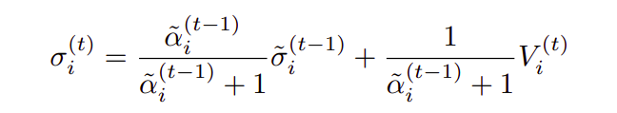

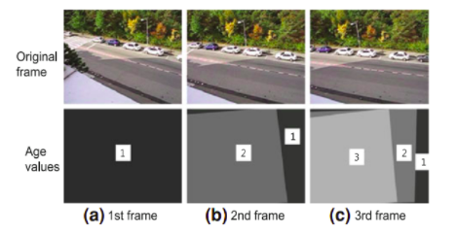
1st step: bg statistical model
We represent the background as a statistical model as described in [1]: - We create a dual-mode Single Gaussian Model (SGM) for each grid of 4x4 in the image - for each new frame we'll update 3 parameters: mean,variance and age based on these formulas
The wave above the params refers to params updated after motion compensation

Slide 10
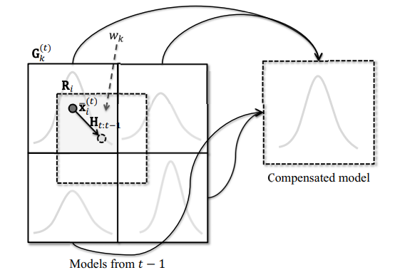
Motion compensation model
The model is based on KLT algorithm which estimates the 2D translation and the scale change We divide the image in 32x24 grids and perform KLT on every corner of the grid Because an accurate estimation is time consuming, we use a projective camera model which we denote H_{t:t-1}
Because each grid overlap multiple grids containing an SGM we'll mix them and create a compensated model
The result model will be weighted according to the proportion of each
Model in the grid

Slide 11
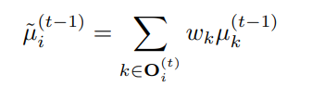
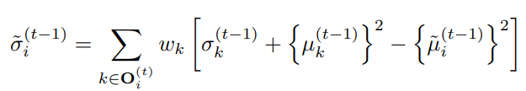
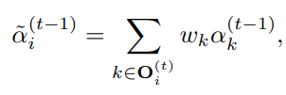
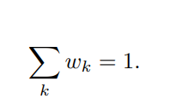


The compensated model is computed as:
After computation of compensated parameters if 2 nearby regions differ a lot , we'll obtain large variance so the model has not learned much so we'll decrease the age as:
if

Slide 12

Dual-mode SGM
The interesting point of the method is to use dual-mode SGM one apparent and one candidate and according to the age of the each one we will swap between them
The problem of having only one SGM is that with the time we cumulate errors due to foreground pixels in the grid so we add a candidate model that will swap the apparent model if
As we saw in model compensation that if the variance is too large we'll decrease the age and that means that we don't learn the targeted model and so cumulate errors so we'll swap with the candidate model that is initialized with last info and is not polluted with foreground pixels

Slide 13

Foreground detection
After getting the background model, to determine foreground pixels , we select those that have distances larger than threshold from the mean

Slide 14
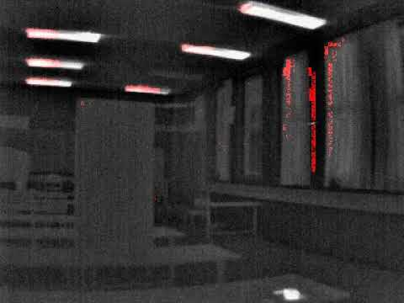
Results
14

Slide 15
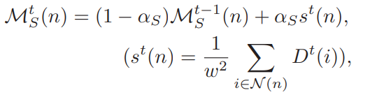

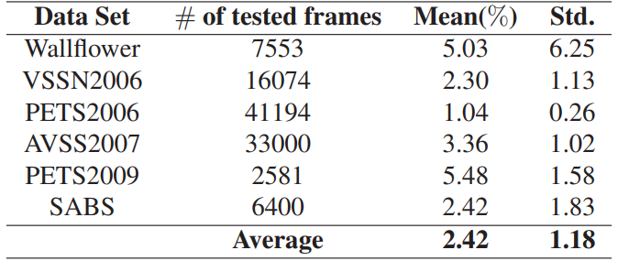
Active Attentional sampling [2]
To speed up the algorithm, instead of sampling all the pixels in every frame we search for foreground pixels only in areas of interest
The sampling is based on two main properties:
Spatial property : at each location of detection mask we will sample the neighborhood of those pixels
2. Temporal property : pixels detected as foreground in recent history are more likely to be foreground
Pixels will also be sampled randomly so as not to miss new moving objects

Slide 16
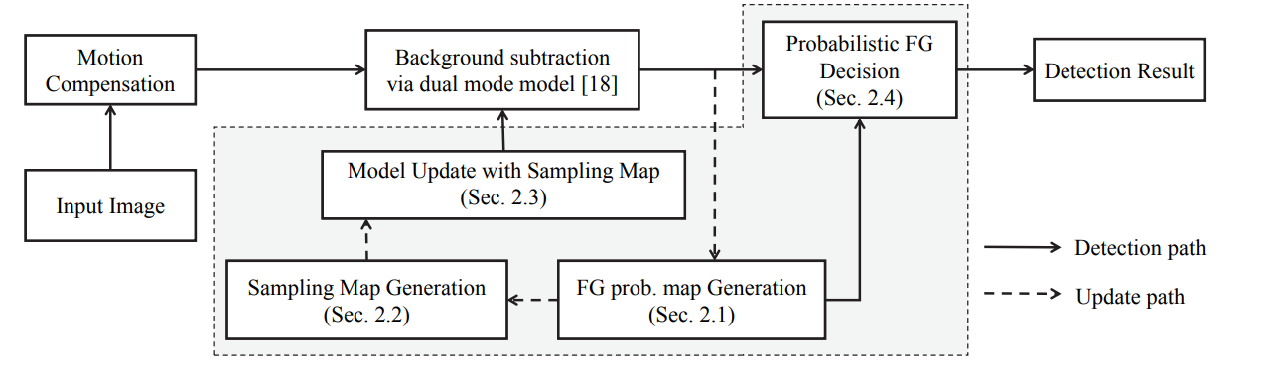
Improvement to the foreground detection [3]
The improvement of this algorithm is based on the assumption that objects move smoothly spatially and temporally so in the same way used in previous active attentional sampling we'll use spatial and temporal properties to improve our model and decrease false detections

Slide 17
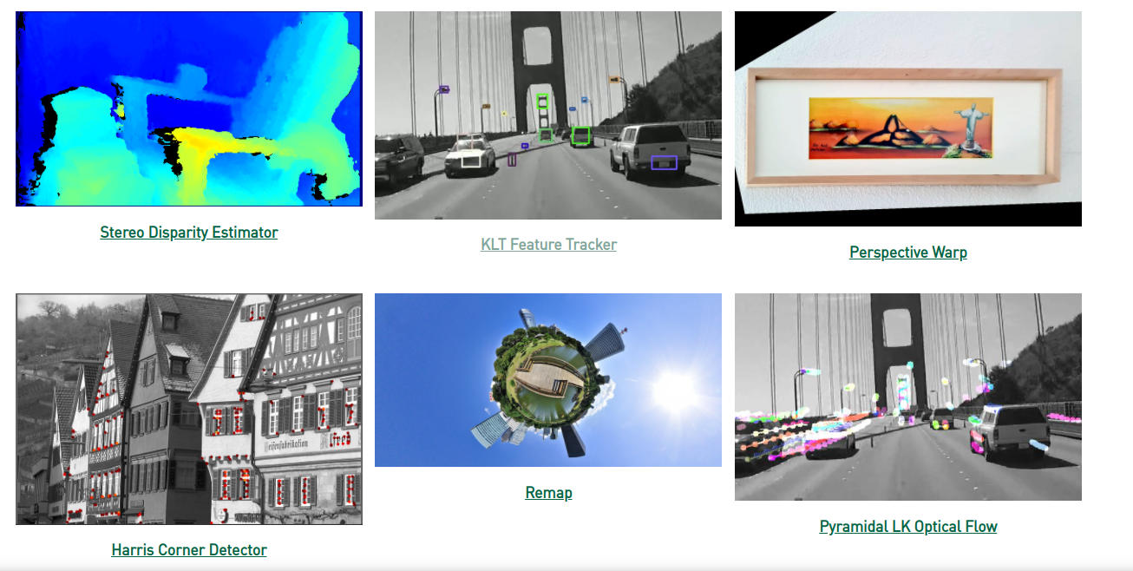
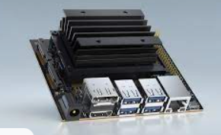
Implementation on Jetson device
Our goal is to implement on embedded devices, one of them is Jetson nano from NVIDIA that is small and relatively cheap (200 shekels for 2GB GPU memory)
One other advantage is that it contains a GPU that allows to perform parallel computing and so accelerates the algo's performance. Moreover, NVIDIA has developped a new library called VPI [4] (Vision Programming Interface) that optimize Image processing algorithms for GPUs

Slide 18
Summary
The background subtraction is a challenging task with non-stationary cameras but we have implemented a lightweight algorithm that gives encouraging results but suffer from false detections especially in high illumination areas
We proposed improvements in sampling and also in foreground probability detection to improve our results
The implementation is optimized to perform in Real-Time on embedded devices particularly on Jetson devices.
17

Slide 19
Conclusions
We have seen a new method for background subtraction with non-stationary camera. Some improvements need to be applied to decrease the false detection rate
Also after the background subtraction we need to implement a tracking algorithm to identify each objects
18

Slide 20
References
[1] Kwang Moo Yi et al. Detection of Moving Objects with Non-Stationary Cameras in 5.8ms: Bringing Motion Detection to your Mobile Device 2013
[2] Chang et al. Active Attentional Sampling for Speed-up of Background Subtraction 2012
[3] Yun et al. ROBUST AND FAST MOVING OBJECT DETECTION IN A NON-STATIONARY CAMERA VIA FOREGROUND PROBABILITY BASED SAMPLING 2015
[4] VPI library
19

