Slide 1

Social, Ethical and Professional Issues in Computing
Security Governance I

Slide 2

Delivered By
Yojan Dhakal | Lead IS Auditor IS Audit Practitioner @CryptoGen Nepal ISO 27001 : 2013 / 2022 | CEH Practical | AZ 900 | CSFPC NSE 1 | NSE 2 | LogPoint Certified Admin & Analyst

Slide 3
Agendas
Concept of Security Governance
Effective and board level Communication
IT Compliance
Managerial Policy

Slide 4

01
Concept of Security Governance

Slide 5
Governance
Governance refers to the system or framework of rules, processes, and structures through which an organization, community, or society makes and implements decisions, exercises authority, and manages its affairs.
In the context of business entities, corporate governance involves the system of rules, practices, and processes by which a company is directed and controlled. It includes balancing the interests of various stakeholders such as shareholders, management, customers, suppliers, financiers, government, and the community.

Slide 6
Security Governance
Security Governance refers to the framework, processes, and practices that an organization employs to manage and control its information security efforts.
It is the top-level approach to ensuring that an organization's information assets are protected in a consistent, coordinated, and efficient manner.
Security governance involves defining roles, responsibilities, policies, and procedures that guide the overall security strategy and decision-making process within the organization.

Slide 7
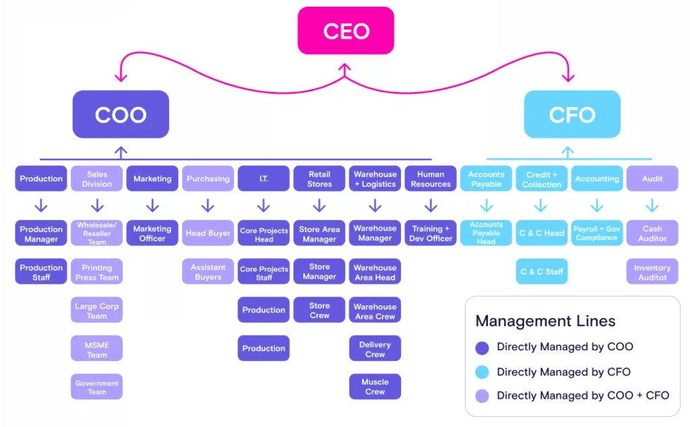
Organizational Chart

Slide 8
Information Security Governance
For Information Security to effectively address the challenges of providing adequate protection for information assets, an information security strategy is essential.
This strategy documents the direction and goals for the information security program as determined by the senior management.

Slide 9
Information Security Governance
Establishing an Information Security Governance includes the senior management determining the outcomes it wants from the information security program.
These outcomes may be stated in terms of risk management and the levels of acceptable risk. (Management Review Meetings, Senior management/business unit leads)
This sets a foundation for the Information security manager to develop a set of requirements for a security program through specific objectives.
Notes:
Gap Analysis
Identification of constraints ie time limits, skills available, fundings, laws and regulations.

Slide 10
Information Security Governance
There are various governance frameworks that might be suitable for an organization to implement such as COBIT 5, ISO/IEC 27000 series etcetera
Security Policies – They are designed to mitigate risk and are usually developed in response to an actual or perceived threat. Policies state management intent and direction at a high level.
Standards – Standards are developed or modified to set boundaries for people, processes, procedures and technologies to maintain compliance with policies and support the achievement of organization’s goals and objectives.
Notes:
Gap Analysis
Identification of constraints ie time limits, skills available, fundings, laws and regulations.
Infosec governance is the subset of corporate governance

Slide 11
Information Security Governance
Depending on the classification levels of the asset related to the standard, there may be multiple standards. Collectively, standards are combined with other controls to create security baselines.
Information security governance is the responsibility of the board of directors and senior management.

Slide 12
Information Security Governance
While senior management has the responsibility to consider and respond to the increasingly complex/destructive IS issues, the BOD is responsible to make information security an intrinsic part of governance, integrated with the processes they have in place to govern other critical organizational resources.
This includes monitoring and reporting processes to ensure that the governance processes are effective and compliance enforcement is sufficient to reduce risk to acceptable levels.

Slide 13
Governance Framework
The Governance framework will generally consist of the following
Comprehensive security strategy linked with business obj.
Governing security policies that express management intent and address aspects of strategy, controls and regulation
Set of standards for policies to ensure PPT comply with policy requirements and set appropriate baselines
Effective security organizational structure with sufficient authority and adequate resources

Slide 14
Governance Framework
Defined workflows and structures that assist in defining responsibilities and accountability for information security governance
Institutionalized metrics and monitoring processes to ensure compliances, provide feedbacks on control effectiveness and provide appropriate management decisions.

Slide 15
Communication
Clear communication is essential to the operations of any business. Conversely, miscommunication can lead to some big problems. An organization structure helps ensure everyone throughout the organization understands with whom they need to share different information.
An effective corporate structure outlines how different teams and individuals are connected to each other. Everyone knows whom they are responsible for – and whom they are accountable to. This eliminates the confusion of who is responsible for what.

Slide 16
Main references supporting the course:
Ethics for the Information Age, MichaelJ. Quinn, 5th Edition, Pearson/Addison-Wesley, 2011,ISBN 978- 0-13-213387-6
Supplemental Text (Available in print or online via Creative Commons):
Blown to Bits: Your Life, Liberty, and Happiness after the Digital Explosion, Hal Abelson, 1st edition, Addison-Wesley, 2009, ISBN 978-0-13-285553-2.

Slide 17
End of Lecture 6

