Slide 1

Schedule Shark
Group 8
Kaitlin Anderson
Jeremy Warden
Josh Lewis
Han Chen

Slide 2
REQUIREMENTS
Great scheduling technique used for various places of employment
Balance employees’ availability and requesting off to formulate an accurate schedule

Slide 3
SPRINT ONE
What went well
brainstorming, delegation of work, diagramming
What did not go well
communication
What did we learn

Slide 4
SPRINT 2 & 3
Teamwork Improvements
found each team member's strengths
Problems
Problem ‘Debt’
most problems were resolved fairly quickly

Slide 5
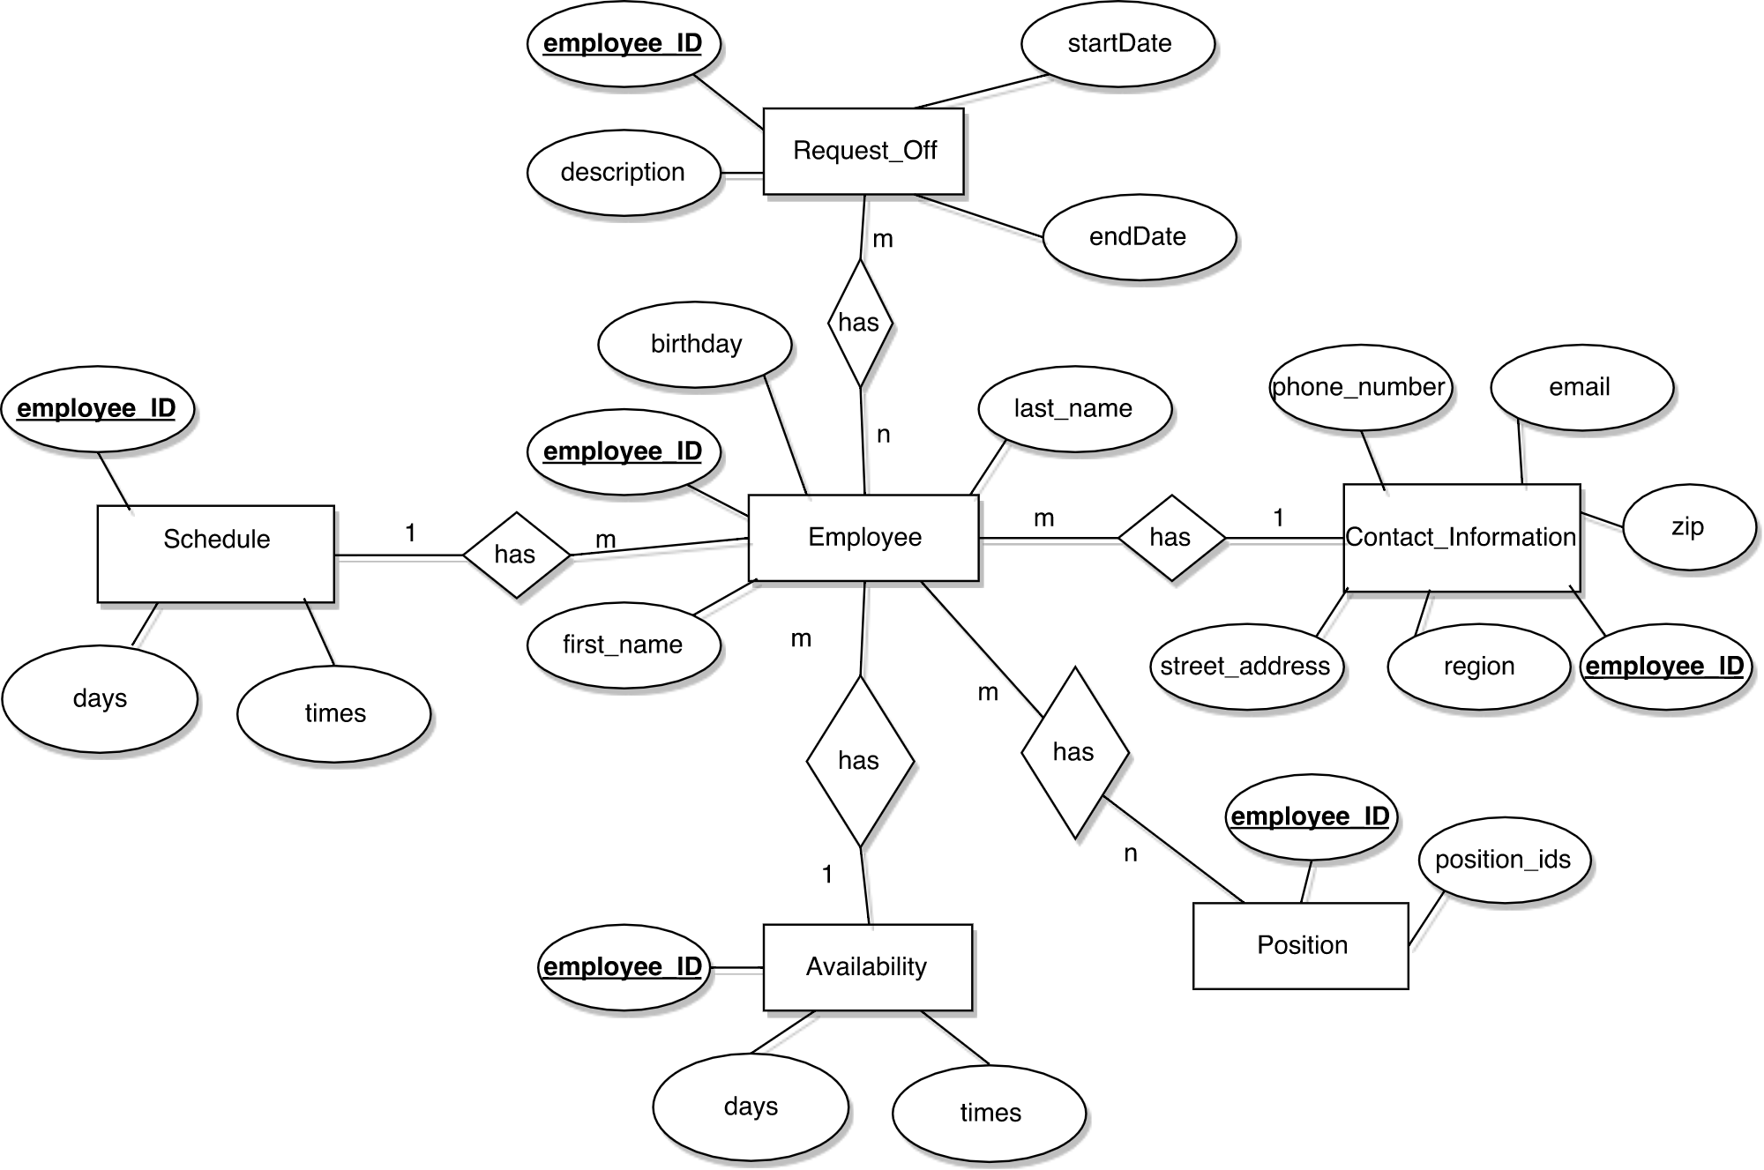
DESIGN:
OUR APPROACH
TO DATA (ERD)

Slide 6







DESIGN:
OUR APPROACH TO DATA
(METHODS/SOFTWARE)

Slide 7
DESIGN:
SOFTWARE PATTERNS
Model View Controller

Slide 8
DESIGN: HCI
Site navigation
Navigation is simple for this version
All the links are available on the home page
For finished UI:
We have big, prominent buttons with clearly marked purposes.
Easy to use and intuitive to find what you need.
Example Screens
http://jdwswe.centralus.cloudapp.azure.com

Slide 9
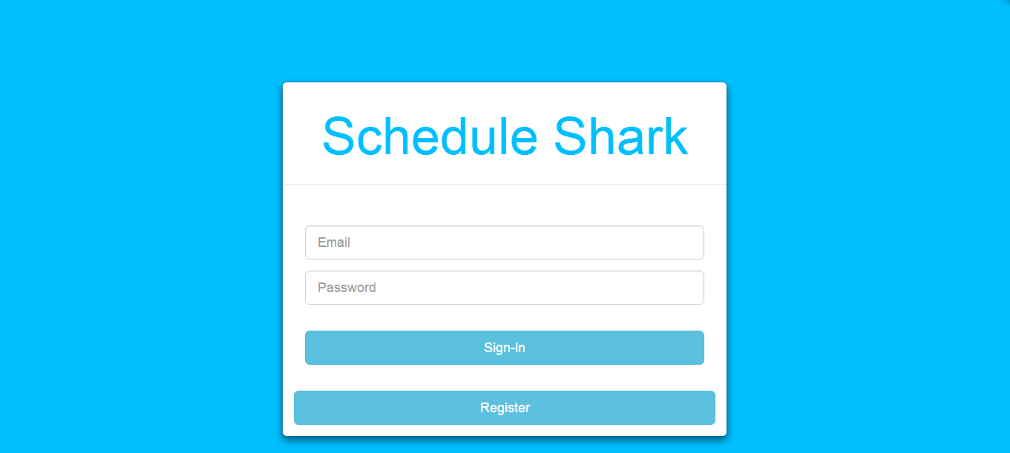
DESIGN: HCI Login/Register page

Slide 10
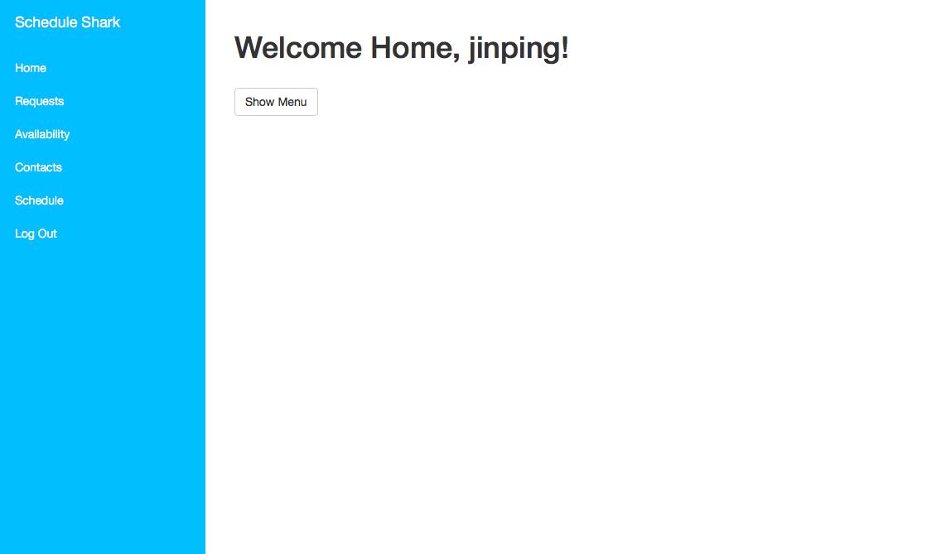
DESIGN: HCI Homepage

Slide 11
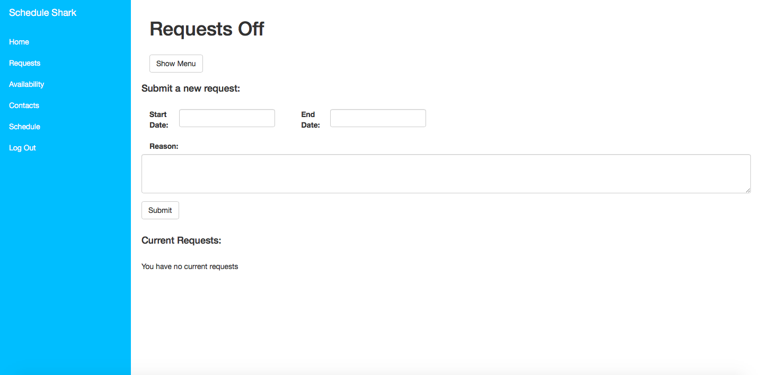
DESIGN: HCI Homepage

Slide 12
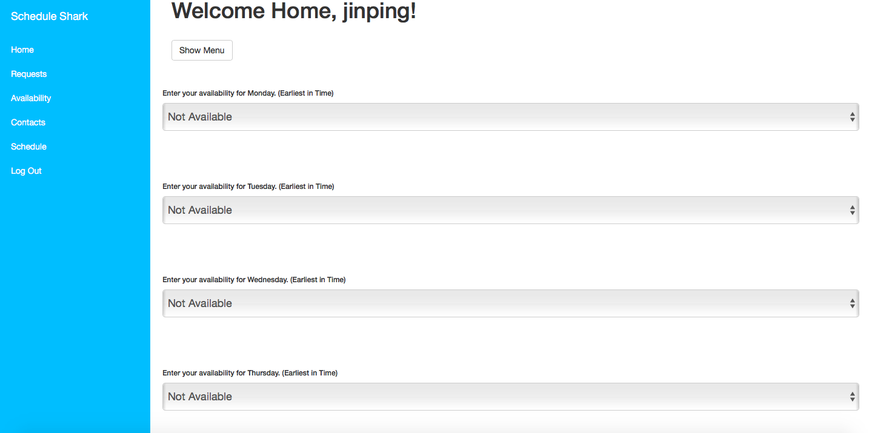
DESIGN: HCI Homepage

Slide 13
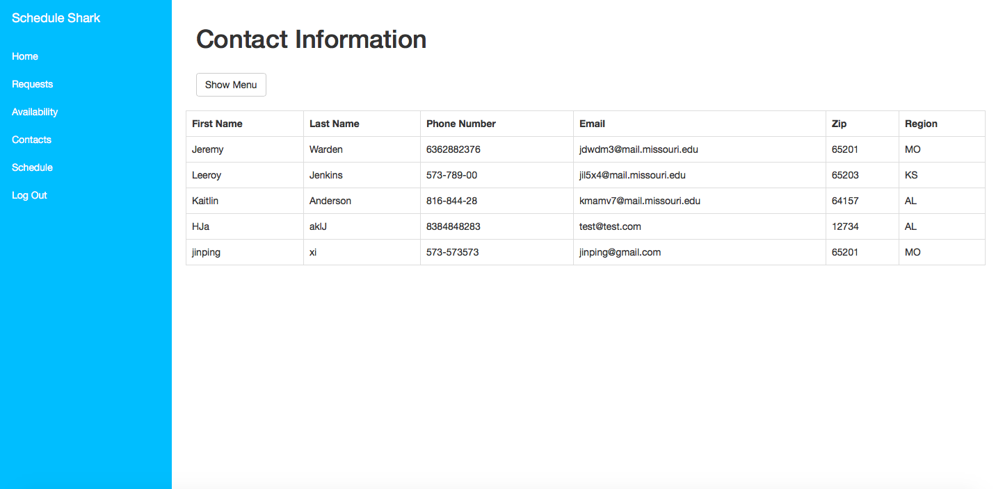
DESIGN: HCI Homepage

Slide 14
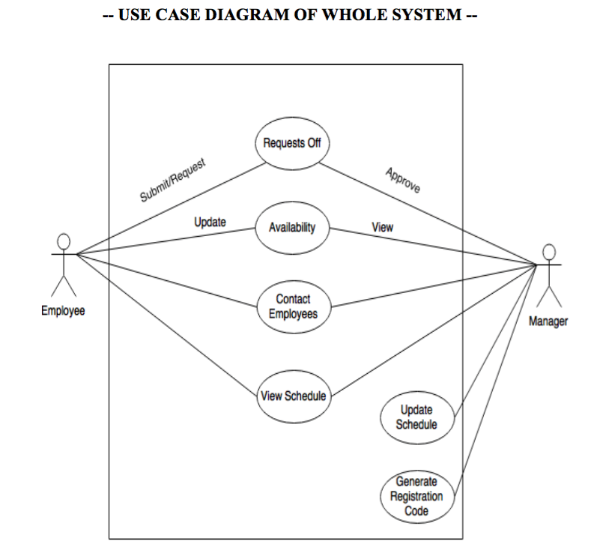
IMPLEMENTATION

Slide 15
IMPLEMENTATION
Register
View Schedule
View Contact Information
Manager: Accept & Deny Request
Employee: Update Availability & Request Off

Slide 16
TESTING
USER ACCEPTANCE TESTING (VERIFICATION)
able to login/register
able to log out

Slide 17
TESTING
UNIT TESTING (VALIDATION)
- Registration form Data is stored into Database
- Availability can be updated by user, viewed by manger, approved and stored back as the default availability for the user who requested the update
- Ensure SERVERS can only view SERVER and MANAGER contact information (not able to view other employee’s info)
- NO SQL INJECTION Vulnerabilities
- Can successfully run an array of queries on Database (General Search page) and return valid results
- NO SQL INJECTIONS
- PREPARED STATEMENTS
- Ensure the Schedule is filled out completely

Slide 18
TESTING
REGRESSION TESTING (VALIDATION)
- Ensuring every piece of information we collect with every functional piece we add to our web application
- Check database to ensure no data was stored improperly

Slide 19
TESTING
INTEGRATION TESTING (VALIDATION)
- Start by creating a LINUX virtual machine
- Integrate an APACHE WEB SERVER onto our VM
- Integrate MYSQL Database that we are using on our APACHE WEB SERVER
- Integrate PHP in order to communicate between our WEB SERVER (Client) and our MYSQL DATABASE (Server)

Slide 20
Putting it all Together: Sprint 4 & 5
Where is our project at
What remains to be done

Slide 21
Reflections on Software Engineering & This Project
Software engineering is human. And procedural. Describe
your experiences
- Organization and communication are important
What would your team do differently next time?
- A fully developed plan
- A clearly defined leader
- Spread out responsibilities more

Slide 22
THANKS!

