Slide 1



MEMUG Scotland
1st December 2022
@MemugScotland
https://memug.scot

Slide 2


Sponsors + Thanks

Slide 3
Speakers
Are you interested in delivering a 30 minute session at a future meetup?

Slide 4
Agenda
18:30 - 18:45 – Registration
18:45 - 19:15 - Tim Hermie - 5 Intune Tips That Will Change Your World!
19:15 - 19:45 - Maurice Daly - Beyond Native Reporting!
19:45 - 20:15 - Pizza, Beers/Soft Drinks, Networking & Giveaway

Slide 5

Me
Scott McAllister
Engineer @ Patch My PC
@scotscottmca

Slide 6
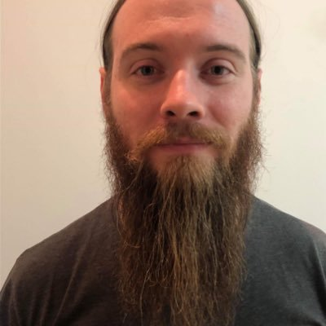

Next meetup
December 1st @ The Incremental Group
Ru Campbell
Microsoft MVP - Enterprise Mobility
@rucam365
TBC
TBC

Slide 7
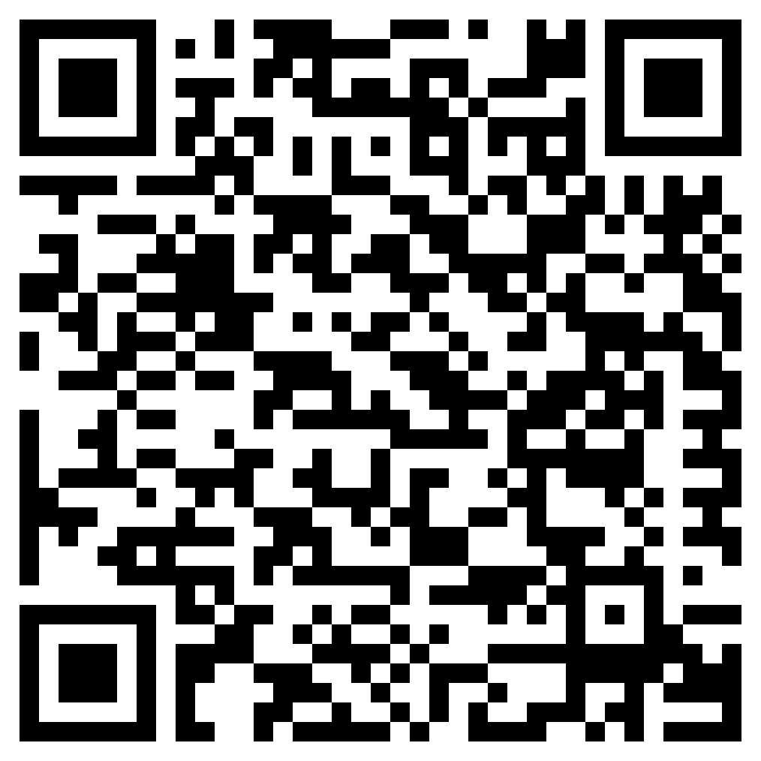
Next meetup
October 18th @ The Incremental Group
https://www.eventbrite.com/e/memug-scotland-1st-december-2022-tickets-444093966007

Slide 8
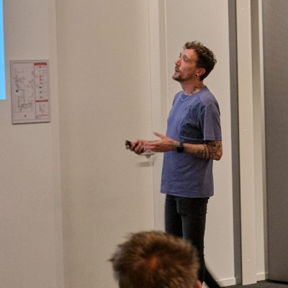
Session 1
Tim Hermie
Microsoft MVP - Enterprise Mobility
@_Cloud_boy
5 Intune Tips That Will Change Your World!

Slide 9
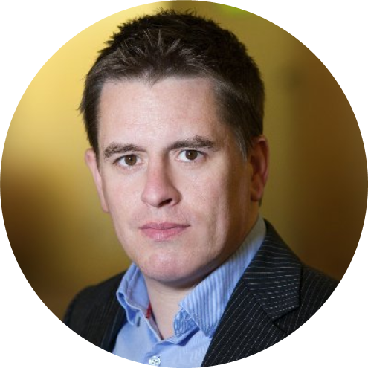
Session 2
Maurice Daly
Microsoft MVP - Enterprise Mobility
@modaly_it
Beyond Native Reporting!

