Slide 1



MEMUG Scotland
29th June 2023
@MemugScotland
https://memug.scot

Slide 2

Sponsors + Thanks

Slide 3
Speakers
Are you interested in delivering a 30-45 minute session at a future meetup?

Slide 4
Agenda
18:00 - 18:30 – Registration
18:30 - 19:15 – Keeran Mistry – Reporting just got ADVANCED!
19:15 - 20:00 – Paul Winstanley – Conditional Access. How the Microsoft templates can help you secure your environment.
20:00 - 20:30 – Pizza, Beers/Soft Drinks, Networking & Giveaway

Slide 5
Next meetup
August – Date TBC

Slide 6
Next meetup
TBC
TBC
@TBC
TBC
TBC
TBC

Slide 7
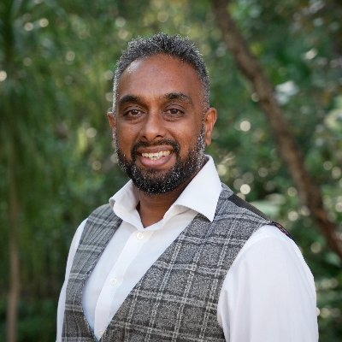
Session 1
Keeran Mistry
Reporting just got ADVANCED!
@Keeran_K_Mistry

Slide 8
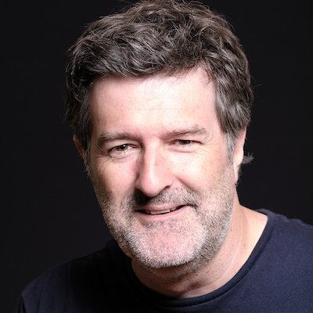
Session 2
Paul Winstanley
Conditional Access. How the Microsoft templates can help you secure your environment.
@SCCMentor

