Slide 1


MEMUG Scotland
31st August 2022
@MemugScotland

Slide 2
Agenda
18:30 - 18:45 - Arrival and check-in
18:45 - 19:30 - Steven Hosking – Why Intune Filters > AAD Dynamic Groups
19:30 - 20:00 - Refreshments

Slide 3


Sponsors + Thanks

Slide 4
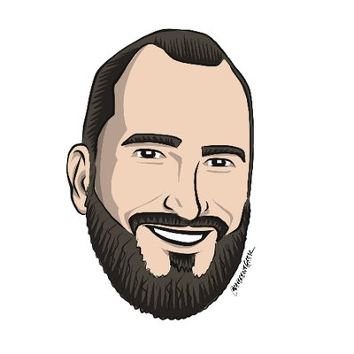
Speaker
Steven Hosking
MMD Product Manager @ Microsoft
@OnPremCloudGuy
Session – Why Intune Filters > AAD Dynamic Groups

