Slide 1



MEMUG Scotland
31st August 2022
@MemugScotland
https://memug.scot

Slide 2


Sponsors + Thanks

Slide 3
Agenda
18:30 - 18:45 - Arrival and check-in
18:45 - 19:30 - Steven Hosking – Why Intune Filters > AAD Dynamic Groups
19:30 - 20:00 - Refreshments

Slide 4
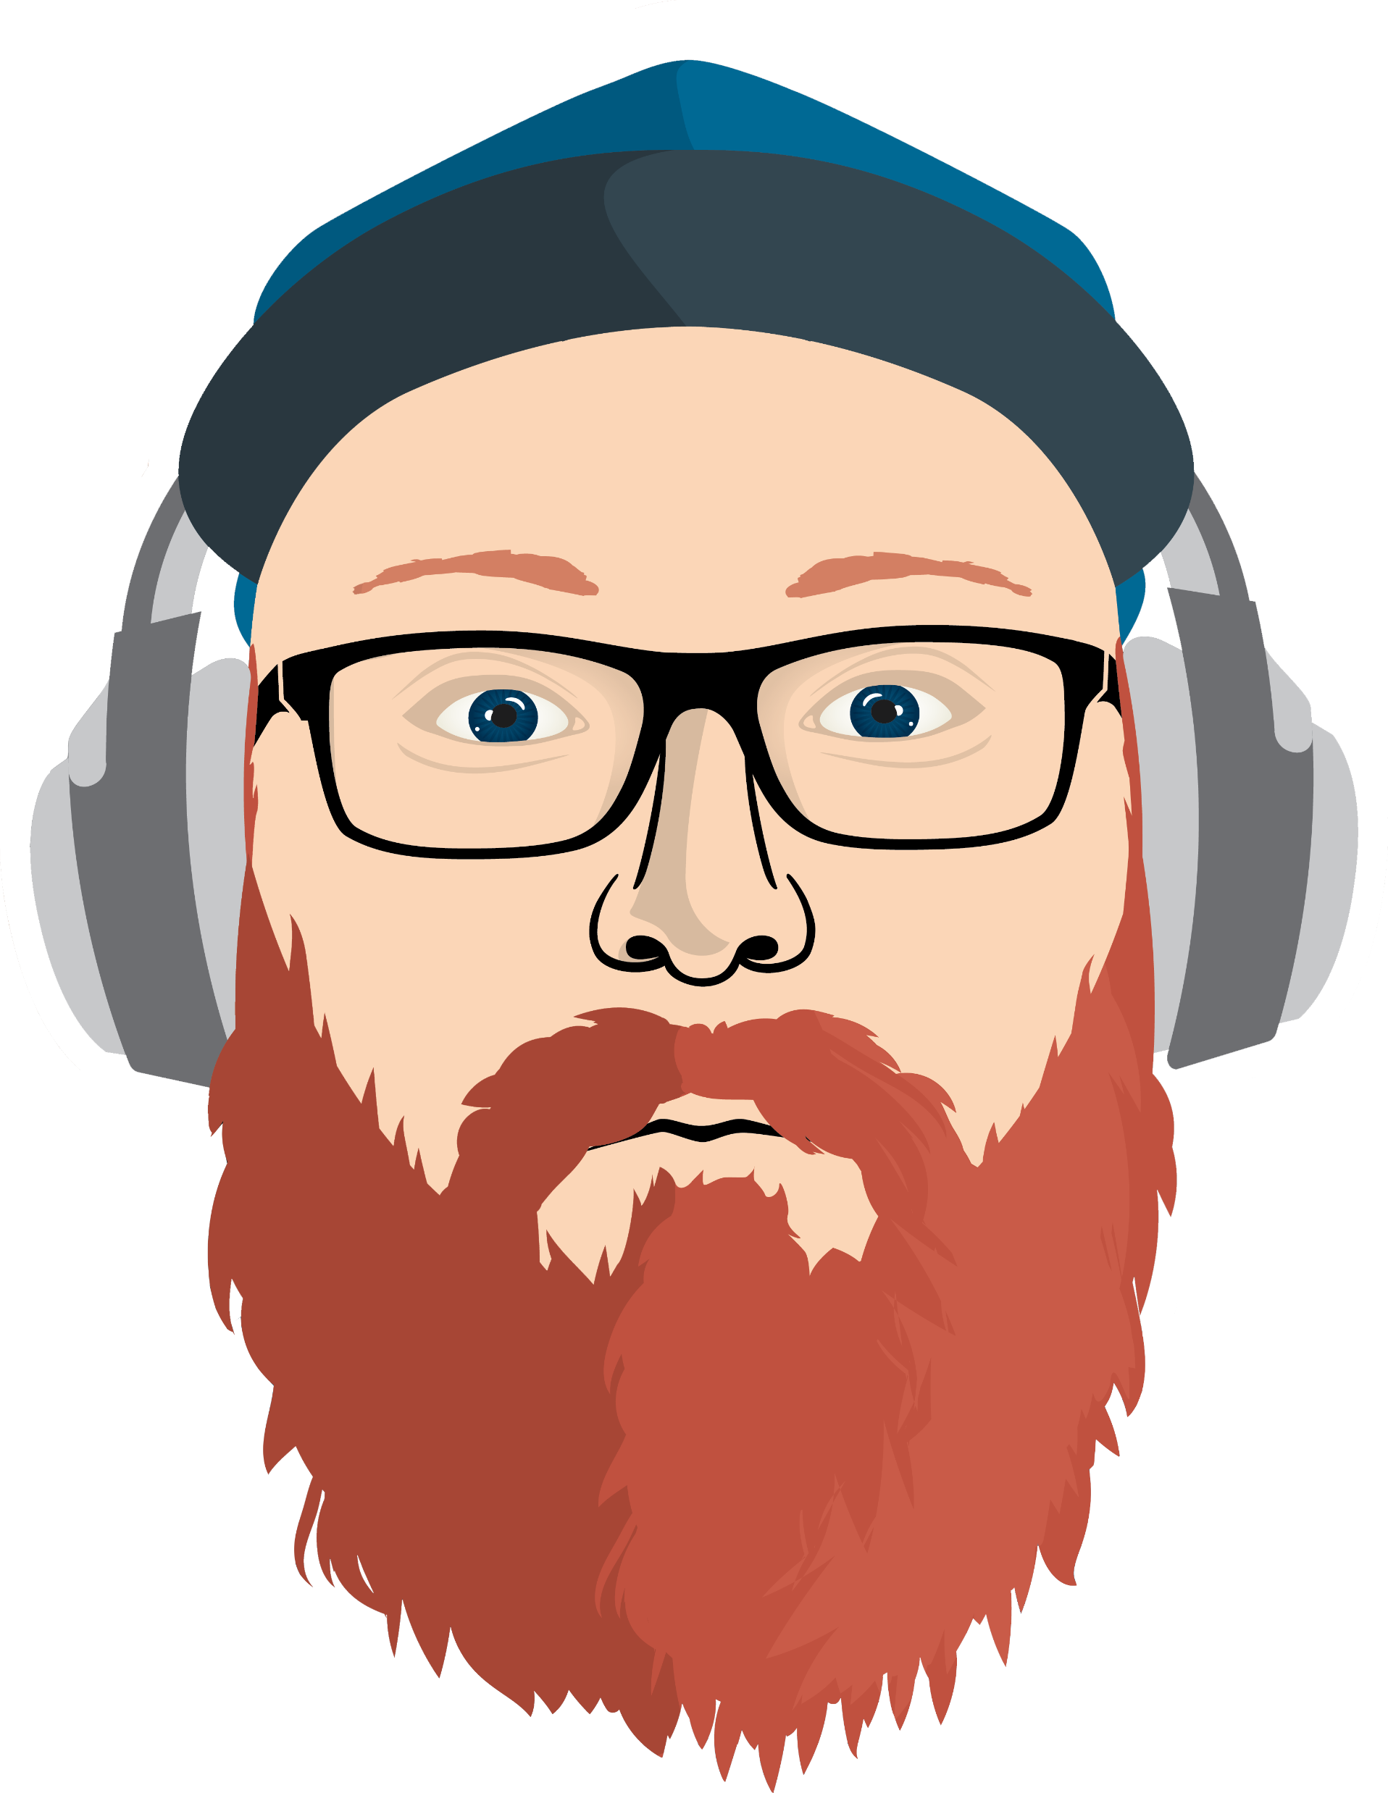
Me
Scott McAllister
Engineer @ Patch My PC
@scotscottmca

Slide 5
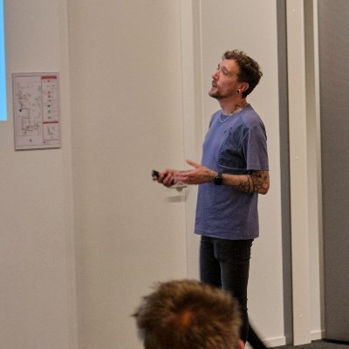

Next meetup
October 18th @ The Incremental Group
Tim Hermie
Microsoft MVP Enterprise Mobility
@_Cloud_boy
TBC
TBC

Slide 6
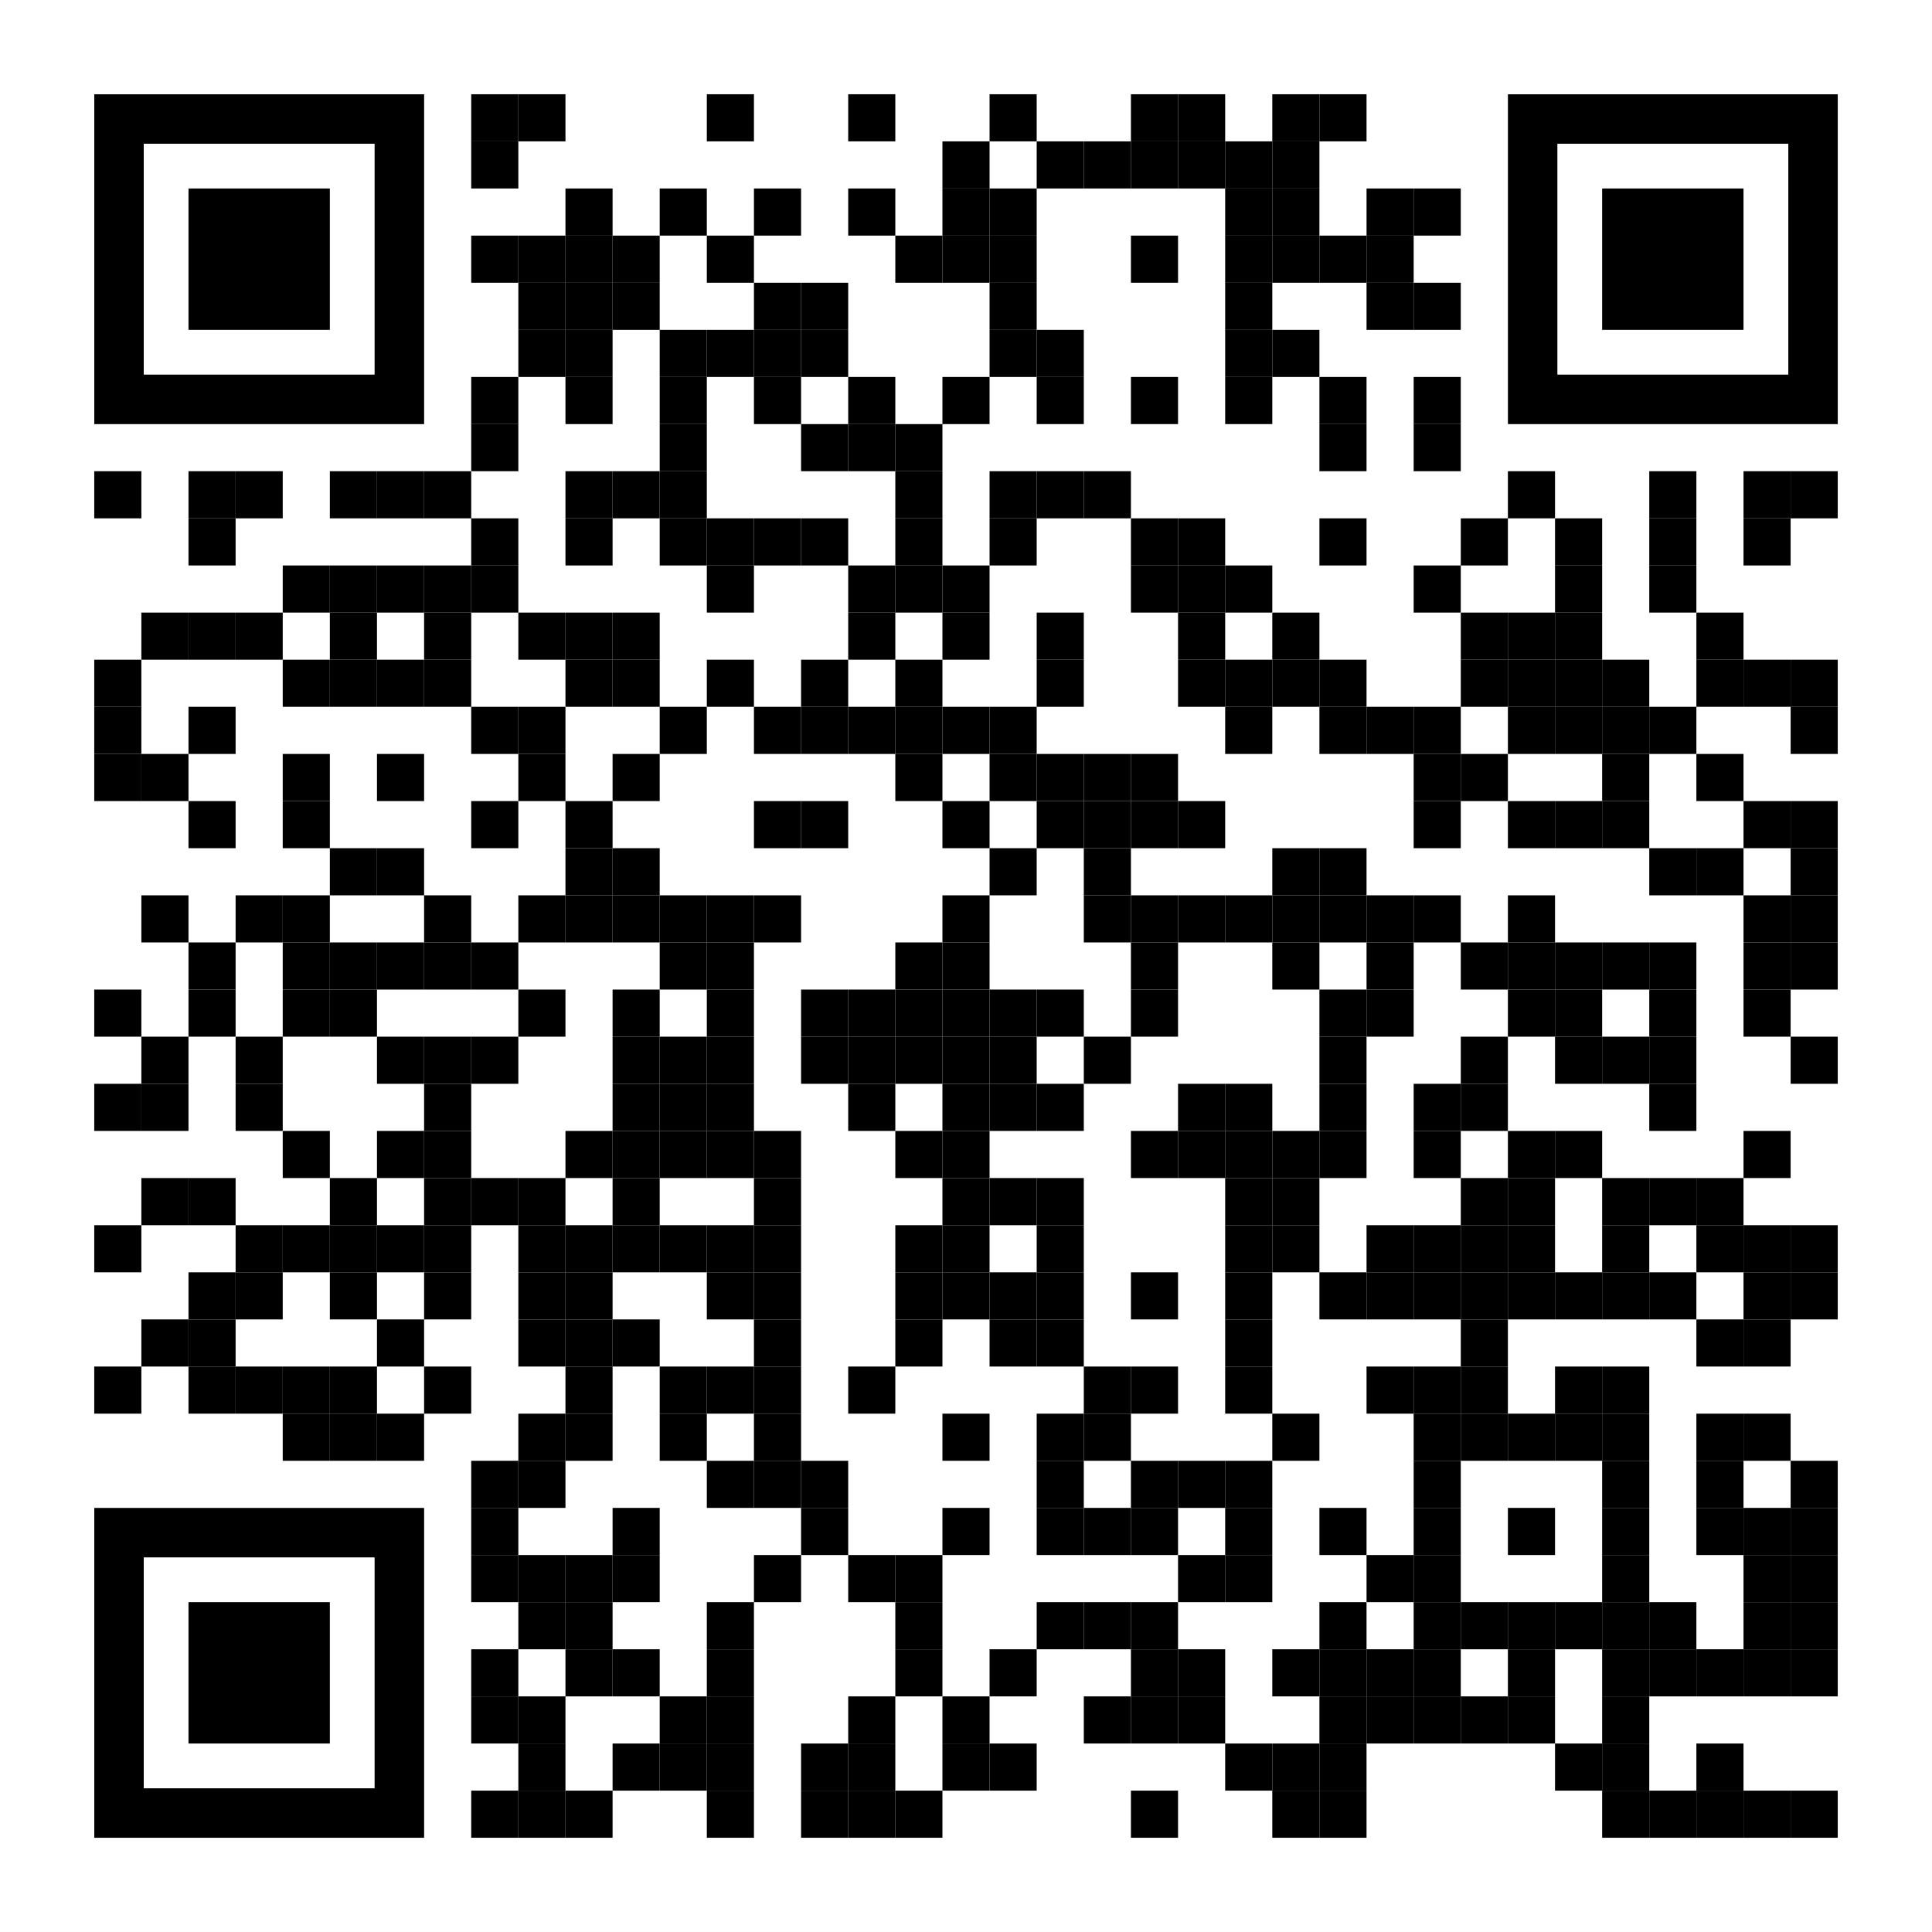
Next meetup
October 18th @ The Incremental Group
https://www.eventbrite.com/e/memug-scotland-18th-october-2022-tickets-411278825037

Slide 7
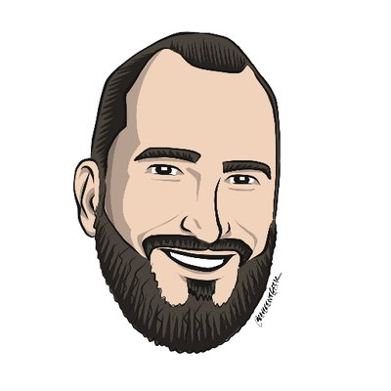
Speaker
Steven Hosking
MMD Product Manager @ Microsoft
@OnPremCloudGuy
Session:
Why Intune Filters > AAD Dynamic Groups

