Slide 1




MEMUG Scotland
18th April 2023
@MemugScotland
https://memug.scot

Slide 2


Sponsors + Thanks

Slide 3
Speakers
Are you interested in delivering a 30-45 minute session at a future meetup?

Slide 4
Agenda
18:00 - 18:30 – Registration
18:45 - 19:30 – Recast – Endpoint Management, Updates and Help Desk (and some goodies)
19:30 - 20:00 – Scott McAllister – We SUSpect your updates suck!
20:00 - 20:30 – Pizza, Beers/Soft Drinks, Networking & Giveaway

Slide 5
Next meetup
June – Date TBC

Slide 6


Next meetup
Paul Winstanley
Microsoft MVP in Enterprise Mobility
Conditional Access
@SCCMentor
TBA
TBA
TBA
@TBA

Slide 7

Session 1
Recast software
Empowering IT at Every Endpoint
@RecastSoftware

Slide 8
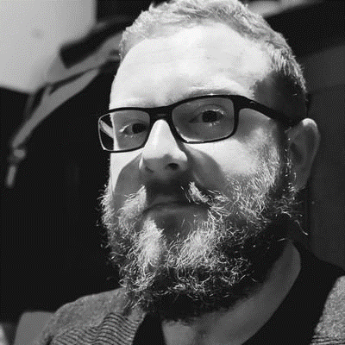
Session 2
Scott McAllister
Engineer @ Patch My PC
@scotscottmca
We SUSpect your updates suck!

