Slide 1
GSAProject
File created on: 8/7/2023 11:56:55 PM

Slide 2
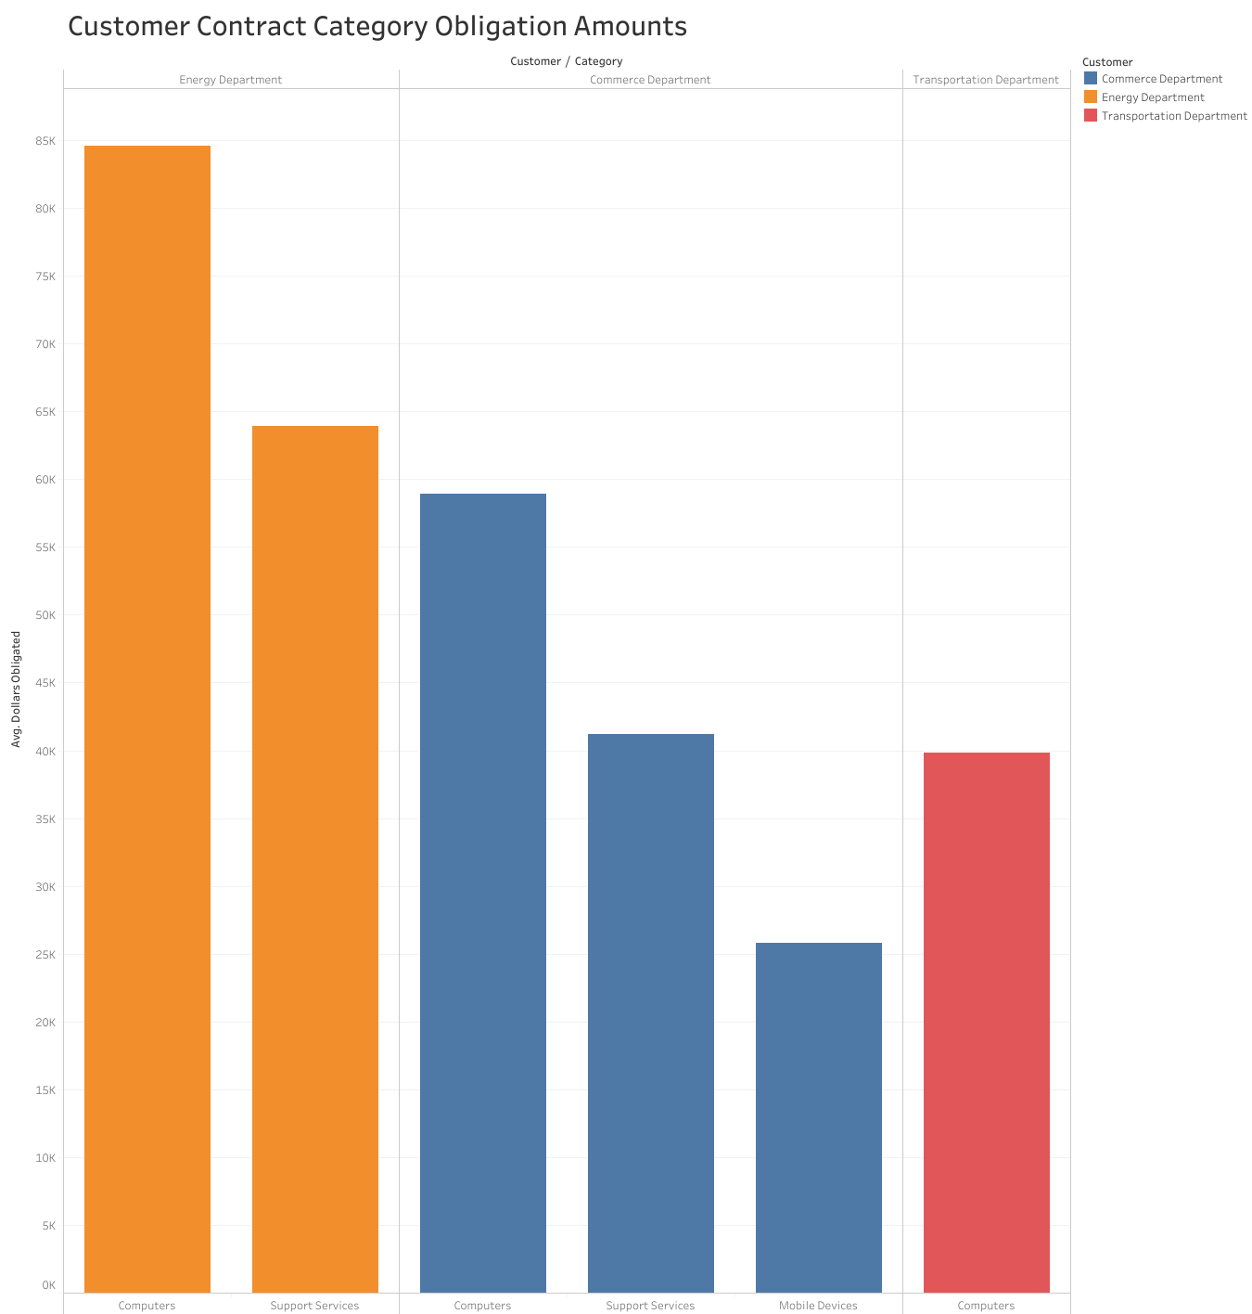

Slide 3
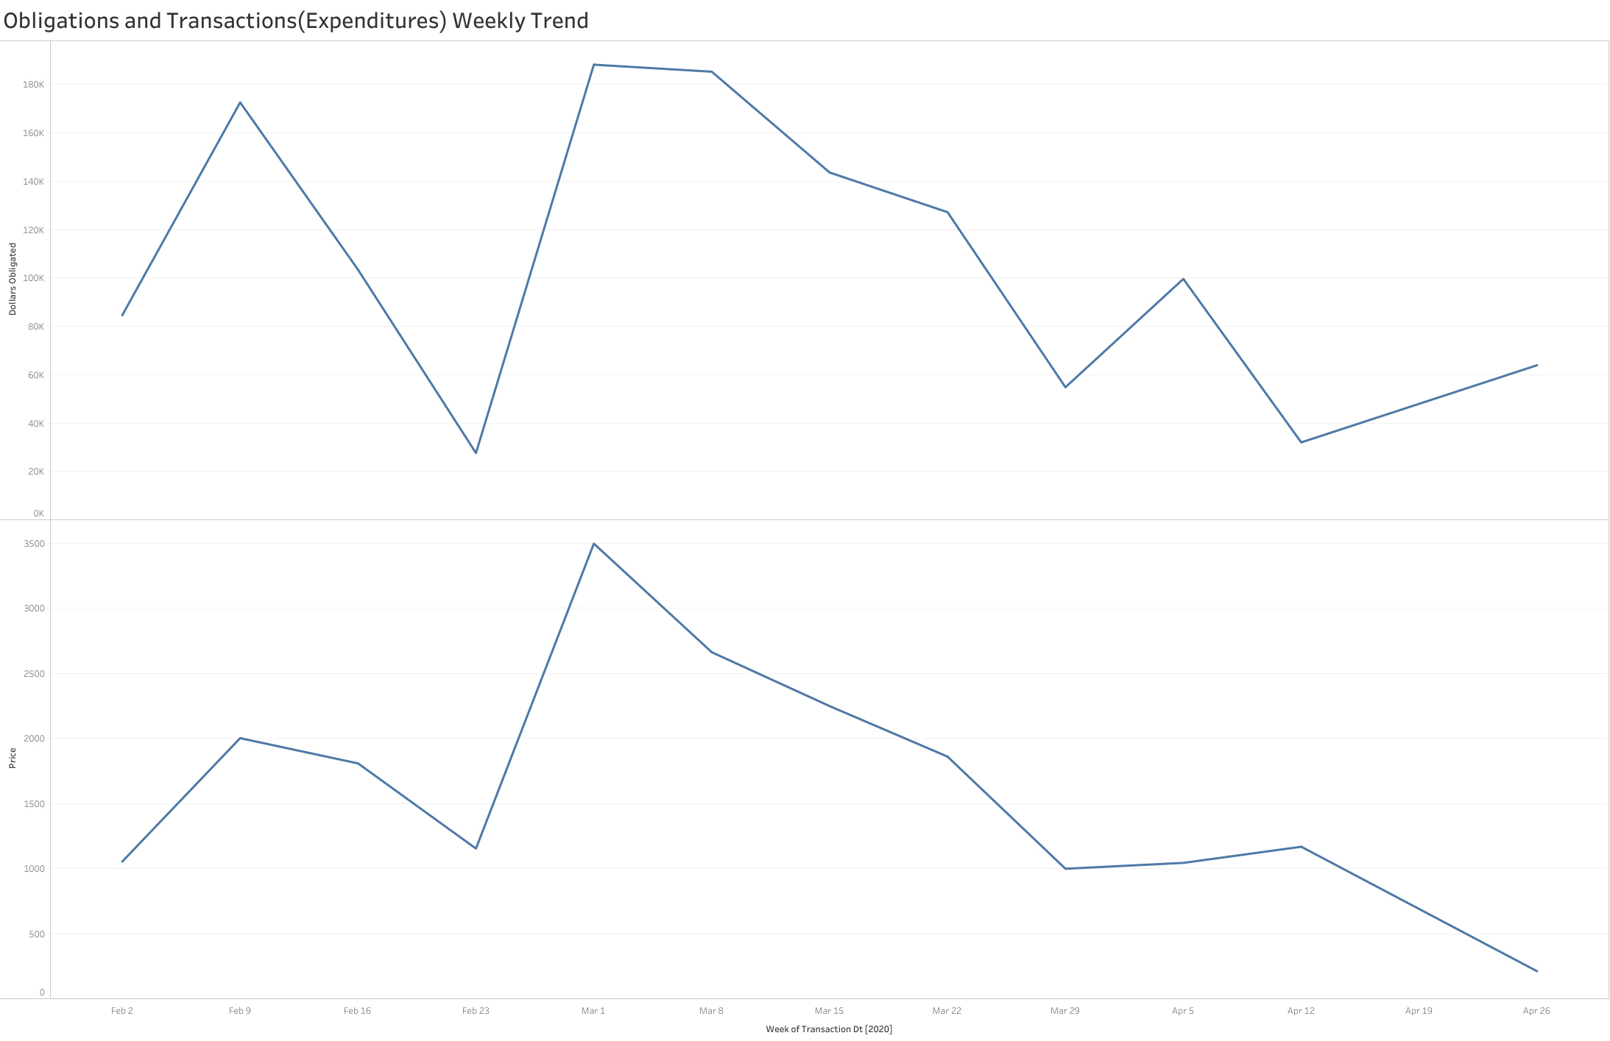

Slide 4
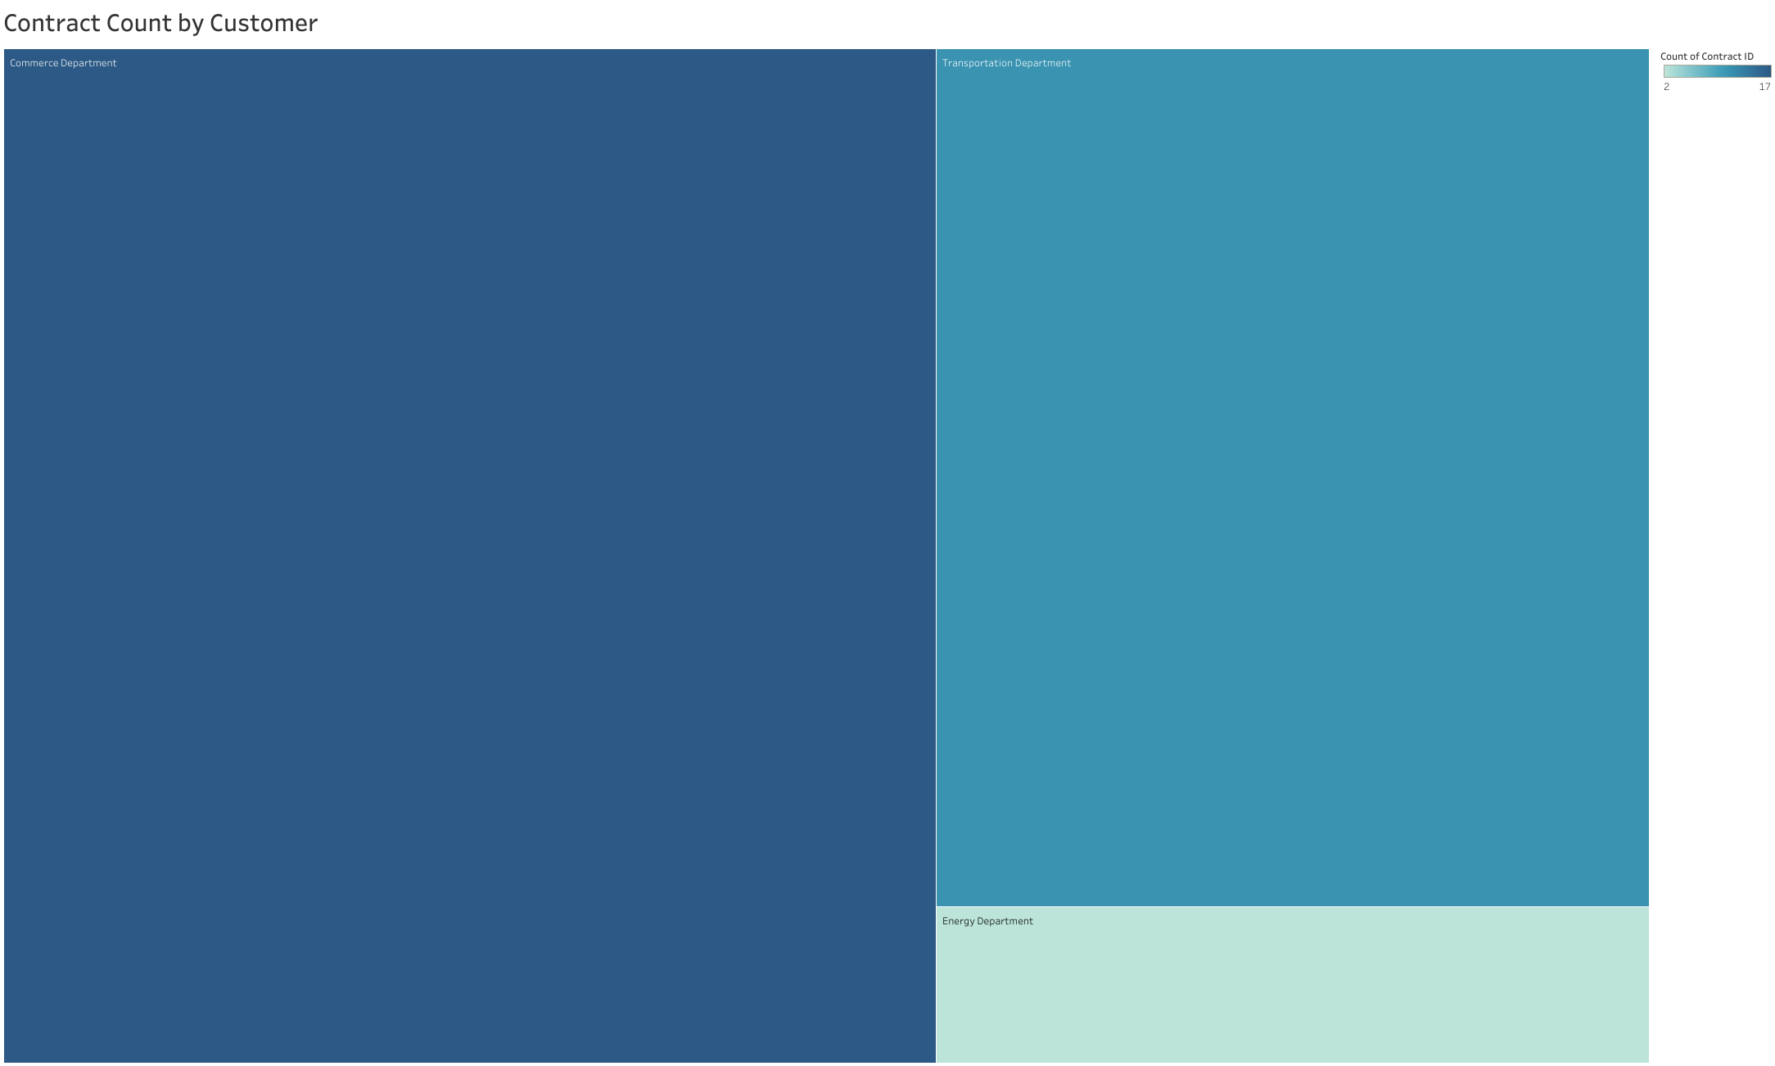

Slide 5
