Slide 1
Bucket Service
A service to tag your tests without a code change
Notes:
Hi all. This presentation is about the bucket service that we open sourced at GoDaddy earlier this year. This is a service that lets you tag your tests without a code change (at its core functionality).

Slide 2



Terminology
Notes:
I wanted to first go over some simple terminology. A bucket is the same thing as a tag. Some testing frameworks allow you to add tags in the code for specific tests. We are using the term bucket. Also, when I use the bucket dt_chrome_regression , that means the desktop chrome regression bucket.

Slide 3
Purpose
Run sub-sets of tests
Disable/Enable tests without code change
Notes:
We originally had these buckets hardcoded in the code, in the title of each test. This became tough to manage as you can imagine. Our code was littered with these buckets, and every time we wanted to update a test’s buckets, we would need a code change. Now we store a unique id in the test, then we link it up to the bucket service with that unique id. We can then make API calls to the bucket service to change the buckets a specific test has.

Slide 4

Project Endpoints
Notes:
There are two kinds of endpoints in our service. Project endpoints and Test endpoints. You first need to create a project in the bucket-service. Each test in the bucket service is tied to a single project. You are able to create, update, or delete a project from these project endpoints. I’ll show the swagger page for these endpoints, and the next slide’s endpoints, during our demo.

Slide 5
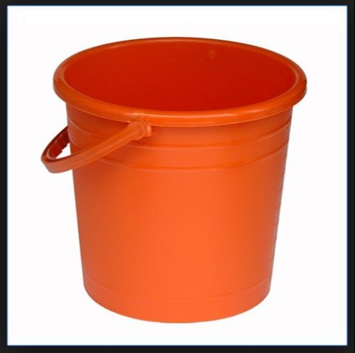
Test Endpoints
Blog
Mobile
Chrome
Firefox
Notes:
After a project is created, you can add a test to the bucket service. You give the test a unique id, like `create-blog-post`, as well as a list of buckets you want to associate with that test. The buckets might be blog, chrome, firefox, mobile, or others. The bucket name can be anything you want, depending how you want to group your tests.

Slide 6
Simple to run !
mkdir ~/data
docker run -d -p 27017:27017 -v ~/data:/data/db mongo
npm run cicd-build
npm run start
Notes:
Show steps, and swagger
We use docker to run mongo, but you don’t have to.

Slide 7

Demo
Notes:
Show:
bucket-service-example.rb - Populates the bucket service with a project, two tests and gets all tests in the bucket service and prints them out.
create-example-list.py – Hits the search endpoint of the bucket service for the specific bucket requested. Writes out an examples.txt file which will be read from a shell script.
run-chrome-specs.sh – Runs the create-example-list script which creates the examples.txt file for all tests with the dt_chrome_regression bucket. Runs rspec and passes in those examples from the txt file.

Slide 8
What else?
NEW
>= 90% pass rate
< 90% pass rate
REGRESSION
REVIEW
Notes:
With the bucket service, you can put all newly created tests in a special bucket. Something like dt_chrome_regression_new. Then you can have all these “new” tests run multiple times, and only if they have a certain pass rate, they get moved to regression. If they fail to have this correct pass rate percentage, they can be moved to another bucket, maybe “dt_chrome_regression_review”. At GoDaddy, these “new” tests do not block our PRs. They may run as part of the PR, but it won’t fail the PR if the test fails. They run multiple times a day, and automatically get moved over to regression if the pass rate is high enough. If not, they get moved to a review bucket. This only happens after 40 test runs.

Slide 9
Gotcha
A test needs to be added to the bucket service to be picked up.
Notes:
It’s not all ice cream and rainbows. If a test isn’t in the bucket service, it won’t be picked up. So after you create a new test, you have to add it to the bucket service, with the correct buckets. This can lead to missing test coverage if you forget. At GoDaddy, we have a pre-check of sorts, which is a step in our CICD pipeline that verifies all tests in the codebase also appear in the bucket service. As well as the opposite of checking that all tests in the bucket service, appear in the codebase.

Slide 10
Where can I use this?
Anywhere you can grep or choose which specific tests you want to run
Ruby Rspec: --example
Javascript Mocha: --grep

Slide 11
How can you help?
Start using the bucket service https://github.com/godaddy/bucket-service
Report issues or create PRs for new features/bug fixes
Notes:
Currently I don’t know of anyone using this bucket service outside of GoDaddy. It would be good to get some outside feedback and suggestions.

Slide 12

Questions
https://github.com/smccarthy/bucket-service-presentation

