Slide 1
Profile Service
A service to lock/unlock test data to safely run your tests in parallel.
Notes:
Hi all. This presentation is about the profile service that we open sourced at GoDaddy. With this service, you can lock test data, to use it in your tests without having to worry about another test using the same data. Originally, this service was bundled with the bucket service I presented last year. It was originally created by another engineer here at Godaddy, Dan Clayton. The SDET team has since forked it internally, and now we released our internal version on the GoDaddy github. You can see some of the differences on the github.com profile service page.

Slide 2
Terminology
Profile – Contains one or more profile entries. Defined by a name.
Profile Entry – The test data.
Notes:
You do not need to create a profile first. Once you create a profile entry, you give it a profile name. When you search that profile name for all the profile entries, you will see all the entries.

Slide 3
Purpose
Don’t let 2 tests use the same test data at the same time!
Notes:
One way to solve this, would have been to create new test data every time the test runs. One reason we chose not to go this way is because creating that data could use APIs that we don’t own. These endpoints might not have 100% uptime in the test environment. We might have to make 4-5 api calls to get the data in the correct state for our tests to run. (Create Shopper, Buy Website, Create Website with Blog widget, just to run a blog test)

Slide 4
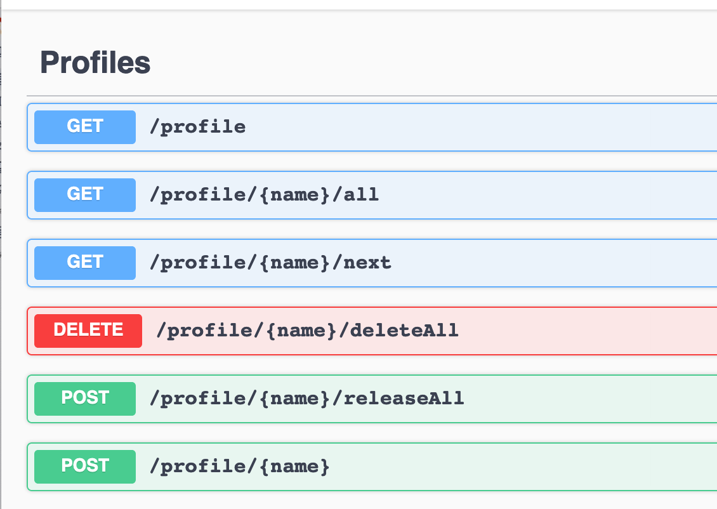
Profile Endpoints
Notes:
Just like the bucket service that I presented last year, there are two kinds of endpoints in our profile service. Profile endpoints and Profile Entries endpoints. The Profile endpoints are used to interact with the profile as a whole. So you can get all profile entries for a profile, or all profile entries total. You can also release all profile entries, or delete all profile entries for an entire profile. As well as adding new profile entries tied to a profile name.

Slide 5
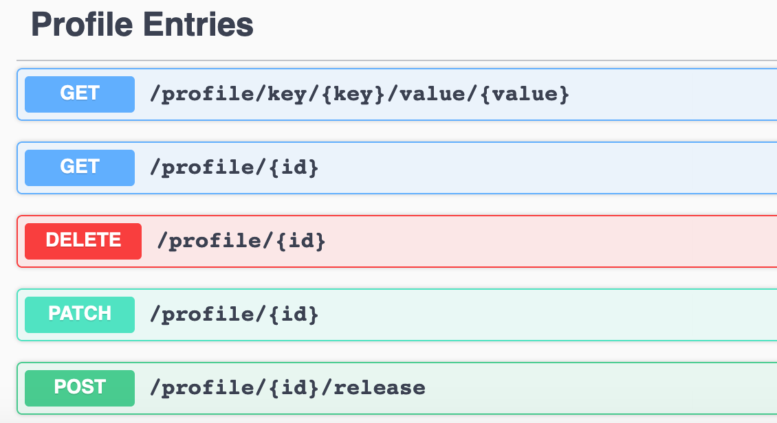
Profile Entries Endpoints
Basic Plan
Custom Plan
Pro Plan
Notes:
The profile entries endpoints are for interacting with a single profile. You can get, update, delete, or release a profile. That first endpoint should probably be under the other section, since it lets you search for all profile entries with a certain key/value pair. You may have a profile for basic plan accounts, and another one for a pro plan accounts, and even a third one for custom plan accounts.

Slide 6
Simple to build !
npm i

Slide 7
Simple to run !
mkdir ~/data
docker run -d -p 27017:27017 -v ~/data:/data/db mongo
npm run start
Notes:
Show steps, and swagger
We use docker to run mongo, but you don’t have to.

Slide 8

Demo
Notes:
Show:
profile-service-example.rb - Populates the profile service with 3 profile entries.
test_spec1.rb & test_spec2.rb – The individual tests to run
parallel_rspec spec/* -n 2

Slide 9
What else?
Q: What happens if I do not release/unlock my profile entry?
A: By default, all locked profile entries will unlock after 10 minutes.
Q: What if I want to use this in multiple environments?
A: At GoDaddy, we put the environment in the profile name
blog-dev
blog-test
blog-prod
Notes:
The default timeout of a profile entry is 10 minutes. This is assuming that a test will not take longer than 10 minutes.

Slide 10
Gotcha
You do not create a profile. You add data to the service with a profile name.
Notes:
A lot of people get confused on this part. Profiles do not get created. Once you add a profile entry to the profile service, with a specific profile name, you can access it.

Slide 11
Where can I use this?
Everywhere !

Slide 12
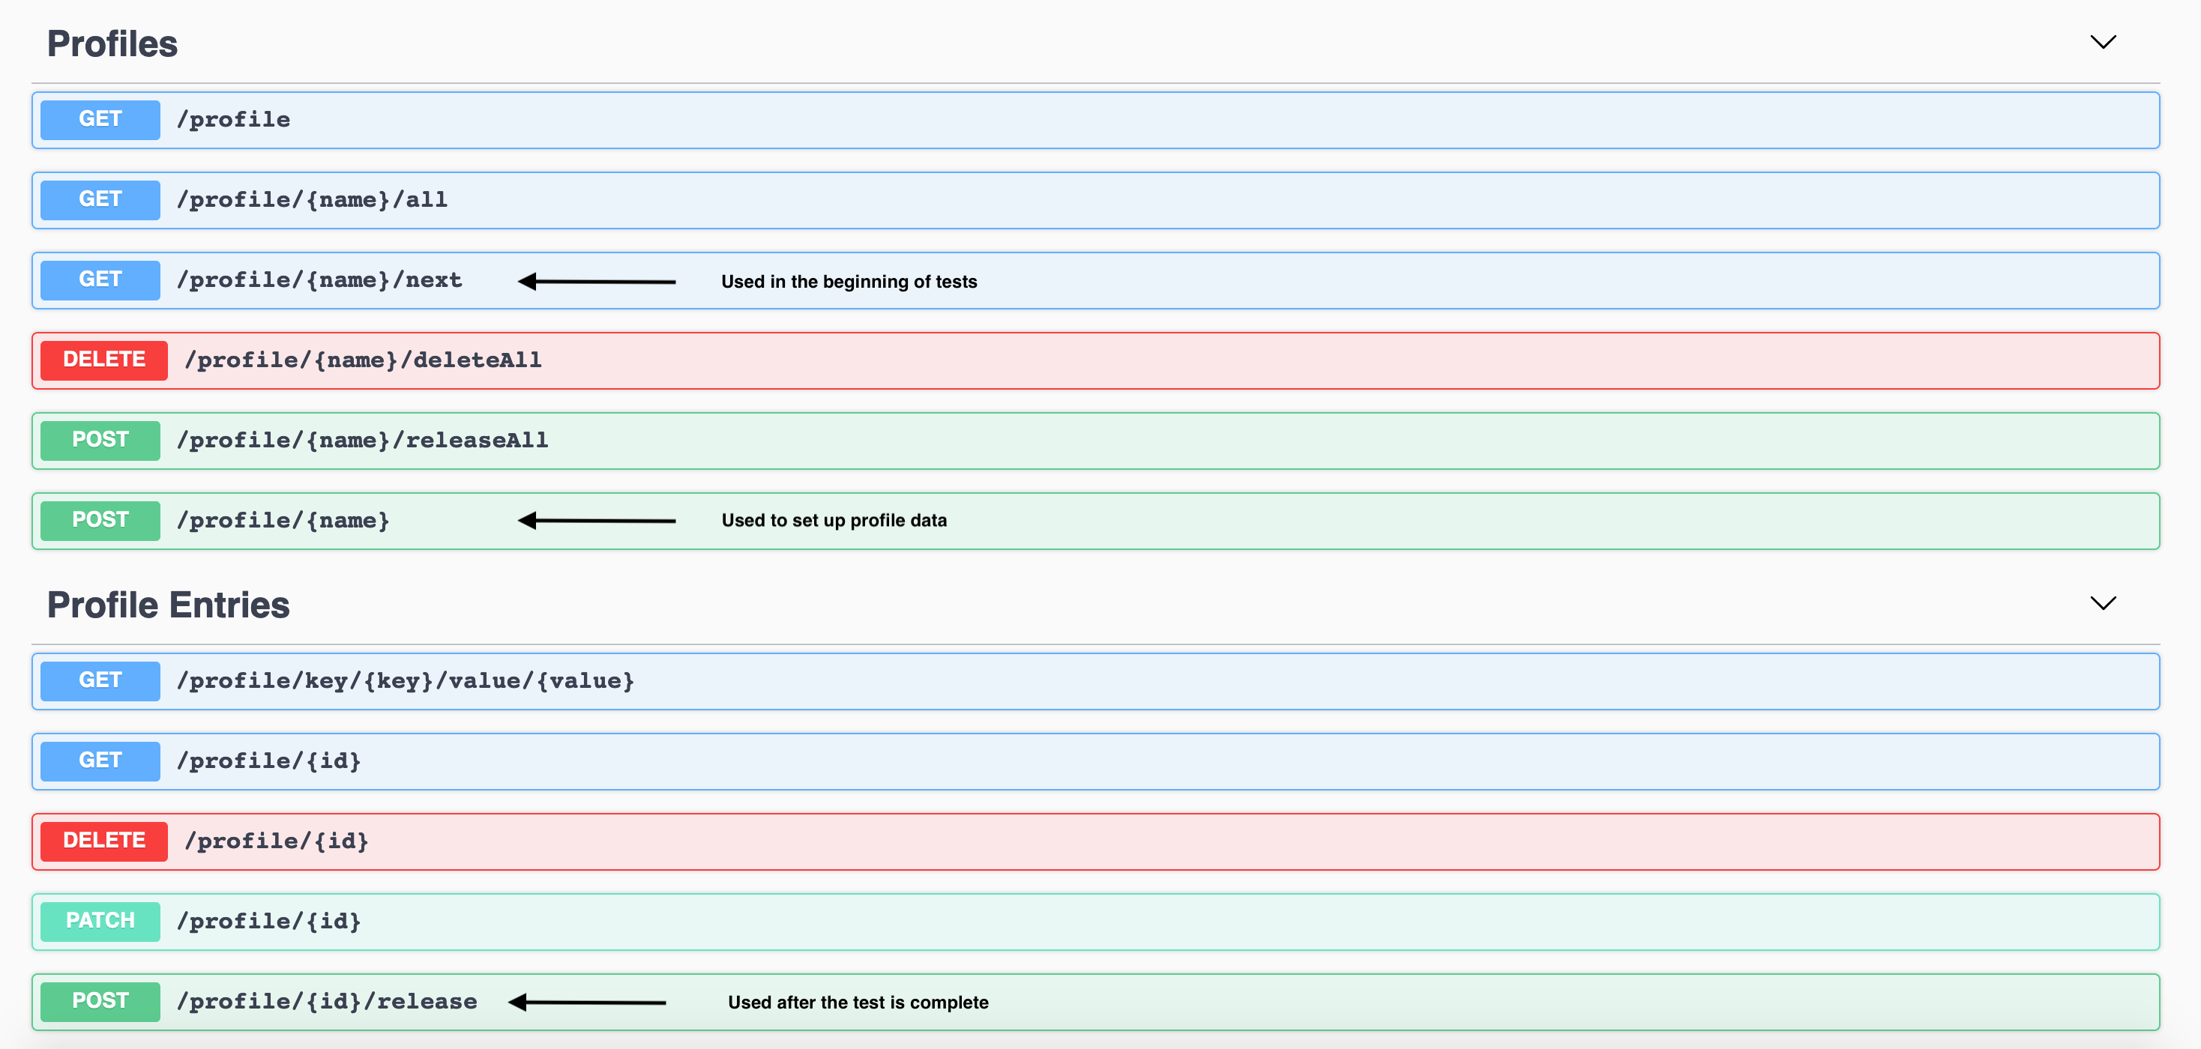
Most Used Endpoints

Slide 13
How can you help?
Start using the profile service https://github.com/godaddy/profile-service
Report issues or create PRs for new features/bug fixes
Notes:
We love hearing from other companies, to see how this service can help them, and how this service can be improved to work better for everyone.

Slide 14

Questions
https://github.com/smccarthy/profile-service-presentation

