Slide 1
Box plots with ggplot
Sue McClatchy
July 27, 2016

Slide 2
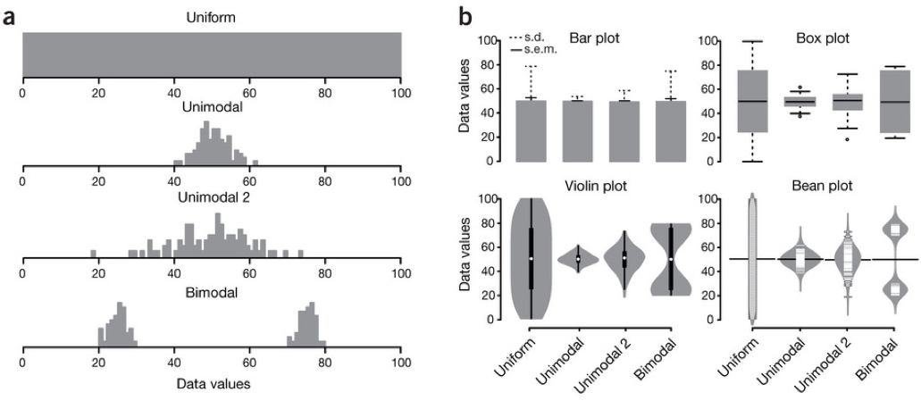
Bar charts vs. box plots
Adapted from BoxPlotR: a web tool for generation of box plots
Michaela Spitzer, Jan Wildenhain, Juri Rappsilber & Mike Tyers
Nature Methods 11, 121–122 (2014)

Slide 3
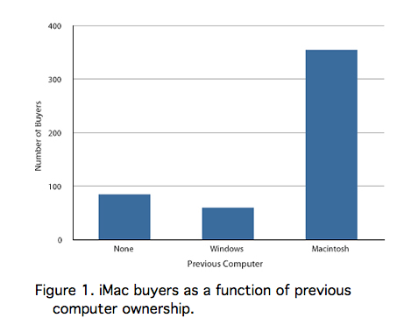
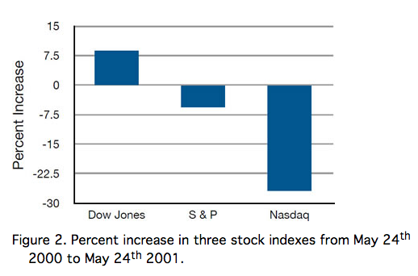
When to use a bar chart

Slide 4
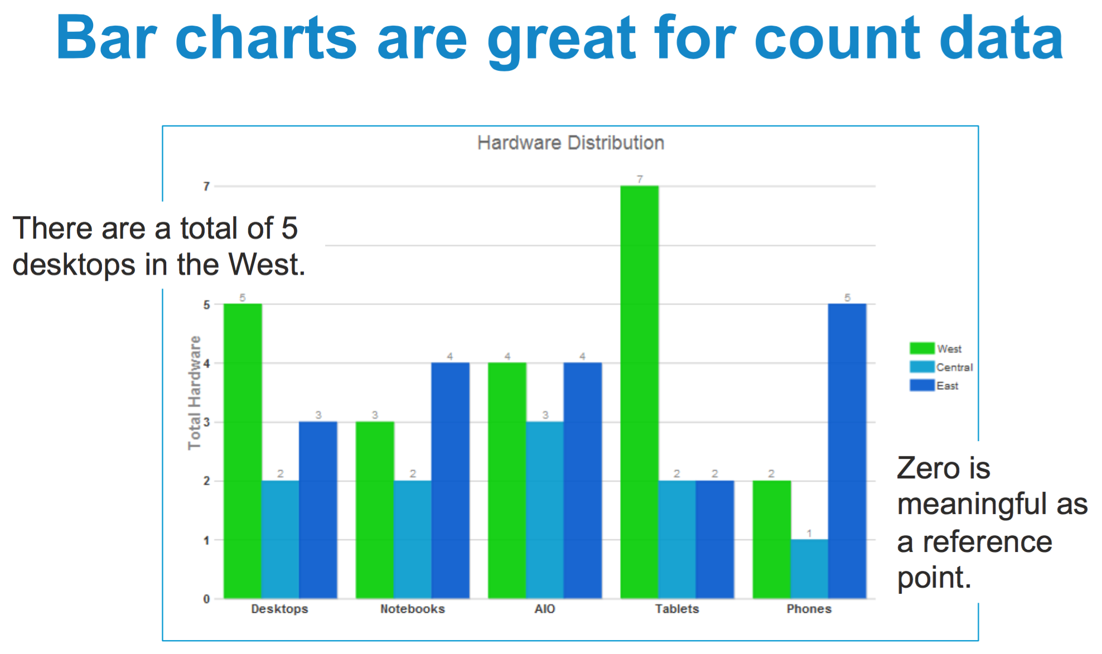

Slide 5
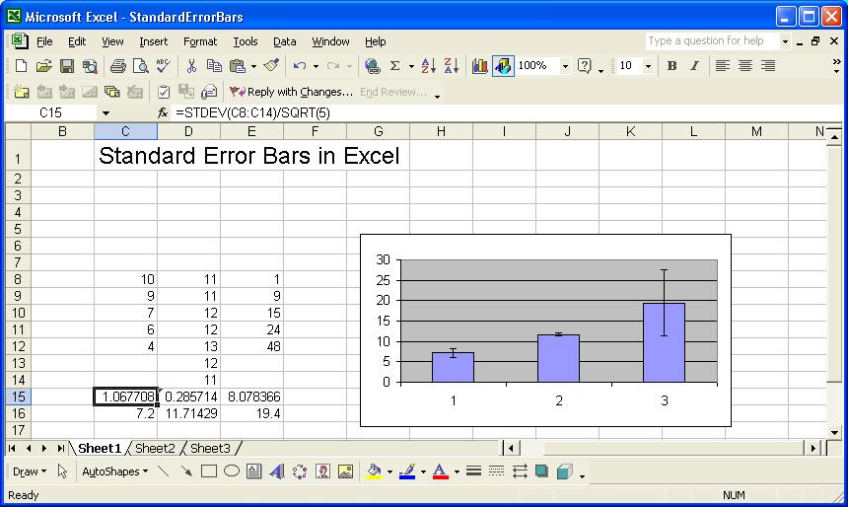
Why are bar charts so commonly (mis)used?

Slide 6

When you don’t own a lawnmower

Slide 7
What do we want to know?
POPULATION
What does the sample tell us about the
population from which it was drawn?
Are two (or more) samples from the same
population or from different populations?
sampling
inference
SAMPLE

Slide 8
Bar charts give only one measure
Adapted from BoxPlotR: a web tool for generation of box plots
Michaela Spitzer, Jan Wildenhain, Juri Rappsilber & Mike Tyers
Nature Methods 11, 121–122 (2014)

Slide 9
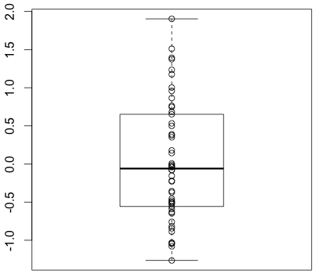
Five measures are better
Q3 + (1.5 * IQR)
Q3
}
median
IQR
Q1
Q1 - (1.5 * IQR)

Slide 10
References
Spitzer M, Wildenhain J, Rappsilber J, Tyers M. BoxPlotR: a web tool for generation of box plots. Nat Meth. 2014;11(2):121-2. doi: 10.1038/nmeth.2811.
Kick the bar chart habit. Nat Meth. 2014;11(2):113. doi: 10.1038/nmeth.2837.
Krzywinski M, Altman N. Points of Significance: Visualizing samples with box plots. Nat Meth. 2014;11(2):119-20. doi: 10.1038/nmeth.2813.

