Slide 1

Current State of End to End Underwater Video Acquisition at the U.S. National Deep Submergence Facility
Scott McCue WHOI/NDSF Data Manager
Community Workshop: Establishing Community Standards for Underwater Video Acquisition, Tagging, Archiving and Access
June 1 & 2, 2016
smccue@whoi.edu

Slide 2
National Deep Submergence Facility
A virtual group at WHOI.
Operators of DSV Alvin, ROV Jason, AUV Sentry.
Alvin and Jason capture video.
Funded primarily by National Science Foundation, some from NOAA and ONR.
Clients from universities and US agencies, occasionally private sector.
Oversight by UNOLS Deep Submergence Science Committee.
Per DeSSC and NSF, WHOI holds copyright for video.
Video is archived by WHOI Data Library and Archives, and NDSF.
Per NSF, NSF rules for data sharing generally apply.
Max 2 year embargo.
smccue@whoi.edu
Community Workshop: Establishing Community Standards for Underwater Video Acquisition, Tagging, Archiving and Access.
June 1 & 2, 2016
Notes:
Some exceptions to the 2 yr rule, i.e., protection of shipwreck locations.

Slide 3
Two Vehicles/Two Environments
Alvin
Sphere: space and power limitations.
Dive durations are up to 9 hours.
Pilot plus two observers
Limited post-processing possible, automation implemented.
Always hosted on R/V Atlantis
Vehicle upgrade 2013: change from media-based to file-based HD recording.
Jason
Unlimited power, lots of space for equipment.
Extended lowering duration, avg = 17 hours, longest 5+ days.
Dedicated post-processor in Jason crew.
Hosted on a variety of global class vessels (2-4 installs/yr)
Evolving video pipeline since 2002.
smccue@whoi.edu
Community Workshop: Establishing Community Standards for Underwater Video Acquisition, Tagging, Archiving and Access.
June 1 & 2, 2016

Slide 4
Two environments/Two Approaches
Alvin
Capture using a handheld recorder model.
Two observers, two recorders.
Scripted post-processing creates proxies and metadata.
Framegrabber captures video framegrabs with sensor data.
Jason
Automated capture in a delivery codec (h264) over full dive duration.
Also, a science watchstander captures highlights manually.
Watchstander tasks include router control, recorder, partial metadata. Jason post-processor completes metadata.
VirtualVan captures snapshots: grabs, sensors, comments
smccue@whoi.edu
Community Workshop: Establishing Community Standards for Underwater Video Acquisition, Tagging, Archiving and Access.
June 1 & 2, 2016

Slide 5
alvin
Handheld recorder (Atomos Samurai)
direct to ProRes422.
built in monitor.
removable hard drives.
Marine techs (SSSG) perform post-processing.
media handling, dive parameters, and script invocation.
Specialized Windows7 system offloads to RAID & LTO on ship.
In-house scripts create proxies (h264), subtitle (time), metadata.
Originals and proxies are available on ship.
Editing stations on ship for science party (MacPro) .
Final Cut, Premier, Media Encoder, more.
smccue@whoi.edu
Community Workshop: Establishing Community Standards for Underwater Video Acquisition, Tagging, Archiving and Access.
June 1 & 2, 2016

Slide 6
Alvin, cont’d
Data package
Up to 700GB of video per dive. Increase expected.
LTO for delivery to WHOI Data Archives
LTO for ship’s “protect while in transit” archive (~1 year)
Milspec portable USB hard drive to chief scientist (1:1 with LTO)
1-3 dives per LTO5/hard drive
At delivery, chief scientist assigns data access.
LTO duplicate made on shore.
Copies on two campuses
LTO delivered to WHOI Data Library and Archives.
Framegrabber material placed on WHOI server
smccue@whoi.edu
Community Workshop: Establishing Community Standards for Underwater Video Acquisition, Tagging, Archiving and Access.
June 1 & 2, 2016

Slide 7
Jason
h264 recorder
Three primary cameras to hard drive.
Subtitles in real time from broadcast metadata.
Timestamps and camera name in filenames.
Post-processing: merge of video and subtitles.
Future: new subtitle with post-processed navigation.
Highlights recorder
Aja KiPro, rackmount ProRes422
Science watchstander records camera source, crude time, activity “sound bite.”
Jason post processor:
Timestamp from imbedded time code (Final Cut)
Rename clips with lowering ID and time
Merge processed and watchstander metadata into cruise metadata
smccue@whoi.edu
Community Workshop: Establishing Community Standards for Underwater Video Acquisition, Tagging, Archiving and Access.
June 1 & 2, 2016

Slide 8
Jason, cont’d
Data package
Video and all other vehicle data assembled by Jason data processor.
Portable RAID hard drive to NDSF internal repo.
Portable hard drive to chief scientist.
Two copies on enterprise RAID on two campuses.
Chief scientist assigns data access at cruise end.
VirtualVan material placed on WHOI server.
smccue@whoi.edu
Community Workshop: Establishing Community Standards for Underwater Video Acquisition, Tagging, Archiving and Access.
June 1 & 2, 2016
Notes:
FG no password protection Vvan passworded.

Slide 9
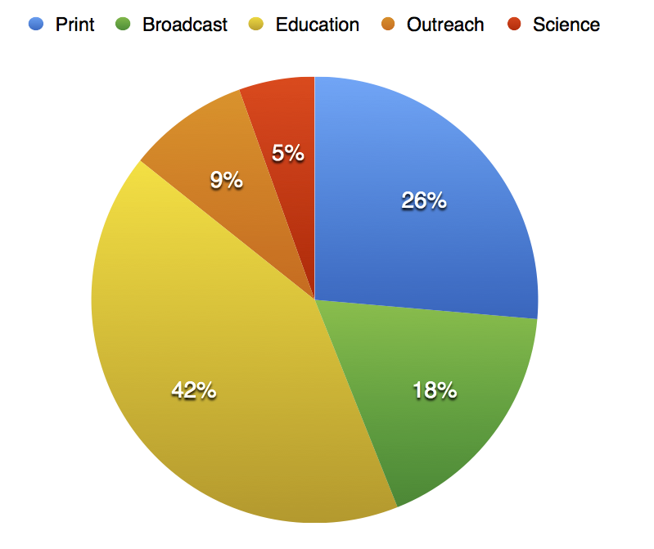
consumers
WHOI Info Office requests for NDSF
imagery (91) 2014-2016.
We must meet the video needs of a wide variety of users: science, media, education, news.
Requests go to NDSF, WHOI DLA, WHOI Information Office
All video archived at WHOI, “permanently”
~106TB since 2013, plus unquantified volumes on original media from 1968.
smccue@whoi.edu
Community Workshop: Establishing Community Standards for Underwater Video Acquisition, Tagging, Archiving and Access.
June 1 & 2, 2016

Slide 10
Issues/challenges
Massive amounts of video data. All worth saving?
How to determine high value/low value video data?
Technology changes rapidly. How to support while limiting costs?
Should the operator archive? PI? Outside archive?
How to improve access affordably?
How to improve our metadata standards and methods affordably?
How to affordably migrate from old media?
smccue@whoi.edu
Community Workshop: Establishing Community Standards for Underwater Video Acquisition, Tagging, Archiving and Access.
June 1 & 2, 2016

