Slide 1
Action days
By Sam W.K

Slide 2
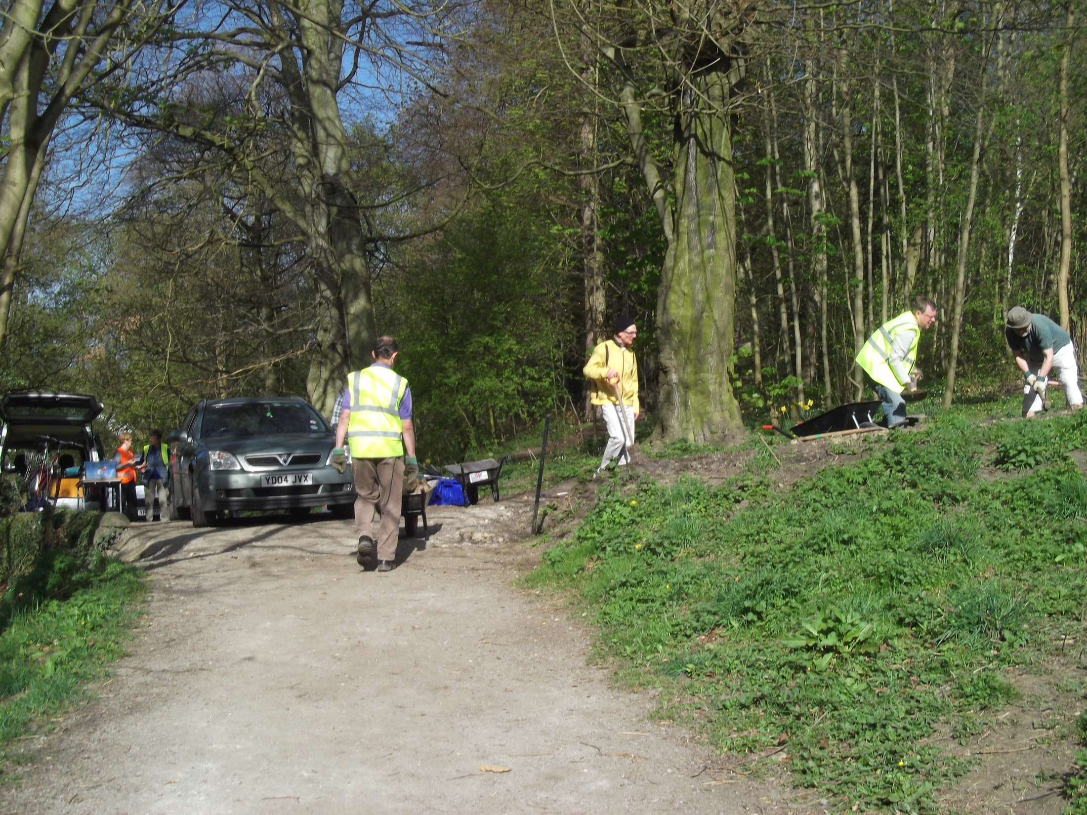
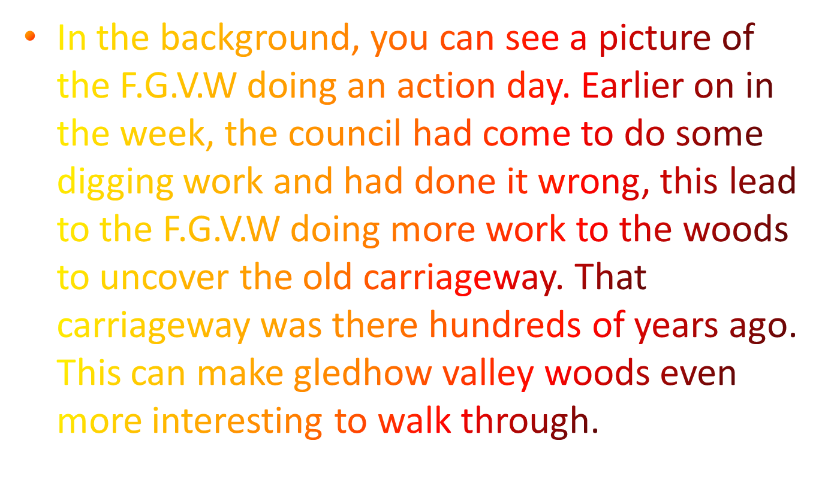

Slide 3
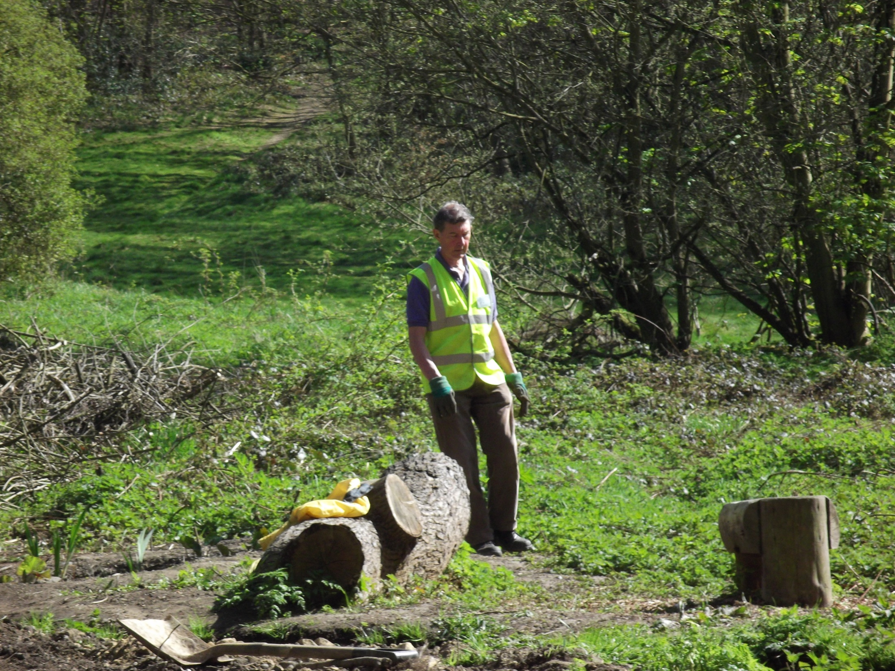
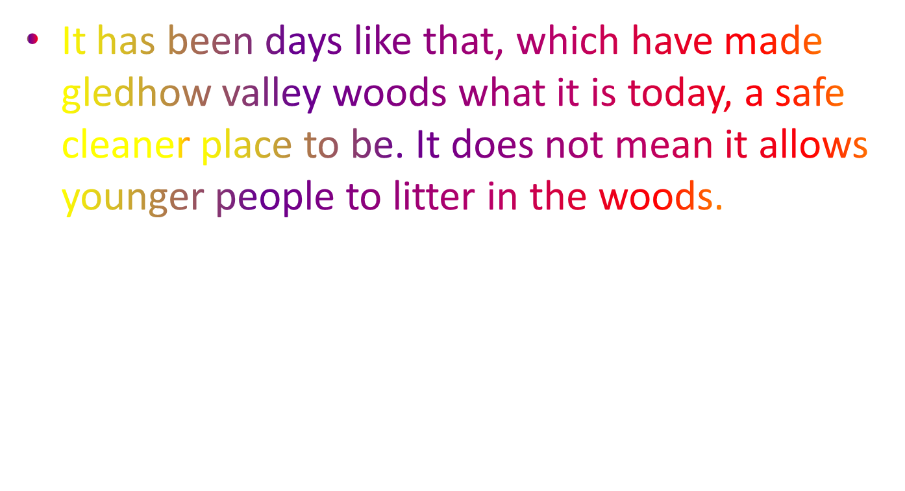

Slide 4
Thank you
I know it was short, but I hope that this presentation has taken effect on your thoughts about doing things for the environment and how easy it can be.
Thank you for watching. ☺☺☺

