Slide 1
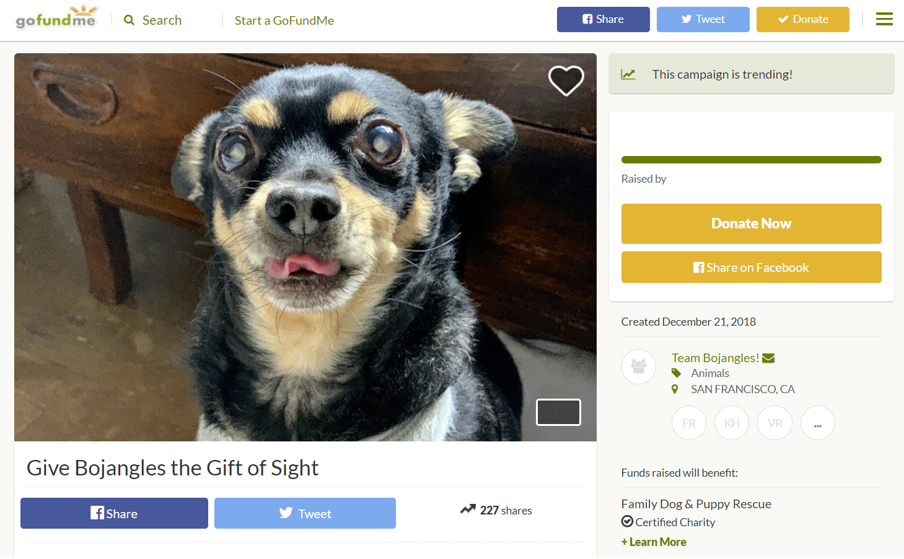

$???? of $3B+ goal
Created December 22, 2018
Team Are You Sh%*ting Me?!
Federal “Volunteers”
All Over
P
WN
ED
Help This Dysfunctional Organization Pay Its Employees
800k
Unpaid Federal Employees

