Slide 1
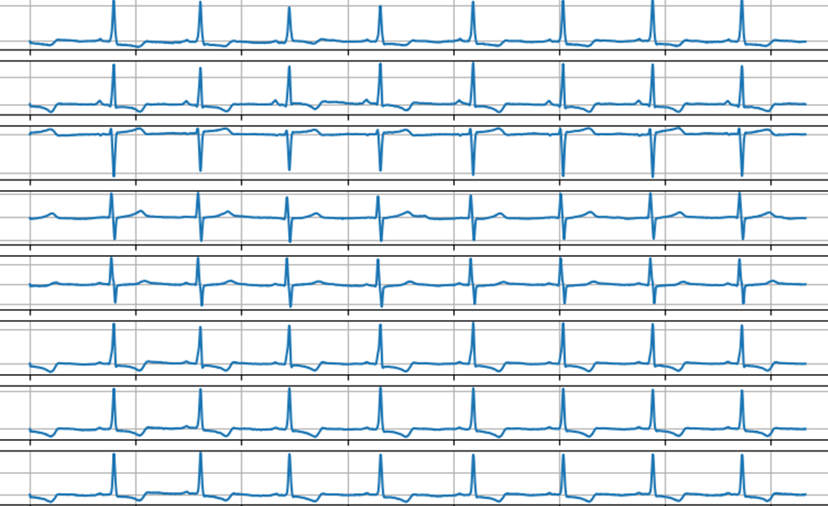
ECG Event Classification using Machine Learning
By Shane McNicholas

Slide 2
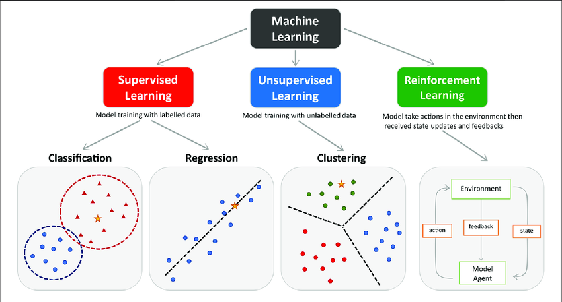
Introduction
This project aims to:
Develop 2 machine learning models for multi-label classification of ECG data.
Briefly explore and evaluate different neural network and non-neural network architectures.
Identify and exploit key features of the data.
Train -> Evaluate -> Tune
Understand the different metrics of scoring and how they individually relate to the model’s performance

Slide 3
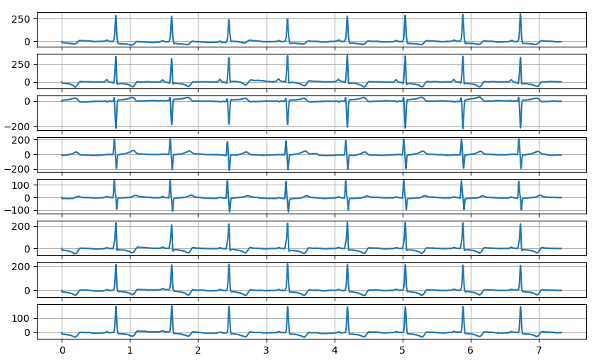
Electrocardiogram (ECG)
Electrocardiograms are recordings of the heart’s electrical activity over time.
Voltage signals taken with electrodes placed strategically on a patient’s body.
8-channel data sampled at 300Hz.
Each ECG recording is split into 7.33s segments, resulting in 2200 samples per recording.
6 labels; 1dAVb, RBBB, LBBB, SB, AF, ST.
Each sample can have multiple labels

Slide 4
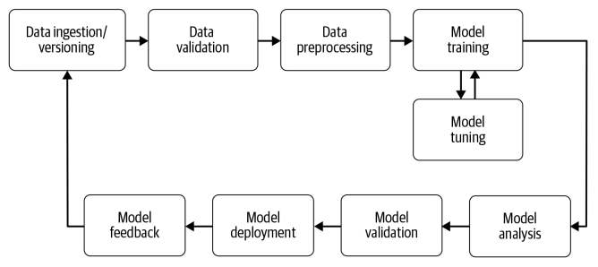
Methods
Two models, one neural network and one non-neural network
Random Forest classifier (non-neural network)
Multilayer Perceptron (neural network)
Data augmentation
Limit training samples?
Preprocessing
Normalization?
Filtering?
Reshaping?
Feature extraction?
Parameter tuning
Postprocessing
Thresholds
Software design

Slide 5
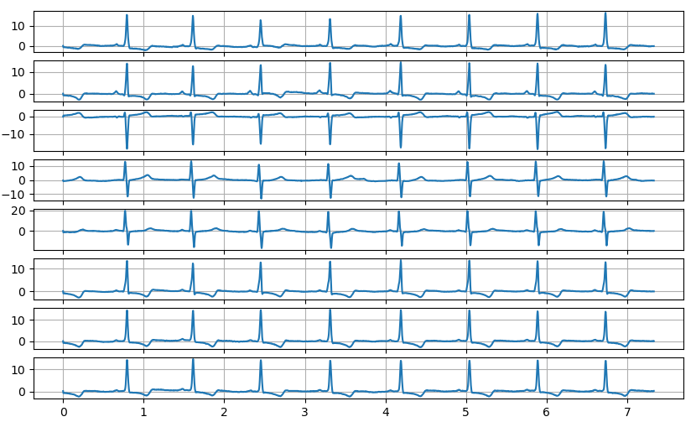
Preprocessing - Normalization
Robust Scaling
“Center to the median and component wise scale according to the interquartile range.”
Insensitive to outliers
Preserves signal shape
Non-parametric
Removes the need for filtering

Slide 6
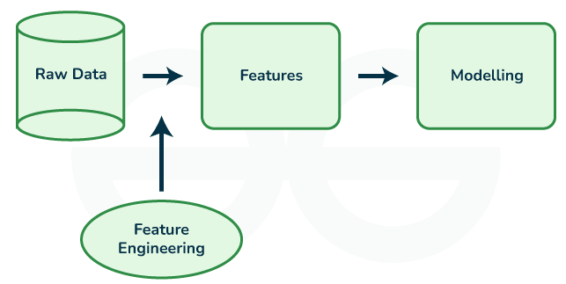
Preprocessing
Feature Engineering
Started with raw and normalized channel data.
Stacked each channel on top of another.
CH11,CH12,CH13,…,CH81,CH82,…
Hand picked feature extraction for RF.
Mean, std, max amplitude, min amplitude, peak-to-peak, total power, mean power
Used normalized, stacked data for MLP.

Slide 7
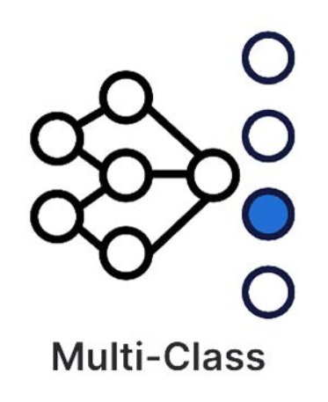
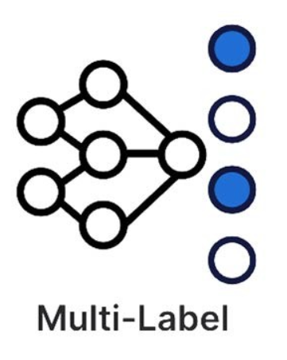
Multi-Output Classification
Each sample can have multiple labels.
Some models cannot predict multiple labels per sample
MLPs can, RFs cannot
An alternative approach must be used for multi-output classification
A binary classifier for each of the given estimator is trained for each label in the data.
Each individual model makes a binary classification for a corresponding label in the data.
sklearn.multioutput.MultiOutputClassifier

Slide 8
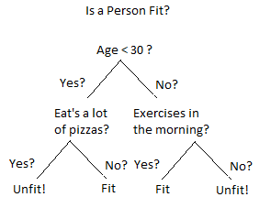
Random Forest Classifier - Overview
A decision-tree based classifier
A series of if statements that a sample passes through that leads to a classification.
Generates multiple decision trees on sub-samples of the dataset.
Averages the outputs of every tree to improve accuracy and limit overfitting.
Relies heavily on inputs features.
Nodes of the trees are based on these features.
Not inherently multi-label.
An entire RF is fitted for each label in the data.
Easily parallelizable.
Each decision tree in the forest can be ran in parallel.

Slide 9
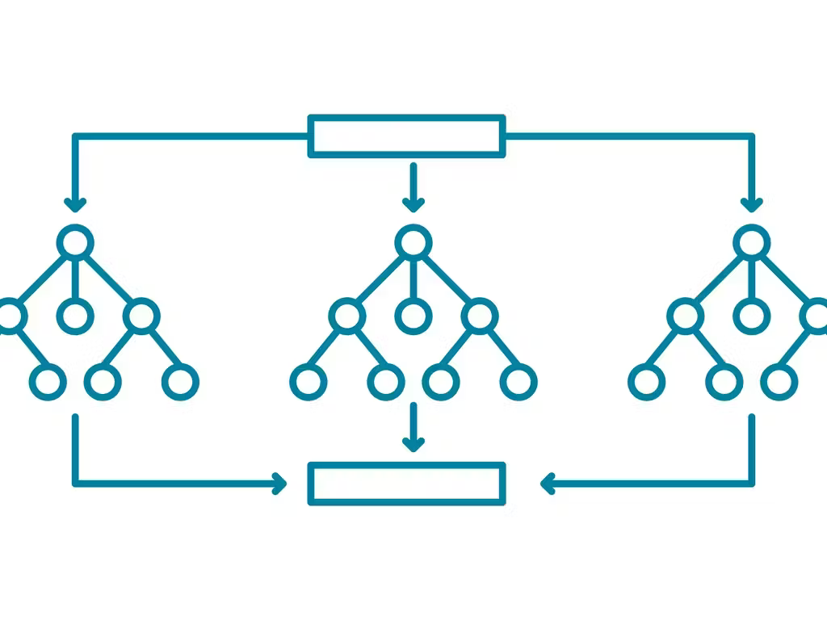
Random Forest Classifier - Hyperparameters
Criterion: The function to measure the quality of a split (dividing a node into child nodes)
Gini: Measures how often a randomly chosen element from a set would be incorrectly labeled if it was randomly labeled according to the distribution of labels in the subset.
N estimators: The number of trees in the forest.
The default of 100 is reasonable for most datasets.
Class weights: Apply a weight to each class for output.
Could correlate weights to distributions of labels.

Slide 10
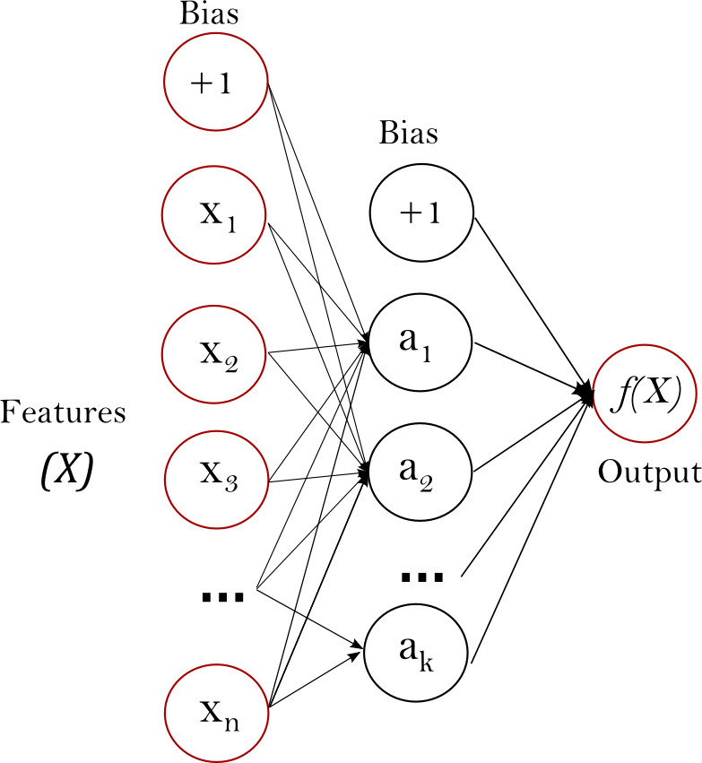
Multi-layer Perceptron – Overview
A supervised, neural-network model that can learn non-linear function approximators for either classification or regression.
Input layer values are passed to one or more hidden layers where the previous layer’s values are transformed using a weighted summation.
Trains using gradient descent, where the gradient descents are calculated using backpropagation.
Classifies by minimizing a cross-entropy loss function.
Natively supports multi-output classification.
Depends heavily on a set of tunable hyperparameters.
Hidden layers, epochs, alpha, solver, etc…

Slide 11
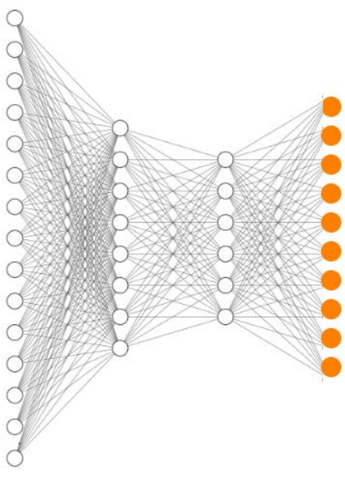
Multilayer Perceptron - Hyperparameters
Activation function: Enables complex modeling.
Rectified Linear Unit (ReLU): returns f(x) = max(0, x)
Solver: The algorithm used for optimizing hidden-layer weights.
Adaptive Moment Estimation (ADAM): “a stochastic gradient-descent based optimizer”
Hidden Layer Architecture: The number of neurons per each hidden layer.
(100, 50, 25, 10) – Results did not change much for different architectures.
Input layer of 17600
Output layer of 6

Slide 12
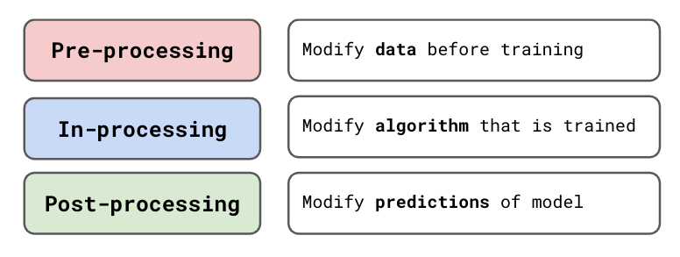
Postprocessing
Thresholding
A simple postprocessing technique to classify based on label probabilities
Compute label probabilities for a given sample, classify as 1 if greater than or equal to threshold, 0 if less than.
Allows greater control over a decoder.
SKLearn’s default threshold is 0.5
Different thresholds for each model
MLP: 0.55
RF: 0.15

Slide 13
Results

Slide 14
Challenges and Final Remarks
Understanding the nature of the data
What do the labels mean?
What are the discerning factors of each label?
What are the best features to extract from the data?
Filtering and normalizing the data?
Time
Developing infrastructure
I/O reads
Models trained faster than planned
If I were to do it again:
Go further into deep learning than MLP
Try an image-based approach
Experiment more with RF parameters
Experiment with models before developing infrastructure (notebooks)

