Slide 1

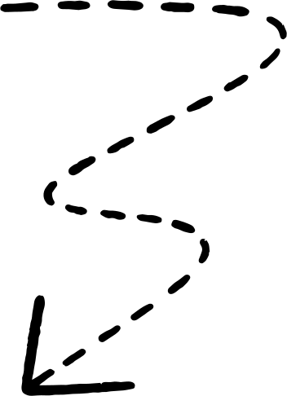

Email Spam Detection — Lab 1
Date: 12-09-2025
YouTube Handle: @csquickrevisionshorts
Course: Big Data Analysis

Slide 2
DAY-1
Experiment 1: Identification of Spam and non-spam (ham) mails from your mail account
Date: 12-09-2025
YouTube Handle: @csquickrevisionshorts
Course: Big Data Analysis

Slide 3
System Diagram
Email Text → TF-IDF Vector → MultinomialNB → Spam/Ham Prediction
@csquickrevisionshorts

Slide 4
Classifier Used: Multinomial Naive Bayes (MultinomialNB)
Library: scikit-learn (sklearn.naive_bayes)
Task: Text classification (Spam vs Ham)
Input Features: TF-IDF vectors from TfidfVectorizer
Advantages:
Simple and fast
Works well with discrete word count features
Effective even with small datasets
@csquickrevisionshorts

Slide 5
Model Results
Accuracy: 0.80
Classification report:
precision recall f1-score support
0 1.00 0.67 0.80 3
1 0.67 1.00 0.80 2
accuracy 0.80 5
macro avg 0.83 0.83 0.80 5
weighted avg 0.87 0.80 0.80 5
@csquickrevisionshorts

Slide 6
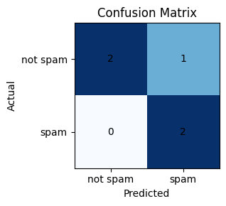
Confusion Matrix
@csquickrevisionshorts

Slide 7
Big Data Analysis — Day 3 / Lab 3
Date: 20-09-2025
Experiment: Spam Detection — Prediction & Error Analysis
@csquickrevisionshorts

Slide 8
Big Data Analysis — Additional Experiment
Date: 20-09-2025
Experiment: Spam Detection — Prediction & Error Analysis
@csquickrevisionshorts

Slide 9
Predictions on New Emails
Win a brand new car by clicking this link! --> Spam
Don't forget our lunch meeting tomorrow --> Ham
Get free coupons instantly!!! --> Spam
@csquickrevisionshorts

Slide 10
Error Analysis Report
precision recall f1-score support
0 1.00 1.00 1.00 1
1 1.00 1.00 1.00 2
accuracy 1.00 3
macro avg 1.00 1.00 1.00 3
weighted avg 1.00 1.00 1.00 3
@csquickrevisionshorts

Slide 11
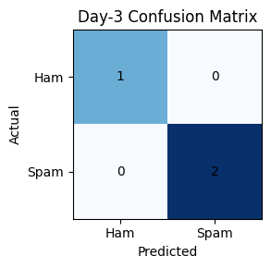
Day-3 Confusion Matrix
@csquickrevisionshorts

Slide 12
Main Code: spam_main.py (part 1)
# --- model + metrics + image saving ---
from sklearn.model_selection import train_test_split
from sklearn.feature_extraction.text import TfidfVectorizer
from sklearn.naive_bayes import MultinomialNB
from sklearn.pipeline import Pipeline
from sklearn.metrics import accuracy_score, classification_report, confusion_matrix
import matplotlib.pyplot as plt
import numpy as np
from pptx import Presentation
from pptx.util import Inches
@csquickrevisionshorts
# Example data (replace with real dataset if available)
emails = [
"Congratulations, you won a free iPhone!", # Spam
"Meeting scheduled tomorrow at 10 AM", # Ham
"Claim your free prize now!!!", # Spam
"Please review the attached project report", # Ham
"Win cash now, limited offer", # Spam
"Lunch at noon?", # Ham
"Exclusive deal: buy one get one free", # Spam
"Minutes of today's meeting attached", # Ham
"Get a free gift card by completing this survey!", # Spam
"Team outing next Friday, RSVP", # Ham
"Limited-time offer! Earn $5000 per week", # Spam

Slide 13
Main Code: spam_main.py (part 2)
"Can you send me the latest sales figures?", # Ham
"Your account has been compromised, reset now", # Spam
"Reminder: doctor appointment tomorrow at 9 AM", # Ham
"Win a luxury vacation to the Bahamas!", # Spam
"Please find the invoice attached", # Ham
"Earn money fast with this simple trick", # Spam
"Family dinner plans for Saturday?", # Ham
"Get free tickets to the concert of your dreams!", # Spam
"Notes from today's lecture attached", # Ham
]
labels = [
1,0,1,0,1,0,1,0,1,0,1,0,1,0,1,0,1,0,1,0
] # 1 = spam, 0 = not spam
# Train / test split
X_train, X_test, y_train, y_test = train_test_split(emails, labels, test_size=0.25, random_state=42)
@csquickrevisionshorts
# Pipeline
model = Pipeline([
('tfidf', TfidfVectorizer(stop_words='english')),
('clf', MultinomialNB())
])

Slide 14
Main Code: spam_main.py (part 3)
model.fit(X_train, y_train)
y_pred = model.predict(X_test)
# Print numeric results
acc = accuracy_score(y_test, y_pred)
report = classification_report(y_test, y_pred, zero_division=0)
print("Accuracy:", acc)
print("Classification report:
", report)
@csquickrevisionshorts
# Confusion matrix plot (matplotlib only)
cm = confusion_matrix(y_test, y_pred)
plt.figure(figsize=(4,3))
plt.imshow(cm, interpolation='nearest', cmap='Blues')
for i in range(cm.shape[0]):
for j in range(cm.shape[1]):
plt.text(j, i, str(cm[i, j]), ha='center', va='center')
plt.xticks([0,1], ['not spam','spam'])
plt.yticks([0,1], ['not spam','spam'])
plt.xlabel('Predicted')
plt.ylabel('Actual')
plt.title('Confusion Matrix')
plt.tight_layout()
plt.savefig('/content/confusion.png', bbox_inches='tight')

Slide 15
Main Code: spam_main.py (part 4)
plt.show()
@csquickrevisionshorts

Slide 16
Prediction Code: spam_prediction.py (part 1)
#Practice Code -1: Prediction
#---------
#Practical big data. Predict spam/ham
# New data for prediction
new_emails = [
"Win a brand new car by clicking this link!",
"Don't forget our lunch meeting tomorrow",
"Get free coupons instantly!!!"
]
# Predict labels
new_preds = model.predict(new_emails)
# Display results
for email, label in zip(new_emails, new_preds):
print(f"Email: {email}
Predicted label: {'Spam' if label == 1 else 'Ham'}
")
#***
#Practice Code -2: Practical-Big data. Error #analysis of spam/ham.
#---------
#Practical big data. Predict spam/ham
# New data with true labels
@csquickrevisionshorts

Slide 17
Prediction Code: spam_prediction.py (part 2)
new_emails = [
"Win a brand new car by clicking this link!",
"Don't forget our lunch meeting tomorrow",
"Get free coupons instantly!!!"
]
true_labels = [1, 0, 1] # Actual spam/ham labels
# Predictions
new_preds = model.predict(new_emails)
# Error analysis
from sklearn.metrics import classification_report, confusion_matrix
print(confusion_matrix(true_labels, new_preds))
print(classification_report(true_labels, new_preds))
@csquickrevisionshorts

Slide 18
Sample Dataset (emails + labels)
email | label
Congratulations, you won a free iPhone! | 1
Meeting scheduled tomorrow at 10 AM | 0
Claim your free prize now!!! | 1
Please review the attached project report | 0
Win cash now, limited offer | 1
Lunch at noon? | 0
Exclusive deal: buy one get one free | 1
Minutes of today's meeting attached | 0
Get a free gift card by completing this survey! | 1
Team outing next Friday, RSVP | 0
Limited-time offer! Earn $5000 per week | 1
Can you send me the latest sales figures? | 0
Your account has been compromised, reset now | 1
Reminder: doctor appointment tomorrow at 9 AM | 0
Win a luxury vacation to the Bahamas! | 1
Please find the invoice attached | 0
Earn money fast with this simple trick | 1
Family dinner plans for Saturday? | 0
Get free tickets to the concert of your dreams! | 1
Notes from today's lecture attached | 0
@csquickrevisionshorts

