Slide 1
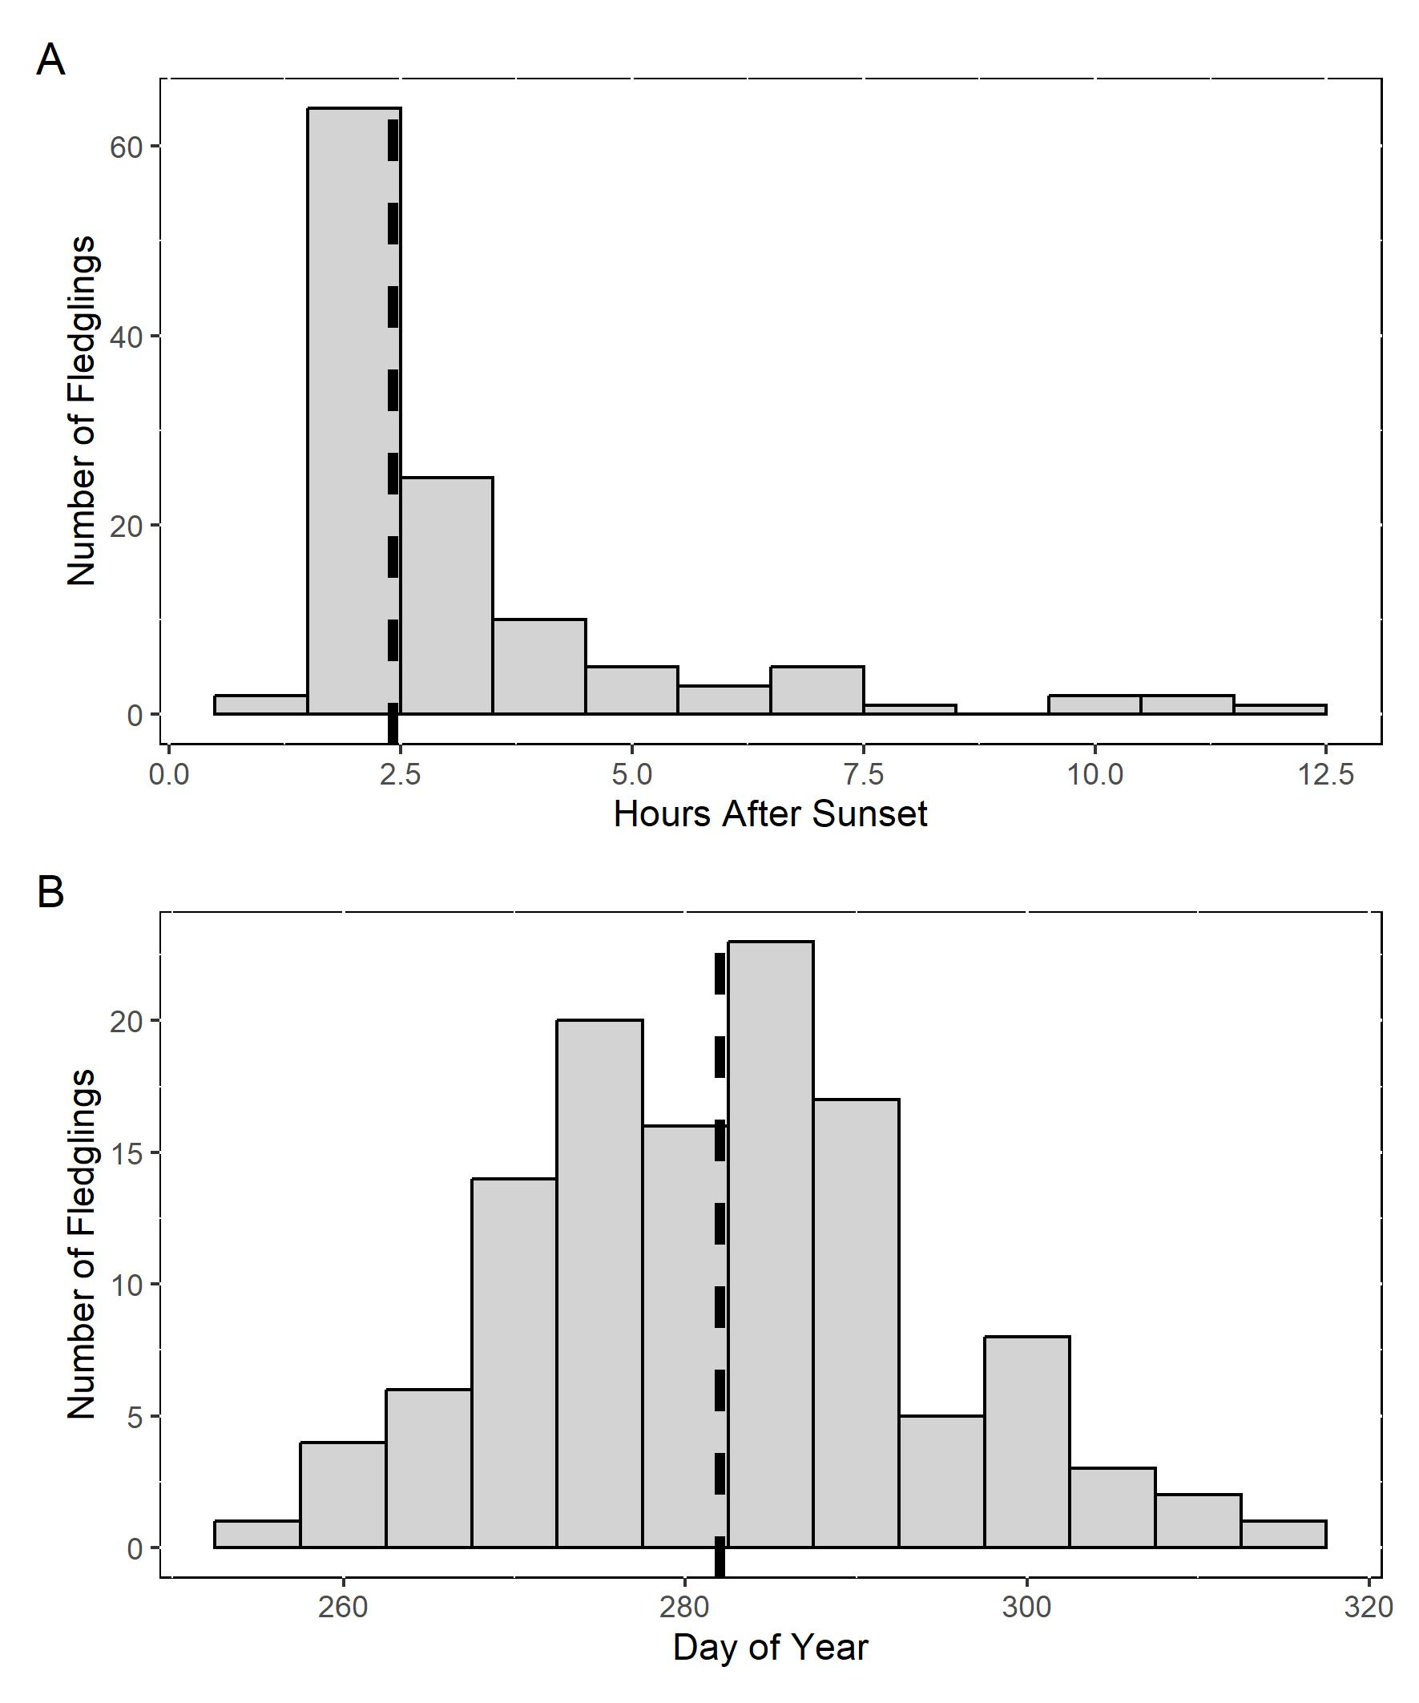
17 Sept
07 Oct
27 Oct
13 Nov

