Slide 1
Visualising Linear Advection Error with Python
Shaun
Using Python
Calculating a measure of error
Selecting useful values
Visualising the results

Slide 2
MatLab v Python
Different but similar syntax
  Annoyingly so
Indentation fiddly but works
Lots of help online
  Very similar to MatLab
Would be good to try in a GUI with interactive Python

Slide 3
Calculating Error

Slide 4
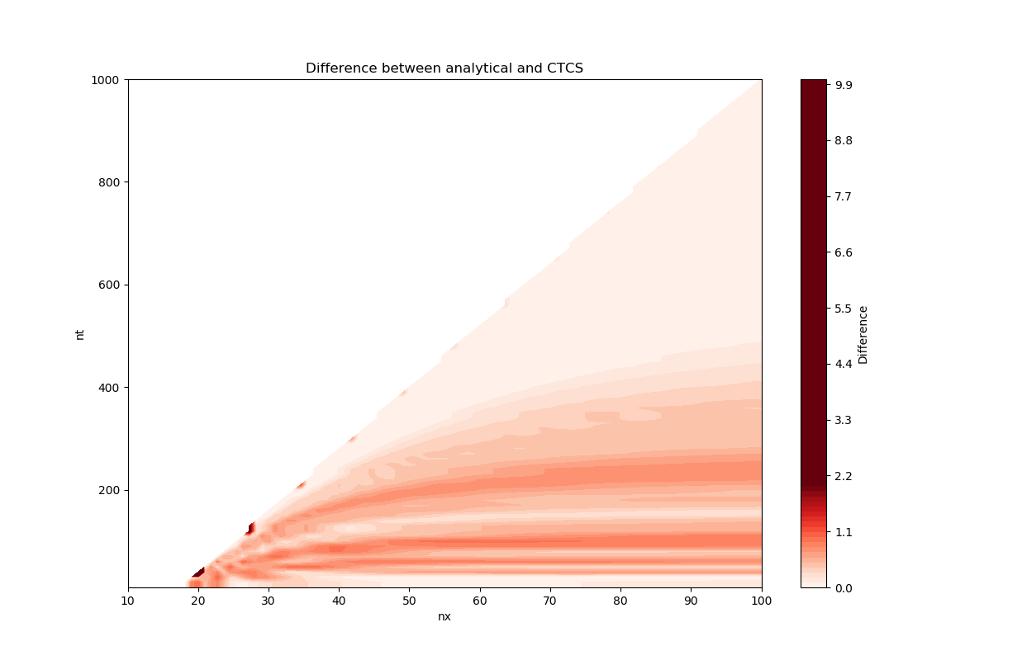

Slide 5
