Slide 1

VOTING WEB APPLICATION USING
DJANGO FRAMEWORK
Mohamed Abdul Rahman S
au951221104023

Slide 2
PROJECT OVERVIEW
The online voting system aims to provide a convenient and secure platform for conducting elections or polls electronically.
It allows eligible users to participate in voting processes from any location with internet access, eliminating the need for physical polling stations.
The system ensures the integrity of the voting process through authentication mechanisms and encryption techniques, maintaining the confidentiality and accuracy of votes cast.

Slide 3
VOTING APPLICATION
Our voting application offers a streamlined platform for conducting a variety of polls, from community decisions to entertainment preferences, enabling users to cast votes and see results in real time.
Built with a focus on user engagement and security, it ensures a transparent and accessible voting process for all participants.
This innovative tool is designed to facilitate democratic engagement and decision-making across diverse groups, fostering a participatory culture in any setting.

Slide 4
Technology Stack:
Django Framework: The backend of the online voting system is built using Django, a high-level Python web framework known for its robustness and scalability.
HTML/CSS/JavaScript: The frontend user interface is developed using a combination of HTML, CSS, and JavaScript to create a responsive and user-friendly voting experience.
Database Management: Django's built-in ORM (Object-Relational Mapping) is used to interact with the database, which stores user accounts, candidate information, and voting data.
Security Measures: The system implements security measures such as user authentication, CSRF protection, and data encryption to safeguard the integrity and confidentiality of the voting process.

Slide 5
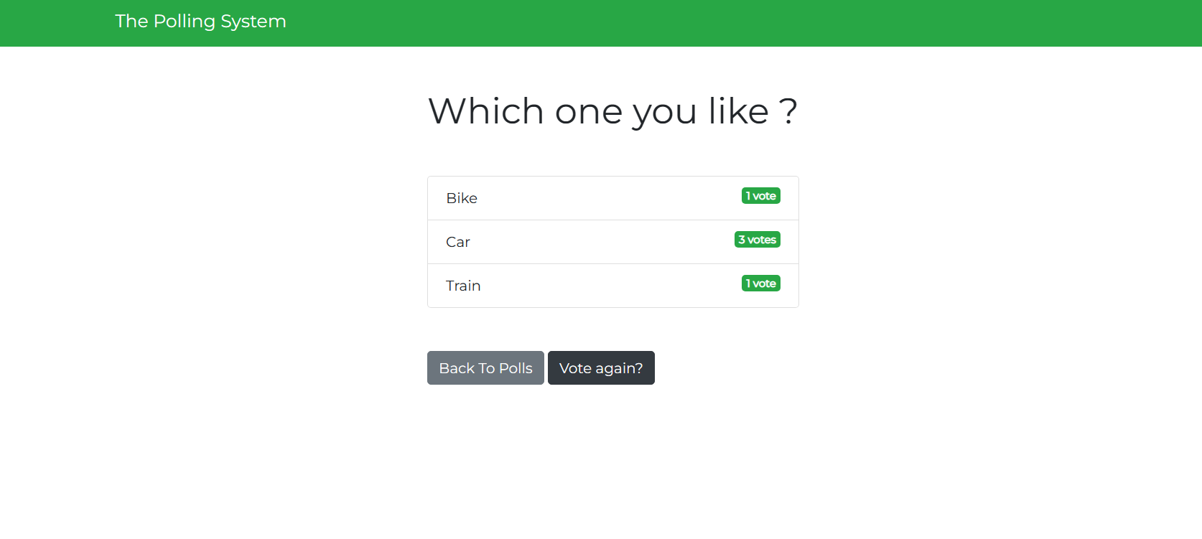
OUTPUT

Slide 6
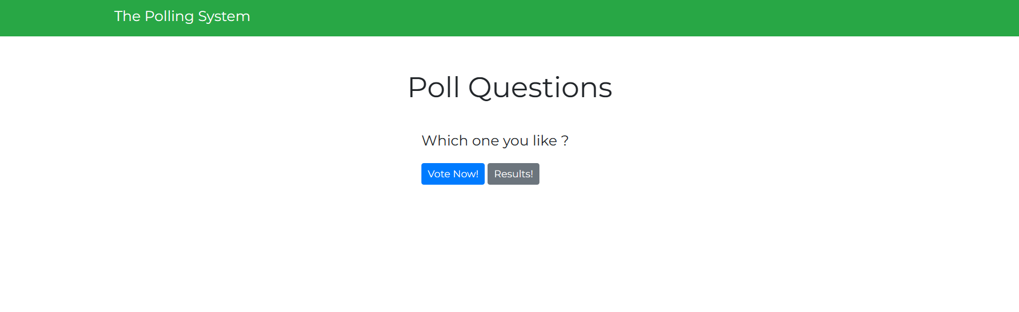

Slide 8
