Slide 1




NEXT GEN EMPLOYABILITY PROGRAM
Creating a future-ready workforce
Team Members
College Name
Student Name : Mohamed Abdul Rahman S
Student ID : au951221104023
JP College Of Engineering

Slide 2

CAPSTONE PROJECT SHOWCASE
Project Title
Voting Web Application using Django Framework
Abstract | Problem Statement | Project Overview | Proposed Solution | Technology Used | Modelling & Results | Conclusion

Slide 3
Abstract
Developed with Django framework, our voting web application offers users a seamless experience for casting votes in various polls. With a user-friendly interface, it ensures efficient participation and accurate tallying of votes. Leveraging Django's robust features, the platform ensures security and scalability, accommodating diverse voting needs. Through its responsive design, users can access the application across devices, enhancing accessibility. The integration of Django's ORM facilitates smooth database interactions, ensuring data integrity throughout the voting process. Overall, our Django-based voting web app delivers a reliable and intuitive solution for democratic engagement.
Source :

Slide 4
Problem Statement
Providing users with a list of available questions.
Allowing users to select a question and submit votes for one or more choices.
Ensuring intuitive, secure, and scalable features for an engaging user experience.
Enabling administrators to effectively manage the voting process.
Creating a platform for users to participate in polls or surveys by casting votes on various questions or topics.
Source :

Slide 5
Project Overview
Framework Choice : Utilizing Django framework for its robustness and scalability in developing web applications. Django's built-in features streamline development, ensuring efficient implementation of voting functionalities.
User Interface Design : Focusing on creating an intuitive and visually appealing interface. Employing modern design principles to enhance user experience and engagement with the voting application.
Security Measures : Implementing stringent security protocols to safeguard user data and prevent unauthorized access.Utilizing Django's built-in security features and best practices to mitigate risks and ensure data confidentiality.
Administrator Tools : Providing comprehensive tools for administrators to manage polls, monitor voting activity, and analyze results.
Source :

Slide 6
Proposed Solution
Creating a versatile web-based voting application using Django, tailored to fulfill the needs of diverse organizations, institutions, or communities seeking efficient and transparent voting processes.
This solution will incorporate the following functionalities:
1. User Authentication and Registration
2. Poll Creation and Management
3. Voting Interface
4. Real-time Updates and Notifications
5. Transparent and Auditable Process
6. Scalability and Performance Optimization
7. Reporting and Analytics
8. Compliance and Security
.
Source :

Slide 7
Advantages
Enhanced Efficiency : Streamlining the voting process through an intuitive interface and automated functionalities improves overall efficiency.
Increased Transparency : Providing real-time updates and audit trails fosters transparency, instilling trust in the voting process.
Scalability : Designed with scalability in mind, the application can adapt to accommodate growing user bases and increased voting demands.
Data Security : Robust authentication mechanisms and compliance measures ensure the security and confidentiality of user data.
Source :

Slide 8
Disadvantages
Potential Security Risks : Despite implementing security measures, there's always a risk of vulnerabilities that could compromise user data or the integrity of the voting process.
Technical Complexity : Developing and maintaining a comprehensive voting application may require significant technical expertise and resources, posing challenges for smaller organizations or teams.
User Adoption Barriers : Users unfamiliar with online voting platforms may face a learning curve, potentially leading to resistance or lower participation rates.
Dependence on Internet Connectivity : Reliance on internet access for voting could exclude individuals or communities with limited or unreliable connectivity.
Source :

Slide 9



Technology Used
Frontend
Backend
Source :

Slide 10
Modelling & Results
Data Modeling: Implementing a robust data model to accurately represent user profiles, polls, votes, and other relevant entities.
Algorithmic Design: Developing algorithms for real-time updates, notifications, and result calculations to ensure accuracy and efficiency.
Testing and Validation: Conducting rigorous testing and validation procedures to verify the functionality, reliability, and security of the application.
Performance Evaluation: Analyzing the application's performance under various load conditions to identify potential bottlenecks and optimize scalability.
User Feedback Integration: Incorporating mechanisms for collecting user feedback and iterating on the application's design and functionality based on user input and voting trends.
Source :

Slide 11
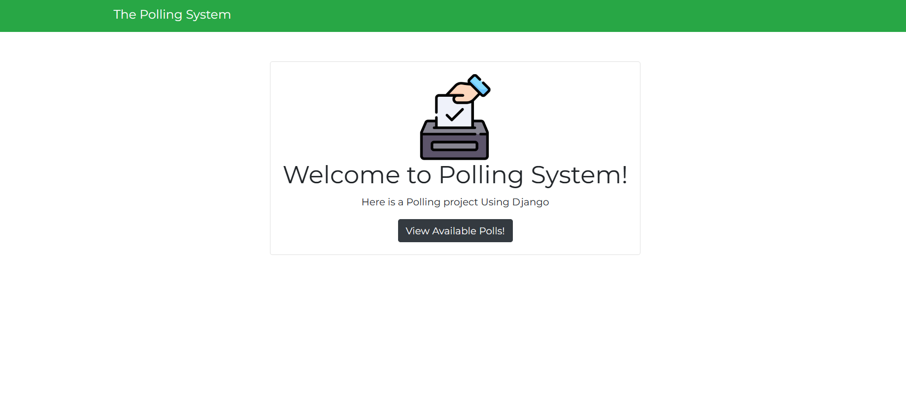
Homepage

Slide 12
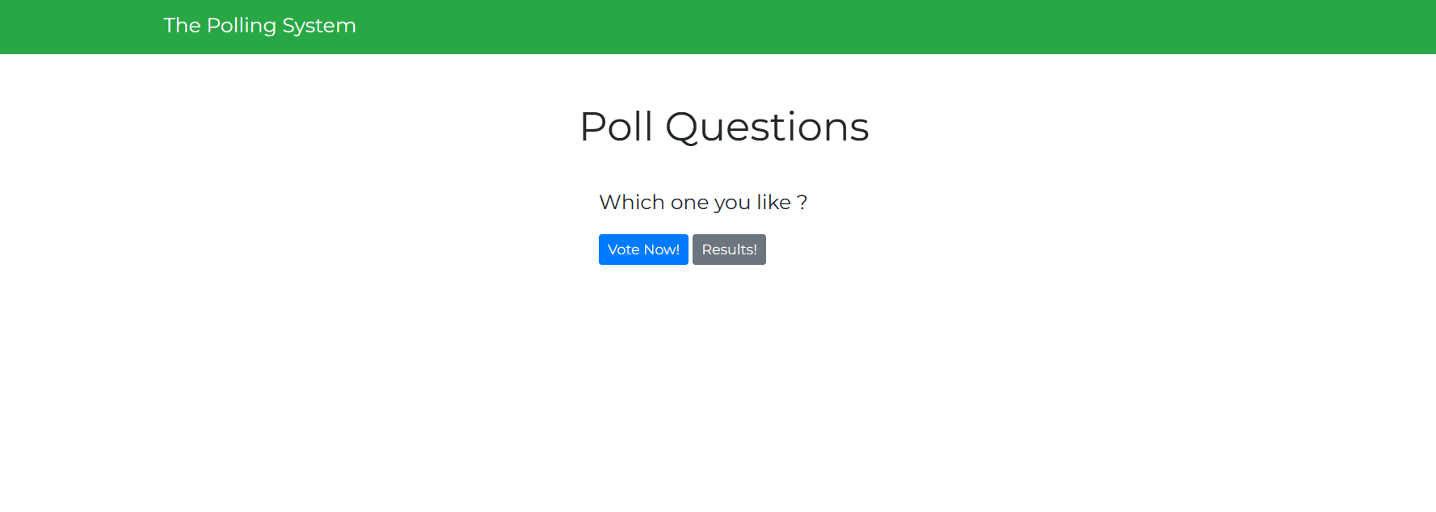
Polls Page

Slide 13
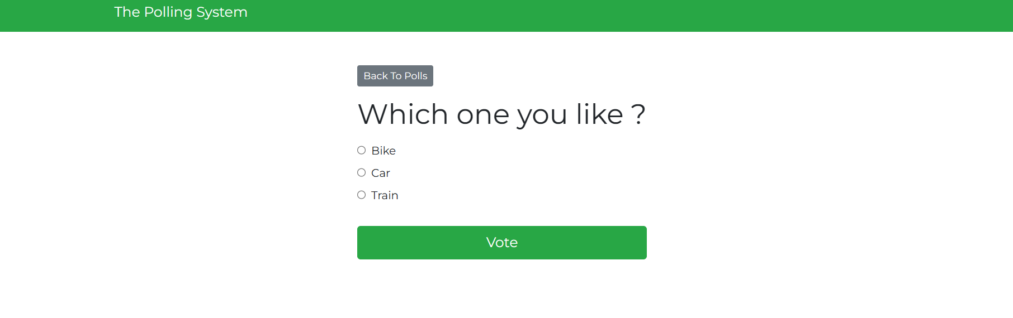
Voting Page

Slide 14

Admin Login Page

Slide 15
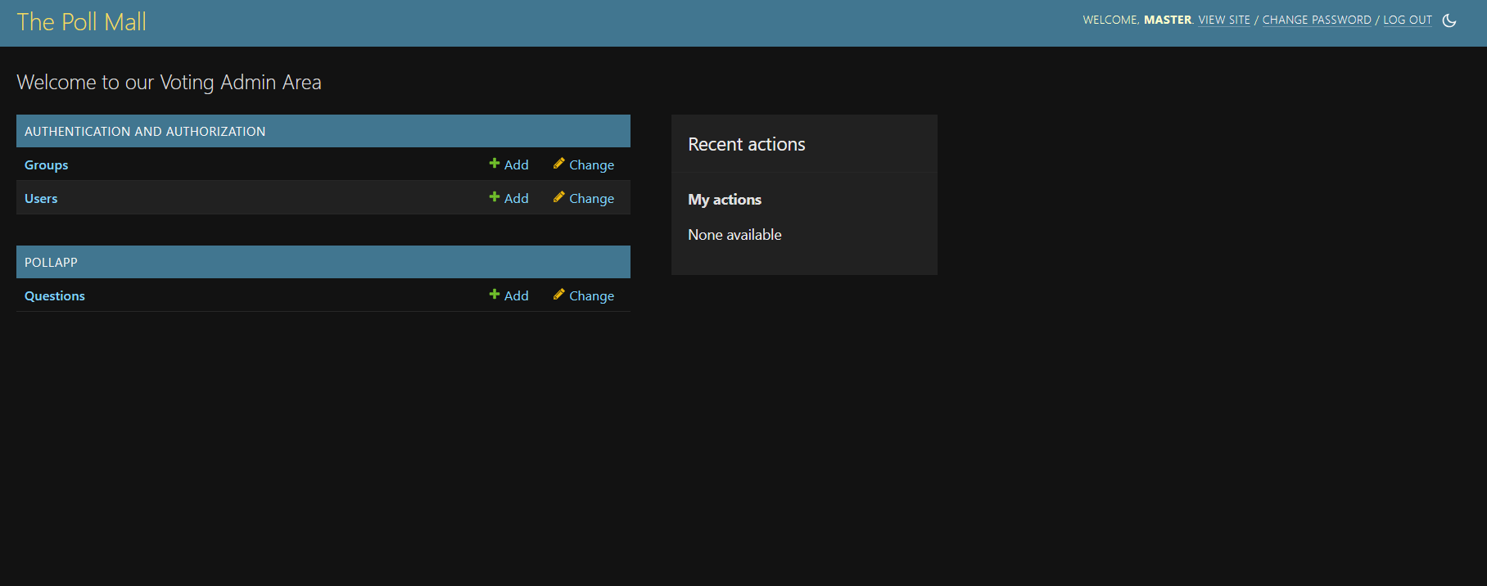
Admin Dashboard

Slide 16
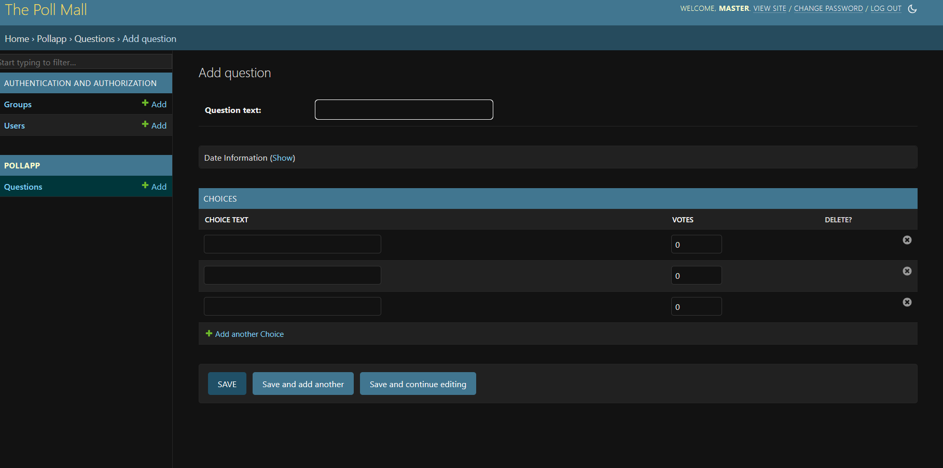
Admin Question Page

Slide 17
Future Enhancements:
Integration of Blockchain Technology: Exploring the use of blockchain for enhanced security, transparency, and immutability in the voting process.
Artificial Intelligence Integration: Implementing AI algorithms for predictive analytics, voter sentiment analysis, and personalized voting recommendations.
Mobile Application Development: Extending the voting platform with dedicated mobile applications to reach a broader audience and enhance accessibility.
Enhanced Accessibility Features: Introducing features such as voice-activated voting or support for assistive technologies to ensure inclusivity for users with disabilities.
Gamification Elements: Incorporating gamification elements such as badges, rewards, or leaderboards to incentivize participation and increase user engagement in the voting process.

Slide 18
Conclusion
In conclusion, the development of a comprehensive web-based voting application using the Django framework offers a promising solution to address the need for efficient and transparent voting processes. By incorporating features such as user authentication, poll creation, real-time updates, and reporting functionalities, the proposed solution aims to streamline the voting experience while maintaining integrity and security. Looking ahead, future enhancements such as blockchain integration, AI algorithms, and mobile application development hold promise for further improving the voting platform's effectiveness and accessibility. Overall, the proposed solution represents a significant step towards modernizing and democratizing the voting process for organizations, institutions, and communities alike.
Source :

Slide 19
Thank You!
Notes:
Thank You !!

