Slide 1
League of legends data classification
CSCI 527 02 E
Advanced Databases & Data Mining
- by Data Enthusiasts Mohammed Abdul Aziz Syed 50143871
Siva Prasad Bhushetty 50145947
Paul Mandrumaka 50137144
Shoebuddin Ahmed Fnu 50144855
Professor
Dr. Truong Huy Nguyen (Ph.D.)

Slide 2
Goal: Classify unlabeled match records with "Win/Loss"
In this challenge, we had access to about 7 Million match records of solo gamers.
Each record comprises of all publicly available game statistics of a match played by some gamer, including an important field called "winner".
If "winner" is true, the gamer in question won the match, otherwise, he/she lost.
Out task was to create a classifier that takes as input one such match record, with the "winner" field left out, and labels this record as a "win" or a "loss".
The test set comprises of ~770K such records.

Slide 3
Approach: divide & conquer
Divide and Conquer creates rules that cover as many instances of each single class as possible
This approach examines only one class at a time.
Results in time efficiency
In our case only two classes – “True”/ “False”
Creates knowledge rules directly
No intermediate decision tree
Immediately excludes instances covered by a newly created rule from further induction

Slide 4
Available algorithms & Decision tree
The divide-and-conquer approach is one of the most reliable approaches in classification learning
uses decision trees to induce classification information
The decision tree
recursively selects attributes to test
splits the dataset into subsets according to the outcome of the test
Goal: obtain a subset that contains instances of only one class.
Some divide-and-conquer systems
ID3 algorithm
C4.5
C5.0
Cart

Slide 5
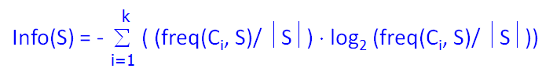
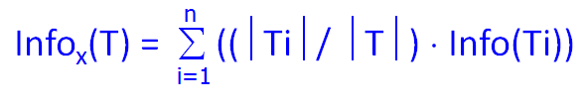

Working background
All the previously listed algorithms work on the basic principle of Information gain
The attribute which yields highest information gain is chosen as the root of decision tree and child's so on and so forth

Slide 6
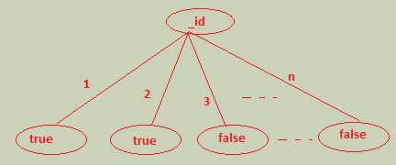
Which one to choose?
ID3 algorithm favors attributes with more possible outcomes over the attributes with fewer possible outcomes
In our case, _id attribute in training data set
This is the extreme case, in which each outcome of the attribute test covers only one instance in the dataset
C4.5 uses same strategy of ID3 with gain ratio as an added feature for the attribute selection criteria to be used when branching
So, we decided to go with C4.5 algorithm

Slide 7
language and choice of libraries
We choose Java for building classifier and predicting results
However, with the choice of libraries available in the market for Machine/Classification Learning, we did not have to write C4.5 algorithm from scratch
Popular available choices
Oracle’s Java Data Mining API’s (available in javax.datamining package) http://docs.oracle.com/cd/B28359_01/datamine.111/b28131/java_api.htm
Apache Spark (http://spark.apache.org/)
Apache Mahout (https://mahout.apache.org/)
WEKA (http://www.cs.waikato.ac.nz/ml/weka/)

Slide 8
Our choice - Weka
We choose WEKA for following reasons
Its accuracy in terms of predictions/classification
Scalability on massive data sets
Full fledged documentation and lot of code samples to start with
Developer support available online
Communities and stackoverflow responses
Awesome visualizations with WEKA tool
Lot of APIs and implemented algorithms
Flexibility to partition training data into training and test so that the algorithm can evaluate classification accuracy

Slide 9
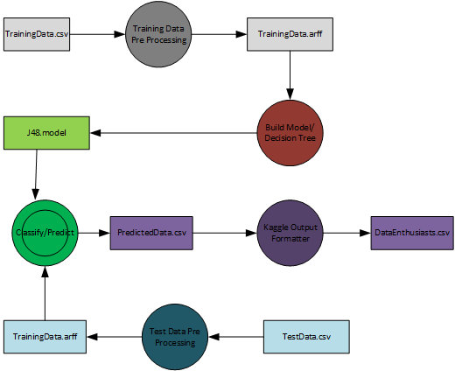
architecture

Slide 10
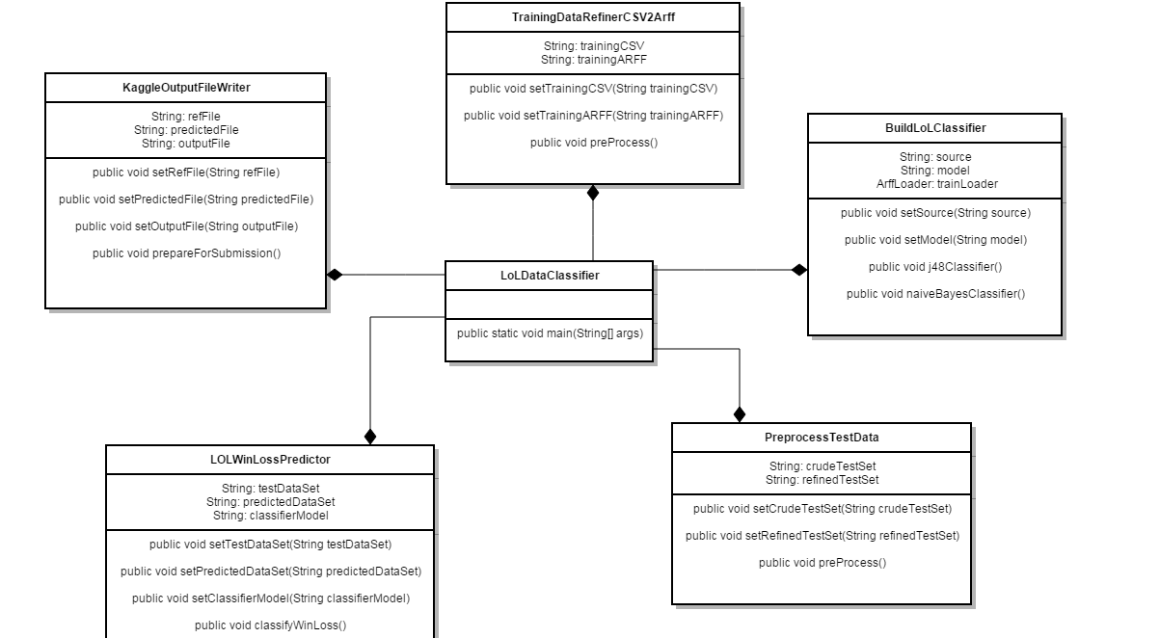
Class diagram

Slide 11
Attribute analysis
Though we are using WEKA for classification, we first loaded data into MongoDB and did some ground work/attribute analysis stuff to check the range of values/unique values in each attribute
Following Attributes were ignored from Training Data Set during pre processing step itself, so that the model built would be more accurate – Noise Elimination
_id, version, region attributes are removed/ignored through out our data

Slide 12
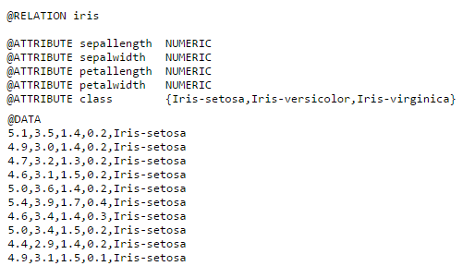
Pre-processing (.csv to .arff)
WEKA understands data in a specific format known as Attribute Relational File Format – ARFF
Sample ARFF file looks like

Slide 13
..continued
The training data set provided has missing values as empty strings
Weka expects missing values to be ‘?’
Also, the strings are to be placed in quotes
All this is done by TrainingDataRefinerCSV2Arff.java

Slide 14
Data Mining (build model, save and classify)
After the training data set is transformed into WEKA supported ARFF format
Load the instances (i.e. each record/transaction), represented by weka.core.Instances class
Now, set the class index (starts with 0) of the attribute we want to build the classifier/decision tree for
Instantiate appropriate classifier (weka.classifiers.trees.J48 in this case)
Turn on debugger if needed
Set/Unset pruning flag on the classifier
Build Classifier by invoking weka.classifiers.trees.J48.buildClassifier(Instances) method
After the model/classifier is built, save it for future use. Building a classifier/model is costly operation – in terms of memory and time

Slide 15
Pre-processing test data
Same as training data, test data has missing values, which would result in error during classification
So, data is cleaned in the same way we did earlier for training data set
Test data in CSV form is converted to ARFF
All those attributes excluded in training data set are removed from test data set as well. Otherwise, there would be various errors in classification result

Slide 16
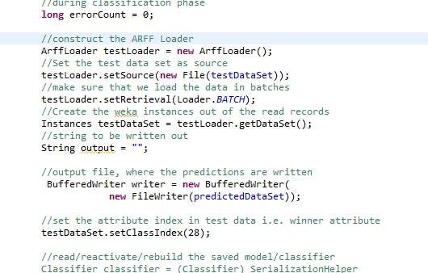
Classification/prediction
Load the test instances using weka.core.converters.ArffLoader class
Set the test data source
Better to load data in batches
Set the class index (position of winner attribute in test data set)

Slide 17
..continued
Reactivate the saved classifier
Iterate through all the instances
Pass the record to be classified to Classifier.classifyInstance(instance) method
The value returned would be the index of class label
Since winner is {true, false}
Returned value would be either 0/1
Write the classified results to a file

Slide 18
Post Processing (output in kaggle format)
The output file generated in previous step would have the value for winner attribute, in addition to all the values previously contained in the test data set
However, this is not the format of file to be uploaded to Kaggle
The generated ARFF file is processed and only the _id & winner attribute are extracted to a CSV file to be uploaded to Kaggle

Slide 19
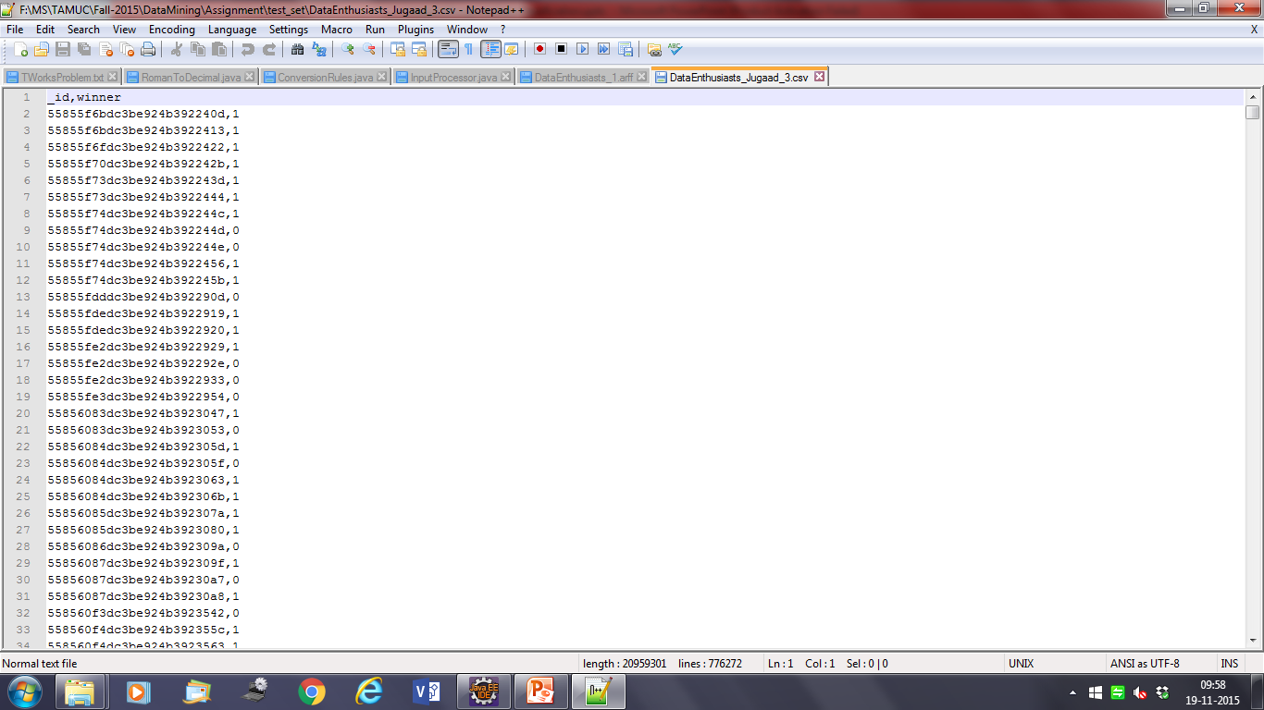
results

Slide 20
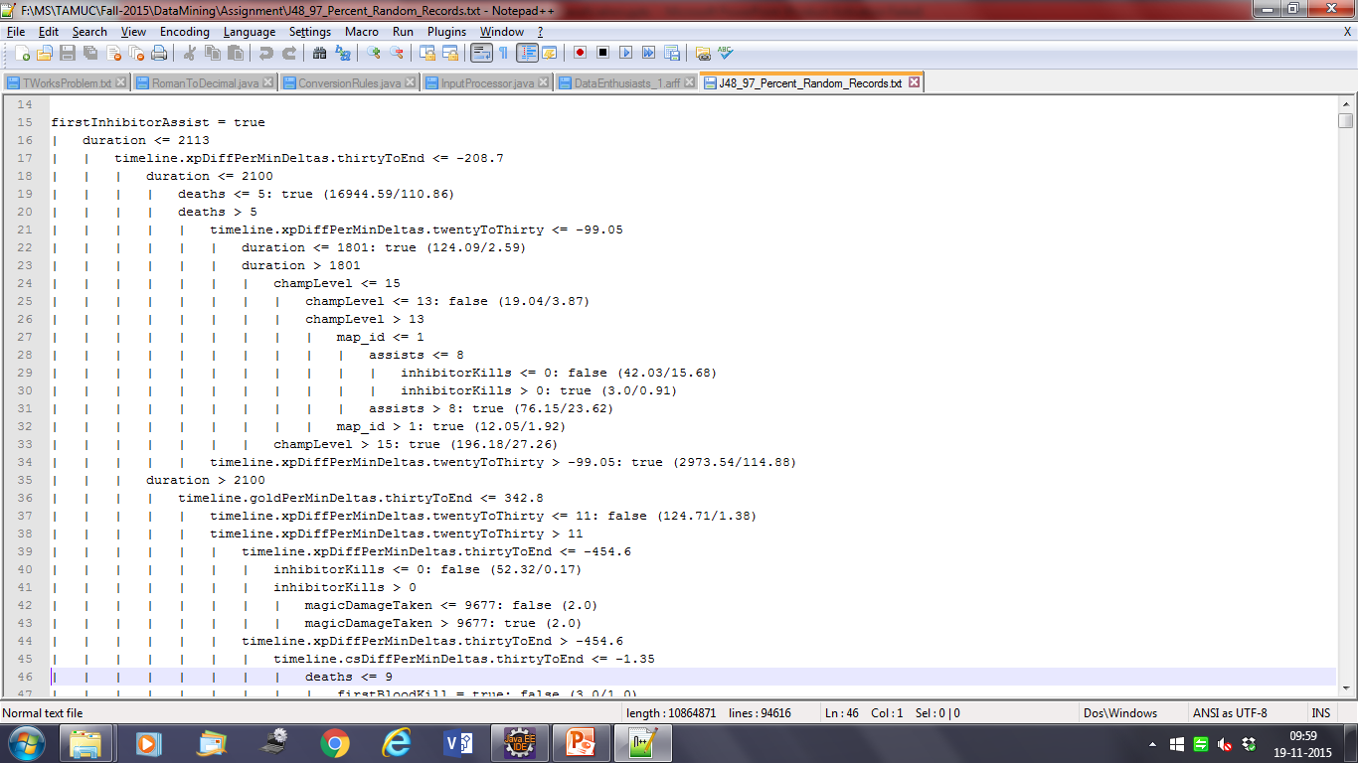
Decision tree generated

Slide 21
rules
Class: true
“If firstInhibitorAssist is true and duration is less than 2113 seconds and timeline.xpDiffPerMinDeltas.thirtyToEnd is under -208.7 and less than 5 deaths”
Class: false
“If firstInhibitorAssist is true and duration is less than 2113 seconds and timeline.xpDiffPerMinDeltas.thirtyToEnd is under -208.7 and more than 5 deaths and champion level under 13”

Slide 22
Source code

