Slide 1

SELF-PLAY REINFORCEMENT LEARNING · IMPERFECT-INFORMATION GAMES
AlphaHoldem-inspired self-play RL
for Heads-Up No-Limit Hold'em
From-scratch PyTorch self-play agent · evaluation harness with behavior gates · exact-exploitability study on Leduc
Sanil Desai · PyTorch · OpenSpiel · single GPU

Slide 2
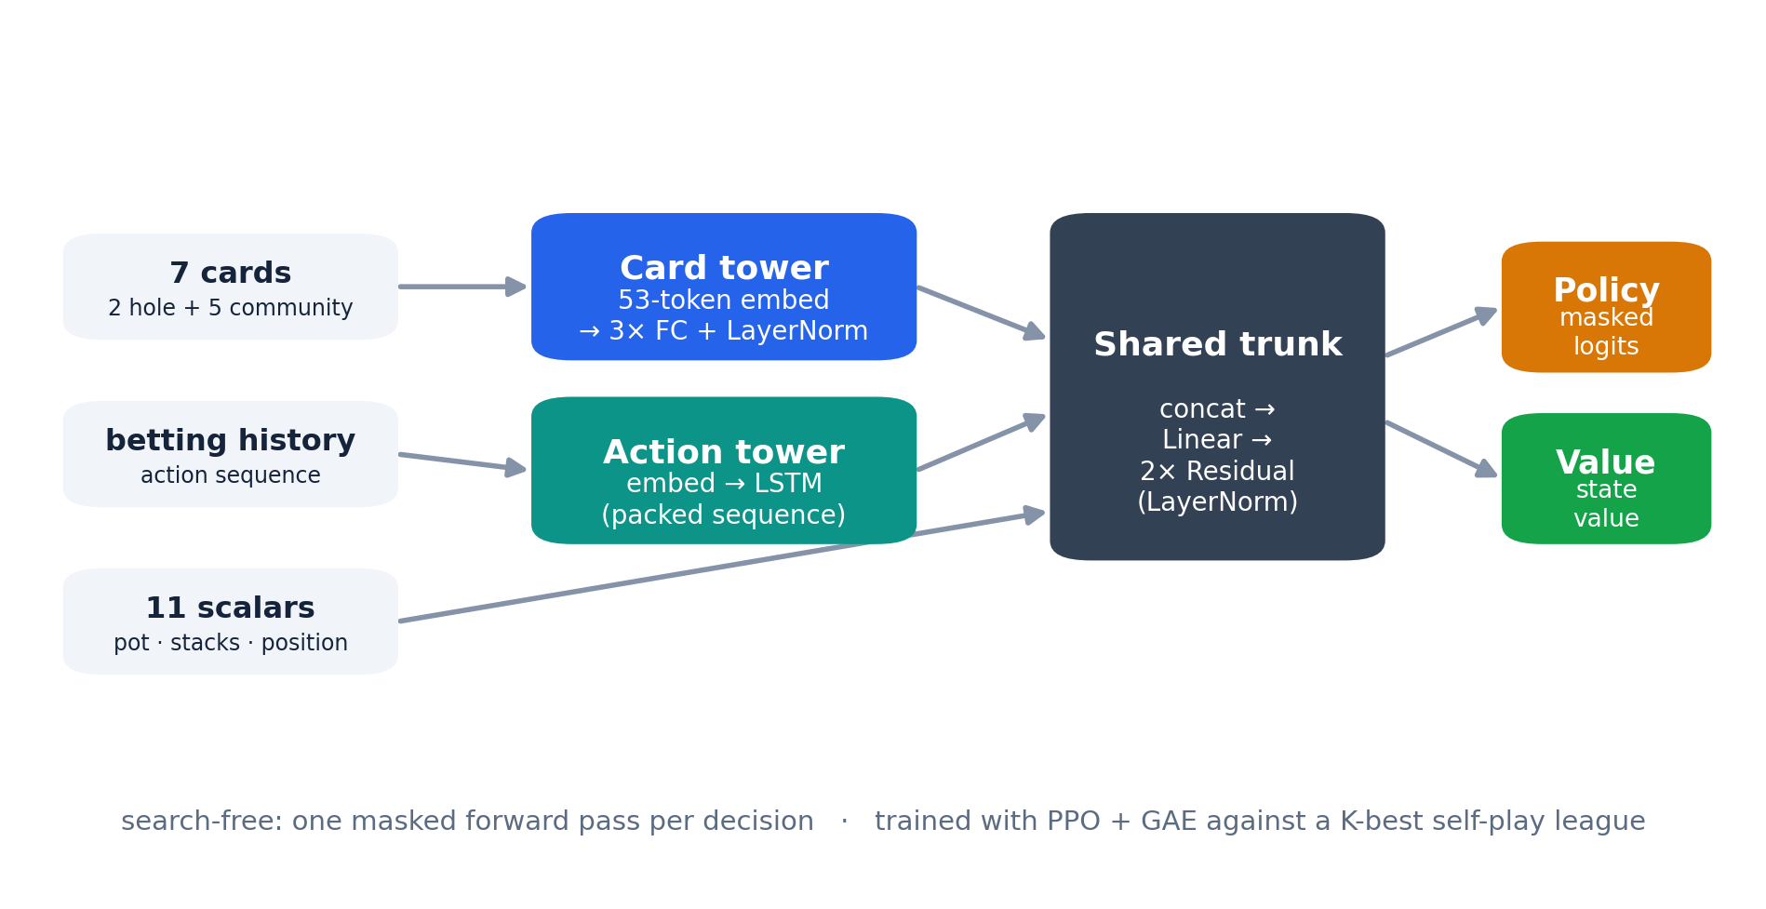
ARCHITECTURE
Pseudo-siamese two-tower actor–critic, ~1.5M parameters.
PPO + GAE · K-best self-play league · FCPA (4) / FCHPA (5) abstraction · OpenSpiel · single GPU
Sanil Desai · AlphaHoldem-inspired self-play RL for Heads-Up No-Limit Hold'em
2

Slide 3
SCOPE
Inspired, not reproduced.
Axis | AlphaHoldem (paper) | This repo
Card / action input | multi-channel tensors → ConvNets | 53-token embedding → MLP / LSTM
Loss | Trinal-Clip PPO | clipped PPO + Huber value
Self-play | top-K by Elo | top-K rolling + rating-temperature sampling
Game scope | abstraction-free full game | FCPA (4) / FCHPA (5)
Inference | search-free, single forward pass | search-free, single forward pass ✓
Parameters | ~8.6M | ~1.5M
Sanil Desai · AlphaHoldem-inspired self-play RL for Heads-Up No-Limit Hold'em
3

Slide 4
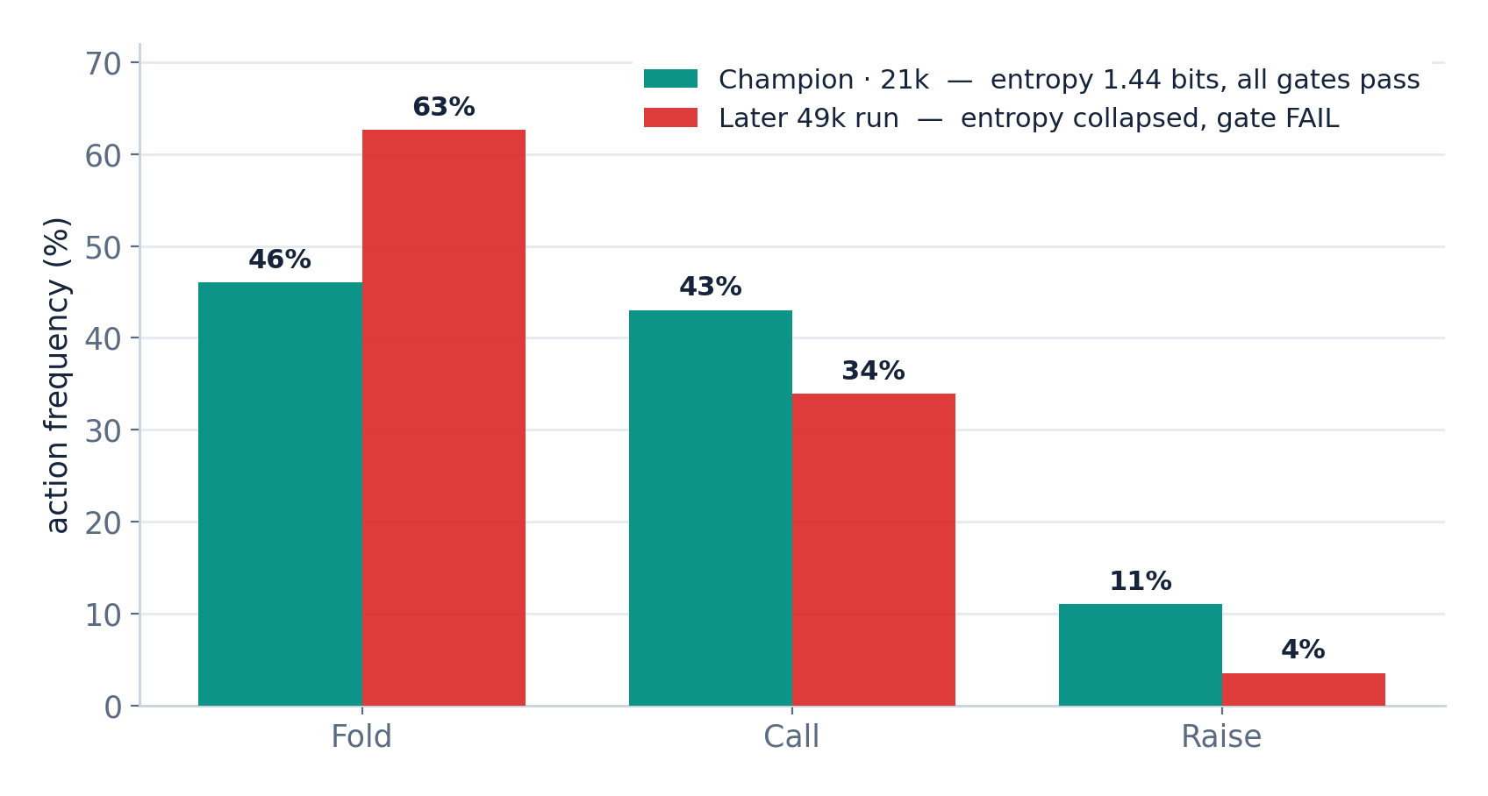
EVALUATION
Behavior gates gate promotion — and caught a policy collapse.
Envelopes on fold frequency, aggression, entropy, and bet-size mix. A later 49k run scored well on win-rate but collapsed to fold-heavy play; the gates blocked it.
Sanil Desai · AlphaHoldem-inspired self-play RL for Heads-Up No-Limit Hold'em
4

Slide 5
BASELINE
“+897 bb/100 vs MCCFR-ES” is vs a near-random control.
+970
+898
+934
vs 0-iteration uniform (random) · bb/100
vs 5k-iteration “solver” · bb/100
vs 10k-iteration “solver” · bb/100
The uniform (0-iteration) control scores highest — adding “solver” iterations makes the opponent easier, not harder. The MCCFR-ES baseline is near-random; the figure is a sanity check, not strength, and is never placed next to AlphaHoldem’s +11 mbb/h.
Sanil Desai · AlphaHoldem-inspired self-play RL for Heads-Up No-Limit Hold'em
5

Slide 6
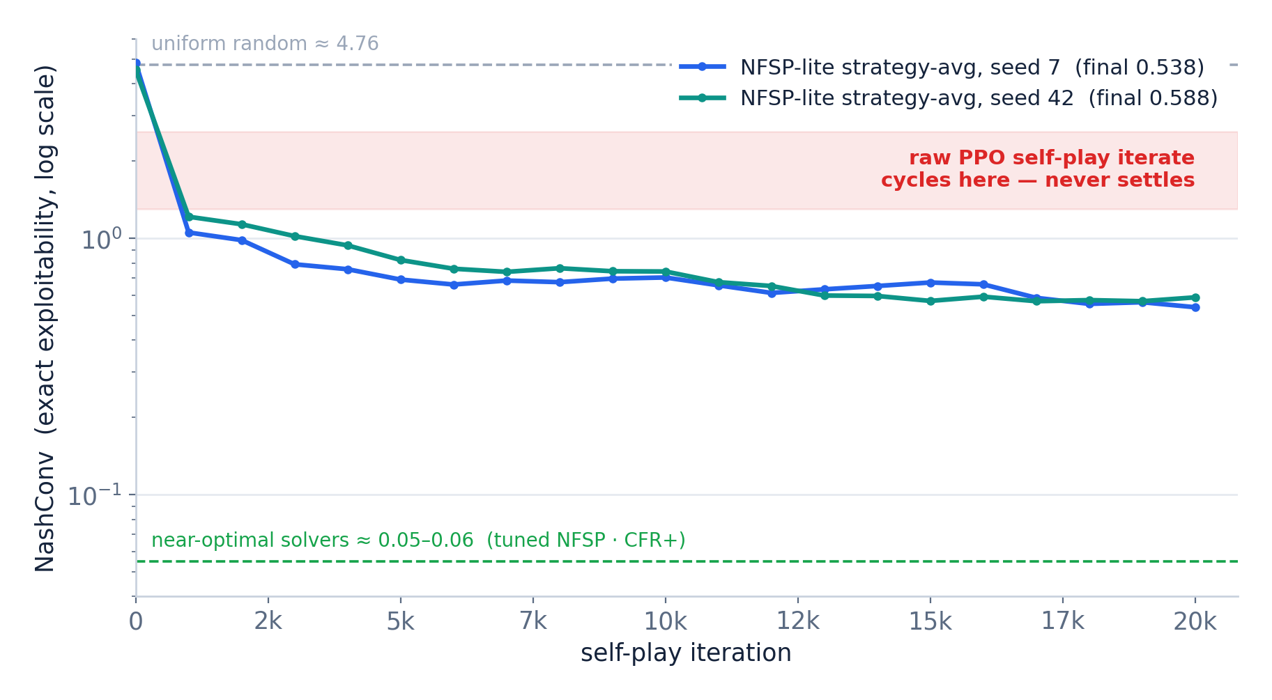
EXPLOITABILITY
Leduc (exact NashConv): the iterate cycles; strategy-averaging plateaus ≈ 0.56.
HUNL exploitability is intractable (~10¹⁶¹ info sets), so the same recipe is probed on Leduc (936 states, exact).
Sanil Desai · AlphaHoldem-inspired self-play RL for Heads-Up No-Limit Hold'em
6

Slide 7
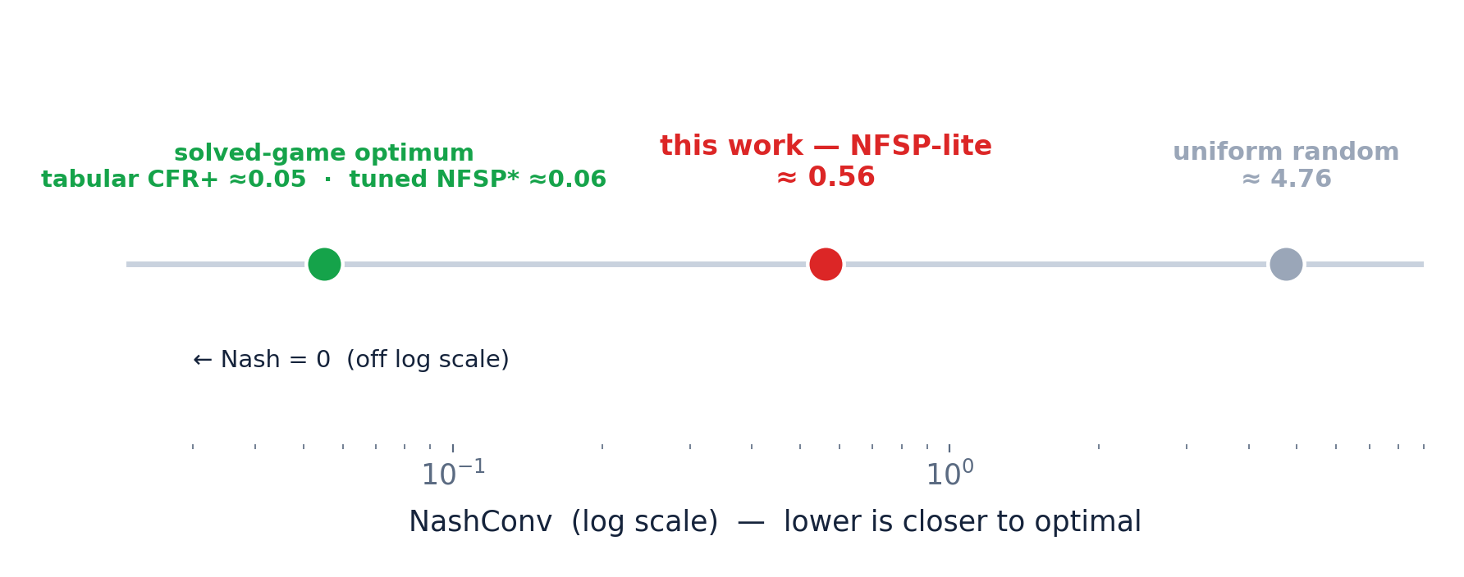
CALIBRATION
≈8× below random, ≈9× above tuned NFSP — methodology, not magnitude.
Sanil Desai · AlphaHoldem-inspired self-play RL for Heads-Up No-Limit Hold'em
7

Slide 8
ALPHAHOLDEM
“Convergence” is not low exploitability.
AlphaHoldem reports loss flattening, Elo plateau, and win-rate (+111.6 mbb/h vs Slumbot). It never computes exploitability.
Win-rate ≠ exploitability — Lisý & Bowling: two bots tied head-to-head (~20 mbb/g) yet ~1300 mbb/g apart in exploitability.
The Leduc study is the test HUNL cannot run — not a failed reproduction.
Sanil Desai · AlphaHoldem-inspired self-play RL for Heads-Up No-Limit Hold'em
8

Slide 9
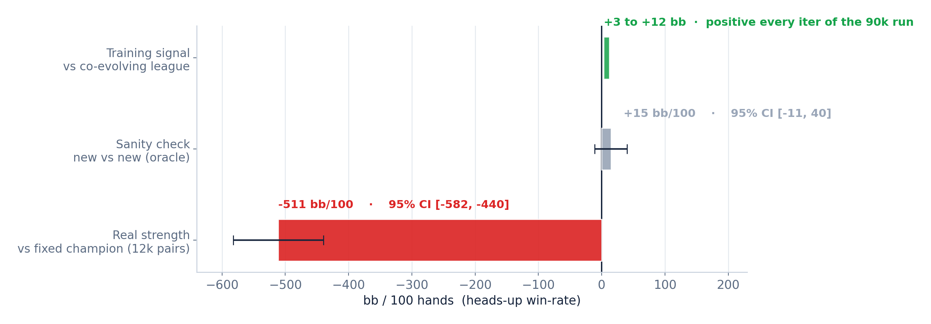
SCALED RUN
Regressed −511 bb/100 against the champion it started from.
90k GPU iterations (~9×10⁷ hands) · vectorized collector (30–100×) · PFSP fix · Trinal-Clip · warm-started from the 21k champion
Sanil Desai · AlphaHoldem-inspired self-play RL for Heads-Up No-Limit Hold'em
9

Slide 10
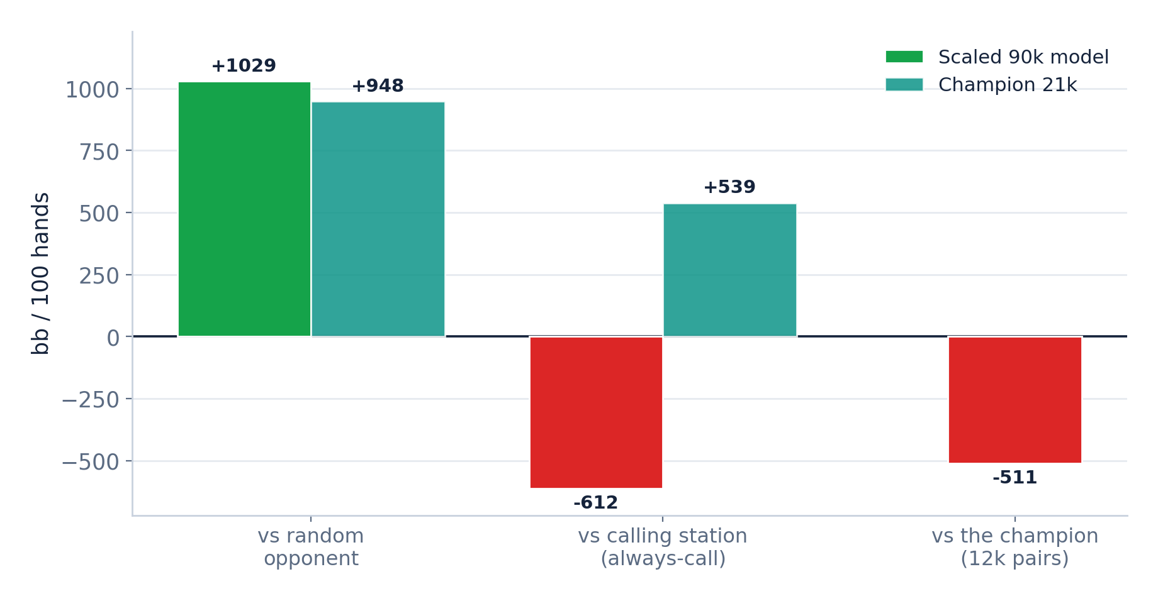
DIAGNOSIS
Over-aggression drift, not collapse.
No calling opponents in the training mix; the co-evolving league learned to fold to aggression.
Sanil Desai · AlphaHoldem-inspired self-play RL for Heads-Up No-Limit Hold'em
10

Slide 11
LIMITATIONS
Strong-but-exploitable, measured carefully.
Not near-Nash, not a record win-rate.
Throughput gap vs AlphaHoldem (~2.7B hands, 8 GPUs, 3 days) is not closeable solo.
The champion remains the strongest model; the scaled run was a negative result.
txhm-poker-api.onrender.com · github.com/smdesai27/TxhmPokerAgent · Sanil Desai

