Slide 1
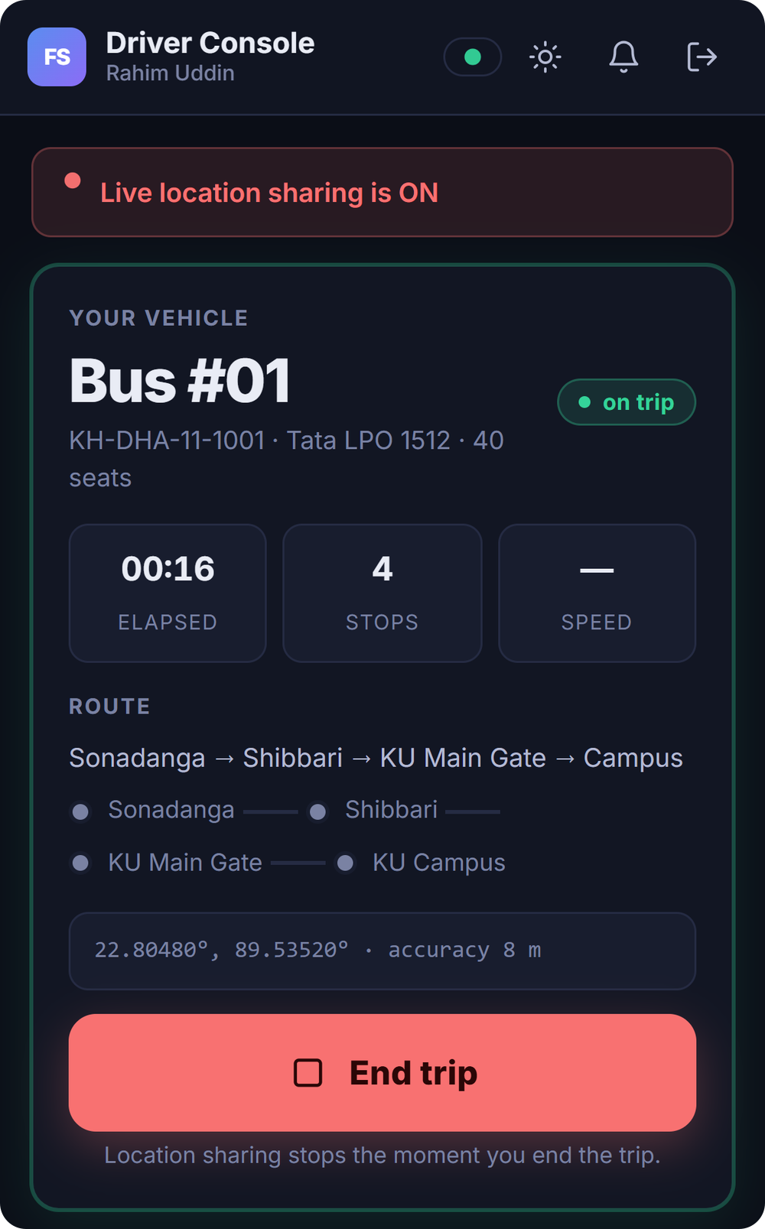
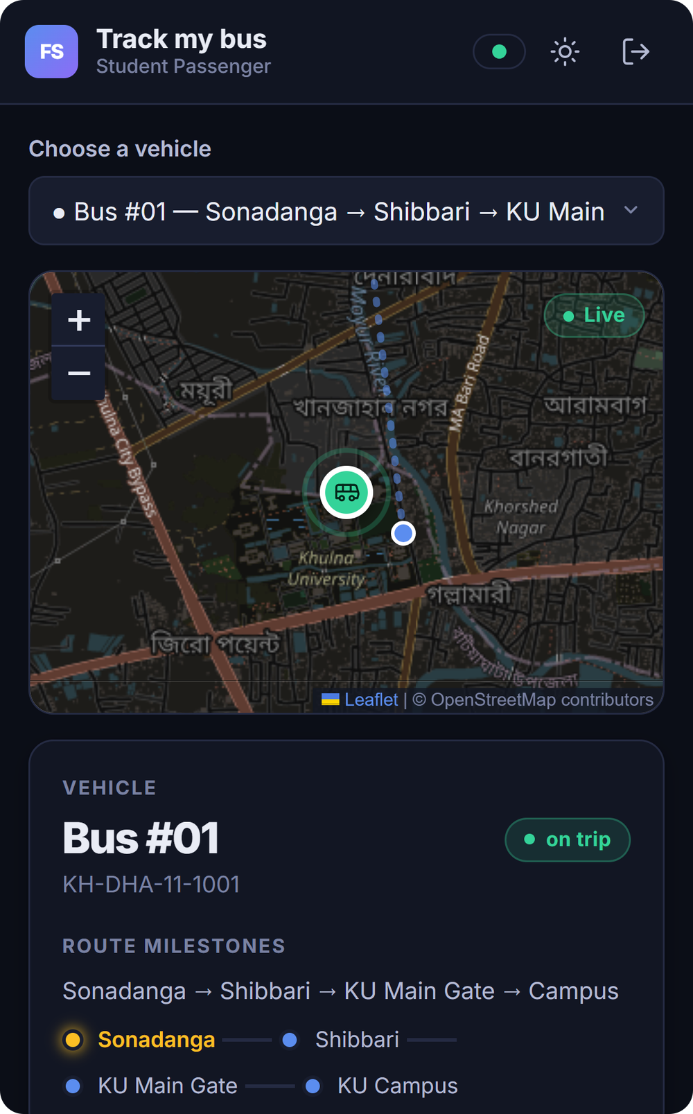
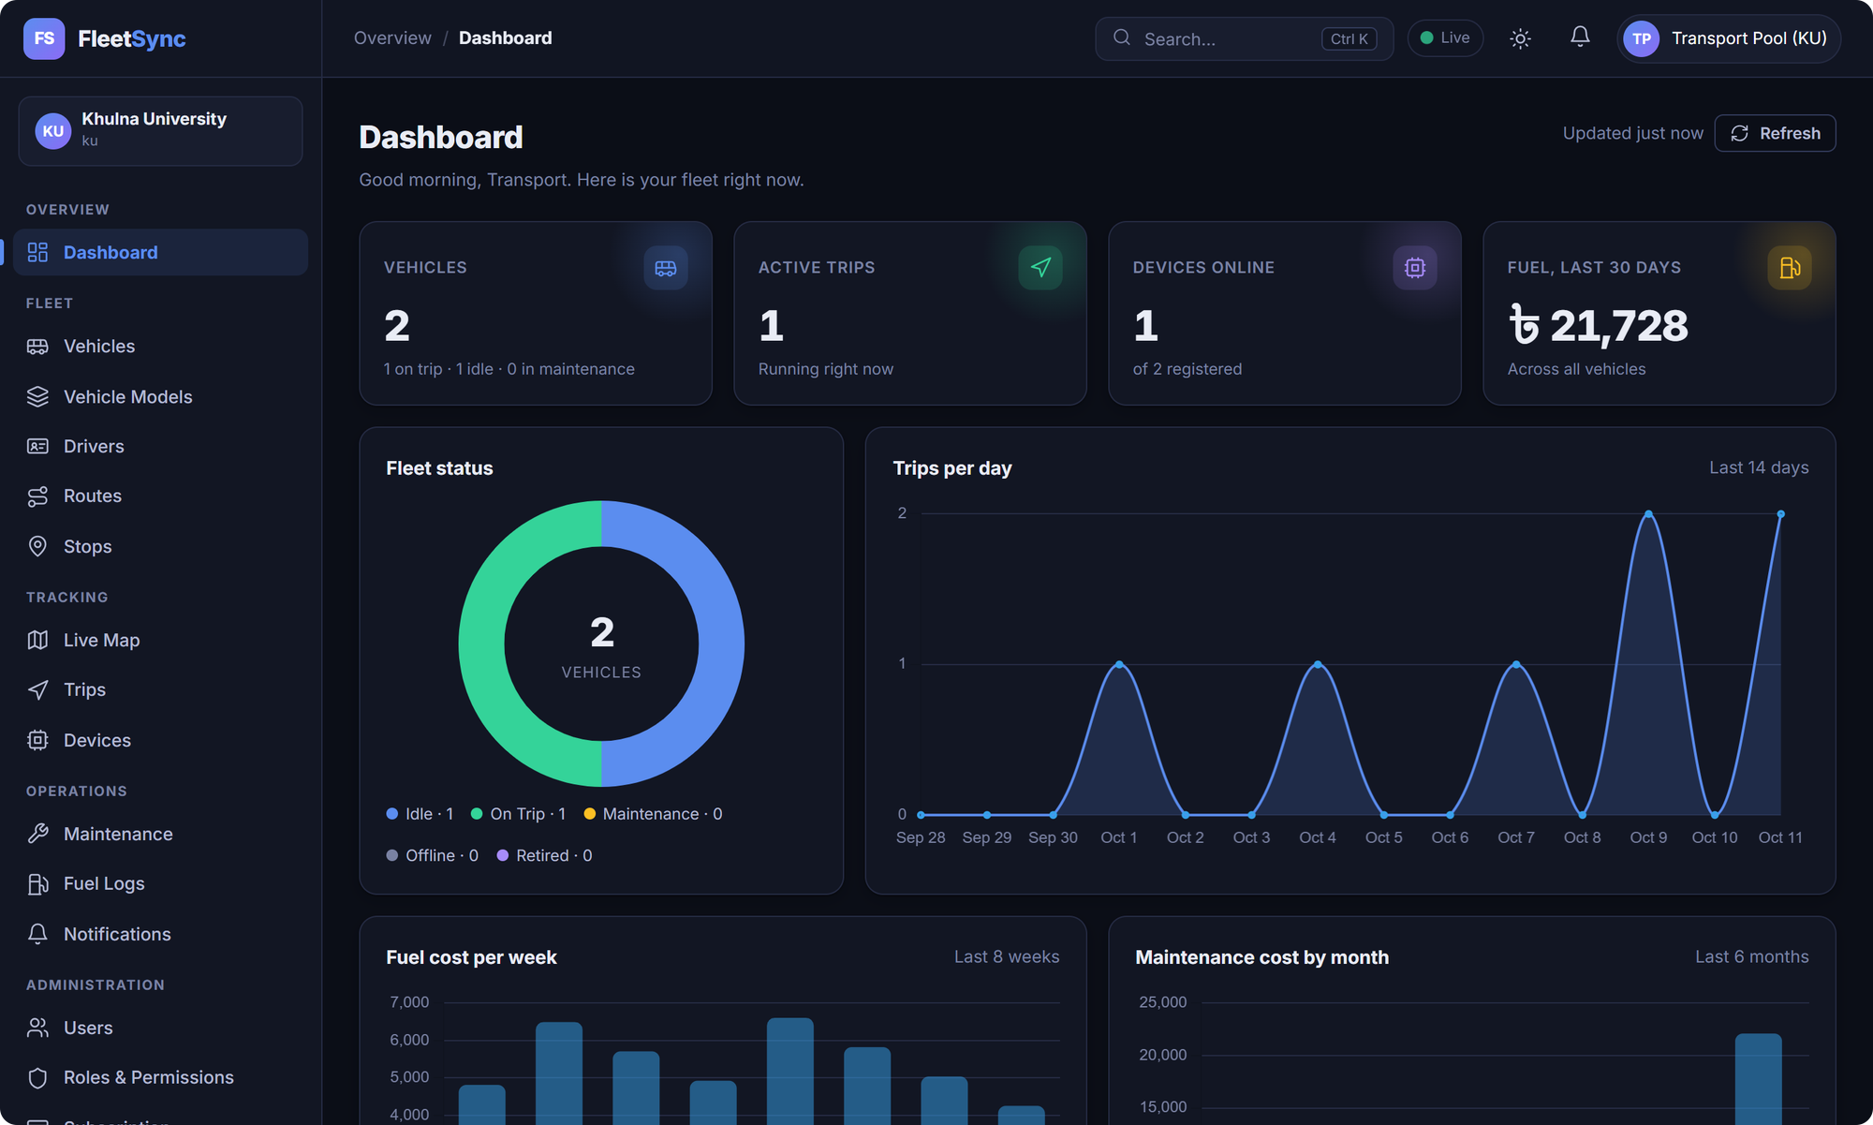
POSTER PRESENTATION ON WEB PROGRAMMING AND MOBILE APPLICATION DEVELOPMENT PROJECT
FleetSync
A Multi-Tenant SaaS Platform for Real-Time Vehicle Tracking and Fleet Management
Sidratul Muntaha (210208) · G M Amanullah (220225)
drik2108@cseku.ac.bd · gmamanullah21@gmail.com
Supervisor: Dr. Kazi Masudul Alam, Professor
Computer Science and Engineering Discipline
Khulna University
Abstract
Introduction
Problem Statement
Institutions still track vehicles with phone calls and spreadsheets, while commercial telematics needs dedicated hardware. FleetSync is a self-service, multi-tenant SaaS platform that tracks vehicles live using only the driver’s smartphone. A Node.js API with JWT roles keeps each tenant’s data isolated, WebSockets push updates instantly, and PostgreSQL/PostGIS stores trips and GPS points. A GPS fix reached the passenger in a median of 9 ms, and all 73 API tests passed.
Campus buses, delivery vans and office shuttles move people every day, yet riders rarely know where their vehicle is. Samsara and Geotab serve large enterprises with in-vehicle hardware. FleetSync targets everyone else: the driver’s phone becomes the tracker, and each institution gets its own isolated workspace.
Riders can’t see where the vehicle is.
Route and driver changes arrive late.
Trackers are costly; always-on phones hurt driver privacy.
Shared systems must keep each tenant’s data apart.
Objectives
Multi-tenant
Three roles
No hardware
Real-time
Private
Operations
Isolated data per institution
Authority, driver, passenger
GPS from the driver’s phone
Instant sync over WebSockets
Tracking only during a trip
Maintenance, fuel and alerts
Methodology
Node.js + Express
JWT + bcrypt
PostgreSQL + PostGIS
WebSockets (ws)
Leaflet + OSM
1
5
DRIVER APP
SERVER (Node.js)
PASSENGER APP
AUTHORITY CONSOLE
Auth & tenant guard
JWT, roles, tenant scope on every query
2
REST API
Express, /api/v1, 63 endpoints
3
WebSocket engine
Rooms per institution and vehicle
4
PostgreSQL + PostGIS
21 tables, Prisma ORM: trips, GPS logs, live positions
1
Driver taps Start trip.
2
Phone sends a GPS fix (HTML5 Geolocation).
3
API checks role, tenant and active trip, then saves the point.
4
WebSocket engine pushes location.update.
5
Passenger and authority maps move. End trip stops sharing.
Dataset & test setup. Seeded multi-tenant data: 3 institutions, 10 users, 4 drivers, 4 vehicles, 4 routes (12 stops), trips with GPS history, fuel and maintenance logs. API and PostgreSQL 18 / PostGIS 3.6 ran on one laptop (Core i7-10510U, 8 GB RAM), so timings exclude mobile-network delay.
Experimental Results
9 ms
median GPS delay, driver to passenger
40 / 40
GPS updates delivered live
73 / 73
API tests passed (17 on tenant isolation)
≈525/s
requests/s, 700/700 OK at 100 clients
Privacy check: 20 of 20 GPS uploads from an off-duty driver were rejected. Throughput levels off near 525 req/s, then latency grows linearly. Login takes 77 ms by design (bcrypt).
Conclusion and Future Work
Source Code
FleetSync shows that a phone-based, multi-tenant platform can deliver live tracking and instant updates without dedicated hardware. Every query is tenant-scoped, and tracking is tied to an active trip.
Next steps
Android app with background GPS
ETA prediction from trip history
Offline GPS buffering in weak signal
Cloud deployment and field testing
Scan the QR code or visit
github.com/smdrik007/FleetSync

