Slide 1


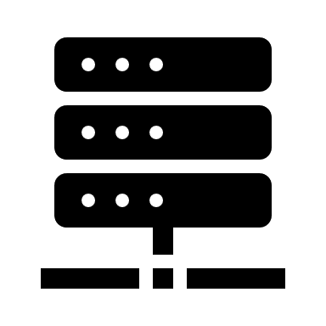

Slide 2
Clients
Storage Nodes
Application
Gestalt Server Process
Per-Thread
Server Heartbeat
Gestalt Client Library
③ Establish
RDMA RC
RDMA Conn. Mgmt.
RDMA Conn. Pool
Bucket Migration
Data Locator
Gestalt Client
Library
② Get bucket
placement
I/O Interface
Space Allocation
① Get cluster topology
③ one-sided
RDMA
Mapped PM Space
Gestalt Cluster
Monitors
Bucket Replica
Gestalt Cluster Mgmt.
Cluster Topology
Cluster Monitoring
...
Pooled PM with RDMA Network

Slide 3

Write-Lock
Update-Primary
Update-Replicas
Write-Unlock
Client
Primary Replica
2nd Replica
3rd Replica
Old data
One-sided Verbs
Persistent Write
New data
CAS
ACK
Write-locked
*Strictly not fault tolerant, no matter how many replicas, for we have only 2 non-atomic update steps/batches, a primary fail will lead to data loss.
(But replica updates, as long as they don’t fail, will complete anyway, so it’s actually okay?)
**For strict n-fault-tolerant, 2*(n+1) replicas are required, (n+1) parallel updates in both steps.

