Slide 1
Portable Electrocardiogram
Stevan Dupor
Peter Gadfort
Johns Lang

Slide 2
Overview
Automation
Portability
Cost

Slide 3
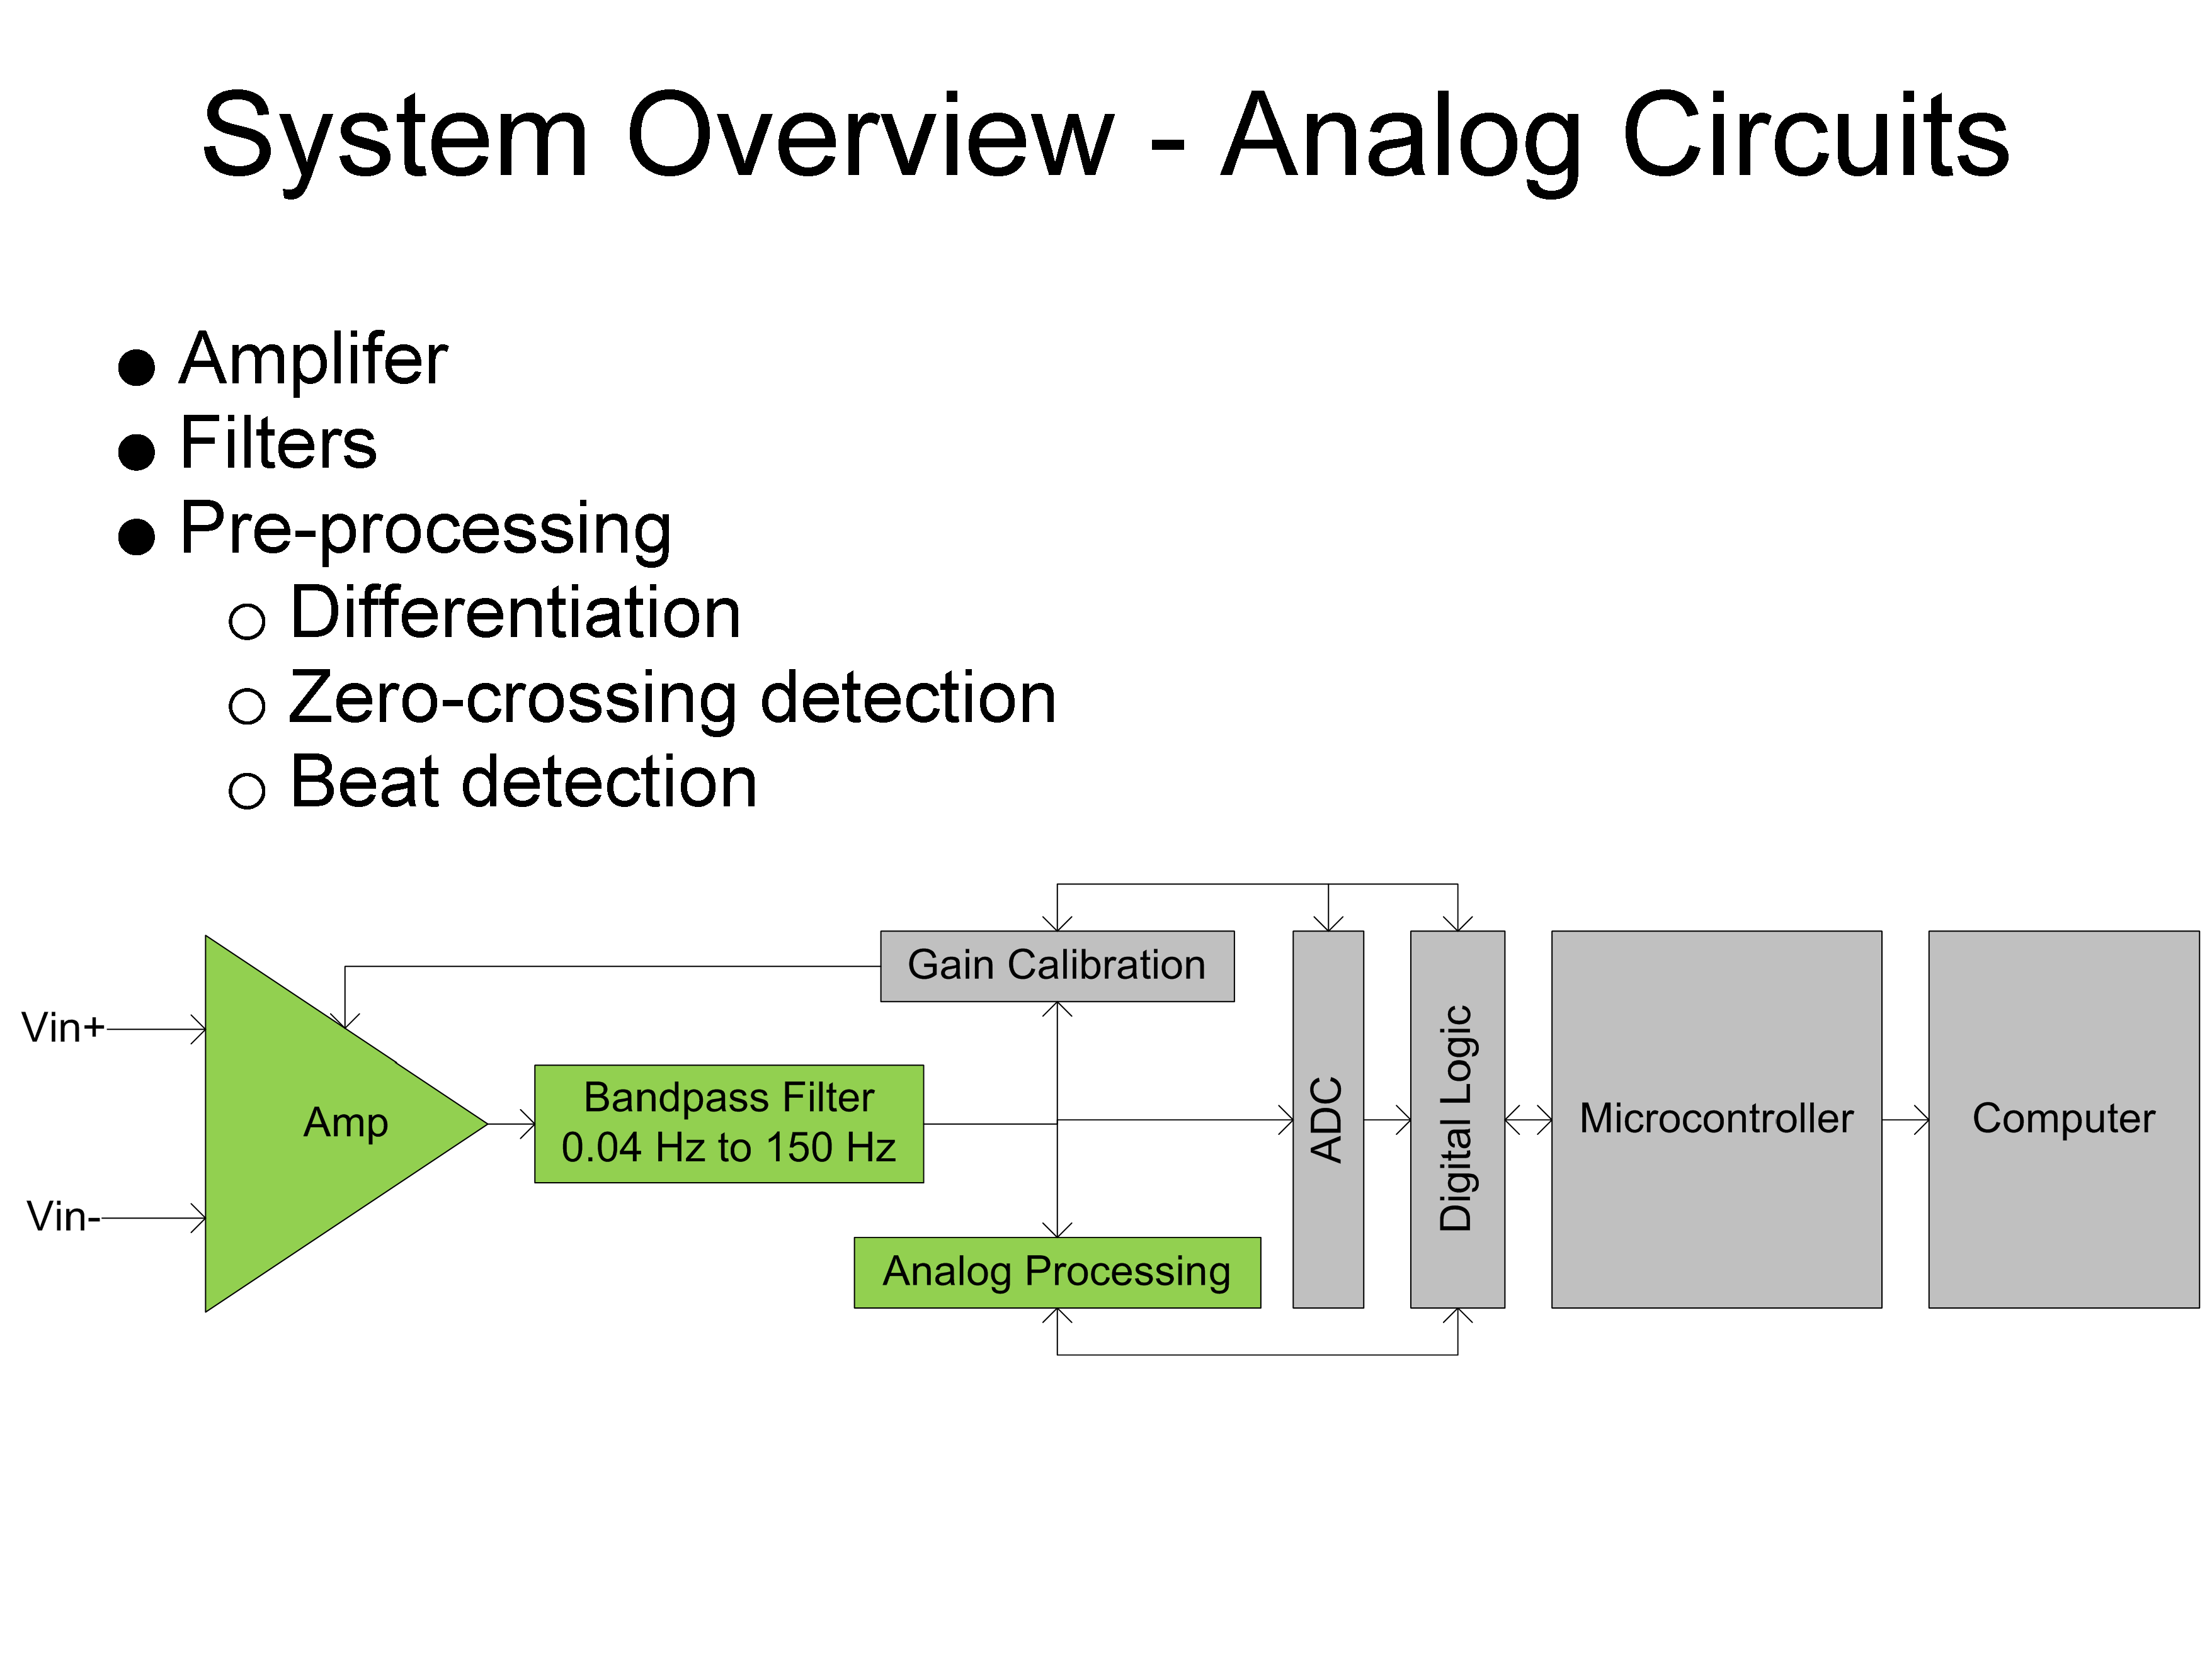

Slide 4
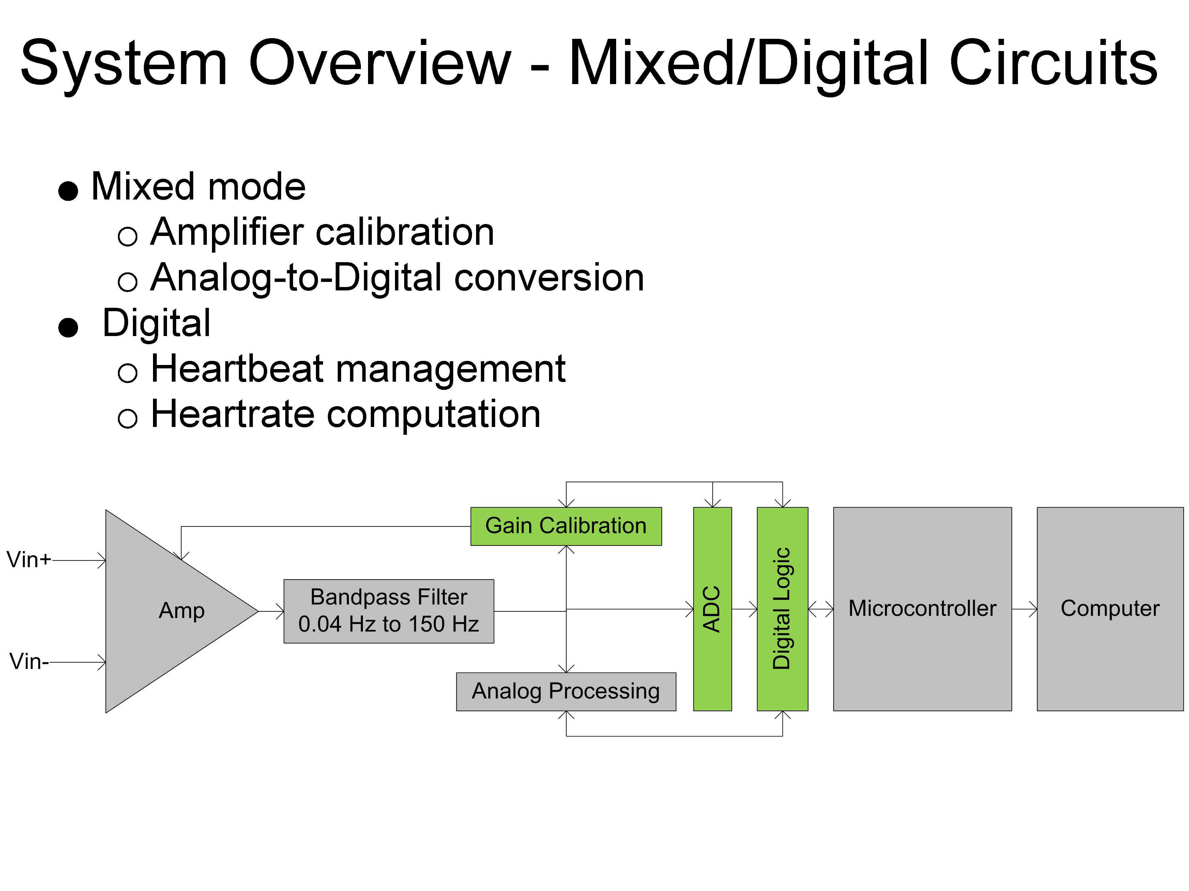

Slide 5
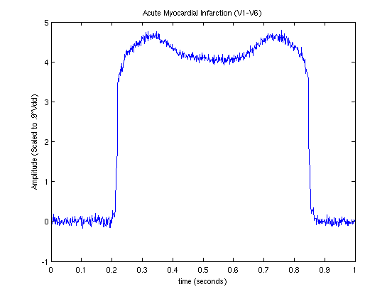
Algorithm

Slide 6
Algorithm

Slide 7
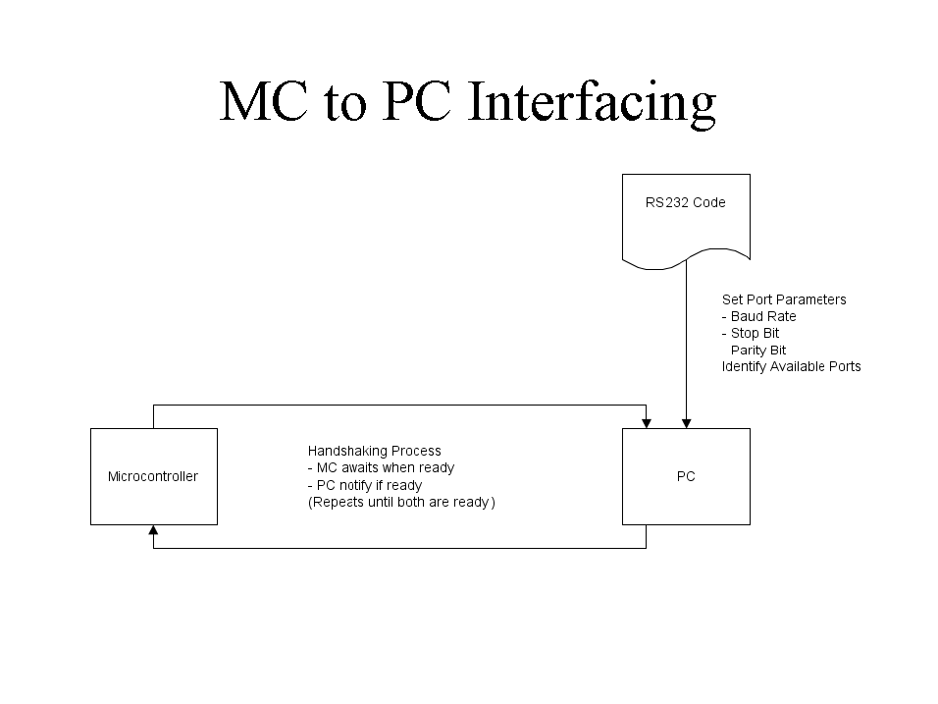

Slide 8
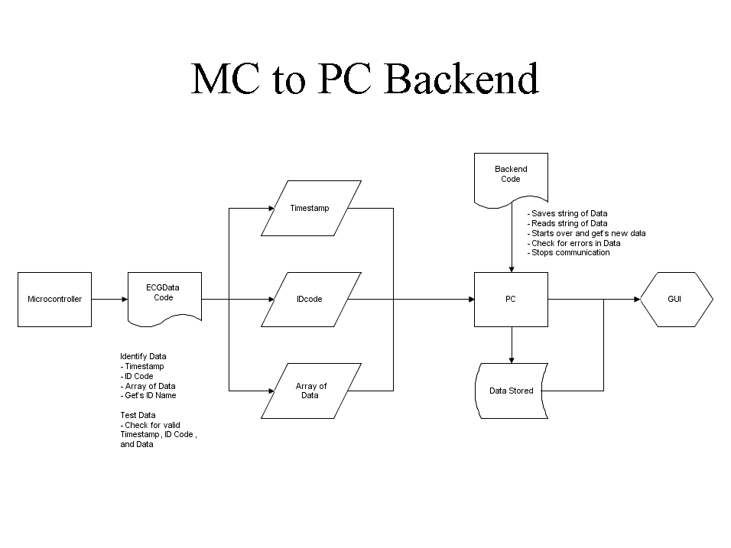

Slide 9
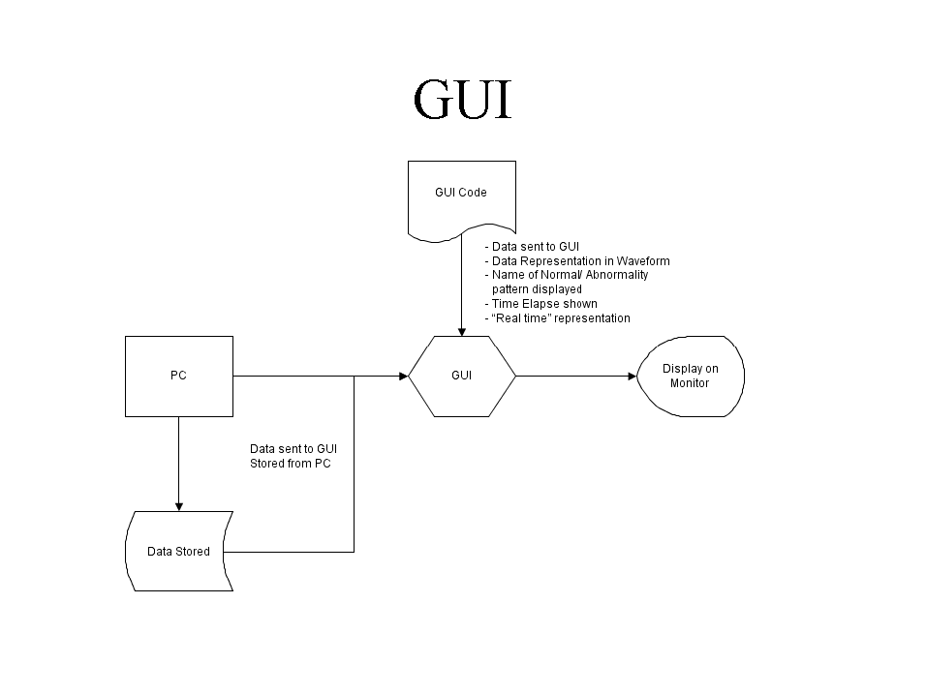

Slide 10
Project Plan Overview

