Slide 1
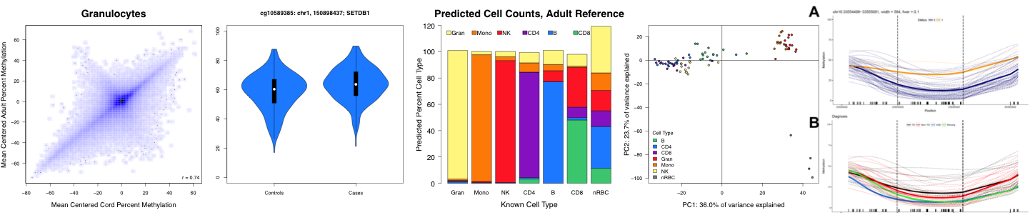

EPID 674 Epidemiologic data analysis in R Kelly M. Bakulski, Ph.D. Research Assistant Professor Department of Epidemiology
January 10, 2018
Exploring data with R

Slide 2
Attendance logistics
Pass/fail class
Emphasis on learning to code, not on numeric grade
Everyone should attend all class sessions
Only need to notify if circumstances change and sustained absences (2+)
7 sessions, each session is 14% of class time, and attendance at each is ~4% of your grade

Slide 3
Common homework mistakes
Include both code and your answers in a Word or PDF file.
Boiling pt of water in F
CORRECT: 9/5*100+32 = 212
INCORRECT: 5/9*100+32=87.56
1²+….+100²
CORRECT: sum(z^2) = 338,350
INCORRECT: sum(z*2) = 10,100

Slide 4
What did we learn last time?

Slide 5
Overall review
Functions are your actions (verbs) in R
Functions come from user supplied packages/libraries
Objects hold your data and can have many shapes (vector, matrix, dataframe, list)

Slide 6
Review: Loading a package
Reminder: you only need to run install.package(“packagename”) the first time
Every time, run library(packagename)
Ex.
library(foreign) #imports data created in other programs
Library(Hmisc) #useful exploring data

Slide 7
Installing a package from a website
install.packages(“webaddress”, repos=NULL)
> install.packages("https://cran.r-project.org/src/contrib/Archive/epicalc/epicalc_2.15.1.0.tar.gz", repos=NULL)
> library(epicalc)

Slide 8
Review: Prep your working directory
See where your current working directory is: getwd()
Change it: setwd(“filepath”)

Slide 9
Reading in a data file
Function used depends on the data file type
Where you likely made the data | Data extension | Function | Library
SAS | .xport | read.xport() | foreign
SAS | .xport | sasxport.get() | Hmisc
SAS | .sas7bdat | read.sas7bdat() | sas7bdat
Excel, SAS | .txt | read.table() | utils (base)
Excel, SAS | .csv | read.csv() | utils (base)
STATA | .dta | read.dta() | foreign
SPSS | .sav | read.spss() | foreign

Slide 10
Review: Remember to give the object you’re reading a name
> library(sas7bdat)
> read.sas7bdat("nhanes3.sas7bdat")
Versus
> nhanes3b <-read.sas7bdat("nhanes3.sas7bdat")
> names(nhanes3b)

Slide 11
Saving data
Once you read an external dataset, helpful to save as an R dataset for future
> save(nhanes3, file="nhanes3.rda")
> load("nhanes3.rda")

Slide 12
Save data for use in another program
> write.table(nhanes3, file="nhanes3.txt")
> write.csv(nhanes3, file="nhanes3.csv")

Slide 13
Every time you load an object, check it out!
Always want to know:
What type of object?
How big is it? Length? Dimensions? Rows? Columns?
Do it’s features have names? Column names? Row names?
What does the top corner look like? Top row? Bottom?

Slide 14
Useful exploring functions
Function | Purpose
str() | Summarize object structure
attributes() | Lists object attributes
class() | Class of object
length() | Length of object
dim() | Dimensions of object
nrow() | Number of rows
ncol() | Number of columns
Note: can run these on the entire dataset or on an individual variable.

Slide 15
Find out the names of your variables, subjects
Function | Purpose
names() | Object names
dimnames() | Vector of names for each dimension
rownames() | Names of rows
colnames() | Names of columns
row.names() | Names of rows

Slide 16
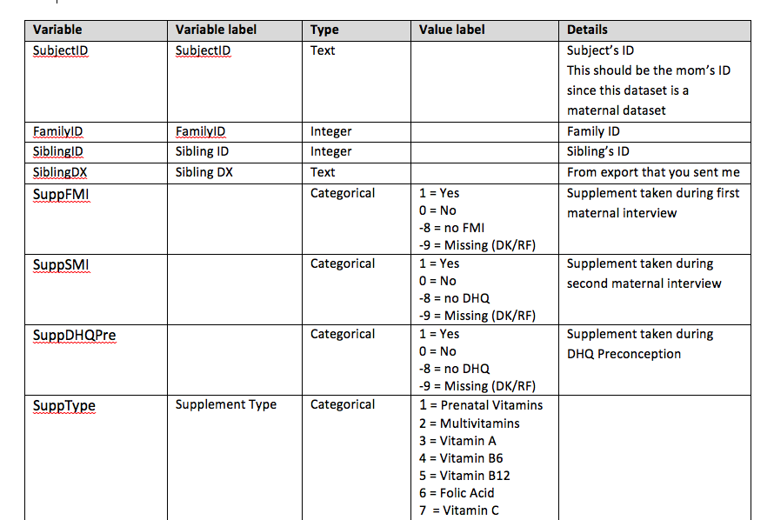
Data dictionaries

Slide 17
Best practices: Data dictionaries
Explains variable names, definitions, and units
In SAS: data label and proc format
In R, typically stored out of the program (excel, word, pdf)

Slide 18
Indexing data objects
Reminder: use [] when looking inside an object. Numbers are positional.
Vectors
> object[4] #shows contents of position 4
> object[3:7] #shows contents of positions 3 through 7
Matrices: object[row,column]

Slide 19
Data for this class
Objective: examine association between blood lead levels and blood pressure and hypertension in general US adults.
References (pdfs on Canvas)
Den Hond et al., The relationship between blood pressure and blood lead in NHANES III. J Human Hypertension 2002;16:563-568.
Vupputuri et al. Blood lead level is associated with elevated blood pressure in Blacks. Hypertension 2003;41:463-468.
Dataset includes 5,064 adults (20 or older) randomly selected from NHANES-III and is created for this class
For simplicity, only White and Black people included
Various confounding factors: such as education, smoking, and serum and dietary calcium variables

Slide 20
Look at a section of the data set
> head(nhanes3) #first 6 lines
> nhanes3[1:6,] #equivalent
What if you have a cumbersome # of columns?
> library(abind)
> acorn(nhanes3)
> nhanes3[1:6,1:5]

Slide 21
Each variable, check it out!
Always want to know:
What type of variable? Categorical? Numeric?
What is the distribution in our population? (Univariate)
How does it compare to my other variables (Bivariate)

Slide 22
Looking at a single column at a time
Can use the numeric indexing: nhanes3[,4], but tricky to remember the index number of every column
Can use the variable name:
Format: dataframe$variable
> nhanes3$age
Attach the dataset and use only the variable names
> attach(nhanes3)
> age

Slide 23
Types of variables
typeof(variable)
Logical: TRUE, FALSE
Numeric: 4, 12.7, 37.89
Integer: 1, 3, 10
Character: “a”, “positive”, “female”
Factor: Specific levels, Ex. 0,1,2 or “male”, “female”

Slide 24
Useful numeric data exploring commands
Function | Purpose
summary() | 5-number summary
mode() | Mode
mean() | Mean
median() | Median
sd() | Standard deviation
quantile() | Default, 0, 25, 50, 75, 100%
IQR() | Interquartile range
summ() | Basic statistics of a data frame or variable

Slide 25
Take a random sample
Function: sample(x, size, replace=FALSE)
> samp<- sample(seqn,100)
> samp<- sample(seqn,100, replace=T)

Slide 26
Turn a numeric variable into a factor
> sex1 <- as.factor(sex)
What if your numeric vector has many, many values?

Slide 27
Split numerical into categorical variable
The long, but intuitive way:
> agecat <- age
> agecat[age<30] <- "20’s"
> agecat[age>=30 & age<40] <- "30’s"
> agecat[age>=40 & age<50] <- "40’s”
> agecat[age>=50] <- “50’s"

Slide 28
Split numeric variables into categories
Using functions
Split by equally spaced interval
> AGE5a <- cut(age, 5)
Split by specified intervals
> AGE5b<-cut(age, breaks=c(19,40,50,60,70,90))
Split by equal sized categories
> AGE5c<-cut(age, quantile(age, c(0,.2,.4,.6,.8,1)), include.lowest=T)

Slide 29
Useful categorical variable exploring commands
Function | Purpose
table() | Frequencies
tab1() | One-way table with bar chart
tabpct() | Two-way cross-tabulation with mosaic plot

Slide 30
Turn a categorical variable into numeric
Go the other way:
Turns a categorical variable into an ordinal variable (for regression)
> numeric <-unclass(categorical)
> sex2 <- as.numeric(sex1)

Slide 31
Select observations
Useful commands:
c(), which(), ==, >, <,-, subset()
By index
> subs <- nhanes3[1:10, c(2, 6, 13,20)]
By value
> young <- nhanes3[age<60,]
> white <- nhanes3[race==“white”,]
By value combinations
> male.black<- nhanes3[sex==“male” & -white,]

Slide 32
Reminder: Quit and save your work when you’re done
Loaded R objects, libraries are in your computer’s active memory.
Need to be saved to the hard drive for future use.
> q()
R will ask if you want to save the workspace image. This would save all of the objects in your current R session as .Rdata.
May rather want to save a single object
> save(object, “filename.rda”)
Always save your R script!!!

Slide 33
R file types
Extension | Name | What’s in there | Notes
.R | R Script | Code you’ve written | Better practice
.rda | R object | A single vector, matrix, etc. object | Better practice
.Rdata |  | Working environment from the last R session | Can be a huge file
.Rhistory |  | All of the commands in the previous R session | Can be messy
.Rmd | R markdown | Includes R script and output | See optional module on creating reports in R

