Slide 1

IXIS Technical Assessment
Sarah Medoff

Slide 2
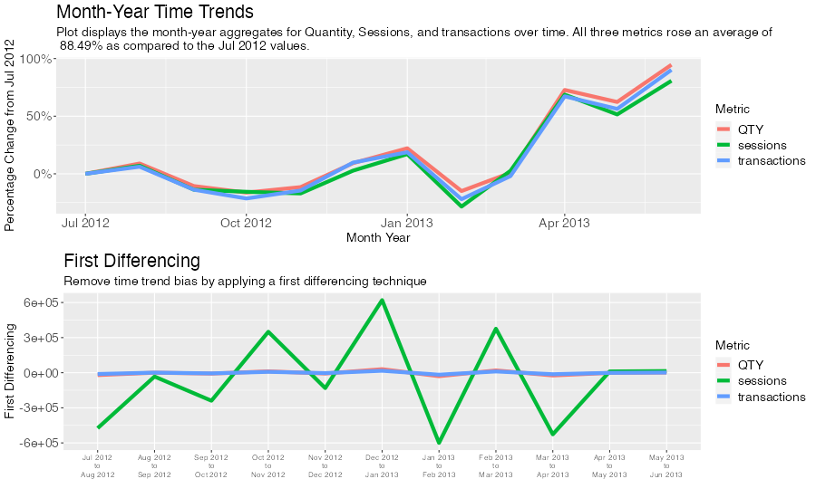
Historical Performance Analysis
Notes:
We track three metrics (quantity, sessions, and transactions) through time by aggregating each metric at the month-year level. Each of these three metrics are recorded at different scales. For example, transactions range between [0,1398], sessions range between [0,43559], and quantity ranges between [0, 2665]. In order to compare time trends, we calculate the percentage change from the baseline month-year, July 2012. Since July 2012, these metrics have risen an average of almost 89%, indicating a strong performance.
However, simply plotting time trends can fall victim of seasonality and time trend bias. As an added measure, we apply a first differencing by subtracting metric values between two consecutive time periods. The first differencing values are plotted on the bottom panel. Quantity and transactions appear to have little to no volatility through time. Sessions is a much more volatile metric.
Figures created can be found in this following R script:
02_historical preformance analysis.R

Slide 3
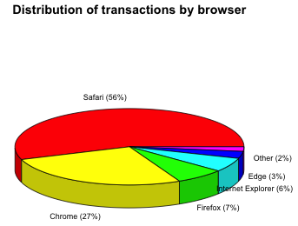
Historical Metric Analysis
Notes:
Historically, Safari has accounted for the largest portion of transaction by browsers. Chrome accounts for the second largest proportion of transactions historically.
Figures created can be found in this following R script:
02_historical metric analysis.R

Slide 4
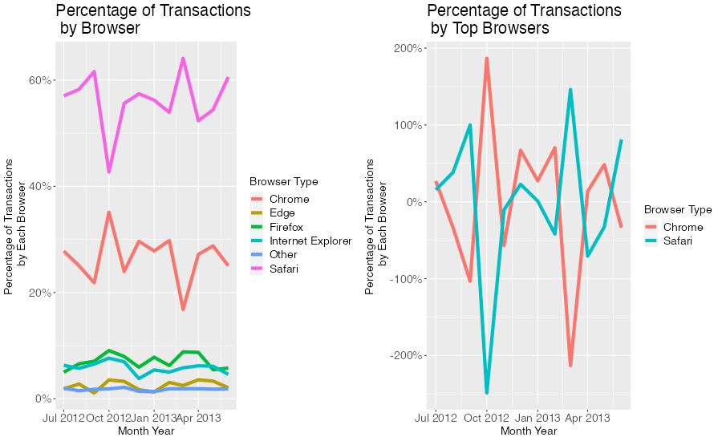
Notes:
To further examine the distribution of transactions across browsers we run a time series analysis.
The left panel of the graph depicted displays the percentage of transactions occurring on each browser. We simplify the total number of browsers being examined by adding an ”other” group which accounts for the least popular browsers used for this website platform. Consistent with the historical distribution, Safari and Chrome remain the dominant browser choice for this website platform.
It is also important to point out that there is an inverse relationship between the use of Safari and Chrome. During periods of high Safari usage, we observe low Chrome usage, and vice versa. This negative relationship, or negative correlation, can be seen more clearly on the right panel. To illustrate this relationship more clearly, we standardize the trends of browser usage between Safari and Chrome such that both trend lines can be displayed in an overlapping manner.
Figures created can be found in this following R script:
02_historical metric analysis.R

Slide 5
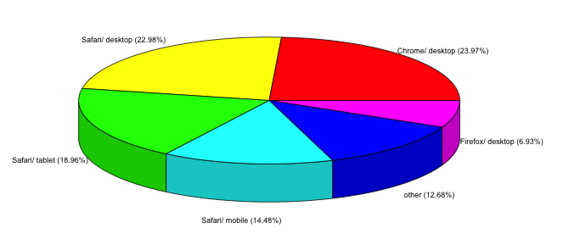
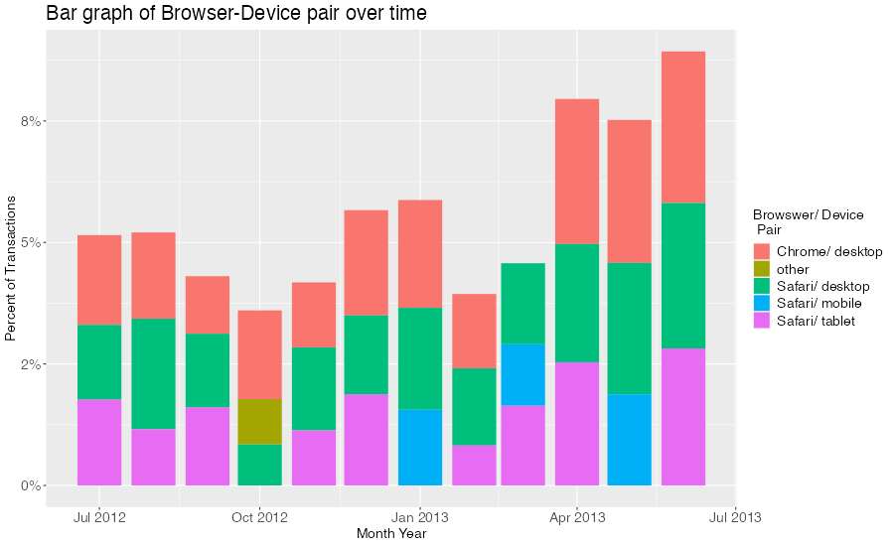
Browser – Device Relationship
Notes:
In addition to identifying which browser is used to maximize transactions, it is also important to identify which devices are used to access the browsers. Further examining the device used in conjunction with the browser choice shows Chrome accessed via desktop computers has slightly more transactions than Safari accessed via desktop computers. This relationship can be clearly shown by the pie chart in the upper left corner.
The bottom right bar graph illustrates how the distribution of browser-device pairs change over time. In previous months, Safari via desktop accounted for the largest proportion of transactions. In more recent months, Chrome via desktop has slightly outperformed Safari via desktop.
Figures created can be found in this following R script:
02_interaction with browsers and device.R

