Slide 1

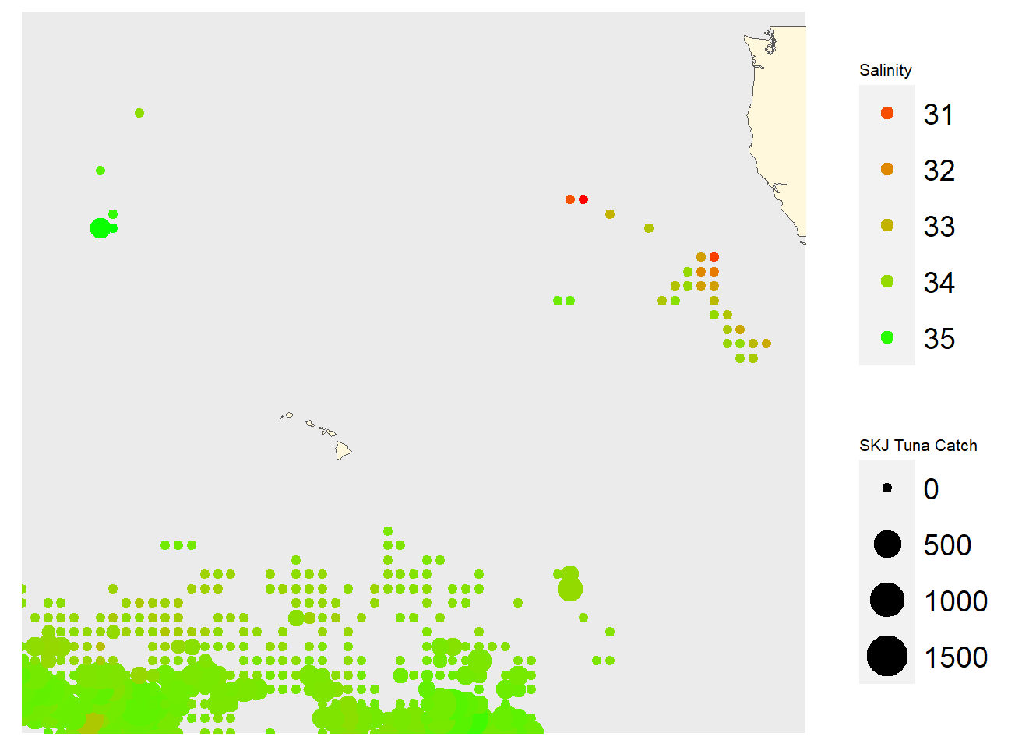
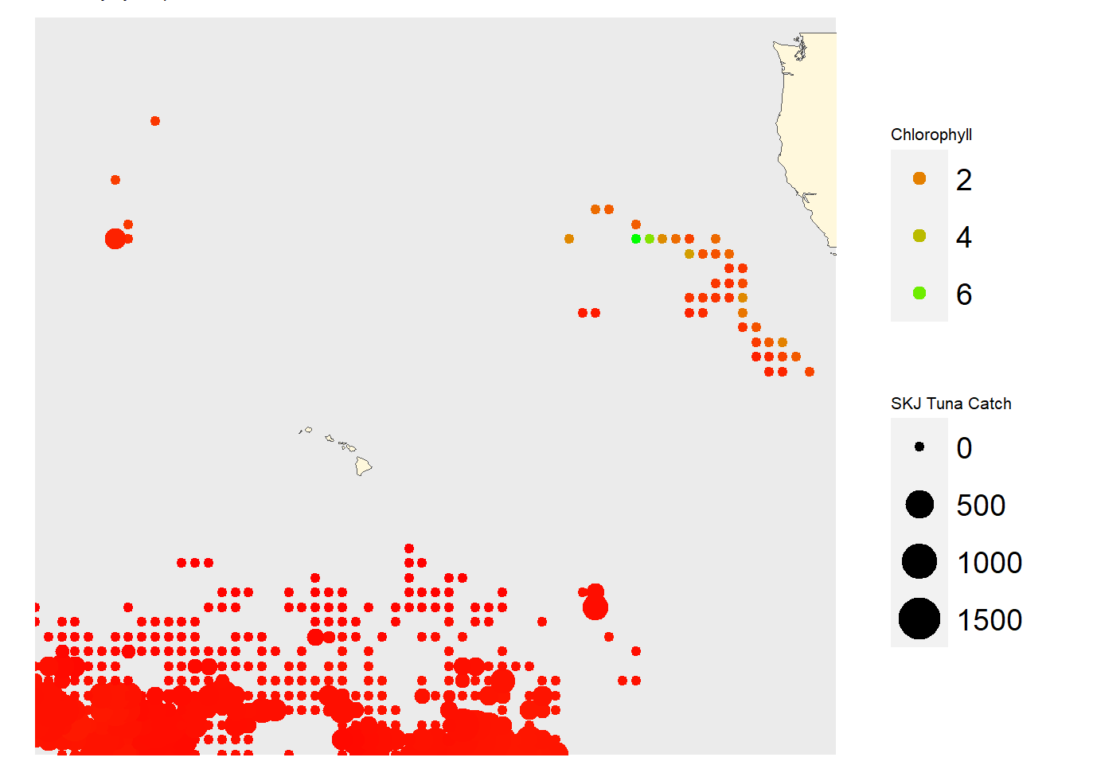
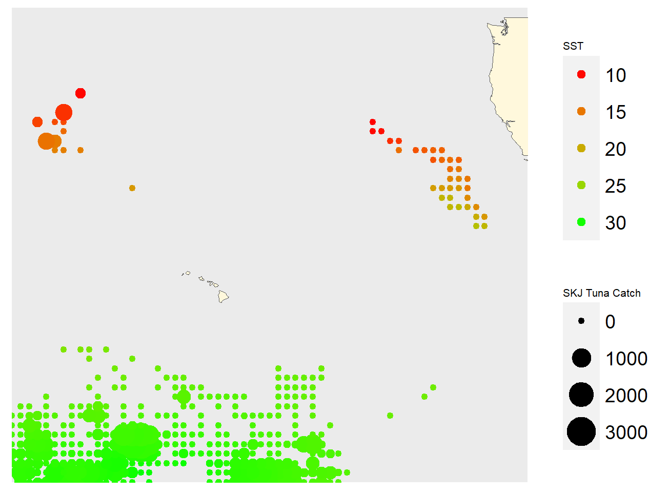

Estimating Skipjack Tuna Catch Using Environmental Conditions
Sarah Medoff
Cooperative Institute for Marine and Atmospheric Research (CIMAR)
Step 1: Download monthly environmental data between 2014 – 2015. Match the coordinates between skipjack tuna catch and each environmental variable
Products Used
Sea Surface Salinity, Aquarius
Chlorophyll a Concentration, Aqua MODIS
Sea Surface Temperature, Coral Reef Watch
Step 2: Run a simple linear regression
Catch = 353*Chlorophyll – 7*SST + 99*Salinity
Apply the linear model using the full environmental data sets to predict skipjack tuna catch for the entire fishing footprint

