Slide 1
Loan Status Prediction using Machine Learning
Team Elevate
(Smegnsh Demelash (ML_eng),
Ayoola Anibaba ,
Ojinnaka Njeze,
Sandra(UI/UX designer),
)

Slide 2
Outlines
Introduction and Objective of the study
Dataset Overview
Univariate and bivariate analysis
Different ML models used
Result
Limitations of the analysis
Reference

Slide 3
Introduction
Machine Learning can be used in the financial sector like high-risk loan applicants, predicting payment default, marketing, credit analysis and so on.
When it comes to borrowing money, there are many different sorts of loans to choose, and it's vital to be aware of your alternatives.
For our case we are sticking on personal loan.
Objective
goal is by using different machine learning algorithm test best for loan prediction.
Apply best performed algorithm for our Mono Api

Slide 4
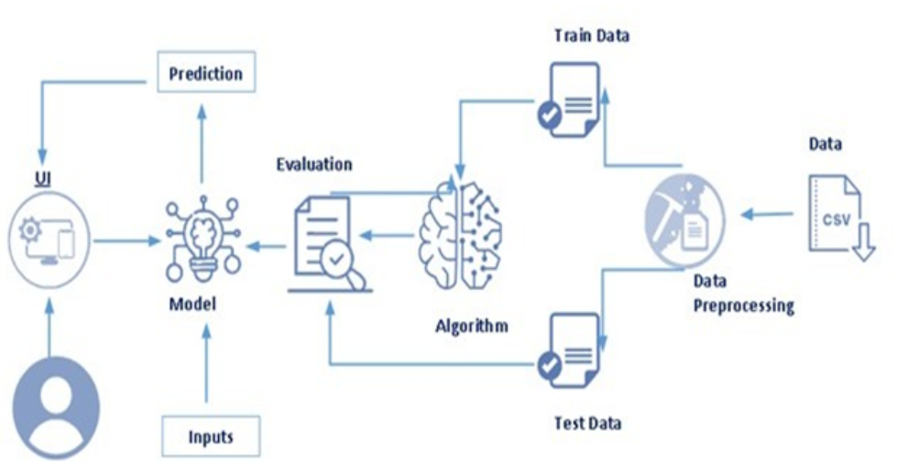
Arctecture

Slide 5
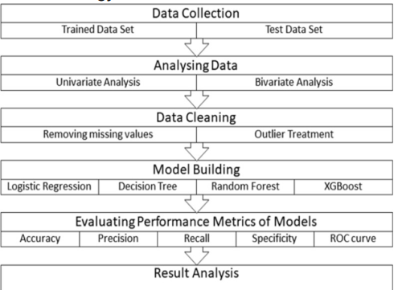
Methdology

Slide 6
Dataset Overview
Data contains 614 rows and 8 columns.
Contains both categorical and numerical variables
Numerical=['ApplicantIncome', 'CoapplicantIncome', 'LoanAmount',
'Loan_Amount_Term‘]
Categorical= ['Loan_ID', 'Gender', 'Married', 'Self_Employed', 'Loan_Status‘]
Dependent=Loan status and others are independent variables
Variable Loan_ID is unwanted one for this analysis.

Slide 7
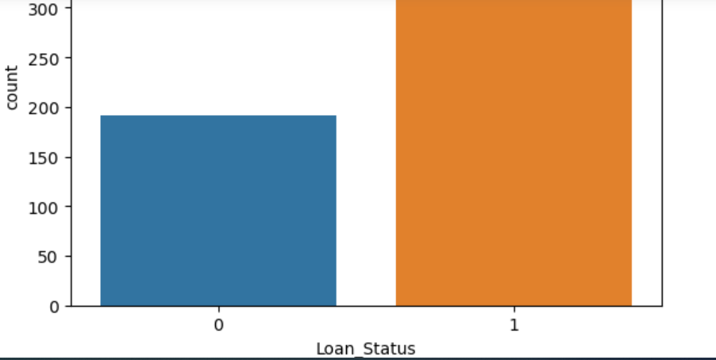
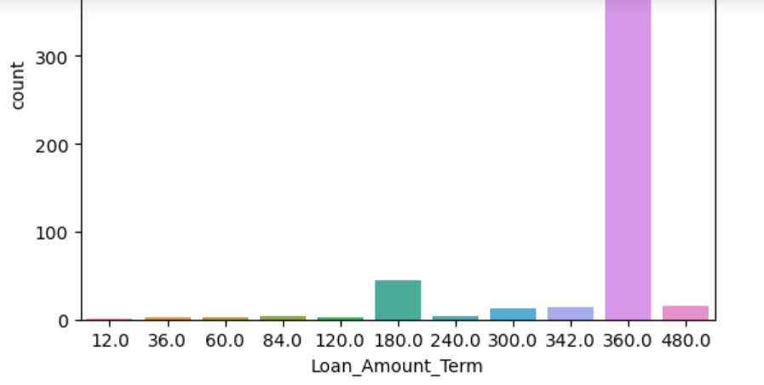
Univariate and bivariate analysis

Slide 8
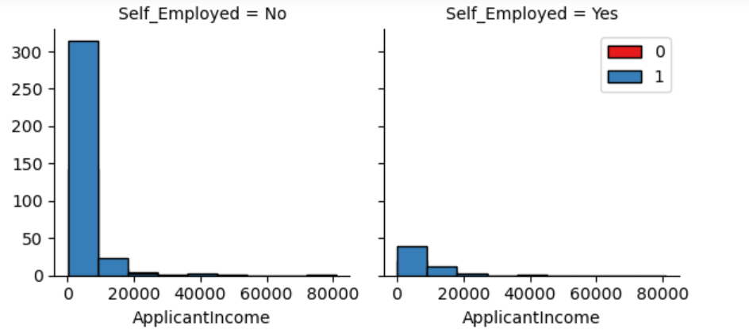
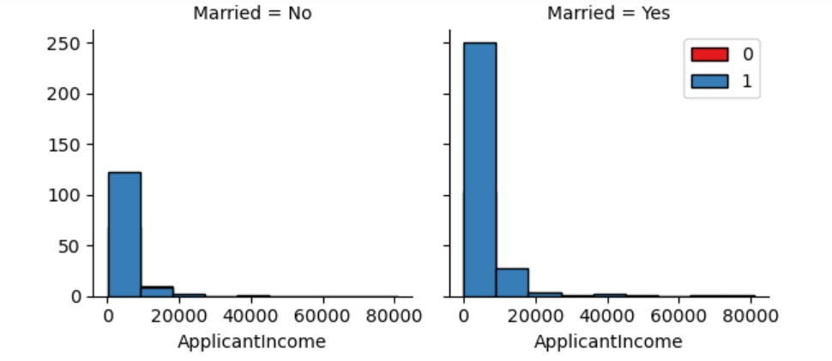
Multivariate analysis

Slide 9
Correlation matrix
 | Gender | Married | Self_Employed | ApplicantIncome | CoapplicantIncome | LoanAmount | Loan_Amount_Term | Loan_Status
Gender | 1.000000 | 0.336094 | -0.025022 | 0.094472 | 0.073308 | 0.136081 | -0.067778 | 0.008690
Married | 0.336094 | 1.000000 | -0.038153 | 0.052119 | 0.069877 | 0.145541 | -0.096253 | 0.096657
Self_Employed | -0.025022 | -0.038153 | 1.000000 | 0.095664 | 0.052218 | 0.089806 | -0.036965 | 0.010880
ApplicantIncome | 0.094472 | 0.052119 | 0.095664 | 1.000000 | -0.116605 | 0.565620 | -0.045242 | -0.004710
CoapplicantIncome | 0.073308 | 0.069877 | 0.052218 | -0.116605 | 1.000000 | 0.187828 | -0.059675 | -0.059187
LoanAmount | 0.136081 | 0.145541 | 0.089806 | 0.565620 | 0.187828 | 1.000000 | 0.038801 | -0.036416
Loan_Amount_Term | -0.067778 | -0.096253 | -0.036965 | -0.045242 | -0.059675 | 0.038801 | 1.000000 | -0.020974
Loan_Status | 0.008690 | 0.096657 | 0.010880 | -0.004710 | -0.059187 | -0.036416 | -0.020974 | 1.000000

Slide 10
Different ML models used
Once the pre-processing of data is done next, we apply the train data to the algorithm.
We use Classification algorithms are Regression algorithms such as Logistic Regression, SVM, Random Forest Classification ,Xgboost,KNN, and Decision Tree Classification .
Among all, for our data set Logistic Regression and SVM (67% accurate) performs better than others .
However, I choose Logistic Regression because SVM will be not good whenever data is getting large.

Slide 11
Result
Loan status is positively related with Marital status, self employment and negatively correlated with Loan amount and term, coapplicants income.
Logistic regression and SVM better fits model (67% accurate)

