Slide 1
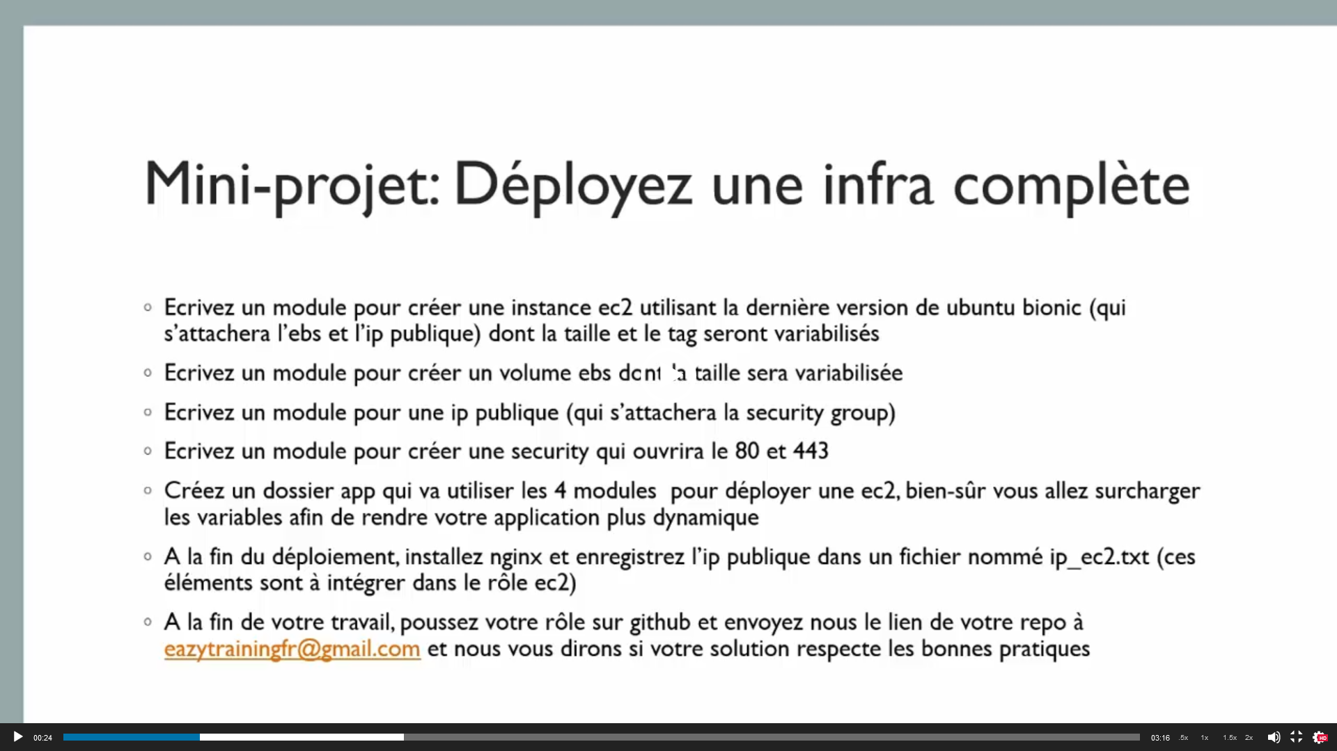

Slide 2






AWS key
EC2
Nginx
credentials
EBS
Elastic IP address
Public ip
Port :
https: 443
http: 80
Ssh :22
Security group

Slide 3




Security group
EC2 instance contents
EIP
User
Internet
Nginx
EBS

Slide 4
Security group
EC2 instance contents
Associate EIP & instance
EIP
User
Internet
Nginx
Associate EBS & instance
EBS

