Slide 1
Project Ideation & Problem Definition
CMPT 3835
Uchenna Mgbaja, Fardad Mokhtari
Designed for: Address-Based Urgency Patterns
Designed by: Group 10 (Varinder Kaur &
Satvir Kaur Mehra)
Iteration: 1#

Slide 2
Prediction Task
Type of task?
Classification(Identify factors contributing to delays in the food hamper delivery process.).
Entity on which predictions are made? Food hamper deliveries
Possible outcomes?
On-time delivery
Delayed delivery
Severity of delay (if predicting a continuous variable)
Wait time before observation?
The wait time before observation is determined by comparing the actual delivery time (datetime_from/datetime_to) with the scheduled collection date (collect_scheduled_date). A delay can only be assessed once the actual delivery occurs.

Slide 3

Decisions
How are predictions turned into proposed value for the end-user?
1.The model helps predict delays in advance, allowing better planning and resource allocation.
2.The system can alert delivery teams about high-risk delays.
Mention parameters of the process / application that does that.
Delivery route optimization
Prioritization of at-risk deliveries
Automated alerts for service providers

Slide 4

Value Proposition
Who is the end-user?
The end-users of this system are food bank staff and logistics coordinators, who oversee the scheduling and delivery of food hampers. They rely on predictions to identify potential delays, optimize delivery routes, and improve overall efficiency in the distribution process.
What are their objectives?
Reduce delays in food hamper deliveries
Improve resource allocation and planning
Enhancing communication with clients

Slide 5

Value Proposition
How will they benefit from the ML system?
Improved efficiency in delivery scheduling
Identification of delay-prone areas or clients
Proactive resolution of potential delays
Mention workflow/interfaces.
Dashboard for real-time monitoring of predicted delays
Automated notifications for high-risk deliveries.

Slide 6

Data Collection
Strategy for initial train set & continuous update.
Initial Train Set: Historical delivery data on scheduled collection times, actual delivery times, and status updates..
Continuous Update: New delivery records will be periodically added to refine the model and improve delay predictions..
Mention collection rate, holdout on production entities, cost/constraints to observe outcomes.
Collection Rate: Real-time tracking of delivery statuses based on scheduled and actual delivery times.
Holdout on production entities: Certain delivery routes or client records can be held back for testing to ensure model generalization.
Cost/constraints to observe outcomes: Limited by data availability, missing timestamps, and inconsistencies in recorded delivery updates..

Slide 7

Data Sources
Where can we get (raw) information on entities and observed outcomes?
Internal databases: Delivery logs and customer records.
API connections: Scheduling systems for real-time updates.
Communication logs: Contact method and contact frequency details. .

Slide 8
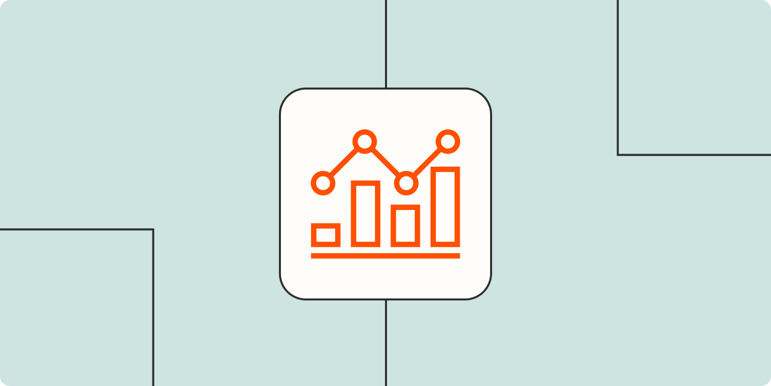
Data Sources
Mention database tables, API methods, websites to scrape, etc.
Database Tables: Delivery logs, customer records, scheduling history, status updates.
API Methods: Scheduling system APIs for real-time tracking, communication logs API for contact method and frequency.
Websites to Scrape: Not applicable in this case, as data is sourced from internal databases and APIs.

Slide 9
Impact Simulation
Can models be deployed?
Yes, integrated into scheduling tools. The model can be deployed and integrated into scheduling tools to optimize delivery planning and reduce delays.
Which test data to assess performance?
To assess performance, historical delivery records can be used as test data. These records provide real-world insights into past deliveries, helping evaluate the accuracy and effectiveness of the model in predicting outcomes.
Cost/gain values for (in)correct decisions?
Incorrect Decision: Missed intervention opportunities, wasted resources
Correct Decision: Improved efficiency, reduced complaints.
Fairness constraint?
A fairness constraint ensures equitable service across all locations and demographics, preventing biases in resource allocation and ensuring that no group is disproportionately advantaged or disadvantaged.

Slide 10

Making Predictions
When do we make real-time / batch pred.?
Real-time: Real-time updates for ongoing deliveries.
Batch predictions: Predictions can be made in batch mode for planning.
Time available for this + featurization + post-processing?
Real-time: Minutes before the scheduled delivery
Batch: Daily/weekly schedule updates
Compute target?
Cloud-based deployment offers scalability and flexibility, ideal for large datasets and remote access.

Slide 11

Building Models
How many prod models are needed?
One main predictive model is needed, with potential fine-tuning for specific locations to improve accuracy and relevance.
When will we update?
The model will be updated periodically (e.g., weekly/monthly) based on new data.
Time available for this (including featurization and analysis)?
The model retraining and evaluation cycle should occur bi-weekly or monthly, allowing sufficient time for featurization, analysis, and performance adjustments.

Slide 12
Features
Input representations available at prediction time, extracted from raw data sources?
Delivery details: collect_scheduled_date, datetime_from, datetime_to.
Client characteristics: age, address, communication_barrier.
Communication factors: contact_method, latest_contact_method, contact_frequency
Status updates: date_reopened, status_update

Slide 13
Monitoring
Metrics to quantify value creation and measure the ML system’s impact in production (on end-users and business)?
Model performance: Accuracy, precision-recall, RMSE (if regression).
Operational impact: Reduction in delays, improved scheduling efficiency.
Business impact: Client satisfaction, resource utilization.

Slide 14


