Slide 1


YodaLang
Scala Internal DSL
Sachin Mehta
CS 345 Rellermeyer Fall 2016

Slide 2
A long time ago, in a galaxy far, far away…

Slide 3
Episode 3 ½ :
A NEW LANGUAGE
In between the atrocious Episode 3 and the decent yet cliché Episode 4, Master Yoda found safety from the Empire on Dagobah…
Yet he got bored one day of hiding and doing Yoda-things, and decided to make a programming language to aid any new hopes that might stop by…
Not only was Yoda a master of the mystical Force, but he aced the AP Physics force chapter as well... Thus Yoda stored his knowledge in his new language.

Slide 4
Major Sources
BAYSICK - https://github.com/fogus/baysick
basic.scala - https://gist.github.com/jrk/87146
gimme - https://github.com/l-hoang/gimme
scala-chef - https://github.com/l-hoang/scala-chef

Slide 5
What is YodaLang?
Internal Scala DSL
Uses simple English-like syntax and semantics (with a Yoda twist)
Type safe (mostly)
Allows Yoda to pass on his knowledge on force

Slide 6
Language Features
Main Language Features
Console output
Variable storage and retrieval
Conditionals
Loops
Functions
Additional features
Planet and object creation
Various force and acceleration calculations

Slide 7
Creating a YodaLang program!
import yodalang.YodaLang
object Program_Name extends YodaLang {
def main(args: Array[String]) = {
Begin we will
YodaLang Code …
Finish we will
}
}

Slide 8
Creating a YodaLang program!
Begin we will
Show me __ you will __ -> “Hello, world!”, 101, 2.3, (5 minus 1)
Force push “var_name” as __ __ -> “String var”, 2, 3.1, (2 times 2)
Finish we will

Slide 9
Creating a YodaLang program!
Fear leads “var” anger 5
Anger leads “var” hate “var”
Hate leads “var” suffering 2.0
Suffering leads “var” darkness 1

Slide 10
Creating a YodaLang program!
Jedi path (__) __ -> 1 equal_to 1
Take Sith path
Restore the balance you will
What you learned
You must unlearn
Patience young padawan

Slide 11
Creating a YodaLang program!
Start training “function_name” you will
Give back “var” you will
Stop your training you will
Force pull “function_name”, (“function_name”, “return_var”)

Slide 12
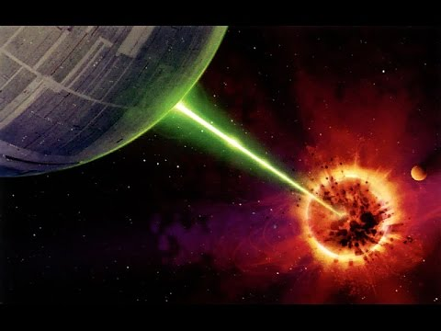
Impending Doom
“Quickly Alderaan the Death Star approaches! Before its inevitable destruction you mourn, use this situation to learn more about the Force you will!” – Master Yoda

Slide 13

Just Out of Reach!
“Tested your physics knowledge will be young Skywalker! Quick! Calculate the force to retrieve saber.” – Master Yoda

Slide 14

Lift, Do You Even, Young Skywalker?
“Your Force too weak it is. At an angle the X-wing lift out you must.”
– Master Yoda

Slide 15
Project Difficulties
Verbose and simple, English-like language as internal DSL
Ensuring type correctness
Variable access as Strings
Implicits to form proper expressions
Storage and manipulation of objects

Slide 16
Future Improvements
Add more features to make it a more usable physics tool
Improved error messages and error checking
Debugging tools
User input
Variable shadowing

