Slide 1
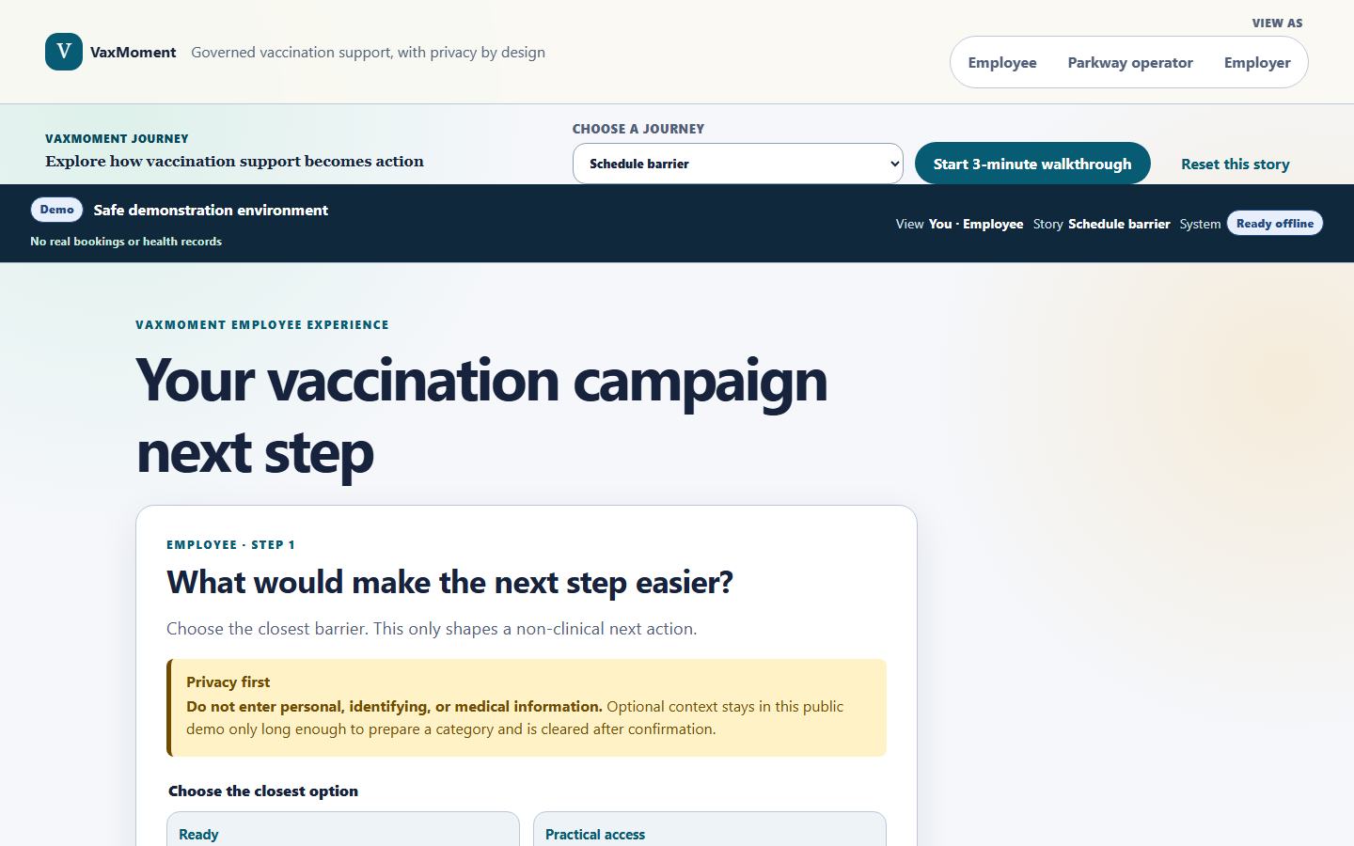
V
VaxMoment
FROM AWARENESS TO
COMPLETED, INFORMED ACTION
A privacy-first barrier-to-booking engine for workplace adult vaccination campaigns.
Team VaxMoment · Hack4Health 2026 Non-Technical Track
Proposed AI interprets optional language · Policy controls the action · Humans own clinical questions · Employers see aggregates only
VaxMoment · Evidence-informed proposition · 11 Aug 2026

Slide 2
PROBLEM
The gap is not awareness alone. It is action.
28.2%
Infrastructure already exists
Generic reminders are inconsistent
Adult influenza uptake
HealthHub and Healthier SG already provide trusted information, subsidies, records and appointment pathways. Another FAQ directory is not the wedge.
A 262,085-person health-system RCT found portal and text reminders did not increase overall influenza vaccination. Message volume is not the same as action.
Singapore residents aged 18–74 reporting influenza vaccination in 2024. This population measure does not estimate unmet need among recommended groups.
Market hypothesis
People may stall for different reasons—practical access, confidence, information, private clinical questions or simply no concrete plan. The product must test and remove the specific friction, not send a smarter-looking reminder.
https://www.moh.gov.sg/newsroom/national-population-health-survey-2024-shows-singaporeans-are-adopting-healthier-lifestyles---but-rising-obesity-is-a-concern/ · https://www.healthhub.sg/programmes/hsg · https://pmc.ncbi.nlm.nih.gov/articles/PMC10949147/
VaxMoment · Evidence-informed proposition · 11 Aug 2026

Slide 3
PRODUCT WEDGE
A governed barrier-to-booking engine—not a vaccine chatbot
1
2
3
4
5
Private barrier
User confirmation
Governed action
Execution
Outcome integrity
Employee selects or describes what is getting in the way.
The system proposes one allowlisted category; the employee confirms or changes it.
A deterministic policy selects the permitted next action—never an improvised clinical recommendation.
A slot, approved information route, opt-out or accountable human handoff follows.
Booking and completion remain separate; only an authoritative source can verify completion.
AI
Understands language and proposes a category
POLICY
Controls what the system is allowed to do
HUMAN
Owns clinical judgement
VaxMoment · Evidence-informed proposition · 11 Aug 2026

Slide 4
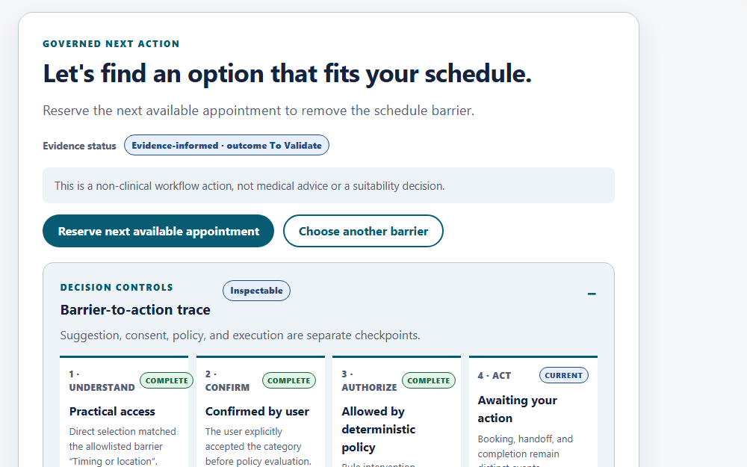
WORKING PROTOTYPE
The employee sees the reason, boundary and next action
Transparent classification
The category is proposed and confirmed—never silently inferred as fact.
Governed intervention
The policy engine authorizes one bounded action matched to the barrier family.
Clinical stop line
Personal suitability questions create an unsubmitted human-handoff receipt; the AI does not answer.
Live prototype: https://vax-moment.vercel.app
VaxMoment · Evidence-informed proposition · 11 Aug 2026

Slide 5
BEHAVIOURAL RATIONALE
Evidence points toward convenience plus concrete planning
+4.2pp
Translation is unproven
No “AI uplift” claim
Date + time planning
The RCT supports a testable mechanism, not an effect-size promise for Singapore, VaxMoment, or a different campaign design.
Demographic tailoring and behavioural framing have also produced null results. VaxMoment is an evidence-informed proposition awaiting a controlled pilot.
A US workplace RCT found a full-sample increase after employees were prompted to form a concrete date-and-time plan.
Design implication
Use AI only to understand long-tail language. Let deterministic policy and service operations remove the friction. Measure authoritative completion—not clicks, message opens or chatbot engagement.
https://pmc.ncbi.nlm.nih.gov/articles/PMC3127912/ · Transfer limits documented in submission/SUPPORTING_EVIDENCE.md
VaxMoment · Evidence-informed proposition · 11 Aug 2026

Slide 6
ALTERNATIVES
The moat is the operating loop—not the chat interface
Alternative | Information | Action | Barrier route | Clinical boundary | Employer privacy
HealthHub / Healthier SG | Strong | Strong | Not established in review | Clinic-led | Not employer-facing
Corporate vaccine provider | Strong | Strong | Not established in review | Provider-led | Varies
Generic AI chatbot | Variable | Usually link-out | Conversation only | Often unclear | Often unclear
VaxMoment | Source-labelled | Barrier → slot/handoff | Core workflow | Observable stop line | Aggregate + suppression
What compounds after a pilot
Approved intervention library · barrier-to-outcome evidence · operational integrations · trusted distribution · privacy governance
Current defensibility is limited; these are future moat mechanisms, not present assets.
VaxMoment · Evidence-informed proposition · 11 Aug 2026

Slide 7
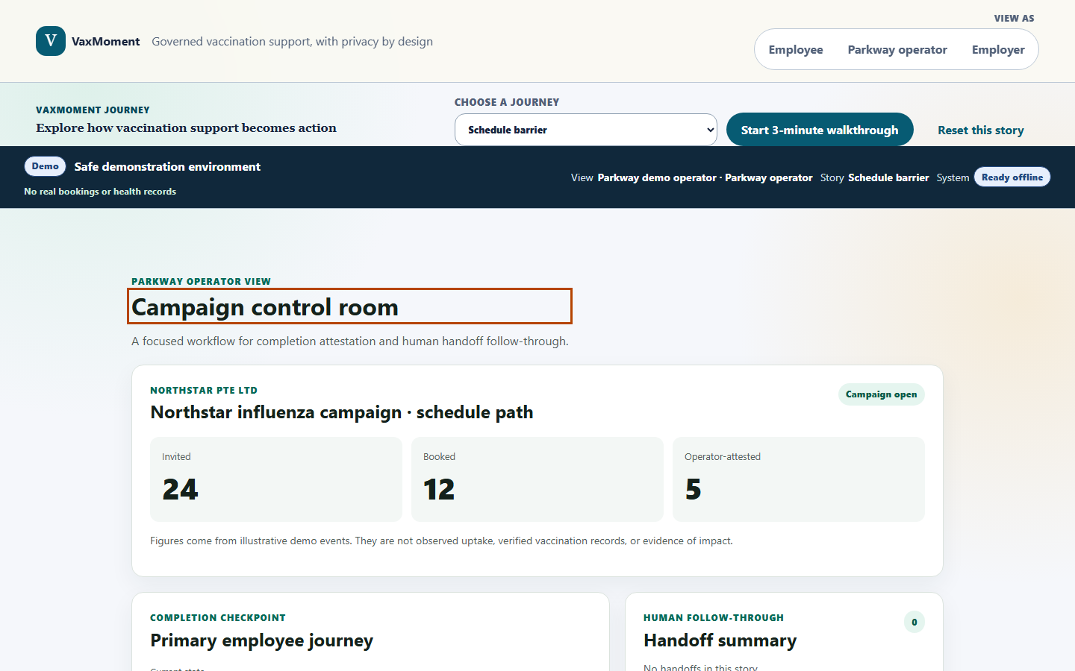
ORGANIZER ECOSYSTEM
Proposed Microsoft pathway for an executable governed contract
COPILOT STUDIO
AGENT FLOW
MICROSOFT BOOKINGS
DATAVERSE
ENTRA + GOVERNANCE
Bounded language-to-category output
Confirmation-gated deterministic action
Availability and appointment execution
Campaign state, consent and provenance
Role identity, DLP, ALM and monitoring
Implemented now
Typed ports, deterministic adapters, policy/state/privacy tests, Adaptive Card payloads, tool contracts and tested fallback and denial paths.
Requires tenant access
Published Copilot agent, Dataverse solution, Bookings connector, Entra roles and production DLP. None are claimed as live or Parkway-approved.
https://learn.microsoft.com/en-us/microsoft-copilot-studio/guidance/sec-gov-intro · https://learn.microsoft.com/en-us/microsoft-copilot-studio/authoring-ask-with-adaptive-card · SMUAI/Petani AI are organizer ecosystem partners; no technical integration is claimed.
VaxMoment · Evidence-informed proposition · 11 Aug 2026

Slide 8
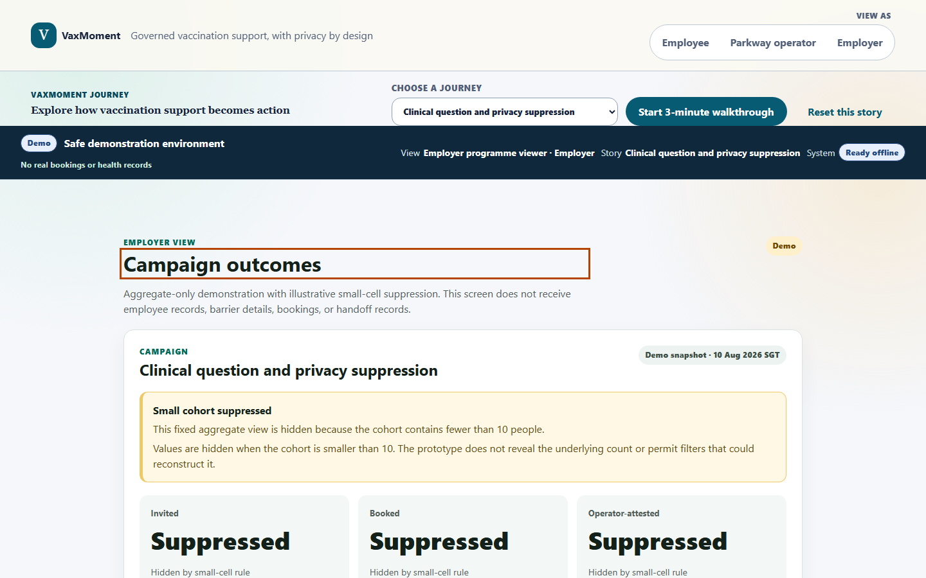
TRUST AND GOVERNANCE
Privacy is part of the value proposition—not a footer
Employee
Chooses what to disclose; optional text is transient; decline is respected.
Parkway operator
Receives actionable handoff and campaign operations—not autonomous clinical answers.
Employer
Receives a fixed aggregate projection; small cohorts are suppressed; no individual barrier is exposed.
Production requires server-side authorization, anti-differencing, retention controls and qualified privacy review.
VaxMoment · Evidence-informed proposition · 11 Aug 2026

Slide 9
BUSINESS MODEL AND GTM
One campaign. One site. One falsifiable pilot.
Primary buyer hypothesis
Commercial entry
Wedge
Corporate-health programme owner as buyer and integration owner; employer as campaign sponsor or co-funder. Both remain to validate.
A fixed-fee, time-bounded pilot priced against campaign operations and unused appointment capacity—not hypothetical healthcare savings.
One employer, one influenza programme, one workplace site and one campaign window. Expand only after evidence and governance review.
Illustrative 90-day validation path
DAY 0–30
DAY 31–60
DAY 61–90
Discovery + data contract
Concierge + governance gate
Pilot or stop
Observe workflow; freeze purpose, fields, source and ownership.
Test manually; secure build and approvals must pass before enrolment.
Only if gates pass: run controlled campaign and make a measured kill/scale decision.
VaxMoment · Evidence-informed proposition · 11 Aug 2026

Slide 10
VALIDATION
Measure authoritative completion—and the cost of getting there
PRIMARY
Authoritative completion
Same source and observation window in both arms.
SECONDARY
Booking + time to action
Understand conversion and friction.
OPERATIONS
Support minutes + exceptions
A solution that overwhelms staff fails.
GUARDRAILS
Privacy, clinical and trust events
Zero tolerance for generated clinical answers or employer access violations.
Current status: pilot design drafted; discovery gates remain unmet. No buyer commitment, customer interviews or measured uplift yet.
VaxMoment · Evidence-informed proposition · 11 Aug 2026

Slide 11
THE ASK
Help us validate the workflow contract, then earn one governed workplace pilot.
Parkway Shenton
Microsoft
Employer sponsor
One operator workflow interview, one campaign pathway and an accountable handoff owner.
A sandbox tenant and guidance to implement the prepared Copilot Studio, agent-flow, Bookings and Dataverse contracts.
One workplace campaign with approved aggregate evaluation and a pre-registered decision threshold.
Don’t optimise vaccination campaigns for clicks. Optimise the journey for completed, informed action.
Prototype: https://vax-moment.vercel.app · Source: https://github.com/smellywesley/Vax-moment

