Slide 1
Ticket Agency - A Reactive Application

Slide 2
Team Members
Leela Gangadhar Vallabhaneni
Srikanth Melugiri

Slide 3
Goals
Build an Scala application that can handle single request successfully. Single User web-based model. Involves Play, Akka(single Actor) H2 DB.
Handle requests with communication between multiple Actors using Akka.
Introduce the application to a distributed framework, Spark on AWS(EC2).
Create Super User to monitor complete status of the application.

Slide 4
Play
A web Application Framework.
Why Play? Good framework with Scala.
Design pattern Model-View-Controller

Slide 5
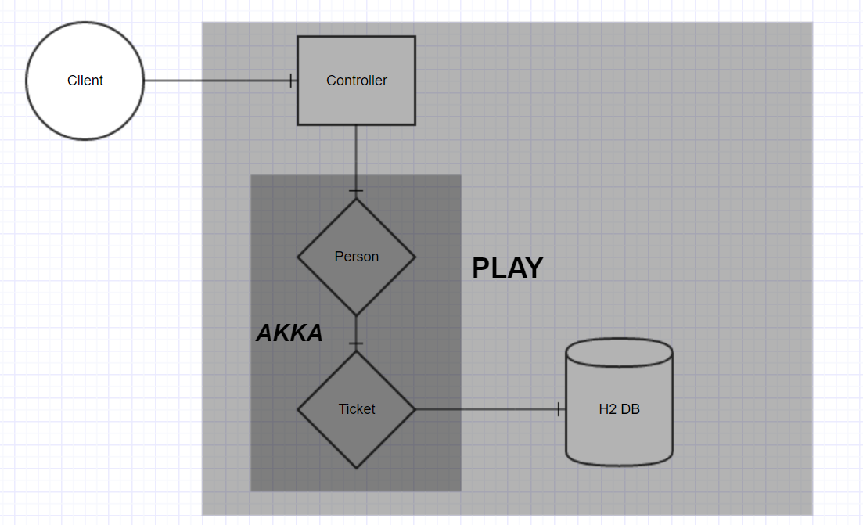
Overview

Slide 6
Akka
Why Actors? Core – Asynchronous Messaging
Scalability Pool of Actors – RoundRobinPool
Fault Tolerance Actor System has hierarchy. Supervision of Parental Actors.

Slide 7
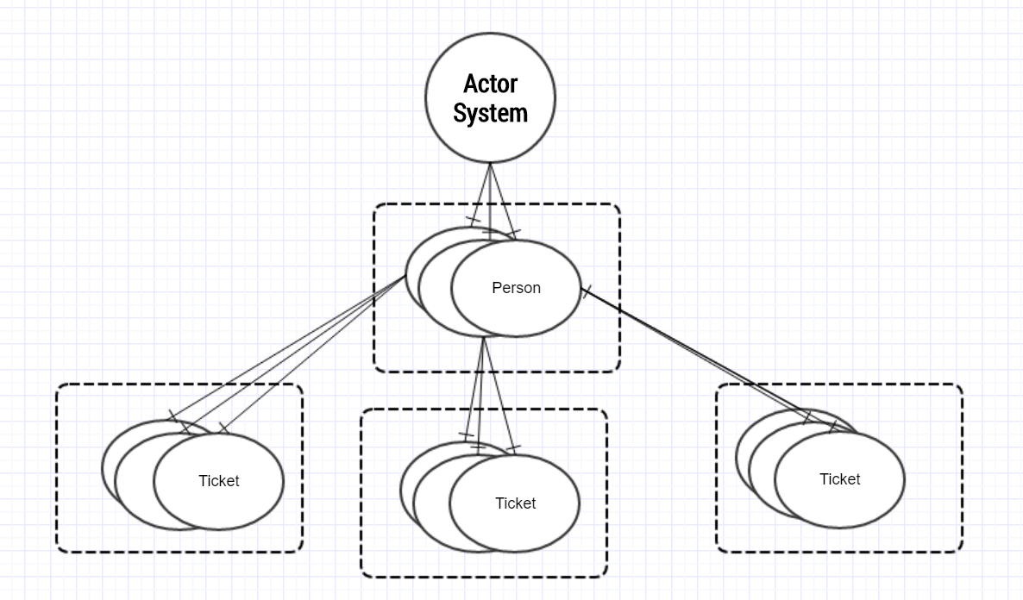
Actor Model

Slide 8
Scalability
Replication of Actors using Actor Pools
Used Round-Robin Routing for equal distribution of messages
E.g. val person2 = system.actorOf(Person2.props(repo,ec).withRouter(RoundRobinPool(10)), name = "PersonActors")

Slide 9
H2 DB Schema
Table: Movie Columns : ID, Name, number of tickets
Table: Ticket Columns: ID, Name, number of tickets, movie name

Slide 10
Improvements
Implement Akka Test-Kit to simulate 3000 POST requests.
Run the Application on distributed environment (AWS) to check for fault tolerance.
Roles for Users.
A Super User to monitor everything.

Slide 11
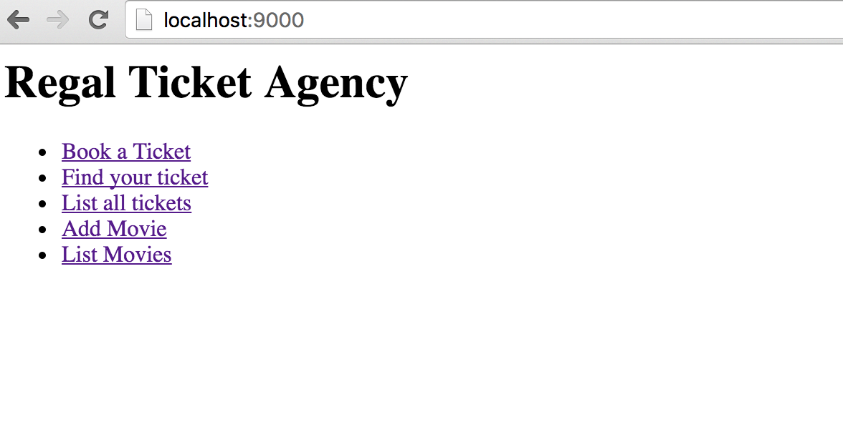
Application overview

Slide 12
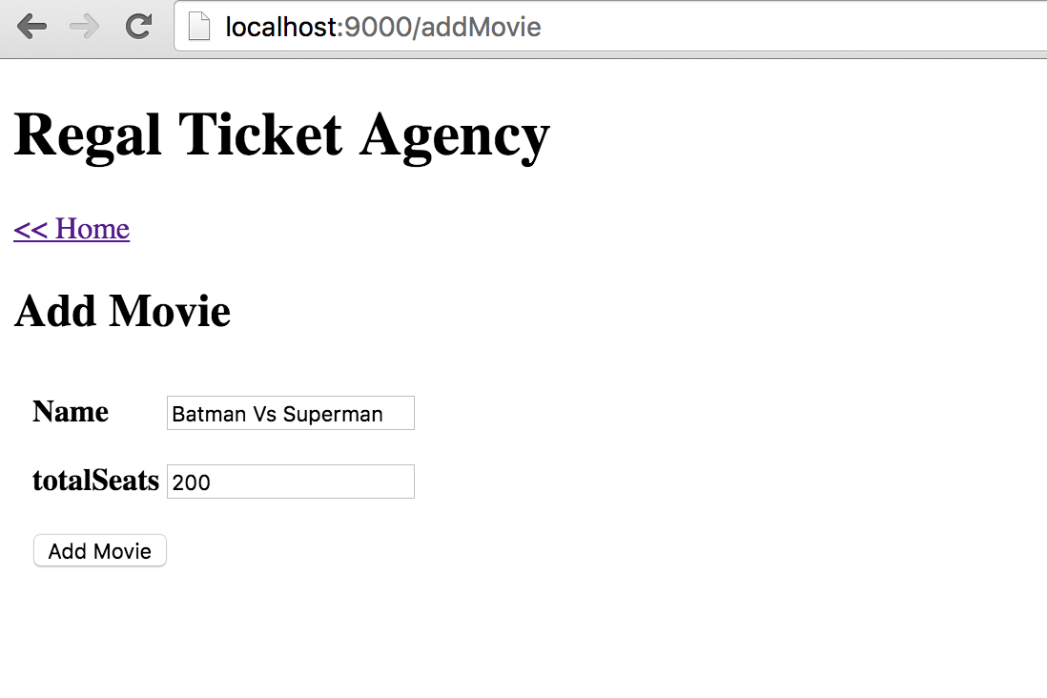
Use Case -1 (Add a Movie)

Slide 13
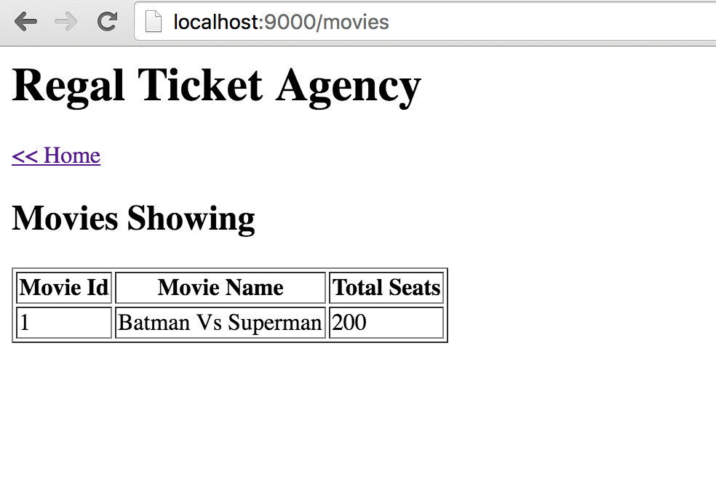
Use Case -2 (List all Movies)

Slide 14
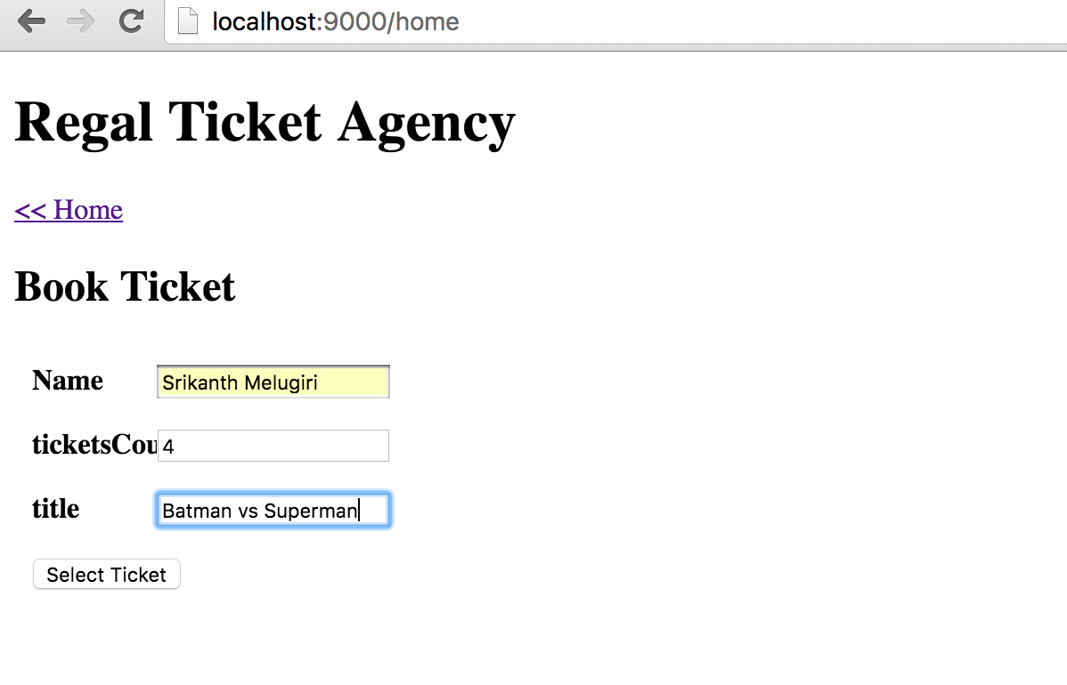
Use Case – 3 (Book a Ticket)

Slide 15
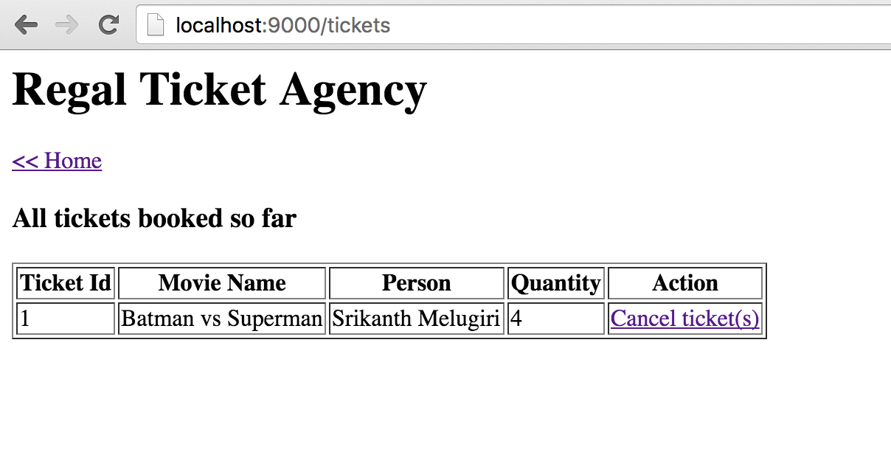
Use Case – 4 (List all Tickets)

Slide 16
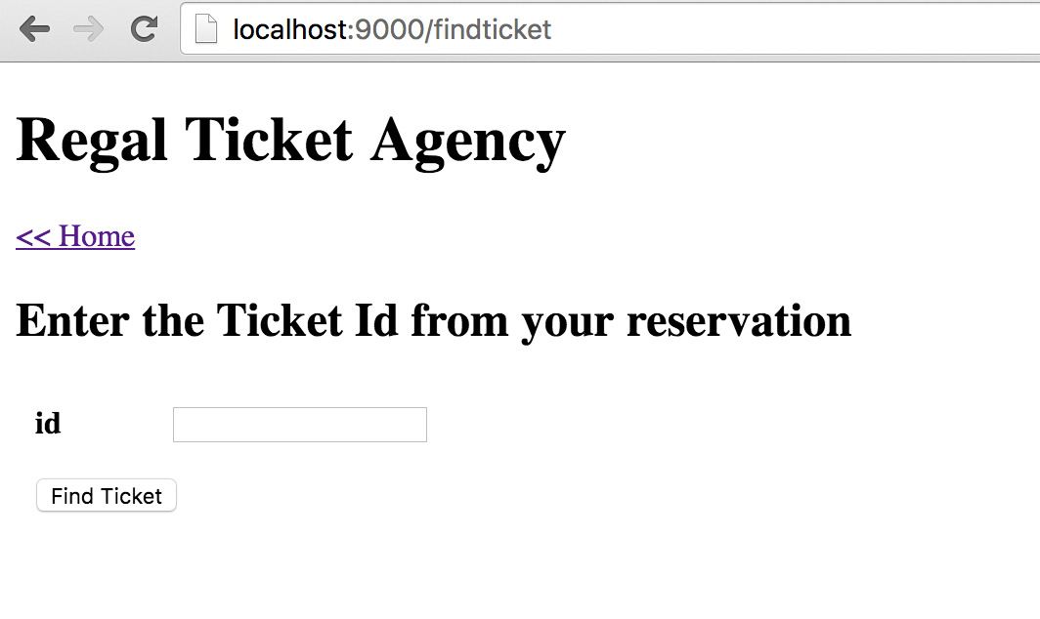
Use Case – 5 (Find the reservation)

Slide 17
Results
Ran 500 requests simulataneously using Paw HTTP Client
Average request processing time ~ 6ms per request
Application is tested upto 4096 requests

Slide 18
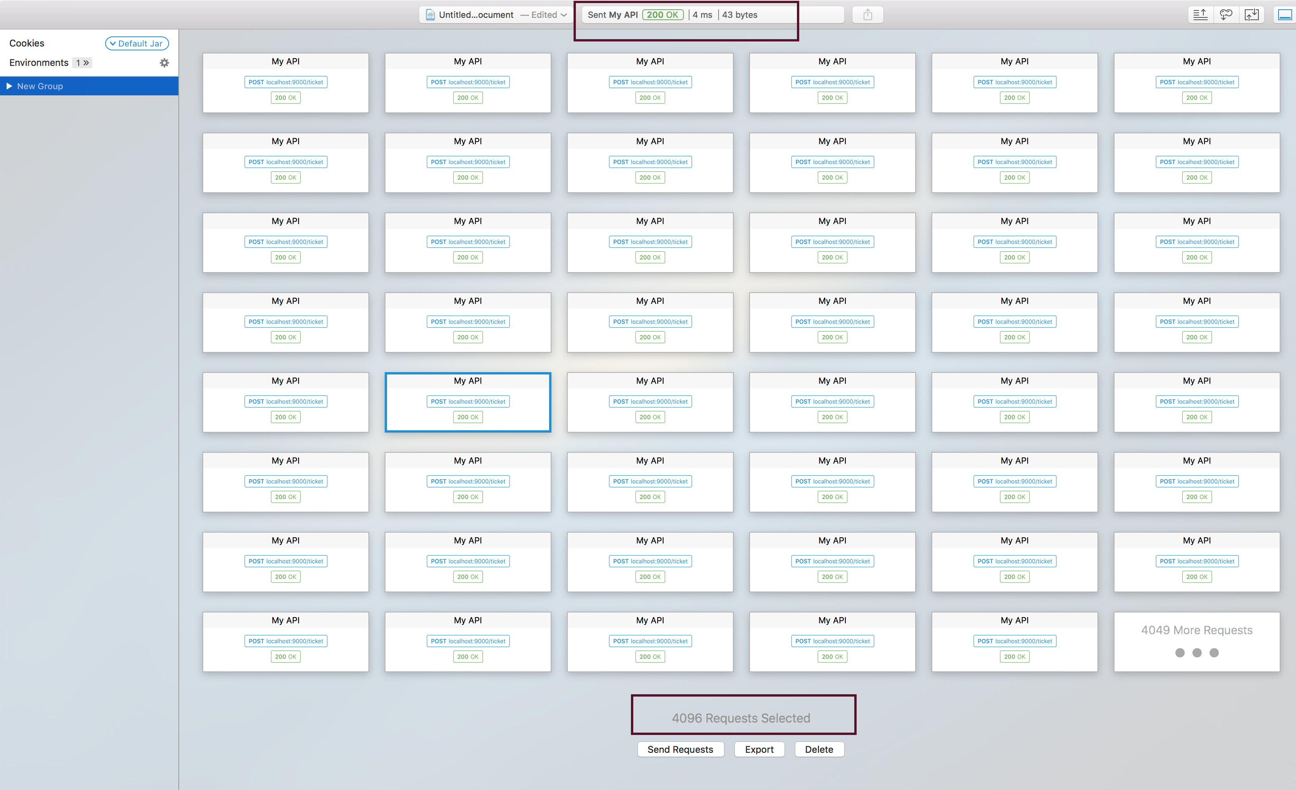
Scalability results

Slide 19
THANK YOU ☺

