Slide 1
TECHNICAL WALKTHROUGH
Method of Morris and BFPS Index for
GenX Uncertainty Screening
From Multiple Policy Scenarios, parameter ranges and sampled trajectories to system-level and zonal sensitivity outputs
Shane Menezes
Dr Neha Patankar
Binghamton University
Research Citation Reference:
Menezes, S., & Patankar, N. (2026). "Zonal Global Sensitivity Analysis for Policy-Constrained Capacity Expansion Planning in New York.” 11th North American International Conference on Industrial Engineering and Operations Management. https://doi.org/10.46254/NA11.20260328
Julia implementation • method_of_morris.jl

Slide 2
1. What problem does the code solve?
PURPOSE
Screen uncertain planning inputs and assess their modeled influence.
INPUTS
MODEL EVALUATION
SENSITIVITY OUTPUTS
Configuration CSVs define active uncertain parameters and their ranges.
Sampled parameter vectors are applied to GenX; the model is updated and solved for each design point.
Morris effects and BFPS indices summarize relationships to system and zonal outputs.
Core question: Which uncertain inputs matter most, and for which outcomes or zones?
Screening prioritizes attention; it does not by itself establish causation or replace detailed uncertainty analysis.
METHOD OF MORRIS • GENX UNCERTAINTY SCREENING
02

Slide 3
2. End-to-end architecture
WORKFLOW
Design Flow
1
2
3
4
5
6
Read config
Build design
Run GenX
Extract
Analyze
Write
Active inputs
and ranges
Trajectories
and spread
Apply sample
and solve
System + zonal
metrics
Morris + BFPS
CSV reports
Main entry
Core engine
Configuration, parameter mapping, baseline capture, model runner, analysis call, and output writing.
Evaluates design points, maps runs to trajectories, computes elementary effects, and invokes BFPS.
METHOD OF MORRIS • GENX UNCERTAINTY SCREENING
03

Slide 4
3. Parameter mapping and sampling
INPUTS
Configuration rows are translated into model-ready perturbations.
Configuration
Parameter resolution
Trajectory design
Reads a Method_of_morris CSV variant. Active rows define an uncertainty and its range.
Helpers map names to resources, fuels, demand, policy matrices, or network inputs.
Builds a trajectory; scores spread; generates candidates and retains high-spread trajectories.
Implementation details
Discrete planning states and continuous scaling parameters can require different mapping logic.
Zone-specific names are parsed and matched to eligible rows or network indices.
Baseline values are retained so each sampled point can be applied consistently.
METHOD OF MORRIS • GENX UNCERTAINTY SCREENING
04

Slide 5
4. The GenX model-run loop
MODEL
The closure evaluates one sampled vector.
A. Apply sample
B. Refresh sets
C. Solve GenX
D. Return vector
Update resources, demand, policy matrices, and/or network arrays.
Refresh RET_CAP, NEW_CAP, RETROFIT and derived network arrays.
Build and solve the optimization model; retry specified transient solver/token errors.
Collect system and zonal outputs into one output vector.
Design principle: Each GenX run must use the intended parameter values and scenario configuration, independent of previous runs.
Baseline snapshots and dependent-set refreshes help keep each evaluation internally consistent.
METHOD OF MORRIS • GENX UNCERTAINTY SCREENING
05

Slide 6
5. What the code measures
OUTPUTS
A multi-output design: system metrics plus zonal metrics.
System KPI vector
Zonal KPI vector
Examples: system cost and emissions; price and curtailment; firm capacity; transmission expansion, flow, and losses.
Zone-specific measures such as Cost_Z1, Cost_Z2, emissions, price, curtailment, firm capacity, flow, and losses.
Why zonal outputs matter
A system-wide metric can conceal localized effects. Zonal outputs help show where a parameter's modeled influence appears.
METHOD OF MORRIS • GENX UNCERTAINTY SCREENING
06

Slide 7
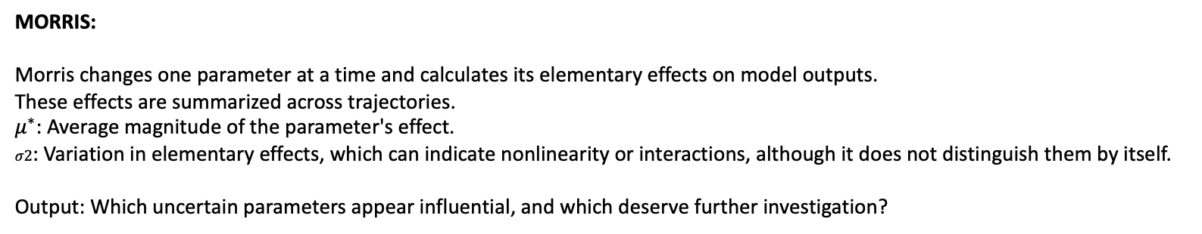
6. Morris - BFPS Optimal Transport
SENSITIVITY
Complementary Sensitivity Assessment
MORRIS:
Morris changes one parameter at a time and calculates its elementary effects on model outputs.
These effects are summarized across trajectories.
$μ^{∗}$: Average magnitude of the parameter's effect.
$σ2$: Variation in elementary effects, which can indicate nonlinearity or interactions, although it does not distinguish them by itself.
Output: Which uncertain parameters appear influential, and which deserve further investigation?
BFPS Optimal Transport:
An Optimal Transport-based sensitivity approach can compare output distributions associated with different parameter settings,
rather than focusing only on average elementary effects. Distributional changes can reveal shifts in spread, tails, or multiple modes
that a mean-based summary may not capture.
Output: Which parameters are associated with meaningful changes in the distribution of model outcomes?
METHOD OF MORRIS • GENX UNCERTAINTY SCREENING
08

Slide 8
7. Morris: elementary effects
SENSITIVITY
Core engine
Move through a structured trajectory
Mean effect (μ)
Average signed effect; opposite directions can cancel.
Mean absolute effect (μ*)
Average effect magnitude; useful for ranking influence.
Each step changes an input dimension (or configured group) and compares the model response.
Effect variance (σ²)
Variation in effects across sampled contexts; may reflect nonlinearity or interactions.
The result structure stores means, absolute means, variances, and raw elementary effects
METHOD OF MORRIS • GENX UNCERTAINTY SCREENING
07

Slide 9
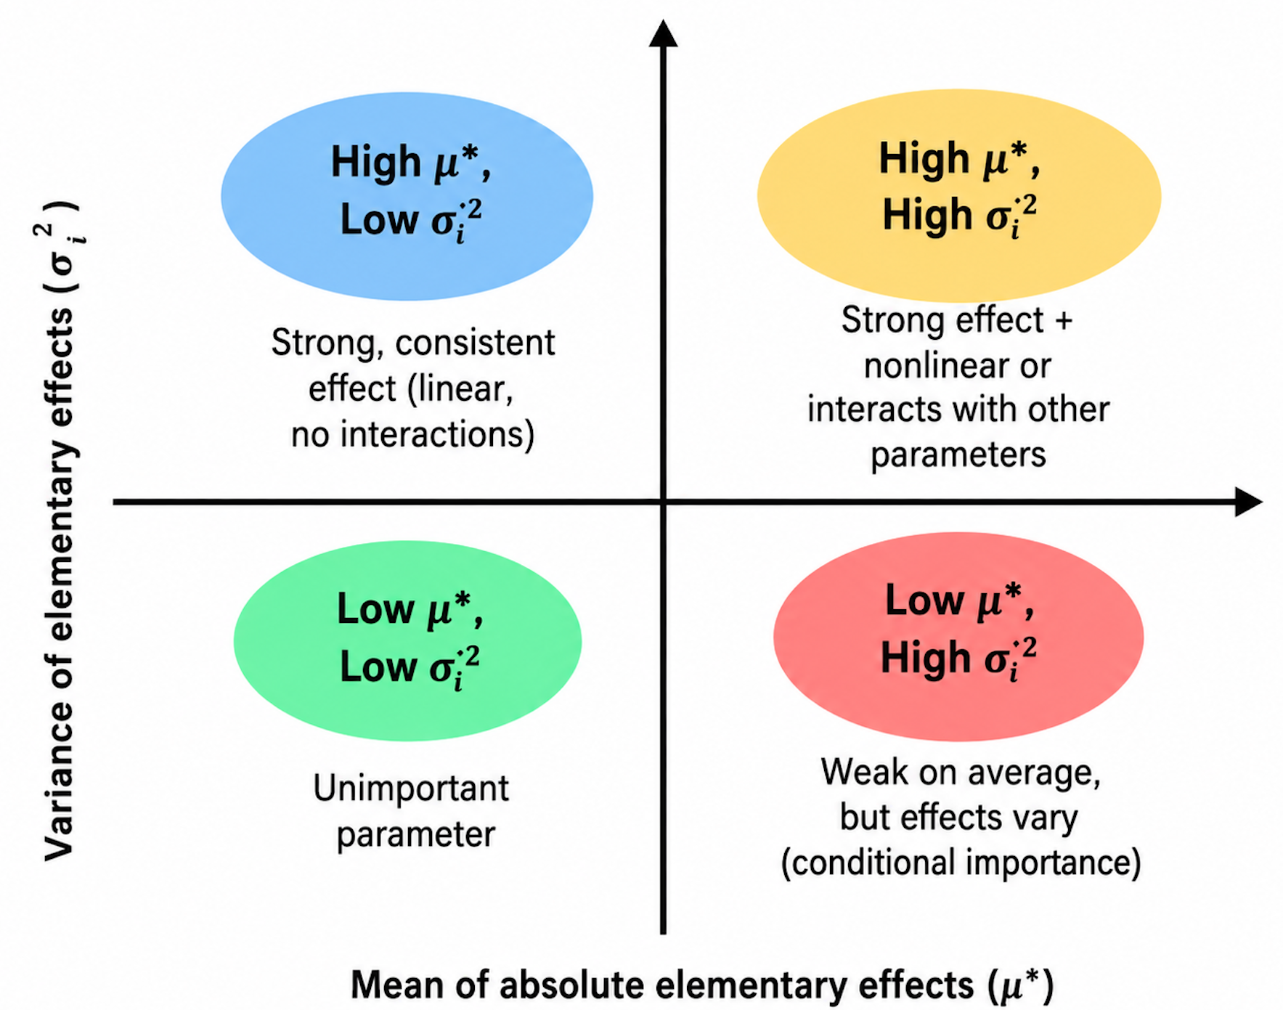
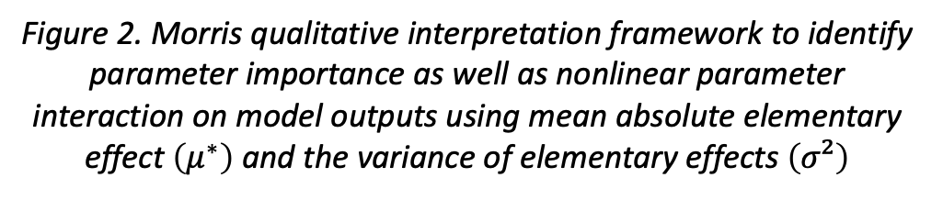
7. Morris: elementary effects
SENSITIVITY
Core engine
Figure 2. Morris qualitative interpretation framework to identify parameter importance as well as nonlinear parameter interaction on model outputs using mean absolute elementary effect $\left(μ^{∗}\right)$ and the variance of elementary effects $\left(σ²\right)$
METHOD OF MORRIS • GENX UNCERTAINTY SCREENING
07

Slide 10
8. BFPS Optimal Transport: a complementary sensitivity lens
SENSITIVITY
Sensitivity Index Function
What it does
How it is used
For an input dimension and output vector, the code groups outputs by input values, compares conditional means with the global mean, and normalizes a weighted squared-distance measure by output variance.
The wrapper computes BFPS across inputs and outputs, prints summaries, and can write a CSV. It provides a second sensitivity view alongside Morris effects.
Interpretation
BFPS–Optimal Transport Sensitivity Index
The BFPS index uses an Optimal Transport approach to assess the sensitivity of GenX model outputs to uncertain input parameters. It complements the Method of Morris by providing an additional perspective on parameter influence across system-level and zonal outcomes.
METHOD OF MORRIS • GENX UNCERTAINTY SCREENING
08

Slide 11
9. Diagnostics and output artifacts
REPRODUCIBILITY
Sensitivity summaries plus run-level evidence.
morris_means_all_outputs.csv
morris_variances_all_outputs.csv
Signed mean effects
Effect variability
morris_bfps_all_outputs.csv
morris_outputs_all_design_points.csv
BFPS indices
Inputs and outputs per design point
morris_effect_diagnostics.csv
morris.csv
Effect/run diagnostics
Main Morris summary
Helpers normalize writer returns and detect CSVs created or modified during a run.
METHOD OF MORRIS • GENX UNCERTAINTY SCREENING
09

Slide 12
10. Strengths, caveats, and integration readiness
REVIEW
A useful screening architecture still depends on model and sampling assumptions.
What it enables
Caveats
• Many uncertain inputs evaluated consistently
• System and zonal sensitivity views
• Morris and BFPS summaries
• CSV artifacts for review and reproduction
• Chosen ranges and configuration.
• GenX version compatibility: Check whether changes in GenX input structures, resource attributes, network parameters, or policy constraints affect parameter mapping and optimization behavior.
METHOD OF MORRIS • GENX UNCERTAINTY SCREENING
10

Slide 13
TAKEAWAYS
The implementation turns uncertainty into sensitivity evidence.
01
Configuration → ranges
Uncertainty definitions become model-ready perturbations.
02
Sample → solve
Each design point is applied to GenX and evaluated.
03
Solve → explain
System and zonal outputs are summarized with Morris and BFPS.

Slide 14
12. Code-flow comparison: Original Morris vs. Current implementation
REVIEW
Chronological code-flow comparison to GenX Morris base- Inherited, Extensions, Added
Step | Code function / stage | Original GenX behavior | Current implementation | Classification
1 | morris() — configuration and parameter ranges | Reads Method_of_morris_range.csv, identifies uncertain parameters, defines ranges and groups | Retains parameter-range setup and adds more output configuration and labeling | Inherited + extended
2 | generate_design_matrix() / erate_design_matrix() — design generation | Creates candidate parameter combinations using discrete levels and grouped changes | Retains the design-generation approach; function is renamed | Inherited + changed name
3 | calculate_spread() — trajectory scoring | Sums Euclidean distances between successive design points | Uses the same formula | Inherited — unchanged formula
4 | sample_matrices() — trajectory selection | Generates candidate trajectories, ranks by spread, retains the highest-scoring candidates | Retains the same ranking and selection mechanism | Inherited — same approach
5 | my_gsa() — design validation | Builds the selected design matrices and processes trajectories | Adds validation for empty ranges, steps, groups, and dimensional consistency | Extended with new checks
6 | my_gsa() — model evaluation | Evaluates the model at each design point; original wrapper returns objective value | Evaluates each design point and supports multiple outputs | Major extension
7 | InputOutputPair — run-level records | No dedicated input-output tracking structure | Stores trajectory number, run index, sampled inputs, and outputs | Added
8 | System and zonal output extraction | Does not extract the same system-level and zonal diagnostic metrics | Builds expanded system and zonal output tables | Added
9 | Morris elementary effects | Calculates effects from consecutive design points and their model outputs | Retains the method but revises trajectory-segment indexing and multi-output handling | Inherited method + modified implementation
10 | Morris summaries | Calculates mean effect, mean absolute effect, and variance | Calculates summaries across multiple outputs and attaches readable labels | Extended
11 | bfps_sensitivity() | No BFPS calculation | Calculates conditional-mean-based sensitivity indices | Added analytical capability
12 | calculate_and_print_bfps_indices() | No corresponding function | Aggregates indices across inputs and outputs and optionally exports results | Added
13 | Output labeling and diagnostics | Primarily prints intermediate matrices and sensitivity results | Adds input/output labels, trajectory-level records, and more descriptive diagnostics | Extended
14 | Results export | Writes morris.csv with parameter sensitivity summaries | Adds expanded Morris input-output and BFPS CSV exports, along with additional summary outputs | Extended
METHOD OF MORRIS • GENX UNCERTAINTY SCREENING
10

Slide 15
GenX Screening Enhancements — Source Code Change Summary
Comparison report for src/load_inputs | Demand • Fuel prices • Resource screening
Overall impact: load and fuel multipliers change model inputs; resource screening is the largest preprocessing change.
1 load_demand_data.jl
2 load_fuels_data.jl
3 load_resources_data.jl
SEVERITY
MEDIUM
SEVERITY
MEDIUM
SEVERITY
HIGH
Demand scaling
Fuel-price scaling
Screening engine
Applied setup load_multiplier to pD, changing demand across zones and times.
Applied fuel_price_multiplier to base fuel costs, affecting dispatch and system cost.
New apply_screening_parameters! applied setup-driven multipliers and binary switches by resource type.
Traceability
Planning assumptions
Adds DEMAND metadata: zone, multiplier, and eligibility flags.
Robustness & tracking
Controls gas retirement, nuclear availability, IRA and VRE/storage costs, siting limits, and flexible-demand capacity.
Adds hydrogen case aliases and FUELS metadata; exempts “None” from screening.
Pipeline change
Screening runs before resource objects are created and validated.
KEY TAKEAWAYS
Demand + fuel multipliers
Directly alter optimization inputs.
Resource screening
Changes feasibility and investment assumptions.
Traceability
New parameter tables support screening workflows.

Slide 16
load_demand_data.jl
Section: Demand scaling with load multiplier
Location: load_demand_data.jl:84
Severity: Medium
What changed: Demand matrix pD is now multiplied by setup load_multiplier after it is loaded.
Impact: This directly changes demand levels used in optimization for all zones and times.
Section: New DEMAND parameter tracking table
Location: load_demand_data.jl:86-90
Severity: Low
What changed: Adds inputs DEMAND DataFrame with zone, load_multiplier, and load_multiplier_eligible columns.
Impact: Mostly metadata/traceability; useful for uncertainty/screening reporting.

Slide 17
load_fuels_data.jl
Section: Fuel cost calculation now includes multiplier
Location: load_fuels_data.jl:34
Severity: Medium
What changed: fuel_cost_vec now multiplies base fuel costs by setup fuel_price_multiplier before storing.
Impact: Changes all modeled fuel prices and therefore production dispatch/system cost.
Section: Hydrogen key aliasing for case tolerance
Location: load_fuels_data.jl:41-46
Severity: Low
What changed: Adds dictionary aliases for hydrogen, Hydrogen, and lowercase handling.
Impact: Reduces risk of case-mismatch lookup issues; minor behavioral expansion.
Section: New FUELS parameter table and None exemption
Location: load_fuels_data.jl:55-63
Severity: Low
What changed: Adds inputs FUELS DataFrame with fuel_price_multiplier and eligibility flags;
Sets None fuel eligibility false and multiplier to 1.0.
Impact: Adds bookkeeping/eligibility control for uncertainty workflows.

Slide 18
load_resources_data.jl
Section: New screening engine function
Location: load_resources_data.jl:412-580
Severity: High
What changed: Introduced apply_screening_parameters! that:
  Added new parameter columns and corresponding eligible flags.
  Matched resource_type rows (case-insensitive exact/prefix logic).
  Applied multiple setup-driven multipliers and binary switches across resource classes.
  Impact: Major preprocessing behavior change affecting capacities, investment costs, retire/new build flags,
  and flexible demand values.
Section: Thermal screening controls
Location: load_resources_data.jl:461-478
Severity: Medium
What changed: Gas_Retirement can overwrite can_retire for Existing_natural_gas; Nuclear_Availability can overwrite
new_build for new nuclear rows.
Impact: Directly changed build/retirement feasibility assumptions.

Slide 19
load_resources_data.jl
Section: VRE and Storage cost multipliers including IRA logic
Location: load_resources_data.jl:481-564
Severity: High
What changed: Applies IRA_InvCost_Multiplier conditionally, plus technology-specific multipliers for solar/offshore/onshore
wind and batteries; can also scale VRE max_cap_mw via Siting_MaxCap_Multiplier.
Impact: Large impact on investment economics and expansion outcomes.
Section: Flexible demand capacity multiplier
Location: load_resources_data.jl:566-577
Severity: Medium
What changed: Demand_Flexibility_Multiplier scales existing_cap_mw for FlexDemand resources when present.
Impact: Alters available flexible demand capacity.
Section: Resource loading pipeline changed to apply screening before resource object creation
Location: load_resources_data.jl:588-617, load_resources_data.jl:894
Severity: High
What changed: New load_and_screen_resources function is introduced and called from
create_resource_array (setup, resources_path), ensuring screening edits happen before resources are instantiated/validated.
Impact: Structural change in data flow; screening now systematically affects all downstream model inputs.

Slide 20
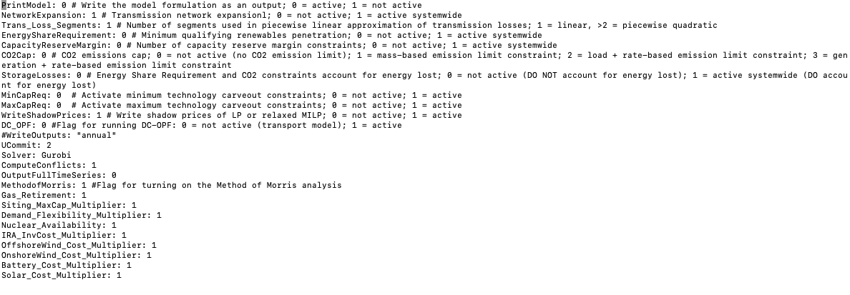
13. GenX Settings Configuration
REVIEW
Uncertainty Global Parameter setting activation
METHOD OF MORRIS • GENX UNCERTAINTY SCREENING
10

Slide 21
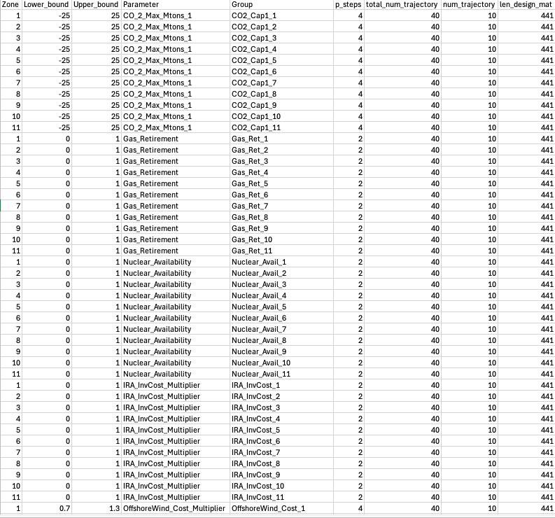
14. Method of Morris Range
REVIEW
Morris Range dataset
METHOD OF MORRIS • GENX UNCERTAINTY SCREENING
10

