Slide 1
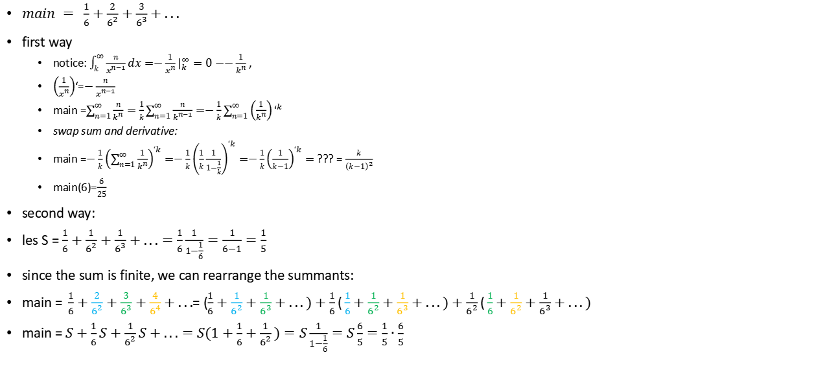
Derivative geometric series in 2 ways
$main = \frac{1}{6}+\frac{2}{6^{2}}+\frac{3}{6^{3}}+...$
first way
notice: $\int_{k}^{∞}{\frac{n}{x^{n−1}}dx}=−\frac{1}{x^{n}}|_{k}^{∞}=0−−\frac{1}{k^{n}}$ ,
$\left(\frac{1}{x^{n}}\right)$‘=$−\frac{n}{x^{n−1}}$
main =$\sum_{n=1}^{∞}{\frac{n}{k^{n}}}=\frac{1}{k}\sum_{n=1}^{∞}{\frac{n}{k^{n−1}}}=−\frac{1}{k}\sum_{n=1}^{∞}{\left(\frac{1}{k^{n}}\right)‘^{k}}$
swap sum and derivative:
main =$−\frac{1}{k}{\left(\sum_{n=1}^{∞}{\frac{1}{k^{n}}}\right)}^{‘k}=−\frac{1}{k}{\left(\frac{1}{k}\frac{1}{1−\frac{1}{k}}\right)}^{‘k}=−\frac{1}{k}{\left(\frac{1}{k−1}\right)}^{‘k}=$ ??? = $\frac{k}{{\left(k−1\right)}^{2}}$
main(6)=$\frac{6}{25}$
second way:
les S = $\frac{1}{6}+\frac{1}{6^{2}}+\frac{1}{6^{3}}+...=\frac{1}{6}\frac{1}{1−\frac{1}{6}}=\frac{1}{6−1}=\frac{1}{5}$
since the sum is finite, we can rearrange the summants:
main =$\frac{1}{6}+\frac{2}{6^{2}}+\frac{3}{6^{3}}+\frac{4}{6^{4}}+...$= ($\frac{1}{6}+\frac{1}{6^{2}}+\frac{1}{6^{3}}+...)+\frac{1}{6}(\frac{1}{6}+\frac{1}{6^{2}}+\frac{1}{6^{3}}+...)+\frac{1}{6^{2}}(\frac{1}{6}+\frac{1}{6^{2}}+\frac{1}{6^{3}}+...)$
main = $S+\frac{1}{6}S+\frac{1}{6^{2}}S+...=S(1+\frac{1}{6}+\frac{1}{6^{2}})=S\frac{1}{1−\frac{1}{6}}=S\frac{6}{5}=\frac{1}{5}∙\frac{6}{5}$

Slide 2
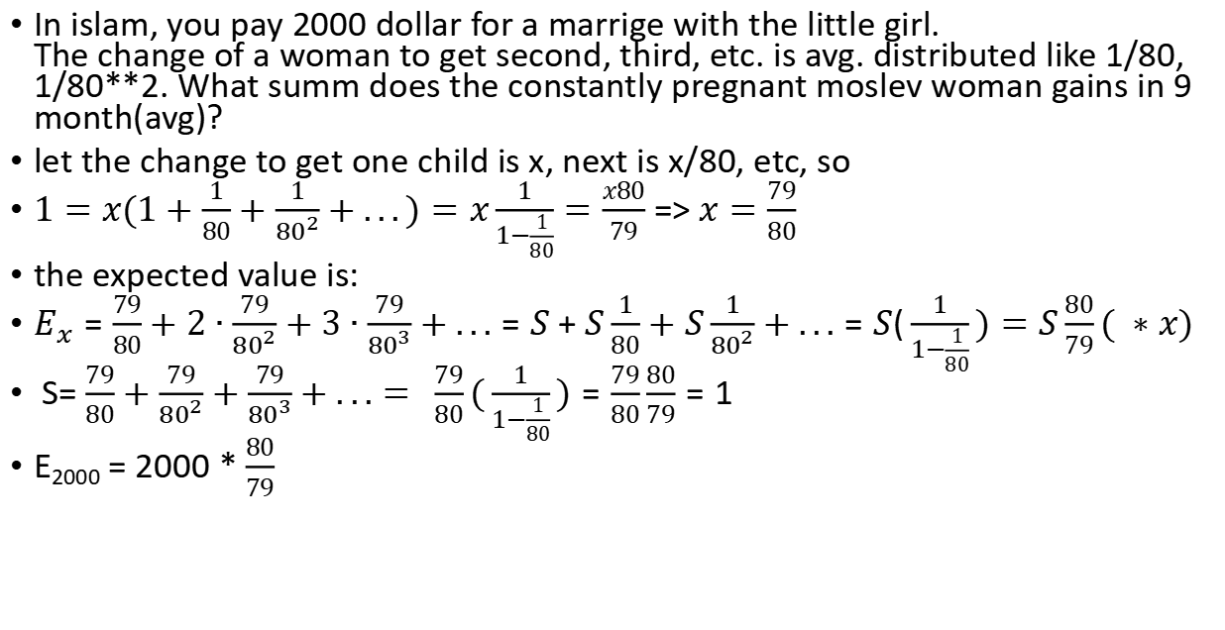
Woman, selling children - geom 2-nd summ
In islam, you pay 2000 dollar for a marrige with the little girl. The change of a woman to get second, third, etc. is avg. distributed like 1/80, 1/80**2. What summ does the constantly pregnant moslev woman gains in 9 month(avg)?
let the change to get one child is x, next is x/80, etc, so
$1=x(1+\frac{1}{80}+\frac{1}{{80}^{2}}+...)=x\frac{1}{1−\frac{1}{80}}=\frac{x80}{79}$ => $x=\frac{79}{80}$
the expected value is:
$E_{x}=\frac{79}{80}+2∙\frac{79}{{80}^{2}}+3∙\frac{79}{{80}^{3}}+...=S+S\frac{1}{80}+S\frac{1}{{80}^{2}}+...=S(\frac{1}{1−\frac{1}{80}})=S\frac{80}{79}( ∗x)$
S= $\frac{79}{80}+\frac{79}{{80}^{2}}+\frac{79}{{80}^{3}}+...= \frac{79}{80}(\frac{1}{1−\frac{1}{80}})=\frac{79}{80}\frac{80}{79}=1$
E₂₀₀₀ = 2000 * $\frac{80}{79}$

Slide 3
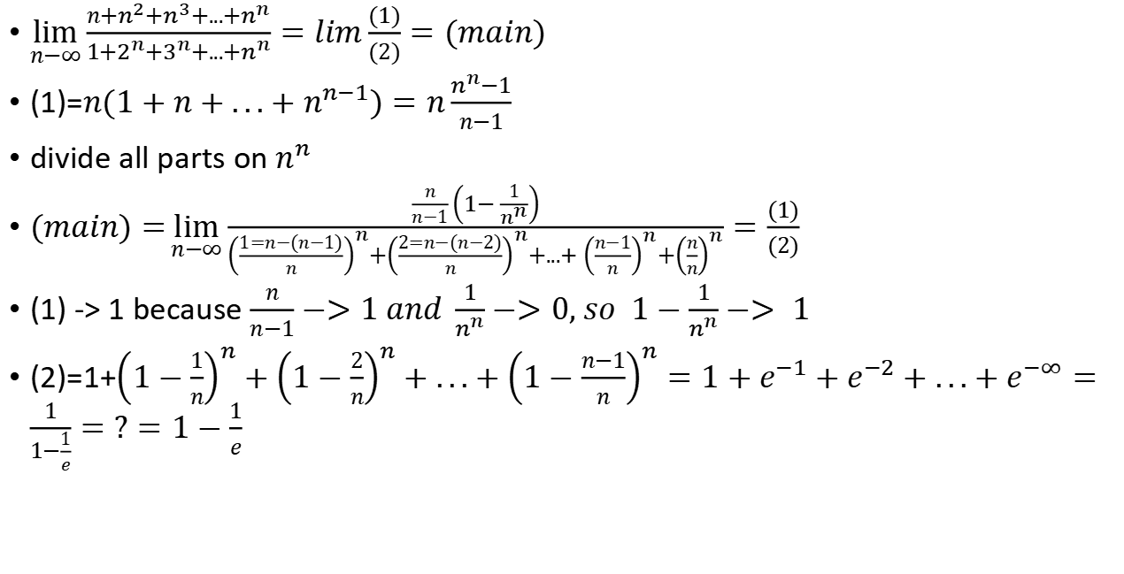
$\lim_{n−∞}{\frac{n+n^{2}+n^{3}+...+n^{n}}{1+2^{n}+3^{n}+...+n^{n}}}=lim\frac{(1)}{(2)}=(main)$
(1)=$n(1+n+...+n^{n−1})=n\frac{n^{n}−1}{n−1}$
divide all parts on $n^{n}$
$(main)=\lim_{n−∞}{\frac{\frac{n}{n−1}\left(1−\frac{1}{n^{n}}\right)}{{\left(\frac{1=n−(n−1)}{n}\right)}^{n}+{\left(\frac{2=n−(n−2)}{n}\right)}^{n}+{...+\left(\frac{n−1}{n}\right)}^{n}+{\left(\frac{n}{n}\right)}^{n}}}=\frac{(1)}{(2)}$
(1) -> 1 because $\frac{n}{n−1}−>1 and \frac{1}{n^{n}}−>0, so 1−\frac{1}{n^{n}}−> 1$
(2)=1+${\left(1−\frac{1}{n}\right)}^{n}+{\left(1−\frac{2}{n}\right)}^{n}+...+{\left(1−\frac{n−1}{n}\right)}^{n}=1+e^{−1}+e^{−2}+...+e^{−∞}=\frac{1}{1−\frac{1}{e}}=?=1−\frac{1}{e}$

Slide 4


$Minus one geometrical sum : \sum_{n=1}^{∞}{\frac{a^{n}}{n}}$
$\sum_{n=1}^{∞}{\frac{a^{n}}{n}}=\int_{0}^{a}{\sum_{n=1}^{∞}{x^{n−1}}}dx =\int_{0}^{a}{\frac{1}{1−x}dx=−ln(1−a)}$

Slide 5

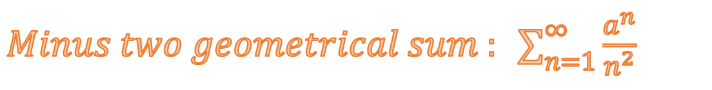
$Minus two geometrical sum : \sum_{n=1}^{∞}{\frac{a^{n}}{n^{2}}}$
$\sum_{n=1}^{∞}{\frac{a^{n}}{n^{2}}}=\int_{0}^{a}{\sum_{n=1}^{∞}{\frac{x^{n−1}}{n}}}dx =\int_{0}^{a}{\frac{1}{x}\sum_{n=1}^{∞}{\frac{x^{n}}{n}}}dx =\int_{0}^{a}{\frac{−ln(1−x)}{x}}dx =$

